Slide 1
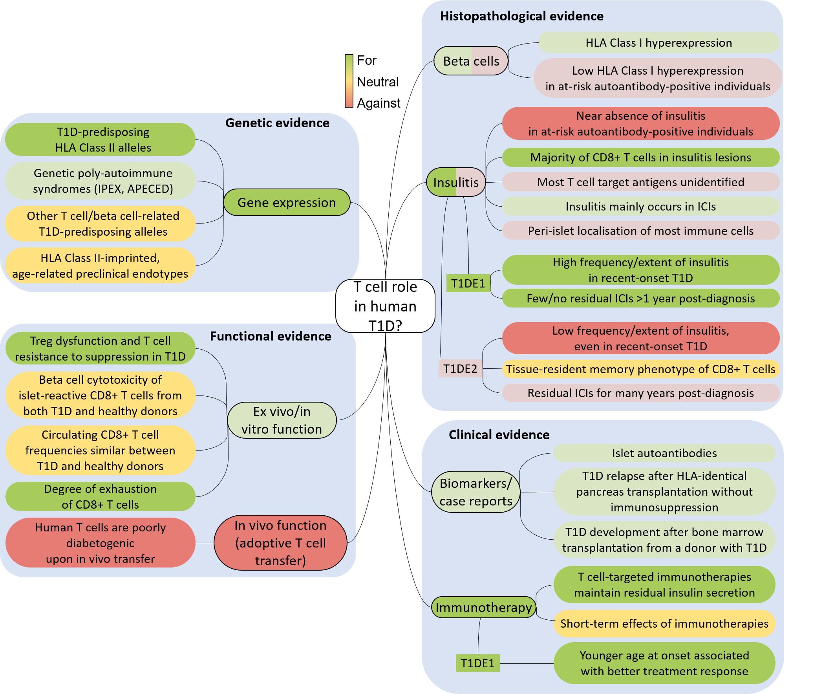
Evidence for or against a primary pathogenic role for T cells in human type 1 diabetes
Carré et al (2020) Diabetologia DOI 10.1007/s00125-020-05298-y
©The Authors 2020. Distributed under the terms of the CC BY 4.0 Attribution License (http://creativecommons.org/licenses/by/4.0/)

Slide 2
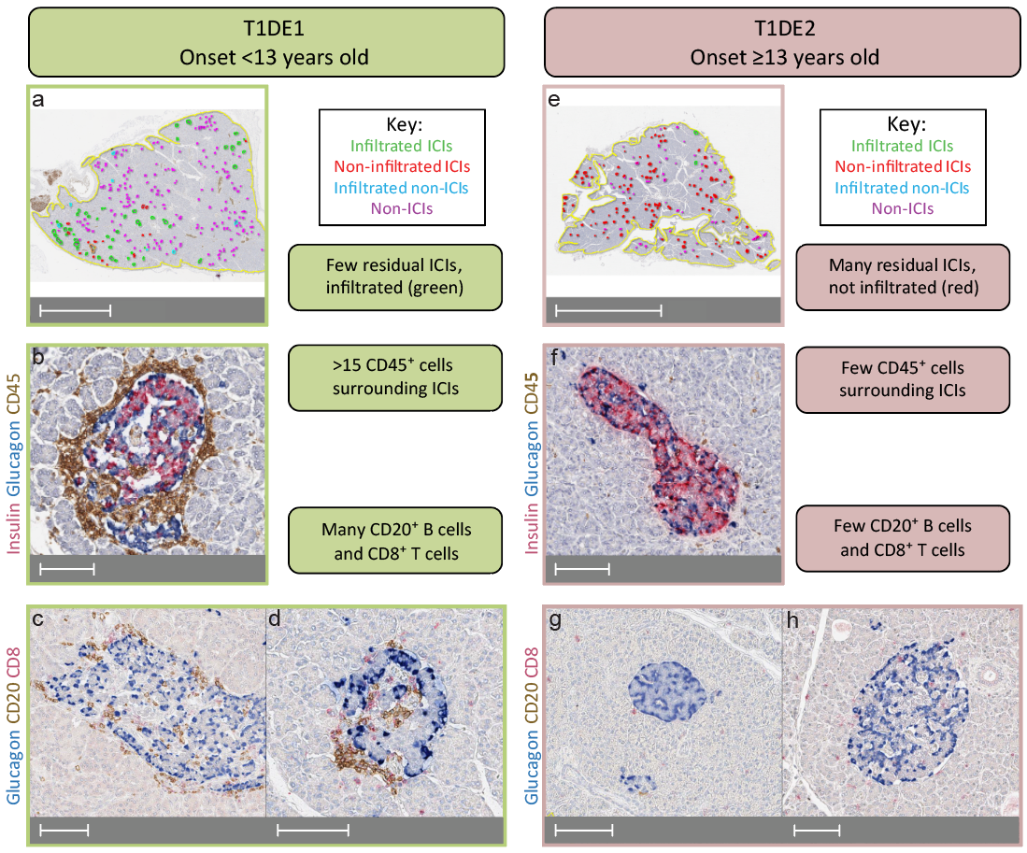
Key differences in insulitis and residual ICIs in type 1 diabetes endotypes T1DE1 and T1DE2
Carré et al (2020) Diabetologia DOI 10.1007/s00125-020-05298-y
©The Authors 2020. Distributed under the terms of the CC BY 4.0 Attribution License (http://creativecommons.org/licenses/by/4.0/)

