Slide 1
Efficacy of low dose pirfenidone in idiopathic pulmonary fibrosis: Real world experience from a tertiary university hospital
Myung Jin Song¹, Sung Woo Moon², Ji Soo Choi², Sang Hoon Lee², Su Hwan Lee², Kyung Soo Chung², Ji Ye Jung², Young Ae Kang², Moo Suk Park², Young Sam Kim², Joon Chang² and Song Yee Kim^{2, *}
¹Division of Pulmonary and Critical Care Medicine, Department of Internal Medicine, Seoul National University College of Medicine, Seoul National University Bundang Hospital, Seongnam, South Korea
²Division of Pulmonology, Department of Internal Medicine, Severance Hospital, Yonsei University College of Medicine, Seoul, Republic of Korea
*Corresponding author
Song Yee Kim, MD, PhD
Division of Pulmonology, Department of Internal Medicine, Severance Hospital, Yonsei University College of Medicine, 50-1 Yonsei-ro, Seodaemun-gu, Seoul 03722, Republic of Korea
E-mail address: dobie@yuhs.ac

Slide 2
Supplementary figure 1
 | First year |  |  | Second year
 | ∆ FVC (ml) | Difference from control (ml) | P-value | ∆ FVC (ml) | Difference from control (ml) | P-value
Control | 200.7±28.2 |  |  | 27.2±45.3
< 1200 mg | 88.4±31.4 | 112.4±42.2 | 0.026 | 76.6±10.8 | 40.5±60.1 | 0.503
≥ 1200 mg | 94.7±35.3 | 106.0±45.2 | 0.047 | 63.5±44.8 | 36.4±63.7 | 0.568
Values are expressed as mean ± standard error

Slide 3
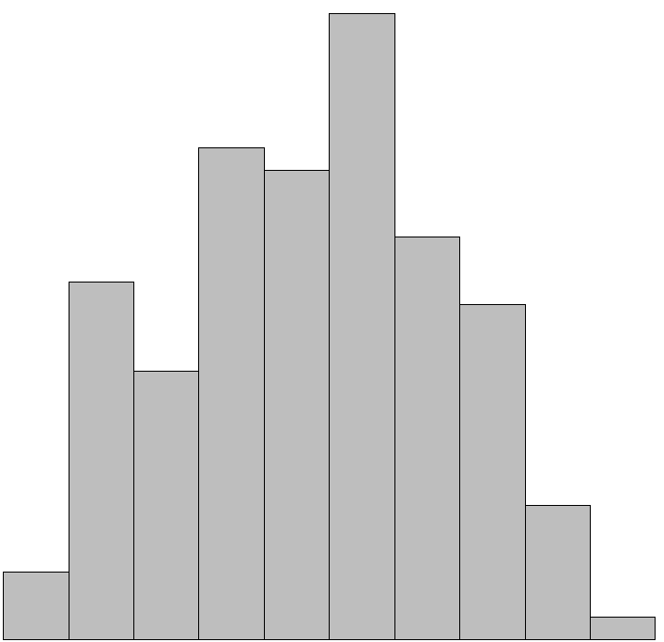
Supplementary figure 2
a
b
28
25
22
21
20
18
16
15
15
Number of patients
12
Functional vital capacity (L)
10
6
5
3
1
0
200
300
400
500
600
700
800
900
1000
1100
1200
BSA-adjusted pirfenidone dose (mg/m²)

Slide 4
Supplementary figure 3
Control
Low-dose group (<1000mg/d)
High-dose group (≥1000mg/d)
 | ∆ FVC at first year (ml) | Difference from control (ml) | P-value
Control | 200.7±28.2
< 1000 mg | 74.8±40.8 | 125.9±49.6 | 0.034
≥ 1000 mg | 99.2±28.7 | 101.5±40.2 | 0.036
Values are expressed as mean ± standard error

