Slide 1
Supplementary Figure S1
A
B
SKOV-3
Caov-3
SKOV-3
TNF-α mRNA
(fold increase)
TNF-a (pg)
LPA 0 1 2 4 hr 0 1 2 4 hr
LPA (μM)
Supplementary Figure S1. A. LPA induces expression of TNF-α mRNA in ovarian cancer cells. Caov-3 and SKOV-3
Cells were serum starved and stimulated with LPA (10 μM) for the indicated durations (hours). Abundances
of TNF-α mRNA were quantified with RT-qPCR and results presented as described in Fig. 1A. B. LPA induces TNF-α
secretion in a dose-dependent manner. SKOV-3 cells were treated with increasing concentrations of LPA for 24 hours.
TNF-α protein levels in culture supernatants were determined by ELISA and results presented as in Fig. 1A.

Slide 2
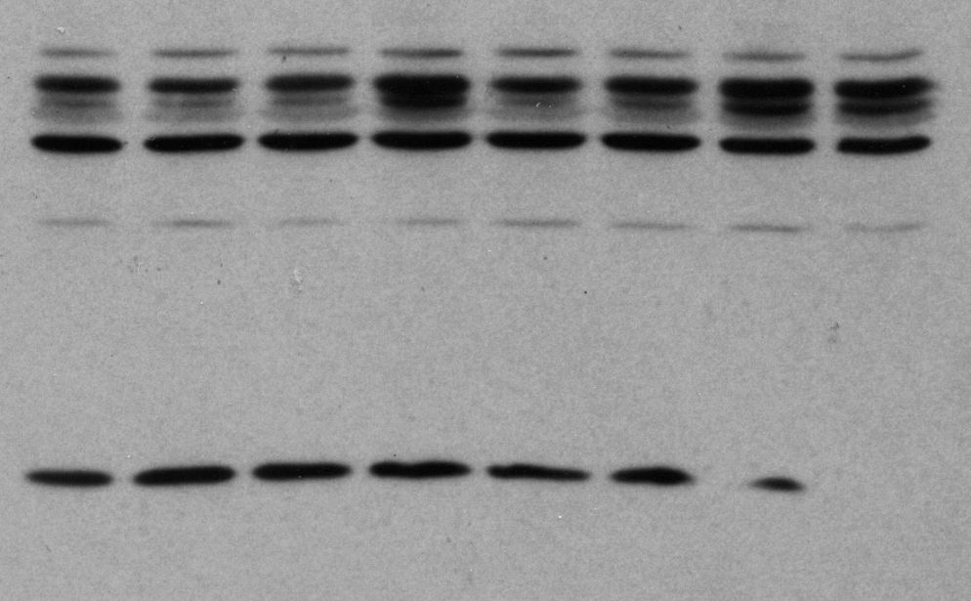
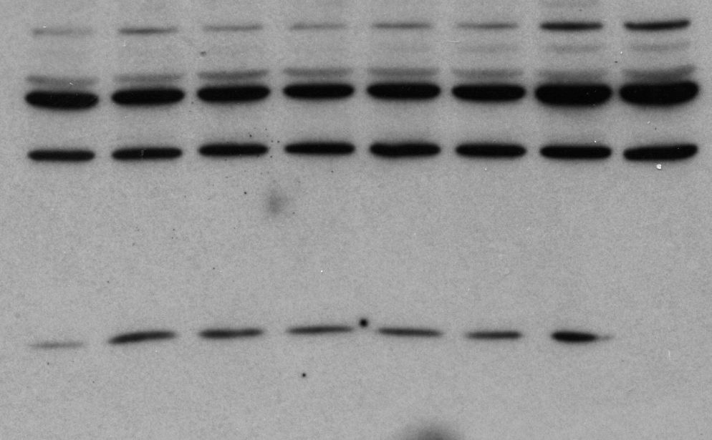
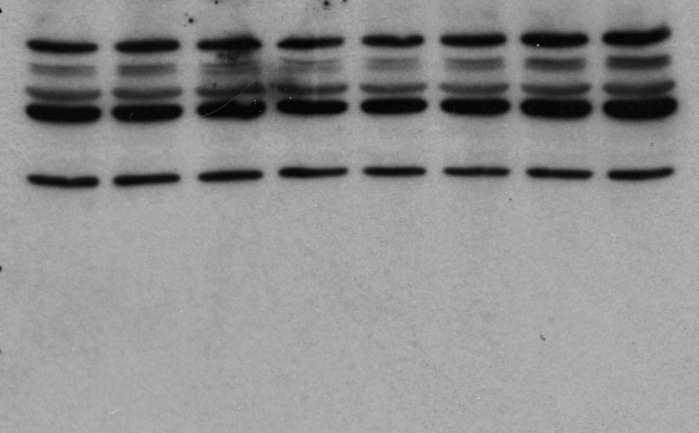
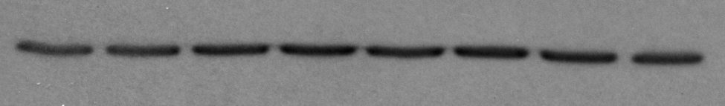
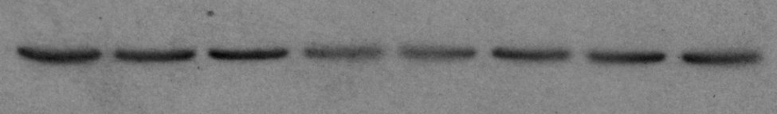
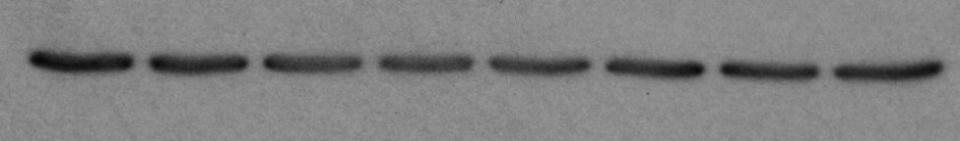
Supplementary Figure S2
A
B
-LPA
+LPA
**
**
n.s.
-LPA
+LPA
**
n.s.
IL-1β mRNA (fold increase)
IL-1β protein (pg)
n.s.
Caov-3
SKOV-3
OVCAR-3
Caov-3
SKOV-3
OVCAR-3
C
LPA
LPA
LPA
0 .25 1 2 4 8 20 24 hr
0 .25 1 2 4 8 20 24 hr
0 .25 1 2 4 8 20 24 hr
50 kD
Procaspase-1
37 kD
25 kD
20 kD
15 kD
Caspase-1 (p10)
10 kD
Tubulin
Caov-3
SKOV3
OVCAR-3
Supplementary Figure S2. LPA induces expression of IL-1β mRNA but not IL-1β protein in ovarian cancer cells.
The effects of LPA on IL-1β mRNA expression (A) and protein release into culture supernatants (B) were determined
by RT-qPCR and ELISA, respectively. LPA concentration, treatment and data presentations were the same
as in Fig. 1. Note, the large variations of IL-1β ELISA results were related to low levels of IL-1β contents in culture
supernatants. C. The effect of LPA treatment on the cleavage of Procaspase-1 to Caspase-1 (p10) was
assessed by immunoblotting analysis.

Slide 3
Supplementary Figure S3
Caov-3
SKOV-3
LPA receptor mRNA
(relative to ctrl-si)
**
LPA receptor mRNA
(relative to ctrl-si)
**
**
**
**
LPA₁ LPA₂ LPA₃
LPA₁ LPA₂ LPA₃
Supplementary Figure S3. LPA₁, LPA₂, and LPA₃ are downregulated by the receptor subtype-specific siRNA.
The mRNA levels of each receptor in siRNA-transfected cells were quantified by RT-qPCR as described in Materials
and Methods. The results were normalized to that of GAPDH and presented as fold changes relative to control
siRNA–transfected cells (defined as 1 fold).

Slide 4
Supplementary Figure S4
ADAM17 mRNA
(fold increase)
Supplementary Figure S4. LPA-induced increase in ADAM17 protein is independent of the NF-κB transcription
Factor. Caov-3 and SKOV-3 cells were treated with 10 μM LPA with or without BAY11-7085 (25 μM in Caov-3 and 10 μM
in SKOV-3) as detailed in Fig. 2. The mRNA levels of ADAM17 were quantified by RT-qPCR. The results were normalized
to that of GAPDH and presented as fold changes relative to untreated control cells (defined as 1 fold).

Slide 5
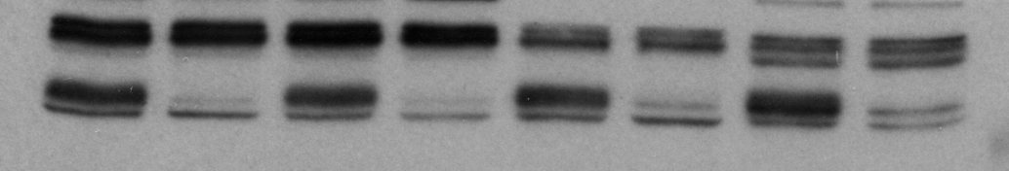
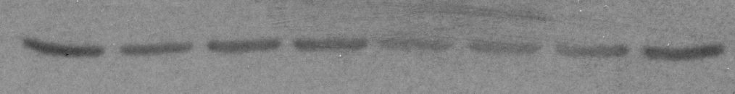
Supplementary Figure S5
Vehicle
Vehicle
Vehicle
Vehicle
TMI-1
TMI-1
TMI-1
TMI-1
100 kD
ADAM17
75 kD
Tubulin
Caov-3
20 hr
SKOV-3
20 hr
OVCAR-3
20 hr
OVCAR-3
1.5 hr
Supplementary Figure S5. TMI-1 treatment leads to upregulation of ADAM17 protein
likely as a compensatory response to inhibition of ADAM17 activity. Caov-3, SKOV-3
and OVCAR-3 cells were treated with vehicle or TMI-1 at 2.5 μM, 20 μM and 5 μM,
respectively, for the indicated periods of time (hours). The expression of ADAM17 was
examined by immunoblotting analysis.

Slide 6
Supplementary Figure S6
Caov-3
SKOV-3
OVCAR-3
TNF-α (pg)
*
TNF-α (pg)
TNF-α (pg)
*
**
Supplementary Figure S6. LPA induction of TNF-α is inhibited by TMI-1 added simultaneously with LPA. Cells were
stimulated for 24 hours with LPA in the absence or presence of TMI-1. TMI-1 was added at the same time as LPA.
TNF-a levels were determined by ELISA and results presented as in Fig. 1A.

Slide 7
Supplementary Figure S7
Caov-3
n.s.
SKOV-3
n.s.
OVCAR-3
n.s.
30
n.s.
n.s.
30
n.s.
**
*
n.s.
30
Cell No x10⁴/well
Cell No x10⁴/well
Cell No x10⁴/well
20
20
20
10
10
10
LPA - + + +
TNF-α Ab 0 0 8 0 (μg/ml)
TNF-α SR 0 0 0 1 (μg/ml)
LPA - + + +
TNF-α Ab 0 0 8 0 (μg/ml)
TNF-α SR 0 0 0 1 (μg/ml)
LPA - + + +
TNF-α Ab 0 0 8 0 (μg/ml)
TNF-α SR 0 0 0 1 (μg/ml)
Supplementary Figure S7. TNF-α is not involved in LPA-driven cell proliferation. Serum-starved Caov-3, SKOV-3 and OVCAR-3
cells in 12-well plates were treated with LPA in the presence of indicated concentrations of TNF-α Ab or TNF-α SR for 30 hours.
Cells were trypsinized and cell numbers quantified with a Coulter Counter. The results were presented as cell numbers/well of
triplicate assays.

Slide 8
Supplementary Figure S8 A
Caov-3
SKOV-3
OVCAR-3
IL-8 mRNA
(fold increase)
IL-8 mRNA
(fold increase)
**
IL-8 mRNA
(fold increase)
**
**
Caov-3
SKOV-3
OVCAR-3
**
IL-8 protein (pg)
IL-8 protein (pg)
IL-8 protein (pg)
**
**
Supplementary Figure S8. AG1478 inhibits LPA-induced IL-8, IL-6 and CXCL1 expression. Ovarian cancer cell lines were
treated with LPA (10 μM) with or without AG1478 (1 μM). The cellular mRNA levels and protein abundances in culture
supernatants of IL-8 (A), IL-6 (B) and CXCL1 (C) were determined by RT-qPCR and ELISA, respectively. The experimental
details and data presentation were the same as in Fig. 4.

Slide 9
Supplementary Figure S8 B
Caov-3
SKOV-3
OVCAR-3
IL-6 mRNA
(fold increase)
IL-6 mRNA
(fold increase)
IL-6 mRNA
(fold increase)
**
Caov-3
SKOV-3
OVCAR-3
*
IL-6 protein (pg)
IL-6 protein (pg)
IL-6 protein (pg)
**

Slide 10
Supplementary Figure S8 C
Caov-3
SKOV-3
OVCAR-3
**
CXCL1 mRNA
(fold increase)
CXCL1 mRNA
(fold increase)
CXCL1 mRNA
(fold increase)
**
Caov-3
SKOV-3
OVCAR-3
*
CXCL1 (pg)
CXCL1 (pg)
CXCL1 (pg)
**
**

