Slide 1
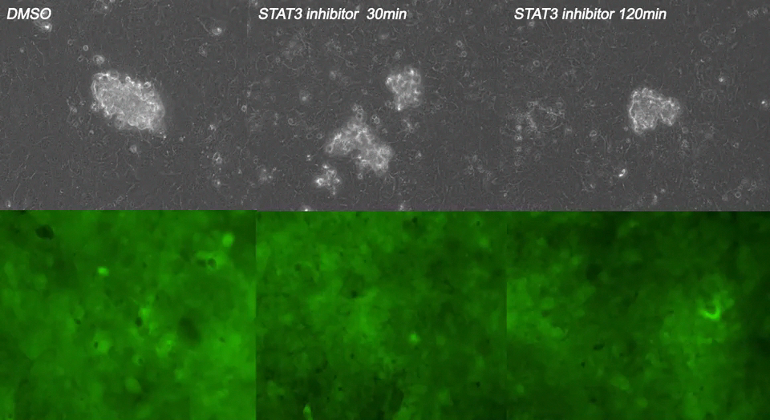
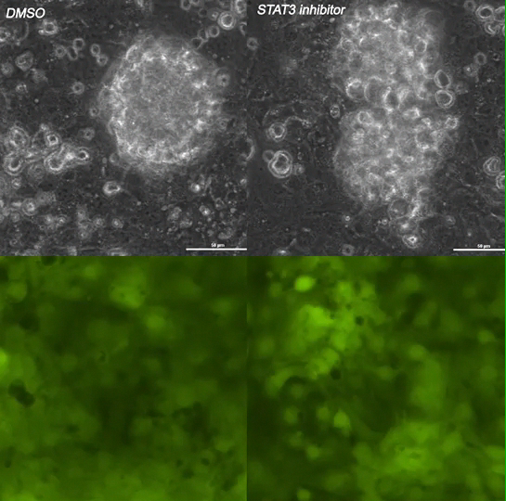
Online Videos 1 and 2
Video 1 and 2. JSI-124 treated spheroids from patient-derived cultures are unable to invade through the mesothelial monolayer compared to DMSO controls.
Live imaging of patient derived spheroids treated for 30 or 120 min with DMSO or JSI-124 followed by drug removal.

Slide 2
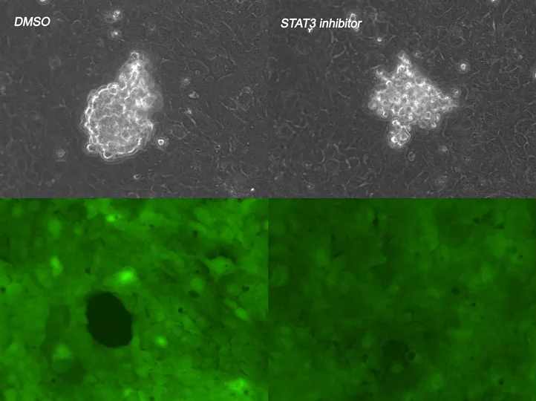
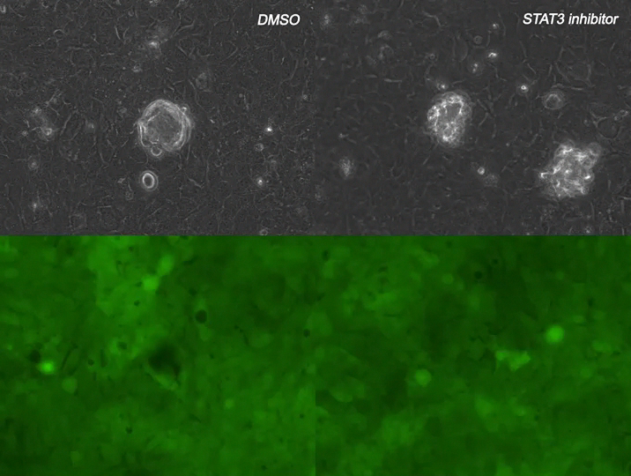
Online Videos 3 and 4
Video 3 and 4: JSI-124 treated spheroids generated from established cell lines are unable to invade through the mesothelial monolayer compared to DMSO controls.
Live imaging of spheroids generated from OVACR4 or TYKNU cell lines treated for 30 min with DMSO or JSI-124 followed by drug removal.

