Slide 1
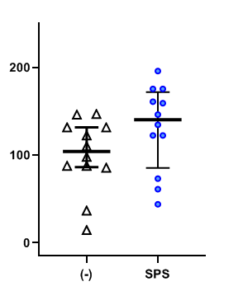
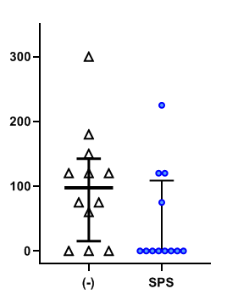
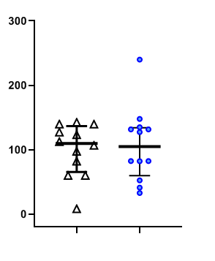
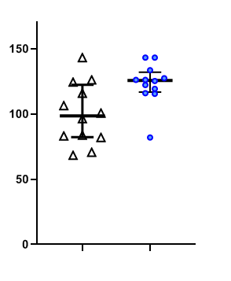
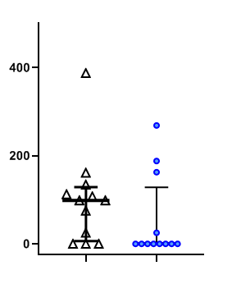
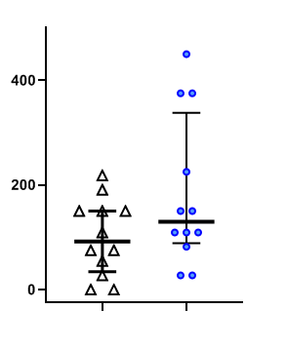
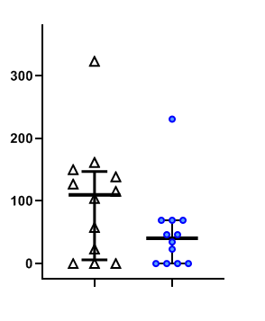
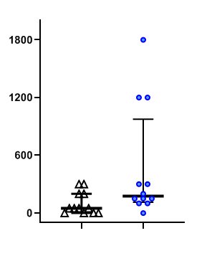
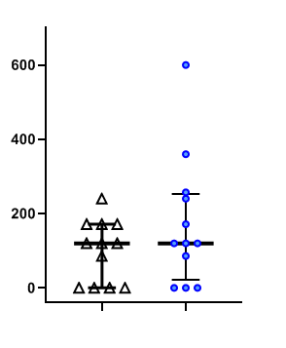
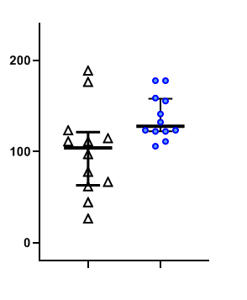
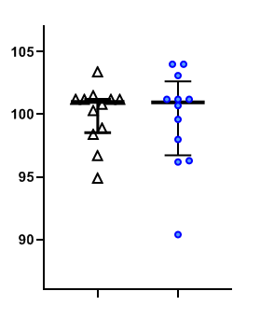
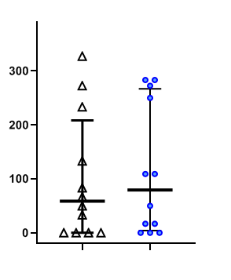
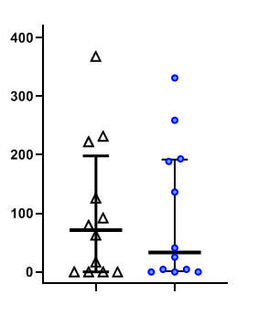
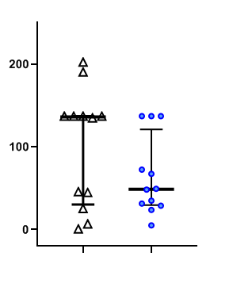
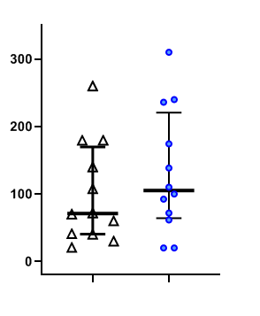
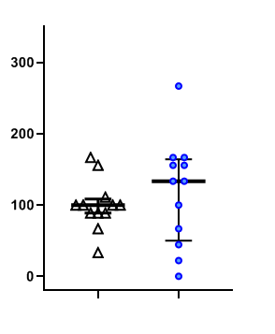
Supplemental Figure 1
(a)
EPM
the numbers of closed arms entry
(b)
EPM
the numbers of staying center area
(c)
EPM
the numbers of open and closed arm entry
(d)
EPM
time spent in closed arms
(%)
p=0.094
(%)
p=0.082
(%)
p=0.93
(%)
p=0.018
numbers (% of control)
numbers (% of control)
numbers (% of control)
time (% of control)
(-)
SPS
(-)
SPS
(-)
SPS
(-)
SPS
(e)
EPM
time staying the center area
(f)
EPM
the number of protected head dipping
(g)
EPM
the number of non-protected head dipping
(h)
EPM
the number of stretched attend posture
(%)
p=0.16
(%)
p=0.18
(%)
p=0.16
(%)
p=0.033
time (% of control)
numbers (% of control)
numbers (% of control)
number (% of control)
(-)
SPS
(-)
SPS
(-)
SPS
(-)
SPS
(i)
EPM
the number of grooming
(j)
EPM
the number of rearing
(k)
OFT
time in the periphery area
(l)
OFT
the number of center area
(%)
p=0.39
(%)
p=0.022
(%)
p >0.99
(%)
p=0.75
number (% of control)
numbers (% of control)
time (% of control)
number (% of control)
(-)
SPS
(-)
SPS
(-)
SPS
(-)
SPS
(m)
OFT
time spent in the center area
(n)
OFT
latency to the center area
(o)
OFT
the number of rearing
(p)
OFT
the number of grooming
(%)
p=0.98
(%)
p=0.37
(%)
p=0.49
(%)
p=0.45
time (% of control)
time (% of control)
numbers (% of control)
number (% of control)
(-)
SPS
(-)
SPS
(-)
SPS
(-)
SPS

Slide 2
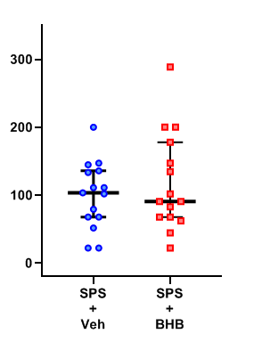
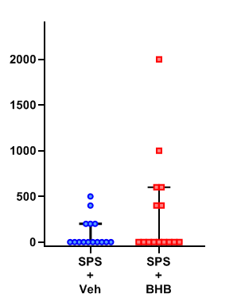
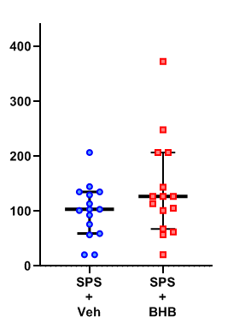
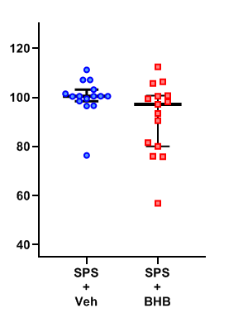
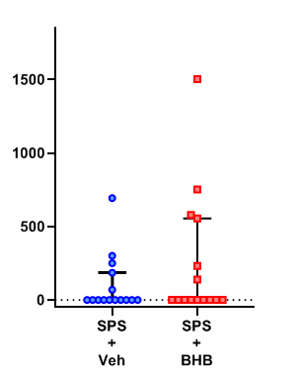
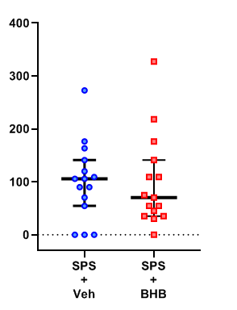
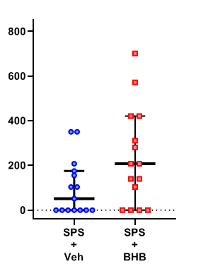
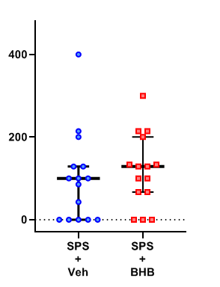
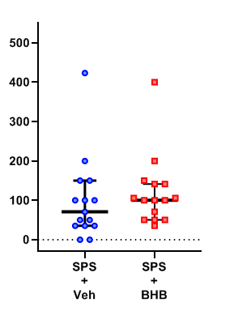
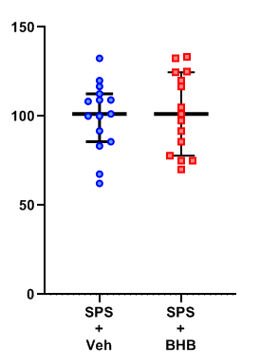
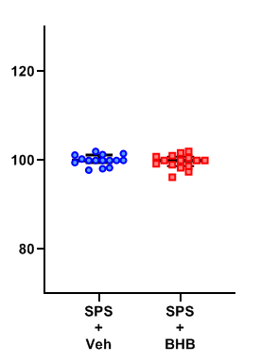
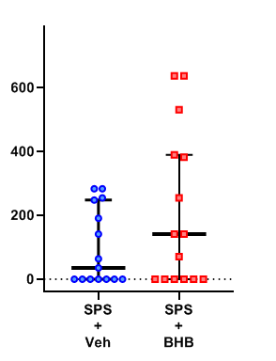
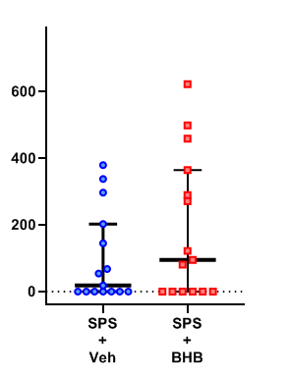
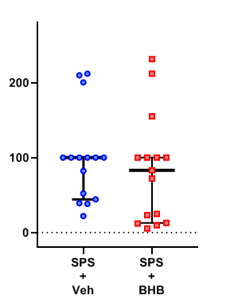
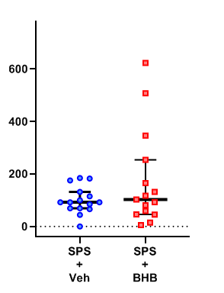
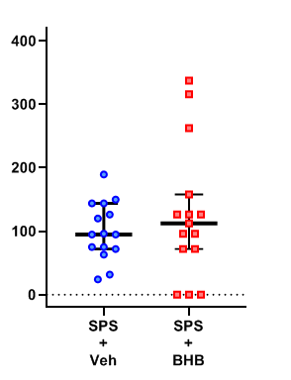
Supplemental Figure 2
(a)
EPM
the numbers of closed arms entry
(b)
EPM
the numbers of staying center area
(c)
EPM
the numbers of open and closed arm entry
(d)
EPM
time spent in closed arms
(%)
p=0.74
(%)
p=0.36
(%)
p=0.29
(%)
p=0.092
numbers (% of control)
numbers (% of control)
numbers (% of control)
time (% of control)
SPS
SPS
SPS
SPS
SPS
SPS
SPS
SPS
Veh
BHB
Veh
BHB
Veh
BHB
(h)
Veh
BHB
(e)
EPM
time staying the center area
(f)
EPM
the number of protected head dipping
(g)
EPM
the number of non-protected head dipping
EPM
the number of stretched attend posture
(%)
p=0.53
(%)
p=0.71
(%)
p=0.081
(%)
p=0.33
time (% of control)
numbers (% of control)
numbers (% of control)
number (% of control)
SPS
SPS
SPS
SPS
SPS
SPS
SPS
SPS
(i)
Veh
BHB
(j)
Veh
BHB
(k)
Veh
BHB
(l)
Veh
BHB
EPM
the number of grooming
EPM
the number of rearing
OFT
time in the periphery area
OFT
the number of center area
(%)
p=0.24
(%)
p=0.77
(%)
p=0.64
(%)
p=0.31
number (% of control)
numbers (% of control)
time (% of control)
number (% of control)
SPS
SPS
SPS
SPS
SPS
SPS
SPS
SPS
Veh
BHB
(n)
Veh
BHB
(o)
Veh
BHB
(p)
Veh
BHB
(m)
OFT
time spent in the center area
OFT
latency to the center area
OFT
the number of rearing
OFT
the number of grooming
(%)
p=0.36
(%)
p=0.36
(%)
p=0.62
(%)
p=0.66
time (% of control)
time (% of control)
numbers (% of control)
number (% of control)
SPS
SPS
SPS
SPS
SPS
SPS
SPS
SPS
Veh
BHB
Veh
BHB
Veh
BHB
Veh
BHB

Slide 3
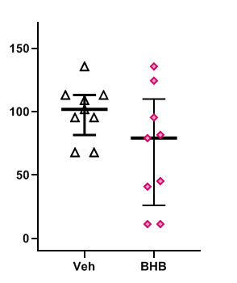
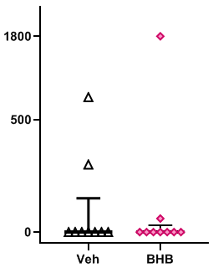
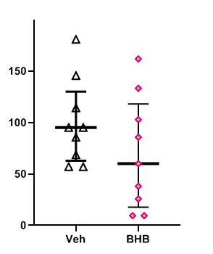
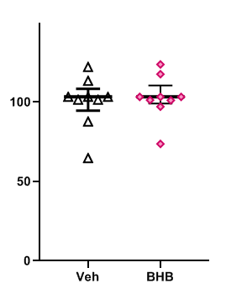
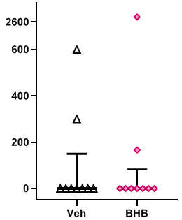
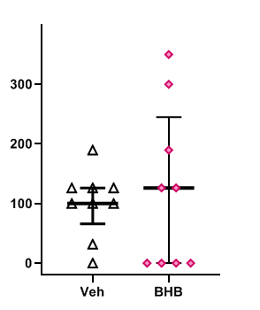
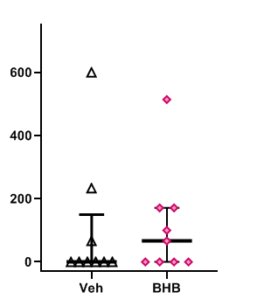
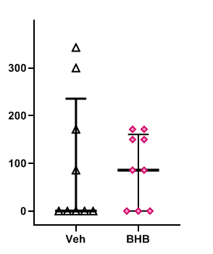
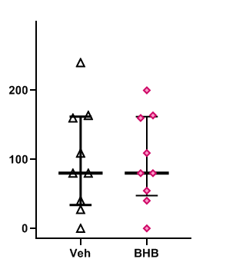
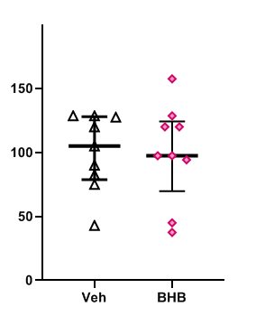
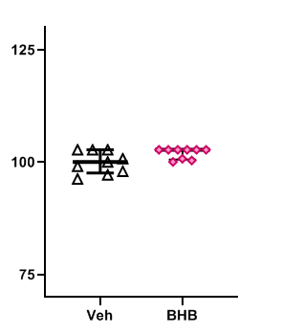
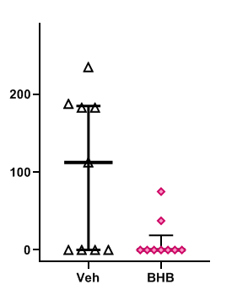
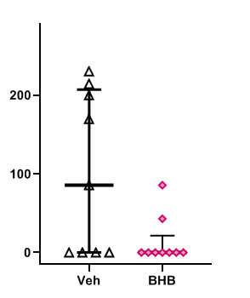
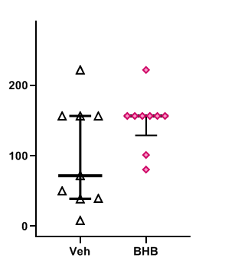
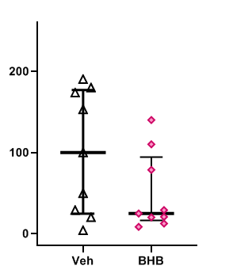
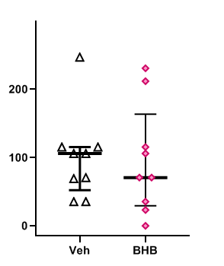
Supplemental Figure 3
(a)
EPM
the numbers of closed arms entry
(b)
EPM
the numbers of staying center area
(c)
EPM
the numbers of open and closed arm entry
(d)
EPM
time spent in closed arms
(%)
p=0.14
(%)
p >0.99
(%)
p=0.23
(%)
p >0.99
numbers (% of control)
numbers (% of control)
numbers (% of control)
time (% of control)
Veh
BHB
Veh
BHB
Veh
BHB
Veh
BHB
(e)
EPM
time staying the center area
(f)
EPM
the number of protected head dipping
(g)
EPM
the number of non-protected head dipping
(h)
EPM
the number of stretched attend posture
(%)
p >0.99
(%)
p=0.96
(%)
p=0.53
(%)
p=0.82
time (% of control)
numbers (% of control)
numbers (% of control)
number (% of control)
Veh
BHB
Veh
BHB
Veh
BHB
Veh
BHB
(i)
EPM
the number of grooming
(j)
EPM
the number of rearing
(k)
OFT
time in the periphery area
(l)
OFT
the number of center area
(%)
p=0.97
(%)
p >0.99
(%)
p=0.073
(%)
p=0.070
number (% of control)
numbers (% of control)
time (% of control)
number (% of control)
Veh
BHB
Veh
BHB
Veh
BHB
Veh
BHB
(m)
OFT
time spent in the center area
(n)
OFT
latency to the center area
(o)
OFT
the number of rearing
(p)
OFT
the number of grooming
(%)
p=0.079
(%)
p=0.12
(%)
p=0.16
(%)
p=0.72
time (% of control)
time (% of control)
numbers (% of control)
number (% of control)
Veh
BHB
Veh
BHB
Veh
BHB
Veh
BHB

Slide 4
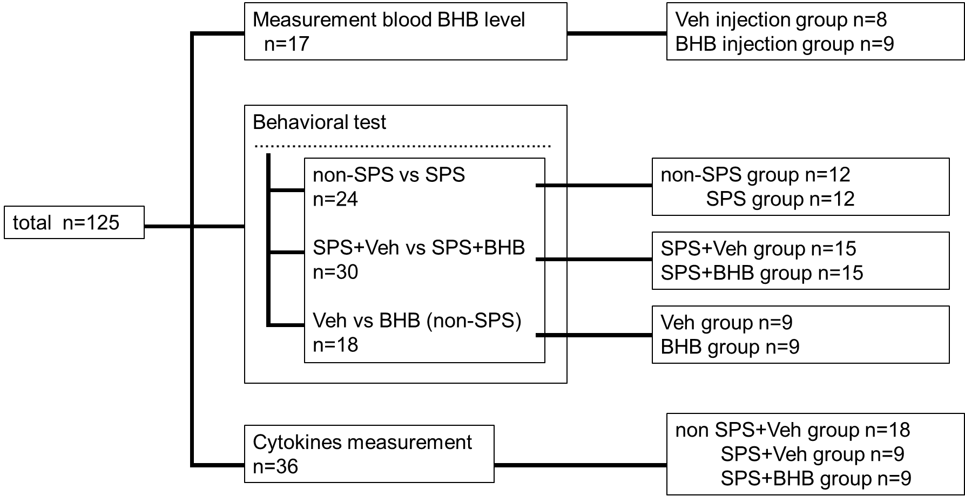
Supplemental Figure 4

