Slide 1
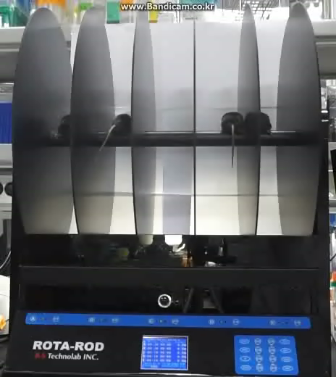
JDFM216
Control
< Accelerated Rotarod test >

Slide 2
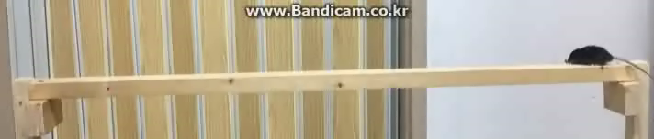
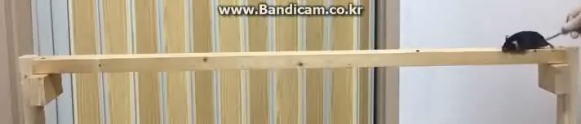
Control
JDFM216
< Balance beam >

Slide 3
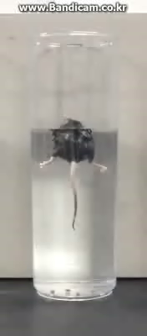
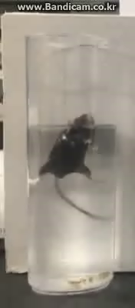
Control
JDFM216
< Forced swimming test >

