Slide 1
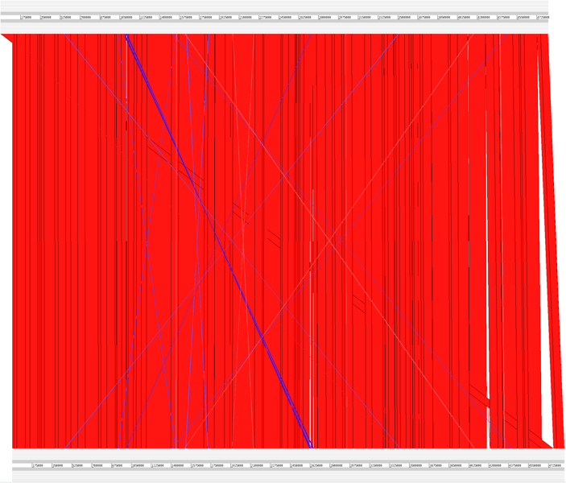
Strain 50
Strain 80

