Slide 1
Supplemental figure 1: Protein abundances indicative of iSN maturity
Total protein levels for markers of neuronal progenitors.
Total protein levels for markers of nociceptors.
Levels of proteins involved in neuronal maturation identified by GO (GO: 0042551).
Levels of proteins involved in action potential and for cell receptors involved in mechanosensation.
Levels of synaptic vesicle proteins.
Supplemental Figure 2: Tracking of mitochondria
The fraction of mitochondria exhibiting mobile characteristics wss decreased from exposure to 100nM bortezomib.
Additional track parameters provided by the analysis of the mobile mitochondrial subpopulation with different bortezomib doses. Data shown represent 3 independent experiments using iSNs obtained from 2 different iPSC lines. All statistical comparisons were determined using a Tukey’s multiple comparison test. Brackets indicate statistically significant comparisons. Confinement ratio (CR) comparisons: control vs 10nM, p = 0.04; control vs 50nM, p = 0.01; control vs 100nM, p = 0.04. Track median speed comparisons: control vs 10nM, p = 0.03; 10nM vs 50nM, p = 0.046; 10nM vs 100nM, p = 0.0026.
Subdivision of the mobile mitochondria into 2 groups illustrates that bortezomib decreased the population of mitochondria that exhibit unidirectional (CR > 0.5) and bidirectional (0.25 < CR < 0.5) mobility patterns. (Mitochondria with CR > 0.5 were more sensitive to the effects of bortezomib.)
Track displacement and track mean speed were affected by bortezomib in the CR > 0.5 subgroup, but not in the 0.25 < CR < 0.5 subgroup. Track displacement comparisons (CR > 0.5): control vs 10nM, p = 0.0014578; 10nM vs 100nM, p = 0.0142015. Track mean speed comparisons (CR > 0.5): control vs 10nM, p < 0.000001; 10nM vs 50nM, p = 0.0000482; 10nM vs 100nM, p = 0.000014.
Supplemental Figure 3: Heatmap of protein level changes
Supplemental Figure 4: ClueGO results of the IPA cellular effects
RNA expression, protein synthesis & translation: biological processes, cellular components, and molecular function.
Viral infection: biological processes, cellular components, and molecular function.
Transport of molecule: biological processes, cellular components, and molecular function.
Export of molecule: biological processes, cellular components, and molecular function.
Endocytosis: biological processes, cellular components, and molecular function.
Homeostasis: biological processes, cellular components, and molecular function.
UPR-related proteins related to the heatmap in Figure 3C.
Biological processes of the UPR downstream effectors of XBP1, NFE2L2, ATF4, HSP90B1, and ATF6.
Supplemental Figure 5: microtubule-associated proteins are affected as a network in bortezomib-induced neurotoxicity
Heat map based on the Pearson’s correlation coefficient among the most significantly affected microtubule-associated proteins.
Illustration of the interconnectivity of microtubule-associated proteins with microtubule-dependent processes. Ribbon width represents the log2-fold change in protein levels.
Supplemental Figure 6: Increased SQSTM1 levels and nuclear accumulation of ATF3 are not observed from paclitaxel exposure. iSNs were exposed to 1uM paclitaxel for 48h. Images shown are representative of 3 different experiments. ATF3 was overexposed to ascertain its absence from the nucleus.
Supplemental Table 1: Materials and reagents used in the methodology

Slide 2
Supplemental Figure 1: Protein abundances
indicative of iSN maturity
A
B
C
D
GO:0042551
GO:0019228 & GO:0007638
E
GO:0008021

Slide 3
Supplemental Figure 2: Tracking of mitochondria
A
B
CR > 0.25
Stationary
Mobile
C
D
TRACK_DISPLACEMENT
0.25 < CR < 0.5
CR > 0.5
TRACK_MEAN_SPEED
Tukey pairwise comparisons for significant differences in the fraction of mobile mitochondria
 | 0.25 < CR < 0.5 | CR > 0.5
DMSO-10nM | 0.004087891 | 0.00030303
DMSO-50nM | 0.000495443 | 4.7175E-05
DMSO-100nM | 0.000123903 | 1.9818E-05
10nM-50nM | 0.286784813 | 0.1989291
10nM-100nM | 0.035020924 | 0.03693135
50nM-100nM | 0.469258193 | 0.6412243
0.25 < CR < 0.5
CR > 0.5
Notes:
Supplemental Figure 1: Tracking of mitochondria
The fraction of mitochondria exhibiting mobile characteristics is decreased from exposure to 100nM bortezomib.
Additional track parameters provided by the analysis of the mobile mitochondrial subpopulation with different bortezomib doses. All statistical comparisons were determined using a Tukey’s multiple comparison test. Confinement ratio comparisons: control vs 10nM, p = 0.04179; control vs 50nM, p = 0.01015; control vs 100nM, p = 0.04304. Track median speed comparisons: control vs 10nM, p = 0.0324586; 10nM vs 50nM, p = 0.0466767; 10nM vs 100nM, p = 0.0026266.
Subdivision of the mobile mitochondria into 2 groups illustrates that bortezomib decreased the population of mitochondria that exhibit unidirectional (CR > 0.5) and bidirectional (0.25 < CR < 0.5) mobility patterns. (Mitochondria with CR > 0.5 were more sensitive to the effects of bortezomib.)
Track displacement and track mean speed were affected by bortezomib in the CR > 0.5 subgroup, but not in the 0.25 < CR < 0.5 subgroup. Track displacement comparisons (CR > 0.5): control vs 10nM, p = 0.0014578; 10nM vs 100nM, p = 0.0142015. Track mean speed comparisons (CR > 0.5): control vs 10nM, p = 0; 10nM vs 50nM, p = 0.0000482; 10nM vs 100nM, p = 0.000014.

Slide 4
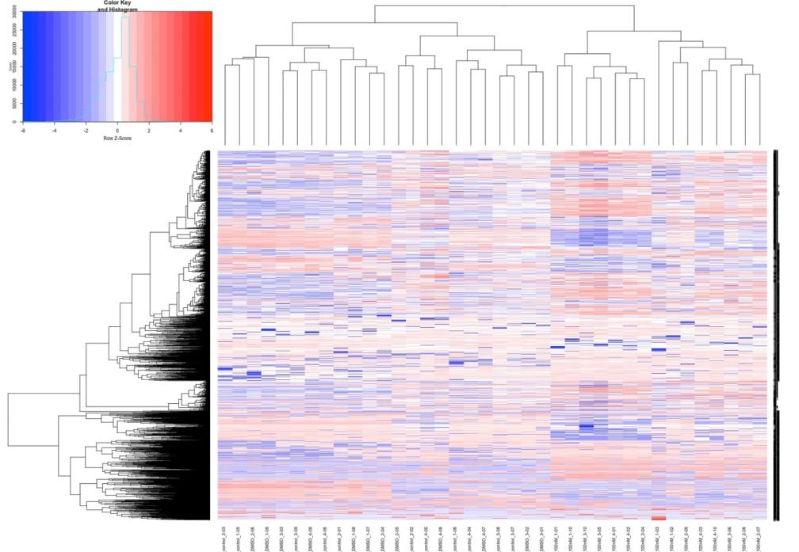
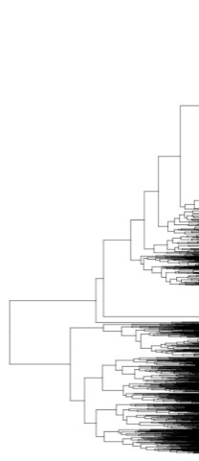
Supplemental Figure 3: Heatmap of protein level changes
1BT1 Cl139 control
1BT1 Cl139 DMSO
1BT1 Cl139 100nM BTZ
6BT1 Cl1 control
6BT1 Cl1 DMSO
6BT1 Cl1 100nM BTZ
100BT8 Cl216 control
100BT8 Cl216 DMSO
100BT8 Cl216 100nM BTZ
Notes:
Supplemental Figure 2: Heatmap of protein level changes

Slide 5
Supplemental Figure 4: GO analysis of IPA cellular functions
A
B
Increased levels of proteins
Decreased levels of proteins
Categories comprised of proteins that increased and decreased in levels
Notes:
Supplemental Figure 3: ClueGO results of the IPA cellular effects
RNA expression, protein synthesis & translation: biological processes, cellular components, and molecular function.
Viral infection: biological processes, cellular components, and molecular function.
Transport of molecule: biological processes, cellular components, and molecular function.
Export of molecule: biological processes, cellular components, and molecular function.
Endocytosis: biological processes, cellular components, and molecular function.
Homeostasis: biological processes, cellular components, and molecular function.
UPR-related proteins related to the heatmap in Figure 3C.
Biological processes of the UPR downstream effectors of XBP1, NFE2L2, ATF4, HSP90B1, and ATF6.

Slide 6
Supplemental Figure 4: GO analysis of IPA cellular functions
C
D
E
Notes:
Supplemental Figure 3: ClueGO results of the IPA cellular effects
RNA expression, protein synthesis & translation: biological processes, cellular components, and molecular function.
Viral infection: biological processes, cellular components, and molecular function.
Transport of molecule: biological processes, cellular components, and molecular function.
Export of molecule: biological processes, cellular components, and molecular function.
Endocytosis: biological processes, cellular components, and molecular function.
Homeostasis: biological processes, cellular components, and molecular function.
UPR-related proteins related to the heatmap in Figure 3C.
Biological processes of the UPR downstream effectors of XBP1, NFE2L2, ATF4, HSP90B1, and ATF6.

Slide 7
Supplemental Figure 4: GO analysis of IPA cellular functions
F
G
H
UPR-related proteins (heatmap; Fig. 3C)
18-CCT7 (+)
19-DERL2 (+)
20-CCT4 (+)
21-YIF1A (+)
22-CCT6A (+)
23-PPIA (-)
24-PPIB (-)
25-ACADVL (+)
26-SEC61A2 (+)
27-MFN2 (+)
28-NPM1 (+)
29-GFPT1 (+)
30-SEC62 (+)
31-CLN3 (+)
32-PREB (+)
33-FAF2 (+)
34-HSPA4L (+)
1-HYOU1 (+)
2-TLN1 (-)
3-STT3B (+)
4-HSP90AA1 (+)
5-HSPA1A/HSPA1B (+)
6-HSPH1 (+)
7-HSP90AB1 (+)
8-SEC61A1 (+)
9-HSPA8 (+)
10-HSPA2 (+)
11-HSPD1 (+)
12-DERL1 (+)
13-TCP1 (+)
14-SERPINH1 (+)
15-MDN1 (+)
16-CANX (+)
17-CCT3 (+)
35-SEC61B (+)
36-KDELR3 (-)
37-SRPRB (+)
38-DNAJB1 (+)
39-CCT2 (+)
40-EXTL3 (+)
41-SEC63 (+)
42-HSPA9 (+)
43-LMNA (-)
44-HSPA6 (+)
45-TMBIM6 (+)
46-AMFR (+)
47-WFS1 (+)
48-ADD1 (-)
49-SEC31A (-)
50-HSPA4 (-)
(+) Increased protein levels in iSNs
(-) Decreased protein levels in iSNs
Notes:
Supplemental Figure 3: ClueGO results of the IPA cellular effects
RNA expression, protein synthesis & translation: biological processes, cellular components, and molecular function.
Viral infection: biological processes, cellular components, and molecular function.
Transport of molecule: biological processes, cellular components, and molecular function.
Export of molecule: biological processes, cellular components, and molecular function.
Endocytosis: biological processes, cellular components, and molecular function.
Homeostasis: biological processes, cellular components, and molecular function.
UPR-related proteins related to the heatmap in Figure 3C.
Biological processes of the UPR downstream effectors of XBP1, NFE2L2, ATF4, HSP90B1, and ATF6.

Slide 8
Supplemental Figure 5A: correlation of protein level changes among the microtubule-associated proteins
1 | CLASP1
2 | SRGAP2
3 | KTN1
4 | CKAP5
5 | CLASP2
6 | DOCK7
7 | PHLDB2
8 | SON
9 | CEP131
10 | MAP2
11 | FLNA
12 | NUMA1
13 | ARHGEF2
14 | EML4
15 | MAP1S
16 | SLK
17 | MAP4
18 | GCC2
19 | SPECC1L
20 | RANBP2
21 | MAP1A
22 | KIF5B
23 | ROCK2
24 | EPHA3
25 | PCM1
26 | NEK1
27 | CEP170
28 | CLIP1
29 | MAP1B
30 | TBCD
31 | IQGAP1
32 | PHLDB1
33 | GOLGA2
34 | AKAP11
35 | KIF2A
36 | NEFM
37 | CC2D1A
38 | HDAC6
39 | APC
40 | DST
41 | RAN
42 | TUBB
43 | KIF5A
44 | UBB
45 | RAB8A
46 | OPA1
47 | TAPT1
48 | MFN2
Notes:
Supplemental Figure 4 : microtubule-associated proteins are affected as a network in bortezomib-induced neurotoxicity
Heat map based on the Pearson’s correlation coefficient among the most significantly affected microtubule-associated proteins.
Illustration of the interconnectivity of microtubule-associated proteins with microtubule-dependent processes. Ribbon width represents the log2-fold change in protein levels.

Slide 9
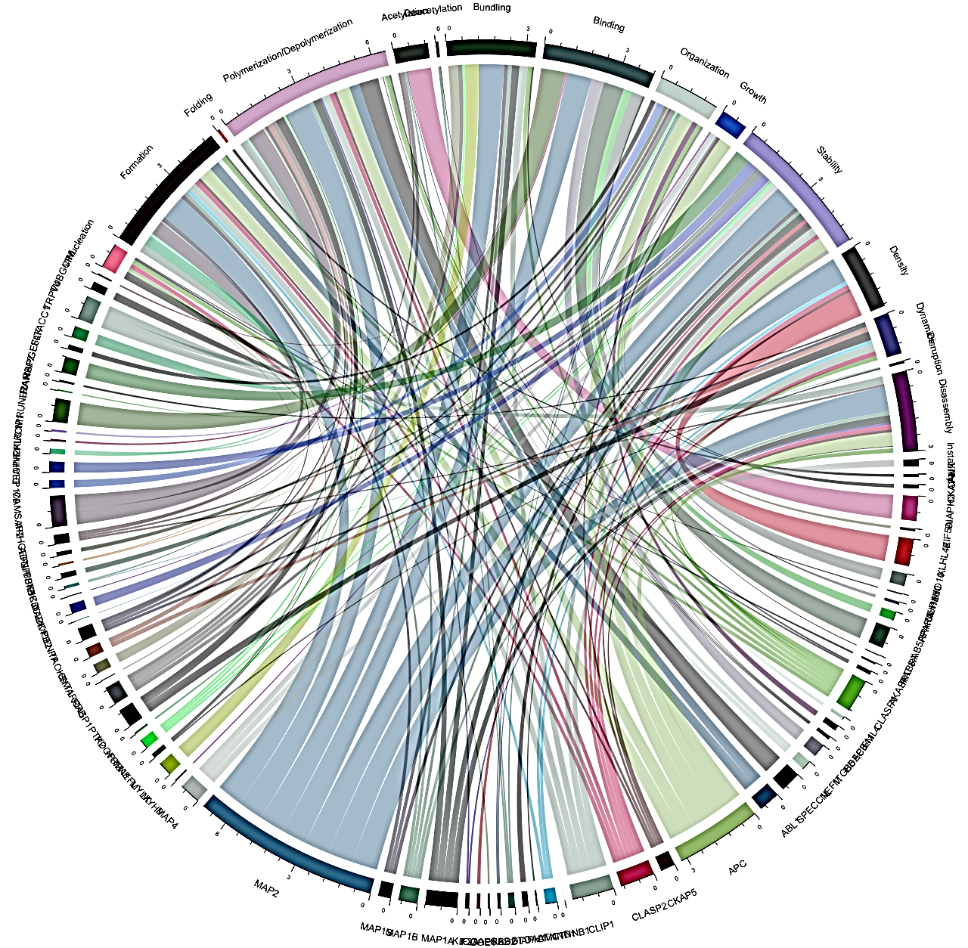
Supplemental Figure 5B: interconnectivity of microtubule-associated proteins and their corresponding biological functions
Acetylation (5)
Deacetylation (2)
Bundling (11)
Polymerization &
Depolymerization (27)
Binding (9)
Organization (15)
Folding (1)
Growth (5)
Formation (19)
Stability (22)
Nucleation (10)
Density (5)
TRPV4
Dynamics (8)
*
Disruption (2)
*
Expression
Disassembly (12)
*
PRUNE2
*
CAMSAP2
DIAPH3
Instability (2)
Decreases Microtubule Dynamics
Expression
SYT1
*
RAB5A
Enhances Dynamics
MYLK
CLASP1
MAP2
*
Expression
MAP1A
*
Expression
CLIP1
APC
*
*
*
Proteins are listed clockwise within each subgroup
**** Increased Expression Diminishes MTD
1-ADNP | 10-RAN
2-ARHGEF2 | 11-RANBP2
3-CAMSAP2 | 12-RAPGEF4
4-CEP170 | 13-SLK
5-DIAPH2 | 14-TACC1
6-INPPL1 | 15-TRPV4
7-KLC1 | 16-TUBGCP6
8-PCM1 9-PRUNE2 | 17-VIM
*** Decreased Expression Diminishes MTD
1-ABL1 | 19-MAP4
2-APC | 20-MYH9
3-CKAP5 | 21-MYLK
4-CLASP2 | 22-NEFL
5-CLIP1 | 23-NUMA1
6-CTNNB1 | 24-PDGFRB
7-CTNND1 | 25-PTK2
8-DAAM1 | 26-RRBP1
9-DIAPH1 | 27-SMARCA5
10-DST | 28-SYT1
11-ERBB2 | 29-TAOK1
12-GOLGA2 | 30-CENPF
13-IQGAP1 | 31-COPB2
14-KIF2A | 32-DAPK1
15-MAP1A | 33-PIK3C2A
16-MAP1B | 34-TBCD
17-MAP1S | 35-TBK1
18-MAP2 | 36-TUBB
* Increased Expression Enhances MTD
1-CANX | 7-NUP160
2-CKAP4 | 8-PAFAH1B1
3-DIAPH3 | 9-PRKCI
4-KIF5A | 10-RAB5A
5-KLHL42 | 11-RAB8A
6-MYO10 | 12-SRC
** Decreased Expression Enhances MTD
1-AKAP11 | 5-HDAC6
2-CLASP1 | 6-ITGB5
3-EML4 | 7-NEFM
4-EPB41 | 8-SPECC1L
Notes:
Supplemental Figure 4 : microtubule-associated proteins are affected as a network in bortezomib-induced neurotoxicity
Heat map based on the Pearson’s correlation coefficient among the most significantly affected microtubule-associated proteins.
Illustration of the interconnectivity of microtubule-associated proteins with microtubule-dependent processes. Ribbon width represents the log2-fold change in protein levels.

Slide 10
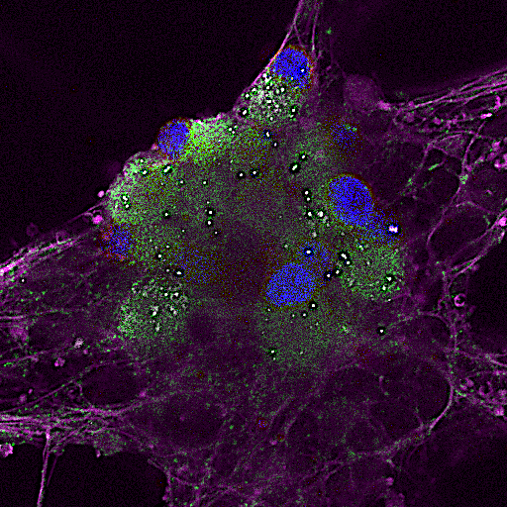
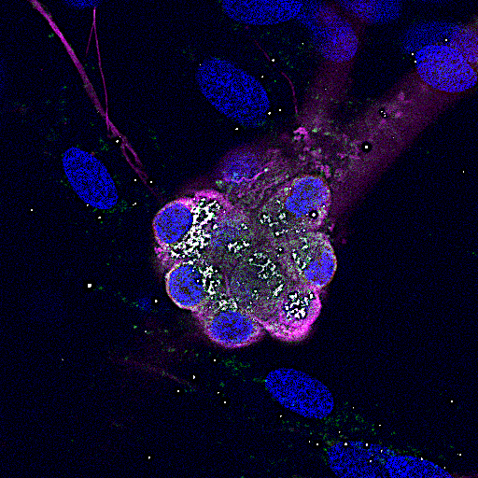
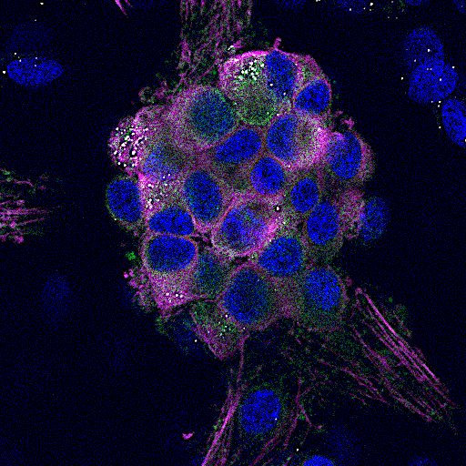
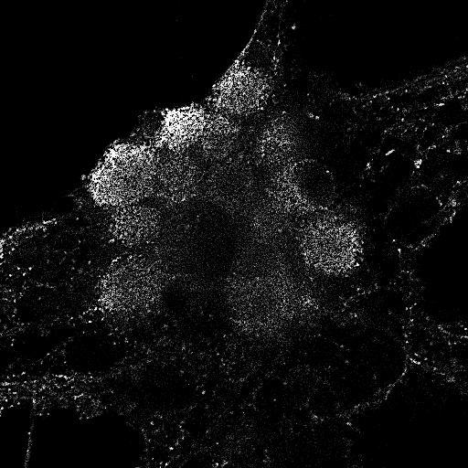
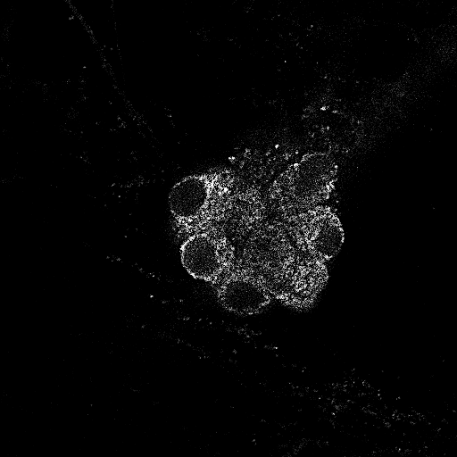
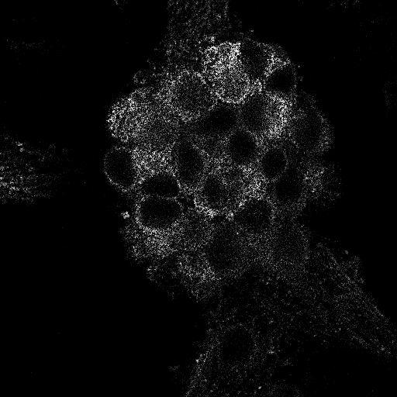
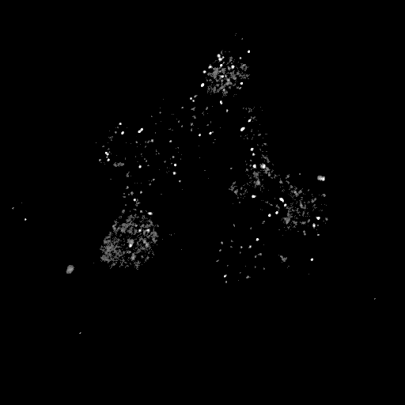


Supplemental Figure 6: Increased SQSTM1 levels and nuclear accumulation of ATF3 are not observed from paclitaxel exposure
ATF3
SQSTM1
Tuj-1
Control iSNs
1uM paclitaxel 48h
1uM paclitaxel 48h
ATF3
ATF3
ATF3
SQSTM1
SQSTM1
SQSTM1
20um

Slide 11
Supplemental Table 1:
Materials and reagents associated with methodology
Unless specified, reagents were used according to the manufacturers’ recommendations.
Reagent | Catalog # | Application & Usage | Source
MAP2 Antibody | 4542 | IF (1:1000); WB (1:125) | Cell Signaling Technology
MAP2 Antibody | ab28032 | IF (1:500); WB (1:125) | abcam
Anti-Tubulin β-III Antibody, clone TU-20, Alexa Fluor®488 Conjugated | CBL412X | IF (1:250) | MilliporeSigma
Tuj-1 (neuron-specific class III beta-tubuin) | MO15013 | WB (1:50) | Neuromics
Rab6 (D37C7) Rabbit mAb #9625 | 9625 | IF (1:500) | Cell Signaling Technology
Human/Mouse/Rat p62/SQSTM1 Antibody | MAB8028 | IF (1:1000); WB (1:25) | R&D Systems
ATF3 (E9J4N) Rabbit mAb | 18665 | IF (1:1000); WB (1:150) | Cell Signaling Technology
CREB3 Antibody | 11275-1-AP | IF (1:1000); WB (1:125) | proteintech
α/β Tubulin Antibody #2148 | 2148 | WB (1:50) | Cell Signaling Technology
TMRM | I34361 | live cell assay (20nM) | Invitrogen
Peripherin antibody | ab4666 | IF (1:500) | abcam
GAPDH (14C10) Rabbit mAb #2118 | 2118 | WB (1:600) | Cell Signaling Technology
Donkey Anti-rabbit IgG (H+L) Highly Cross-Adsorbed Secondary Antibody, Alexa Fluor 555 | A-31572 | IF (1:2000) | Invitrogen
Donkey Anti-mouse IgG (H+L) Highly Cross-Adsorbed Secondary Antibody, Alexa Fluor 555 | A-31570 | IF (1:2000) | Invitrogen
Goat anti-Rabbit IgG (H+L) Highly Cross-Adsorbed Secondary Antibody, Alexa Fluor 633 | A-21071 | IF (1:2000) | Invitrogen
Cell Culture & Biochemistry Reagents
Bortezomib (PS-341), Free Base, >99% | B-1408 | 100 nM | LC laboratories
DMSO | D2650 | 0.0001% | Sigma-Aldrich
mTeSR™ 1 | 85850 |  | STEMCELL Technologies Inc.
KnockOut™ DMEM | 10829018 |  | Life Technologies
KnockOut™ Serum Replacement (15%) | 10828028 | 15% | Life Technologies
GlutaMAX™ Supplement (100X) | 35050061 | 1% | Life Technologies
MEM Non-Essential Amino Acids Solution (100X) | 11140050 | 1% | Life Technologies
2-Mercaptoethanol | 21985023 | 55 μM | Life Technologies
Accutase | AT-104 |  | Innovative Cell Technologies
Y-27632 | 5092280001 | 10 ng/ml | Calbiochem
LDN193189 | SML0559 | 100 nM | Sigma-Aldrich
SB431542 | Ab120163 | 10 μM | abcam
CHIR99021 | 4423 | 3 μM | Tocris Bioscience
DAPT | 2634 | 10 μM | Tocris Bioscience
SU5402 | SML0443 | 5 μM | Sigma-Aldrich
Recombinant human β-NGF | 256-GF-100 | 25 ng/ml | R&D Systems
Recombinant BDNF | 248-BD-005 | 25 ng/ml | R&D Systems
Recombinant human GDNF | 212-GD-010 | 25 ng/ml | R&D Systems
Recombinant NT-3 | 267-N3-025 | 25 ng/ml | R&D Systems
cAMP | D0627 | 0.5 mM | Sigma-Aldrich
L-ascorbic acid | A8960 | 200 μM | Sigma-Aldrich
DAPI | D1306 |  | Invitrogen
16% Paraformaldehyde (formaldehyde) aqueous solution | 15710 | 4% | Electron Microscopy Sciences
Triton™ X-100 | X100-100ML | 0.5% | Sigma-Aldrich
SuperBlock™ (PBS) Blocking Buffer | 37580 | + 0.05% Triton X-100 | Thermo Scientific™
ProLong antifade mountant | P36930 |  | Invitrogen
Halt™ Protease Inhibitor Cocktail (100X) | 87786 |  | Thermo Scientific™
Halt™ Protease and Phosphatase Inhibitor Cocktail (100X) | 78446 |  | Thermo Scientific™
Benzonase® Nuclease | E1404 |  | MilliporeSigma
CytoTuneTM-iPS 2.0 Sendai Reprogramming Kit | A16518 |  | Invitrogen
Geltrex™ LDEV-Free, hESC-Qualified, Reduced Growth Factor Basement Membrane Matrix | A1413302 |  | Gibco®
12-230 kDa Jess or Wes Separation Module | SM-W004 |  | proteinsimple
66-440 kDa Jess or Wes Separation Module | SM-W008 |  | proteinsimple
Anti-Rabbit Detection Module | DM-001 |  | proteinsimple
Anti-Mouse Detection Module | DM-002 |  | proteinsimple

