Slide 1
Supplemental Figure Legend
Figure S1 Negative relationship between leaf mass and leaf nitrogen. This relationship was
shown to reflect nutrient gradients in New England and was suggested for use as a
nutrient pollutant indicator (Lee et al. 2014). For the regression equation y= Leaf
tissue mass (mg/ cm²), x = Leaf tissue N (%), and adj R² is the amount of variance
explained after correcting for the number of parameters in the model.
Figure S2 Photograph of sediment trap array. The array consists of 3 sediment traps, with a
honeycomb baffle inserted into the top of the trap to prevent resuspension of
sediment particles.
Figure S3 Structural, morphological and growth characteristics of eelgrass meadows. Letters
indicate statistical differences (Tukey test) among sites. a. number of leaves/shoot,
b. internode length (cm), c. above-below ground weight (g), d. growth (cm/shoot/d).
Figure S4 Comparison of carbon determination techniques. % C is an output from the
isotope-ratio mass spectrometer. Organic matter is quantified using the loss on
ignition technique.
Figure S5 Carbon stock (g C / m²) of material collected in sediment traps in meadow and
unvegetated areas. Capital letters indicate statistical differences (Tukey test) among
sites in meadows, while lower case letters indicate statistical differences (Tukey test)
among sites in unvegetated areas.

Slide 2
Supplemental Figure Legend
Figure S6 Scatter plots showing model fit for reduced models. The dashed line indicates
the 1:1 relationship between the observed data and the modeled output. The
solid line shows the regression line that best fits the predicted output. For the
regression equation y= Predicted bulk carbon (g C/ m²), x = Observed bulk
carbon (g C/ m²), and adj R² is the amount of variance explained after
correcting for the number of parameters in the model. a. Model output for
top 5 cm of core in meadow, predicted using degree of sorting, shoot density
and % silt-clay. Figure shows model average results based on 14 models and
10 sites
b. Model output for top 5 cm of core in unvegetated areas predicted using
silt-clay. Figure is based on 1 model (as there was only 1 variable) and 10 sites

Slide 3

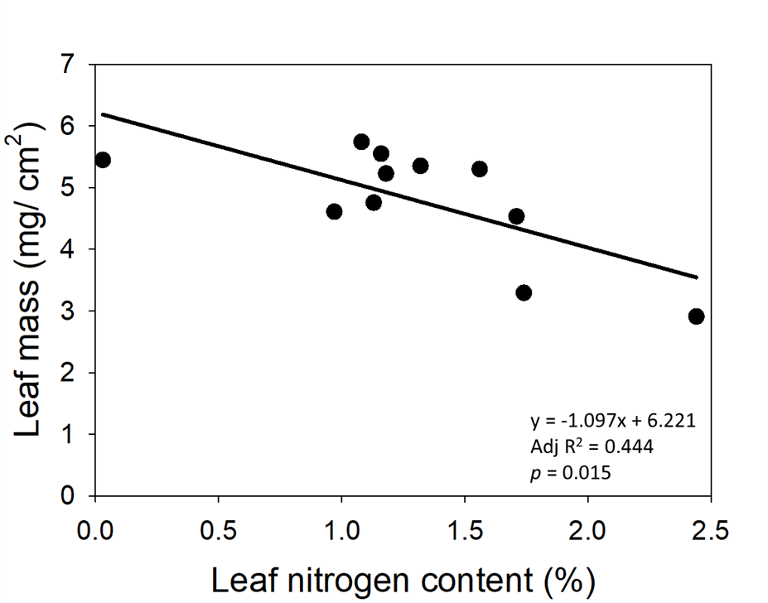

Slide 4
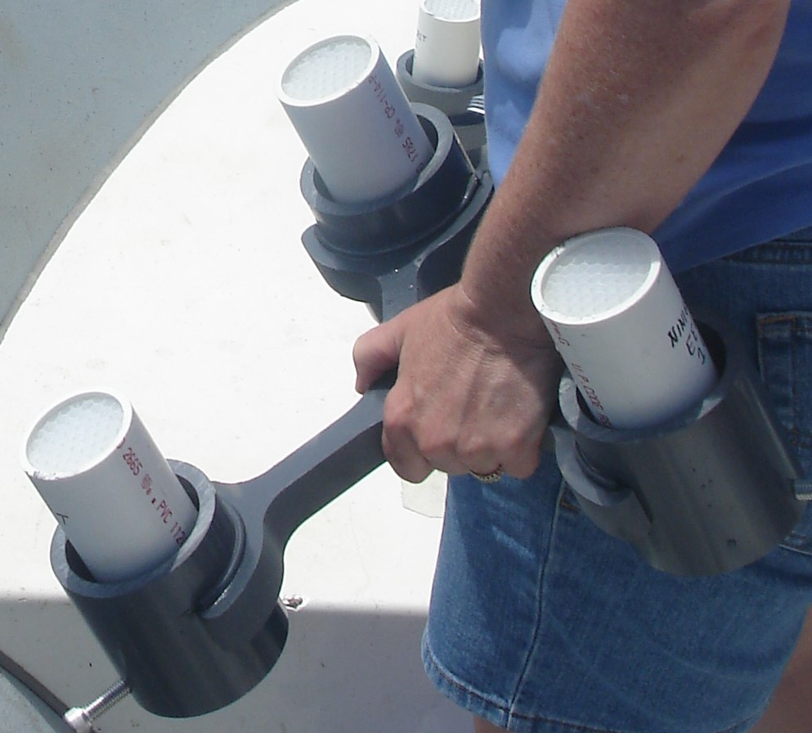
Fig S2

Slide 5
Fig S3
a
b
A
A
BCD
B
AB
BC
BCD
BCD
BCD
AB
CDE
E
DE
BC
CDE
CDE
CD
C
CDE
E
DE
E
c
d
A
A
A
A
AB
AB
ABCD
ABCD
BCD
ABC
ABC
B
BC
BC
BC
CD
C
D
D
No Data
D
No Data

Slide 6
Fig S4
y= 0.337x -0.132
Adj R² = 0.980
p < 0.0001

Slide 7
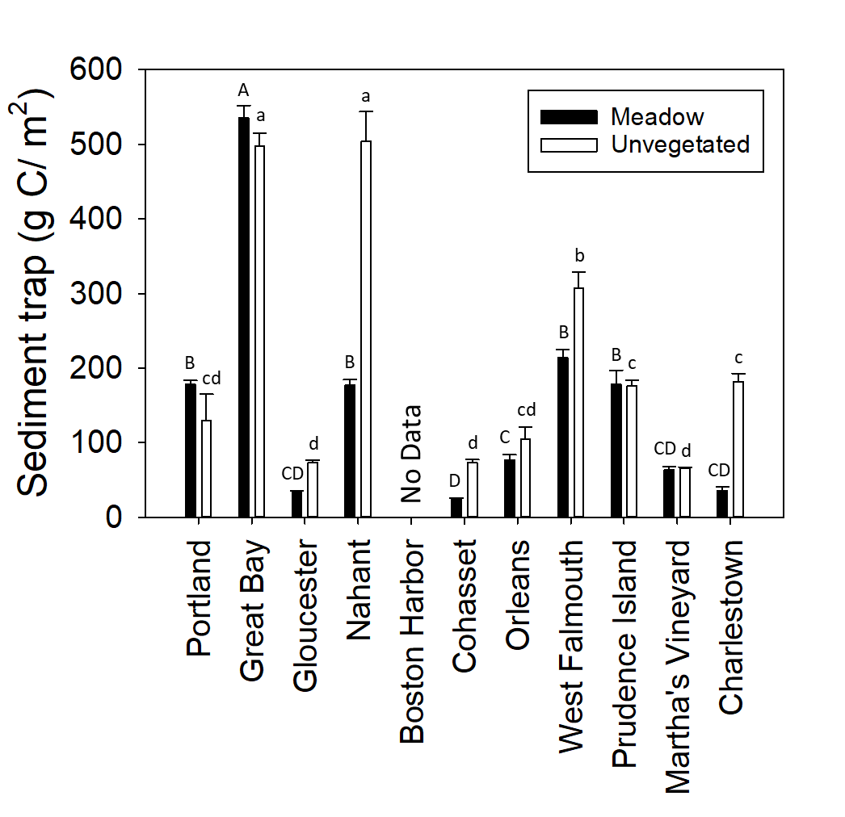
S5

Slide 8
Fig S6
a. Meadow – reduced model
b. Unvegetated – reduced model
y = 0.49*x + 222.96
adj R² = 0.418
p = 0.026
y = 0.76*x + 71.88
adj R² = 0.728
p = 0.001

