Slide 1

The European TREatment of ATopic eczema Registry Taskforce (TREAT) survey: prescribing practices in Europe for phototherapy and systemic therapy in adult patients with moderate-to-severe eczema
F.M. Vermeulen, L.A.A. Gerbens, J. Schmitt, M. Deleuran, A.D. Irvine, K. Logan, W. Ouwerkerk, C. Vestergaard, C. Flohr, and P.I. Spuls, on behalf of the international TREAT Registry Taskforce.
Affiliations (among others): Amsterdam UMC, University of Amsterdam, Department of Dermatology; Centre for Evidence-based Healthcare, Medizinische Fakultät Carl Gustav Carus, TU Dresden; University Allergy Centre, Dresden; and Unit for Population-Based Dermatology Research, St John's Institute of Dermatology, Guy’s & St Thomas' NHS Foundation Trust and King’s College London
British Journal of Dermatology. DOI: 10.1111/bjd.18959

Slide 2



Lead Researchers
Prof. Dr. P. I. Spuls
Prof. Dr. C. Flohr
Prof. Dr. J. Schmitt
British Journal of Dermatology. DOI: 10.1111/bjd.18959

Slide 3
Introduction
What’s already known?
Varying prescribing practices were found for adult (in the United Kingdom) and paediatric (in Northern America and Europe) patients with moderate-to-severe atopic eczema (AE)
Not much is known about the prescription of phototherapy and (off-label) systemic therapy for adult AE patients in Europe
Although therapies like dupilumab are promising new treatment modalities, better-known safety-profiles, lower costs and better availability are reasons to improve the evidence profile of conventional systemic therapies
British Journal of Dermatology. DOI: 10.1111/bjd.18959

Slide 4
Objectives
To provide insight into:
Current prescribing practices of conventional phototherapy and systemic immunomodulatory therapies for adults with AE
Factors influencing these prescribing practices, before biologics and other novel therapeutics become routine clinical practice
British Journal of Dermatology. DOI: 10.1111/bjd.18959

Slide 5
Methods: Study design
  An online, anonymous, multiple response survey was conducted among European dermatologists caring for adult patients with moderate-to-severe atopic eczema (AE)
  Participants prescribed phototherapy and systemic therapy on a regular basis for moderate-to-severe AE
  Definition of moderate-to-severe AE: atopic eczema not adequately controlled by standard and optimised topical treatment
British Journal of Dermatology. DOI: 10.1111/bjd.18959

Slide 6
Methods: Survey questionnaire
135 questions split into 5 sections:
Demographics
Treatment options
Phototherapy
Systemic therapy
Future work
British Journal of Dermatology. DOI: 10.1111/bjd.18959

Slide 7
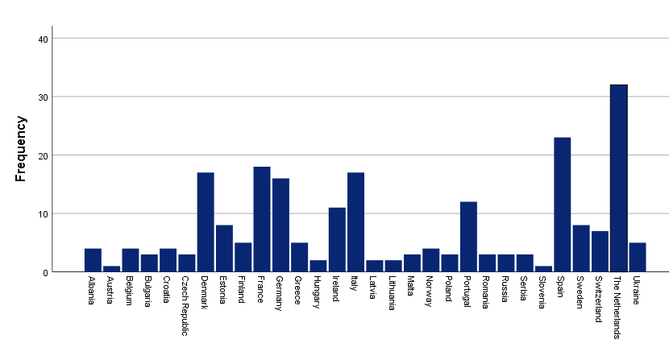
Survey participants
229 surveys from 30 countries were analysed
Number of dermatologists that participated per country:
Country
British Journal of Dermatology. DOI: 10.1111/bjd.18959

Slide 8
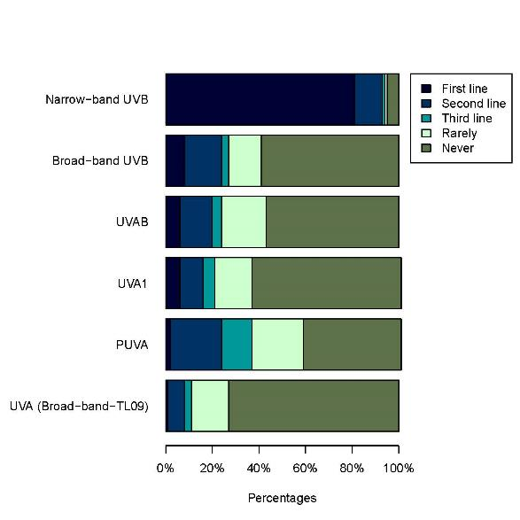
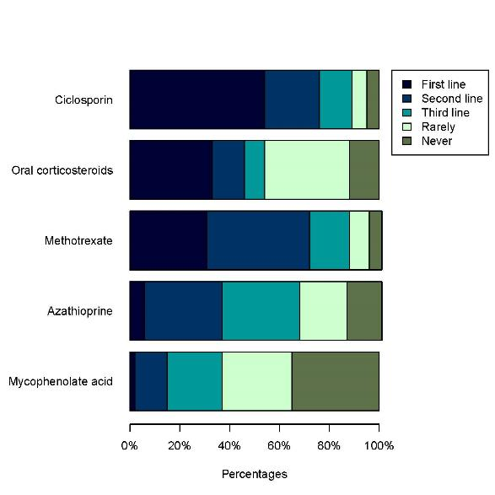
Results: Treatment choices
Participants were able to select multiple therapies as first line, second line, third line, rarely or never prescribed:
Phototherapy (n=194)
Systemic therapy (n=218)
British Journal of Dermatology. DOI: 10.1111/bjd.18959

Slide 9
Results: Reasons for therapies
Reasons FOR therapies, N(%) | Phototherapy, N=194 | Systemic therapy, N=218
Sufficient short term (<3 months) efficacy | 77 (39.7) | 87 (39.9)
Sufficient medium term (>3 months) efficacy | 103 (53.1) | 118 (54.1)
Sufficient long term (>12 months) efficacy | 28 (14.4) | 103 (47.2)
Low potential acute side effect profile | 102 (52.6) | 112 (51.4)
Low potential long-term side effect profile | 95 (49.0) | 123 (56.4)
Baseline tests and co-morbidities | N.A. | 128 (58.7)
My knowledge of the evidence base for treatment efficacy including support by RCTs | 62 (32.0) | 107 (49.1)
My knowledge of national/international guidelines | 75 (38.7) | 115 (52.8)
My knowledge of expert opinion disseminated through lectures/clinical meetings | 40 (20.6) | 84 (38.5)
My own clinical experience | 114 (58.8) | 140 (64.2)
Costs | 53 (27.3) | 57 (26.1)
Comorbidities | 75 (38.7) | 98 (45.0)
Other | 5 (2.6) | 0 (0.0)
British Journal of Dermatology. DOI: 10.1111/bjd.18959

Slide 10
Results: Reasons against therapies
Reasons AGAINST therapies, N (%) | Phototherapy, N=35 | Systemic therapy, N=11
Insufficient effect in previous patients | 7 (20.0) | 0 (0.0)
Insufficient medium-term (>3 months) efficacy | 4 (11.4) | 0 (0.0)
Insufficient long-term (> 12 months) efficacy | 8 (22.9) | 0 (0.0)
High potential acute side-effect profile | 7 (20.0) | 6 (54.4)
High potential long-term side-effect profile | 5 (14.3) | 4 (36.4)
Relative contraindication due to previous UV therapy (cumulative dose) | 5 (14.3) | N.A.
Suspected risk of long-term organ toxicity | N.A. | 5 (45.5)
Lack of guidelines | 4 (11.4) | 4 (36.4)
Lack of evidence base for treatment efficacy | 5 (14.3) | 1 (9.1)
Lack of personal experience | 9 (25.7) | 4 (36.4)
Colleague(s) with more experience in the use of the therapy | 11 (31.4) | 3 (27.3)
Comorbidities | N.A. | 5 (45.5)
Patient preferences | 10 (28.6) | 5 (45.5)
Logistics (not available in centre) | 16 (45.7) | 2 (18.2)
Costs | 3 (8.6) | 4 (36.3)
British Journal of Dermatology. DOI: 10.1111/bjd.18959

Slide 11
Discussion
  First survey study for moderate-to-severe atopic eczema in adult patients in Europe
  Took place before dupilumab became part of routine clinical practice
  Potential limitations: selection bias, simultaneous use of systemic therapy was not questioned, recall-bias
British Journal of Dermatology. DOI: 10.1111/bjd.18959

Slide 12
Discussion
Still many gaps of evidence
More high-quality, long-term evidence is needed because dermatologists prefer both on and off label therapies
Large prospective patient cohorts might provide this evidence
  TREAT Registry Taskforce: treat-registry-taskforce.org
Prescribing practices should be re-evaluated in the future with new developments in treatment
British Journal of Dermatology. DOI: 10.1111/bjd.18959

Slide 13
Conclusions
What does this study add?
Prescribing practices of European dermatologists treating adult moderate-to-severe AE patients show diversity
Most dermatologists prefer narrow-band UVB as first line phototherapy, followed by psoralen and UVA as second line
Next to most commonly prescribed ciclosporin, (off-label) methotrexate and oral corticosteroids are also frequently used as first line systemic agents in chronic AE
Lack of personal experience with azathioprine and mycophenolate acid was the most important reason against their prescription
British Journal of Dermatology. DOI: 10.1111/bjd.18959

Slide 14

The Team
British Journal of Dermatology. DOI: 10.1111/bjd.18959

Slide 15
Call for correspondence
Why not join the debate on this article through our correspondence section?
Rapid responses should not exceed 350 words, four references and one figure
Further details can be found on the BJD website

