Slide 1
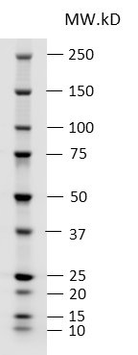
Figure 1B: NLRX1/Actin

Slide 2
p-Akt
Akt
Actin
Figure 4A: p-Akt/Akt/Actin

Slide 3
p-AMPK
AMPK
Actin
Figure 4C: p-AMPK/AMPK/Actin

Slide 4
p-STAT3
STAT3
Actin
Figure 4E: p-STAT3/STAT3/Actin

Slide 5
p-PDH
PDH
a-tubulin
Figure 6C: p-PDH/PDH/a-tubulin

Slide 6
cytoHK II
Actin
Supplementary Figure 1
mtHK II
COX IV

