Slide 1
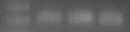
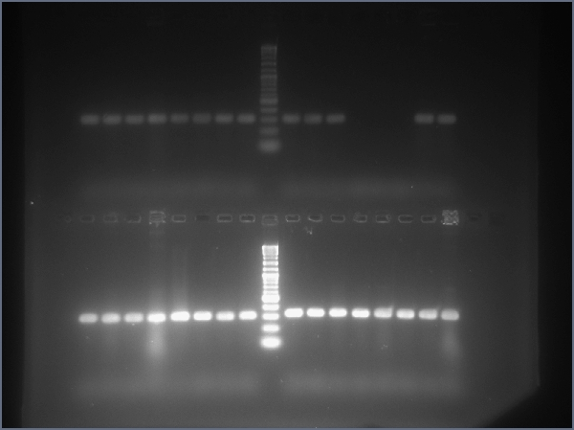
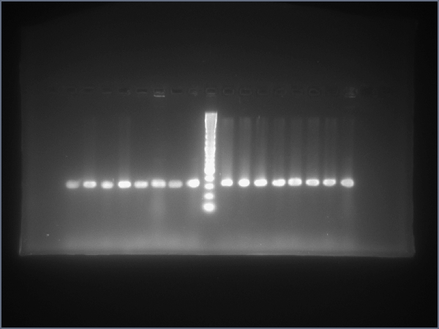
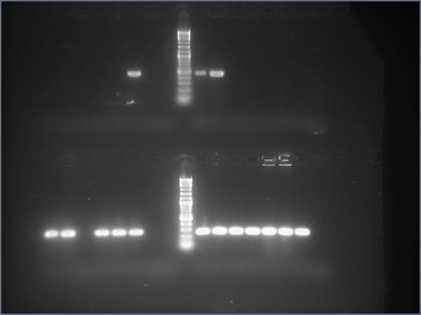
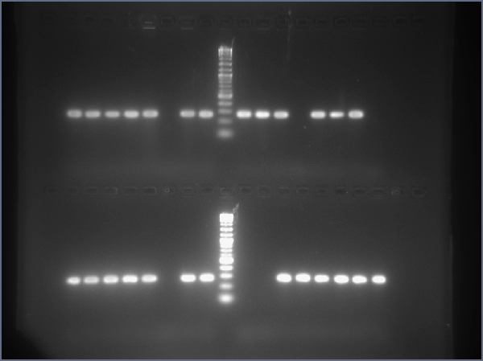
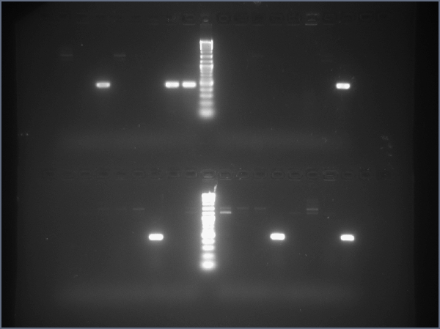
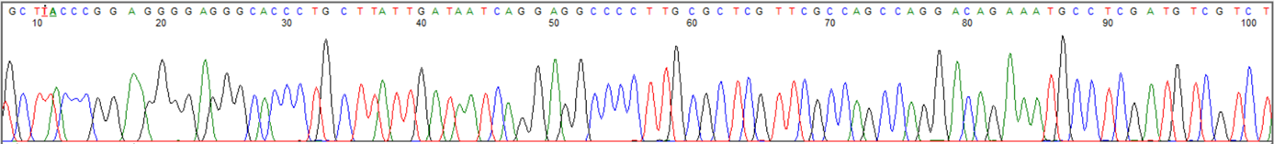
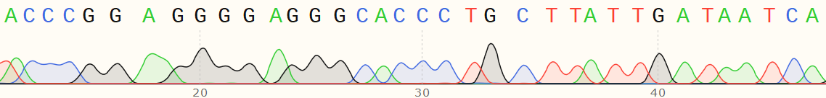
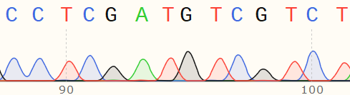
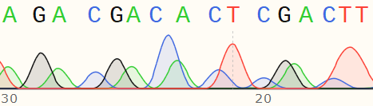
A
protospacer
tnsABC
F plasmid
specR
tniQ-cascade
L
CRISPR
R
kanR
Kan^{R} Spec^{R} Nal^{R} Rif^{R}
Spec^{R} Nal^{R} Rif^{R}
Transposition frequency =
24 hr induction
90 min
mating
R
kanR
L
Induced donor pool
Recipient strain Nal^{R} Rif^{R}
B
Tn6900 transposition
typical = 24/24 (100%), atypical 24/24 (100%)
*second PCR reaction and gel
Primer pair
a
a
typical
1-9
9-16
17-24
protospacer
kanR
L
a
R
atypical
1-9
9-16
17-24
b
protospacer
kanR
R
Tn6677 transposition
L
typical = 19/24 (79.1%), atypical 19/24 (79.1%)
Primer pair
a
b
1-9
9-16
17-24
typical
a
b
1-9
17-24
atypical
9-16
C
pS44-1 insertions
Insertion 4
46bp
ffs insertions
Insertion 3
47bp
Insertion 4
47bp
Insertion 2
45bp
Insertion 3
47bp
Insertion 1
46bp
Insertion 2
46bp
CGGAAGGGGAGGGCACCCUGCUUAUUGAUAAU
||||||||||||||||||||||||||||||||
ACCCGGAAGGGGAGGGCACCCTGCTTATTGATAATCAGGAGGCCCCTTGCGCTCGTTCGCCAGCCAGGACAGAAATGCCTCGACTT
ACCCGGAAGGGGAGGGCACCCTGCTTATTGATAATCAGGAGGCCCCTTGCGCTCGTTCGCCAGCCAGGACAGAAATGCCTCGA TGTCGTCT AGACGACA CTCGACTT
Insertion 1
46bp
Right end
Left end
protospacer
TSD
Right end
Left end
TSD

