Slide 1
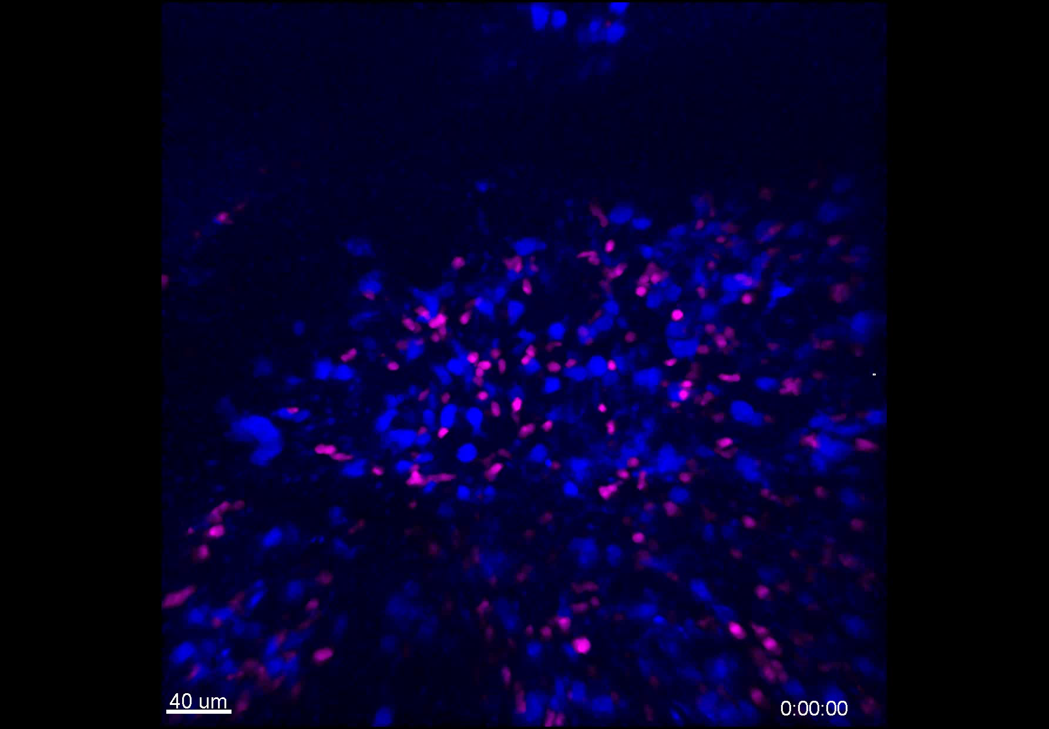
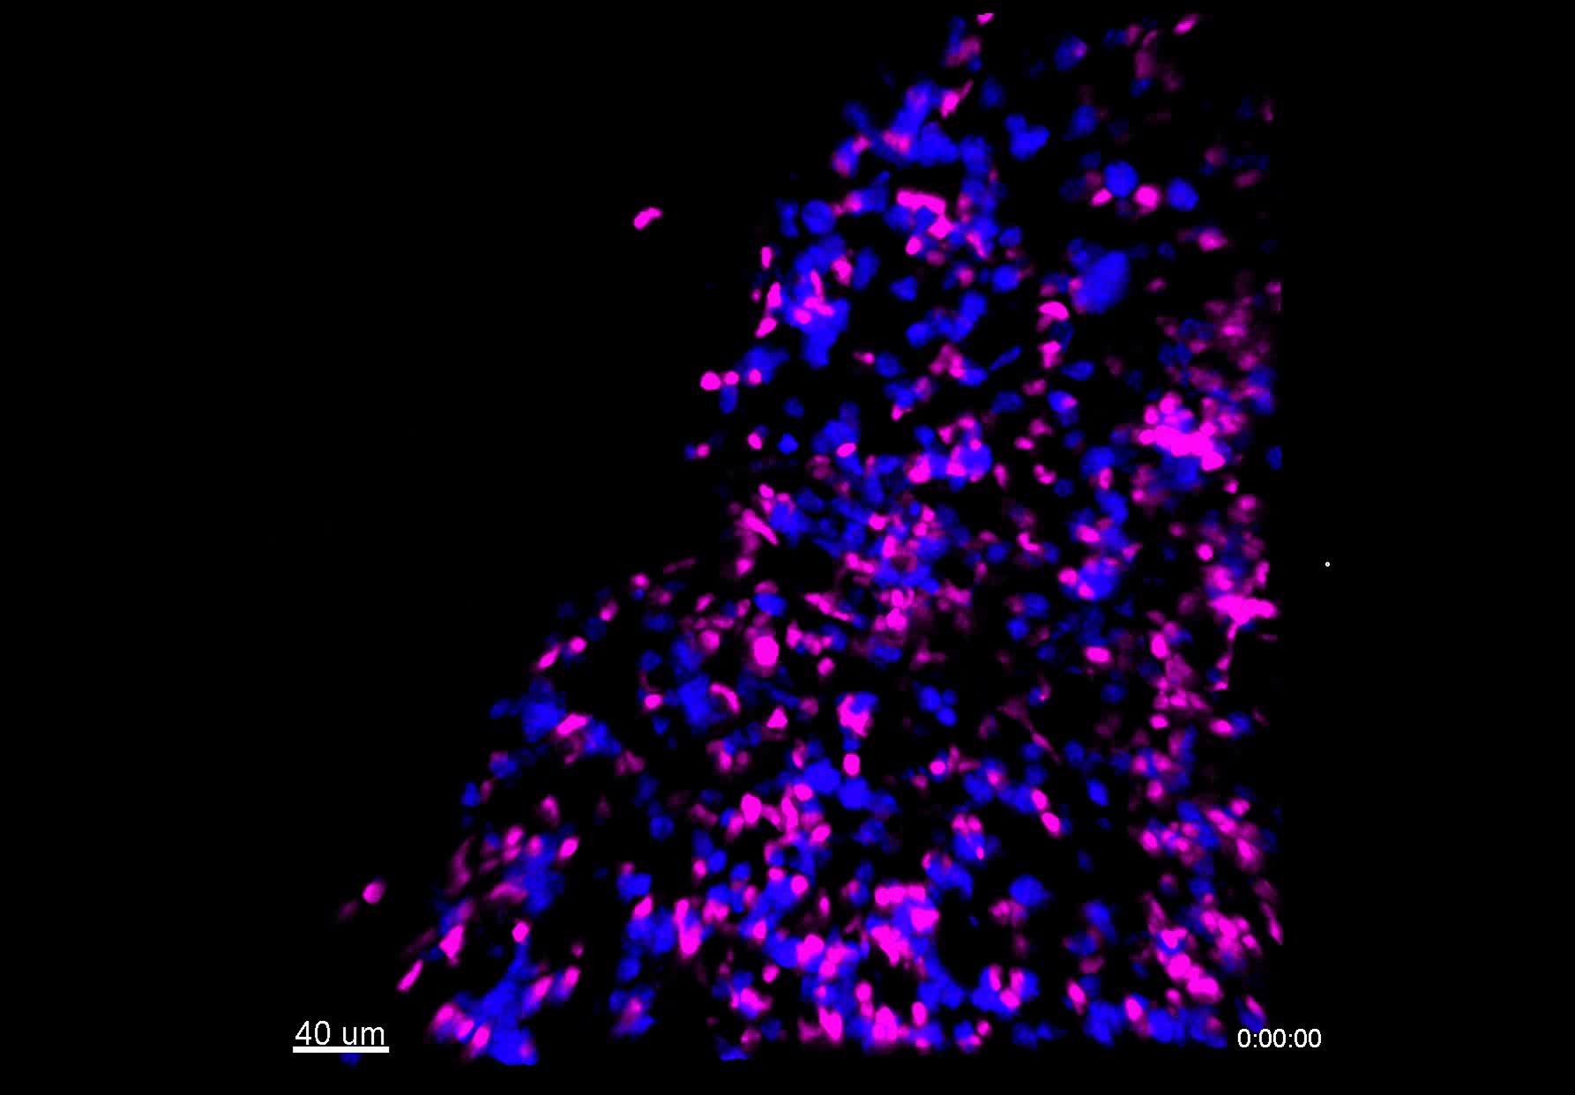
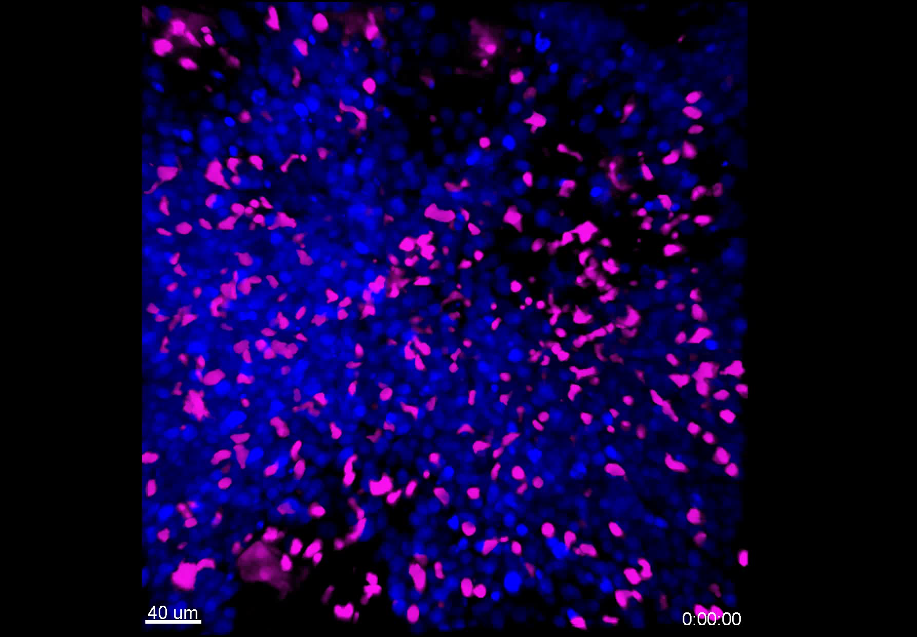
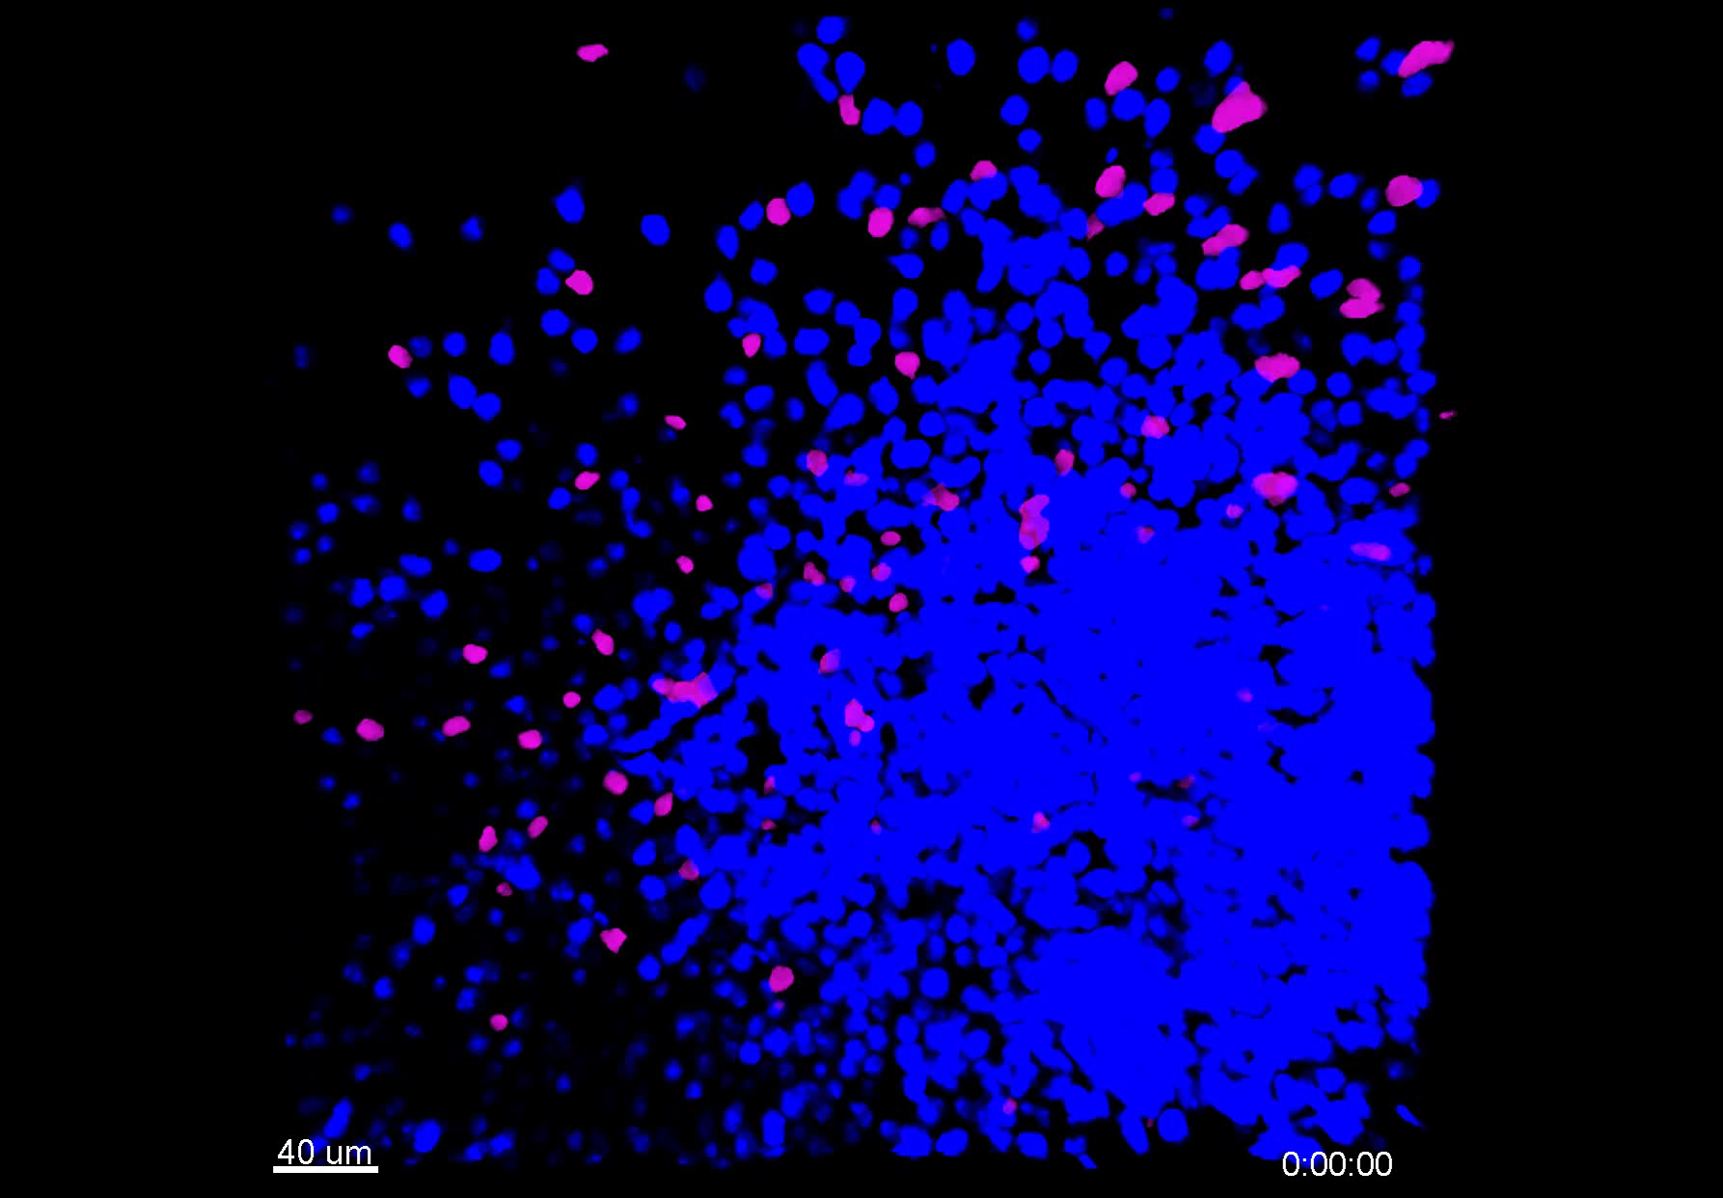
S2 Supplementary Videos
Vehicle
CD20-TCB
PBMC-NSG
Supplementary video 5
Supplementary video 6
HSC-NSG
Supplementary video 7
Supplementary video 8
Resident T cells WSU DLCL2

