Slide 1
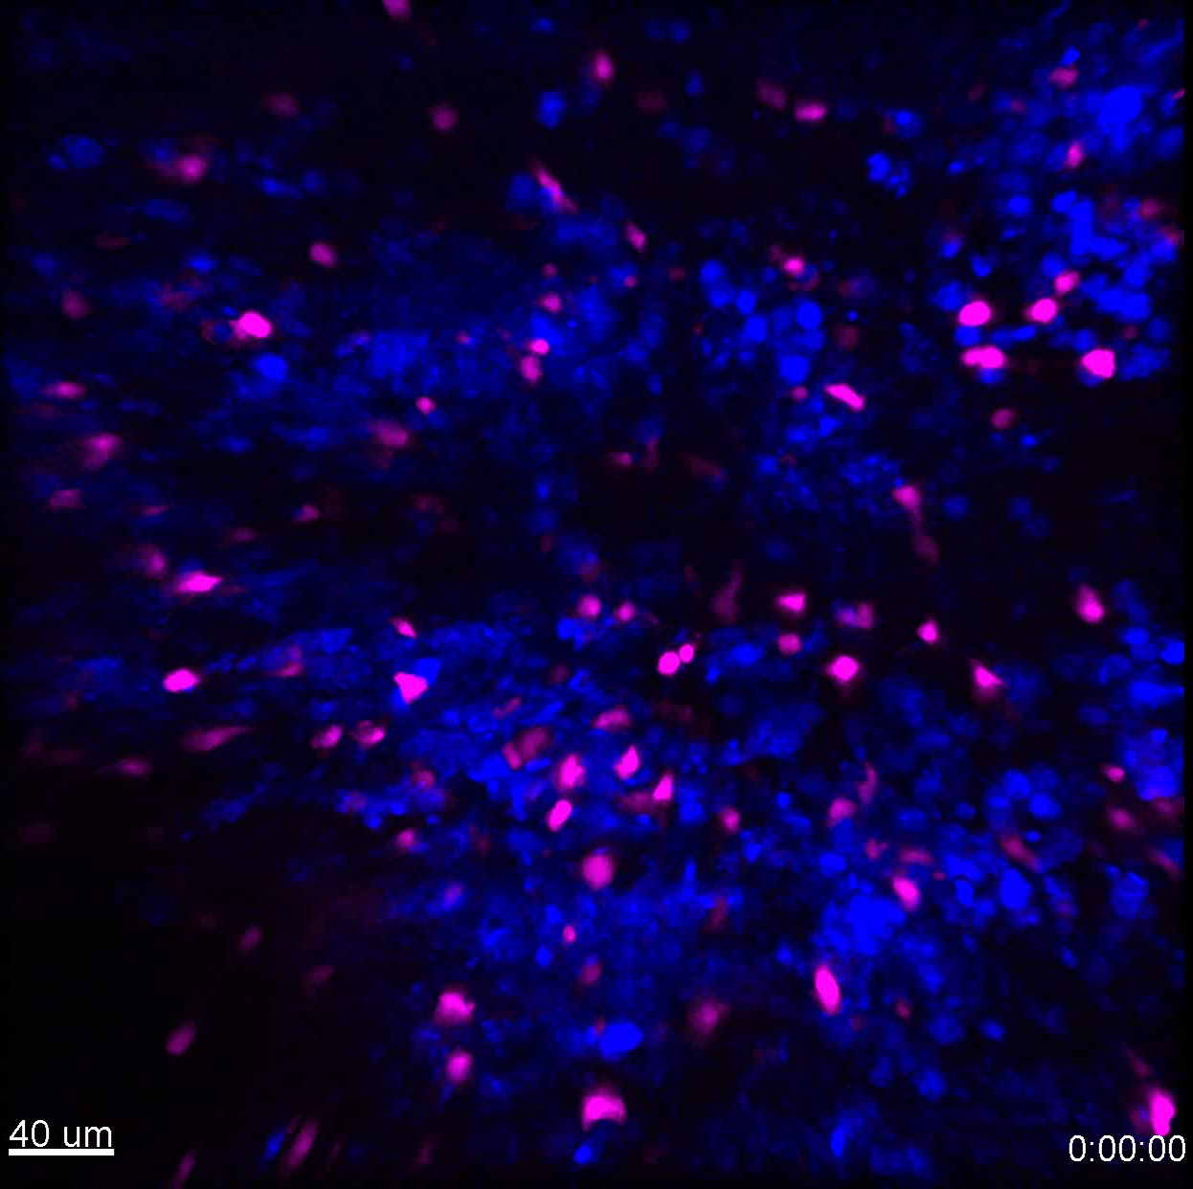
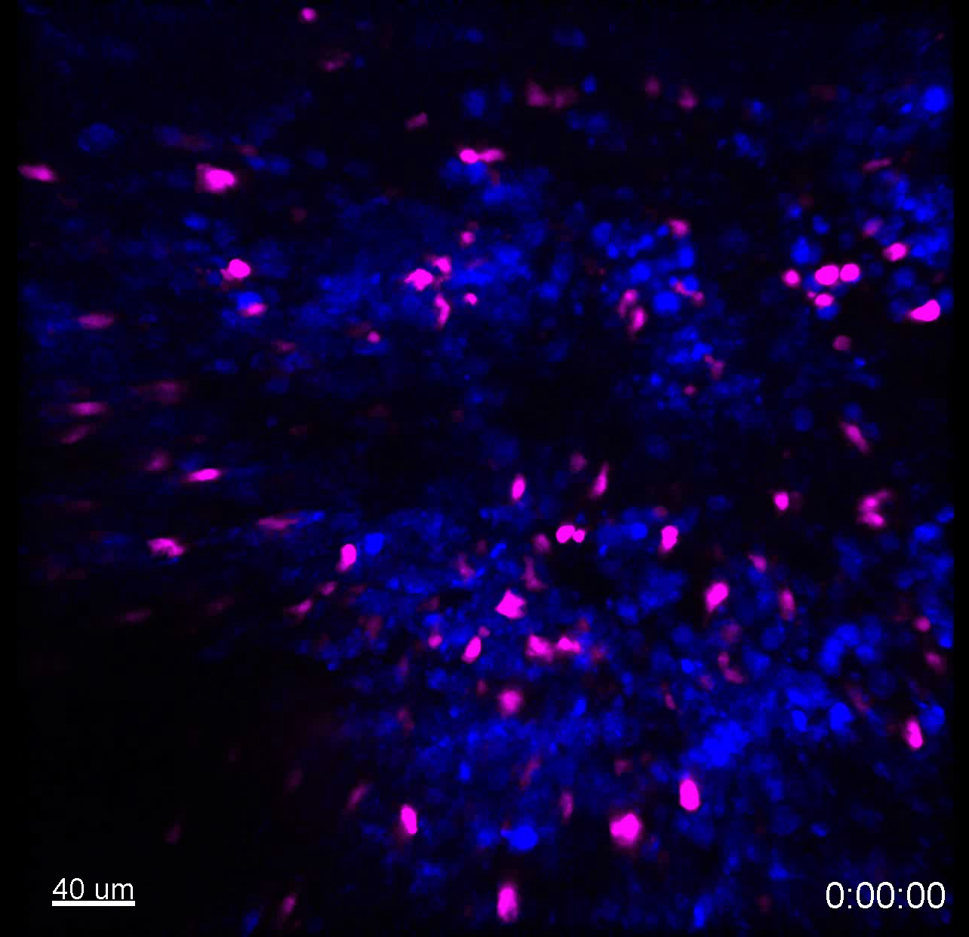
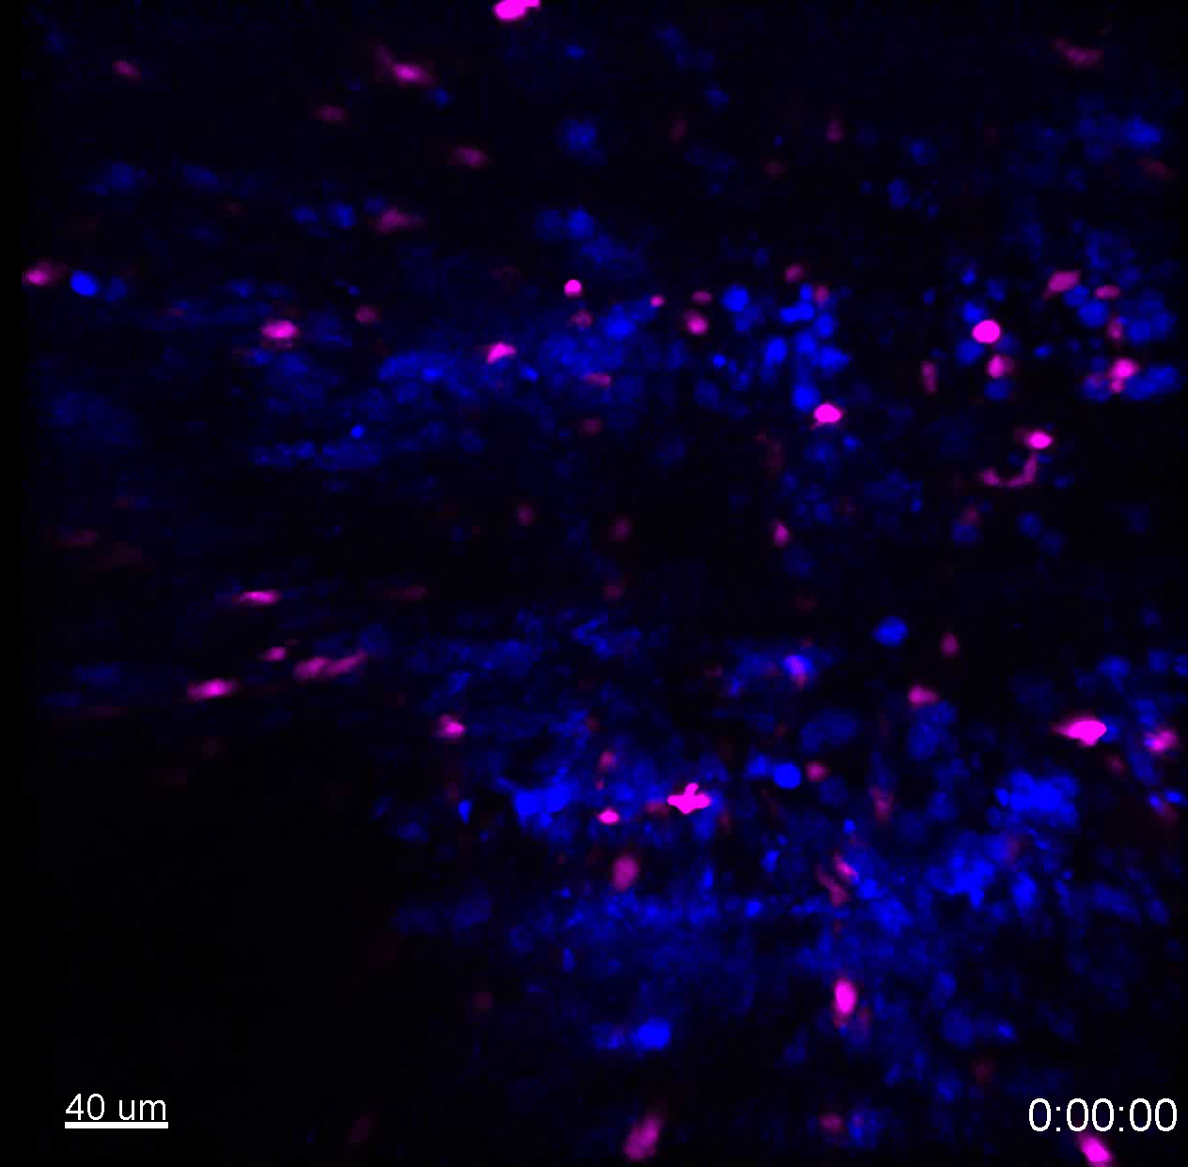
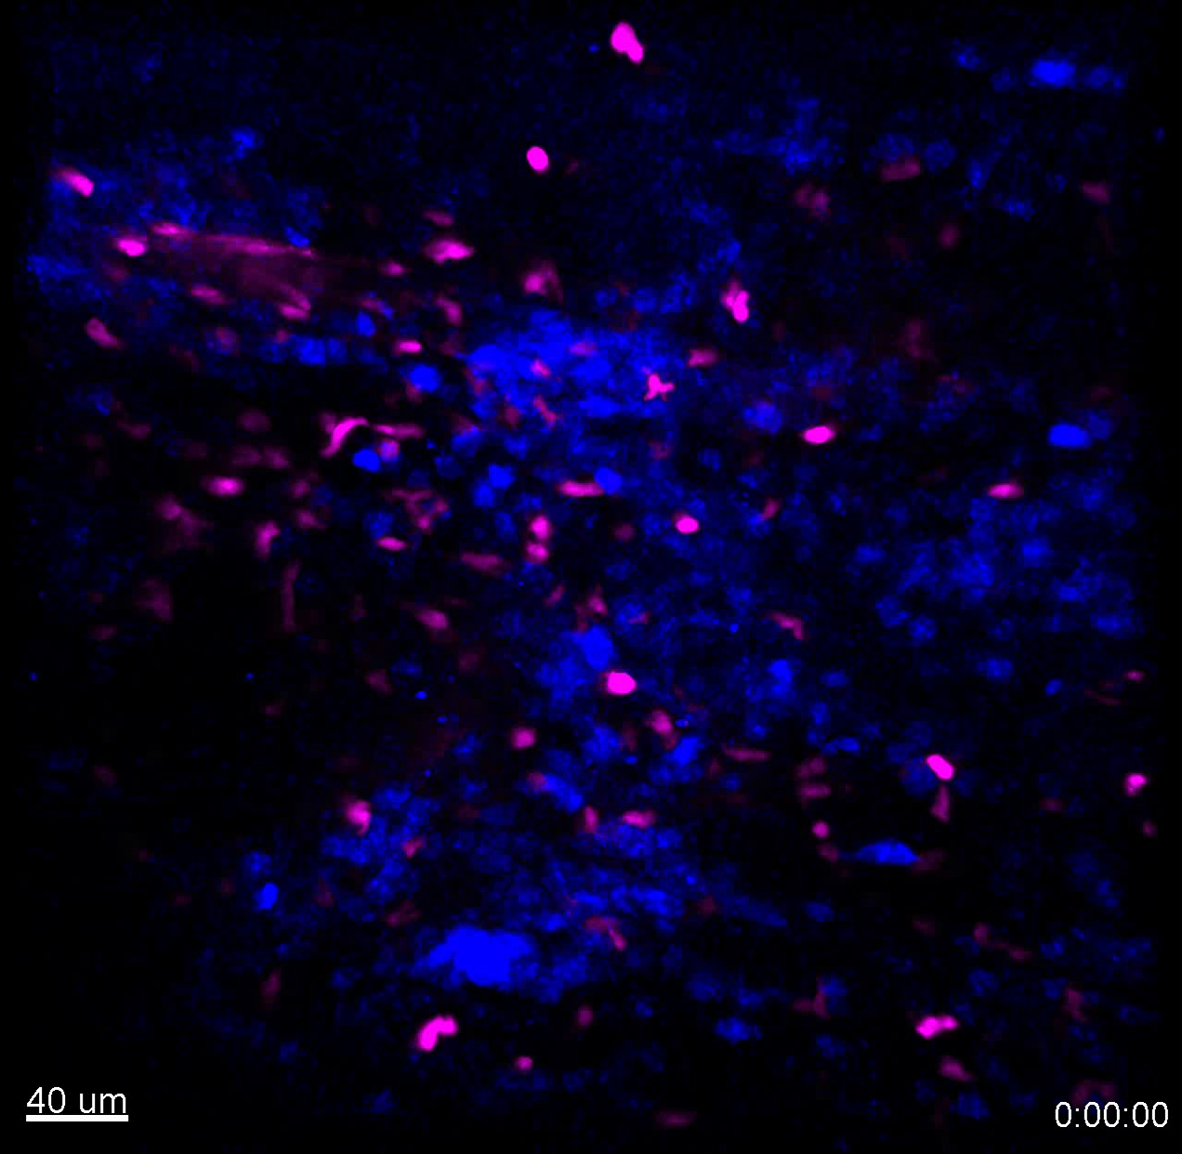
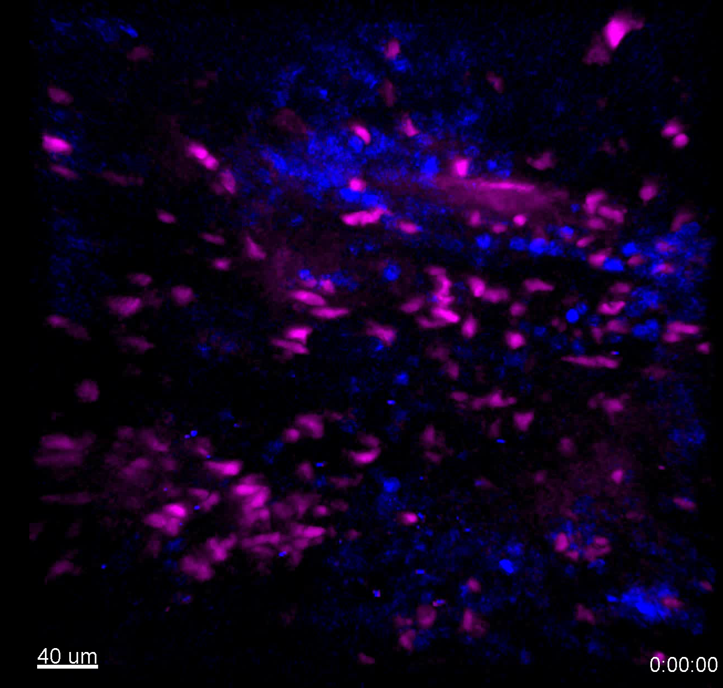
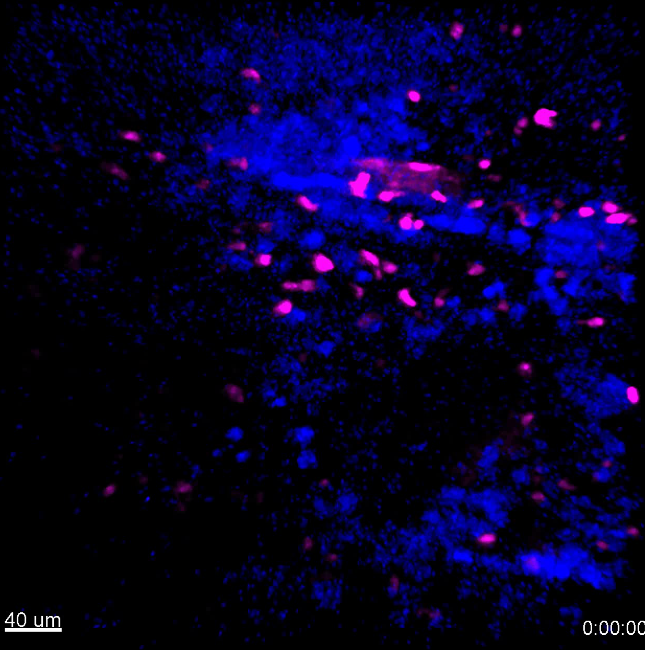
S3a Supplementary Videos
Before injection
After injection
0-1h
1-2h
0-2h
Vehicle
Supplementary video 9
Supplementary video 10
Supplementary video 11
0-1h
1-2h
CD20-TCB
Supplementary video 12
Supplementary video 13
Supplementary video 14
Resident T cells WSU DLCL2

Slide 2
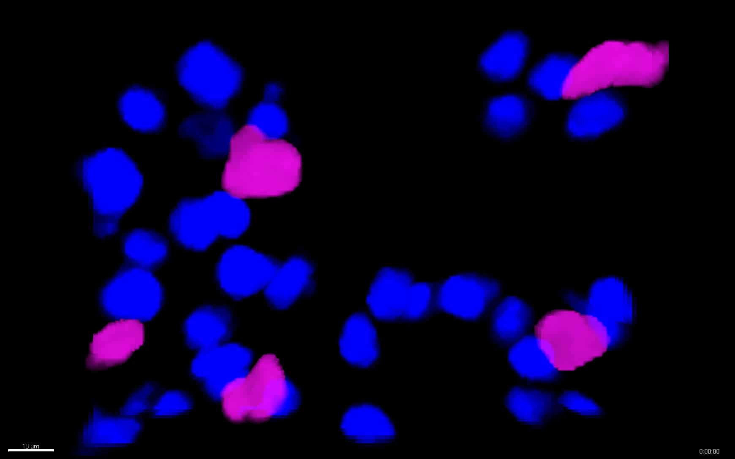
S3b Supplementary Videos
T cells WSU DLCL2
T cell
Behaviours
i
ii
iii
Supplementary video 15
Time course tracking of T cells after intravenous injection of 0.5 mg/kg CD20-TCB. Highlighted are the 3 different possible behaviors of T cells. i) Light blue track:this T cell is moving fast at the beginning, with a straight trajectory. When it encounters a tumor cell in the presence of therapy, it suddenly stops, and starts interacting. ii) Yellow track: this cell is interacting with the tumor since the beginning, its track is revolving around the same coordinates. iii) Pink track: this cell does not interact with the environment.
Notes:
d) Movie4_a1_24h_vehicle_023pinvivo, Movie7_B3_24h_Therapy_023pinvivo,Movie8_A3_48h_Vehicle_023pinvivo, Movie10_B3_48h_Therapy_023pinvivo , Movie12_A3_72h_Vehicle_023pinvivo, Movie14_B1_72h_Therapy_023pinvivo

Slide 3
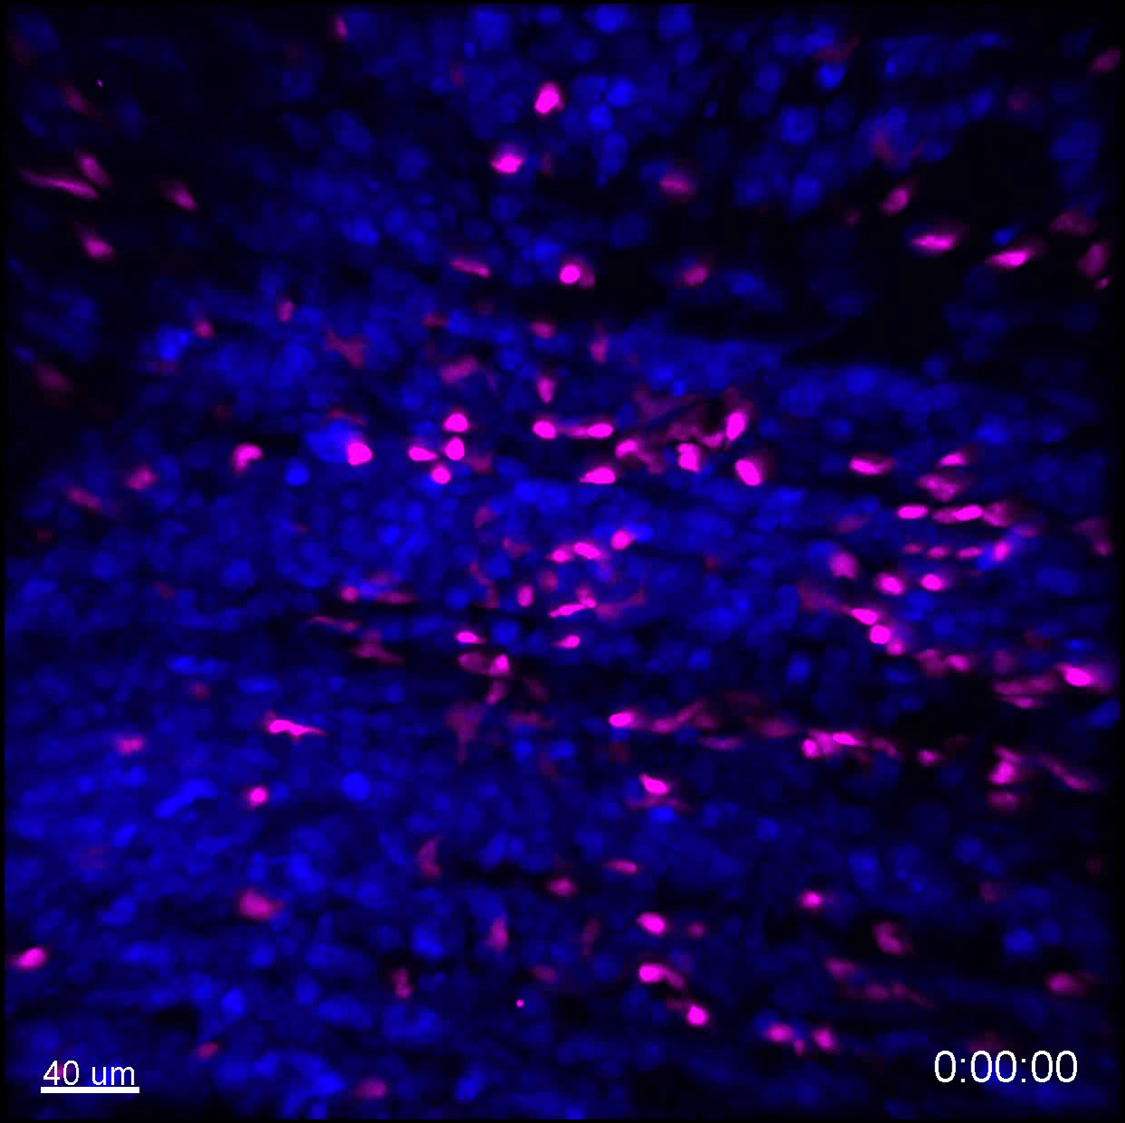
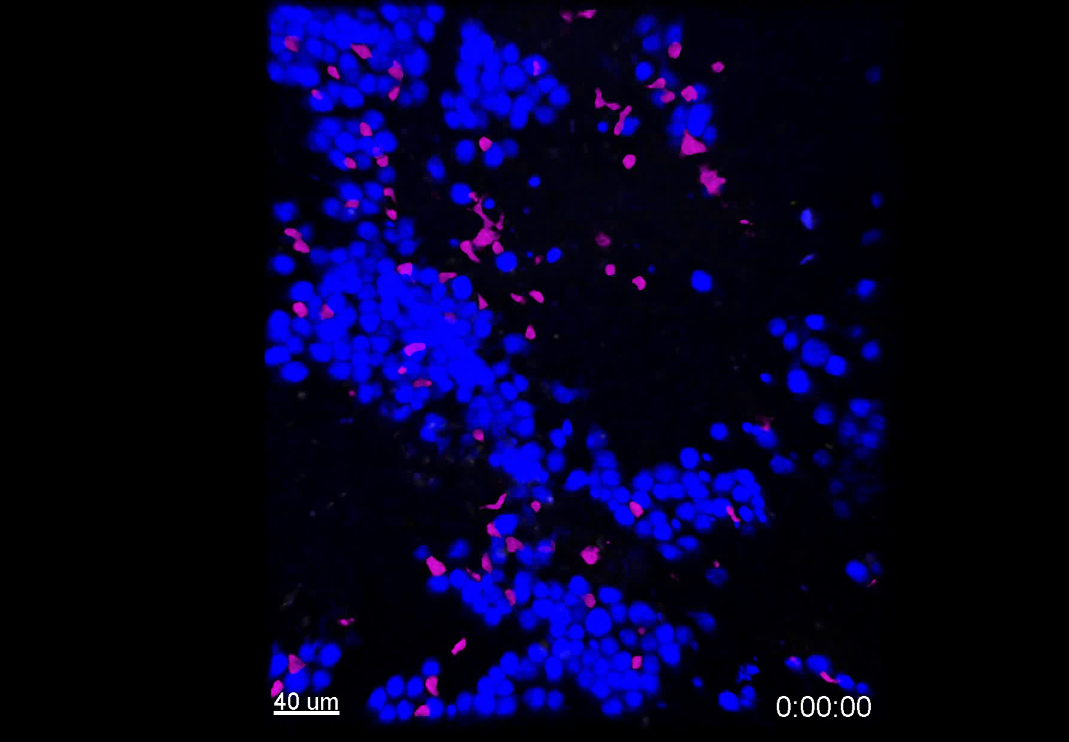
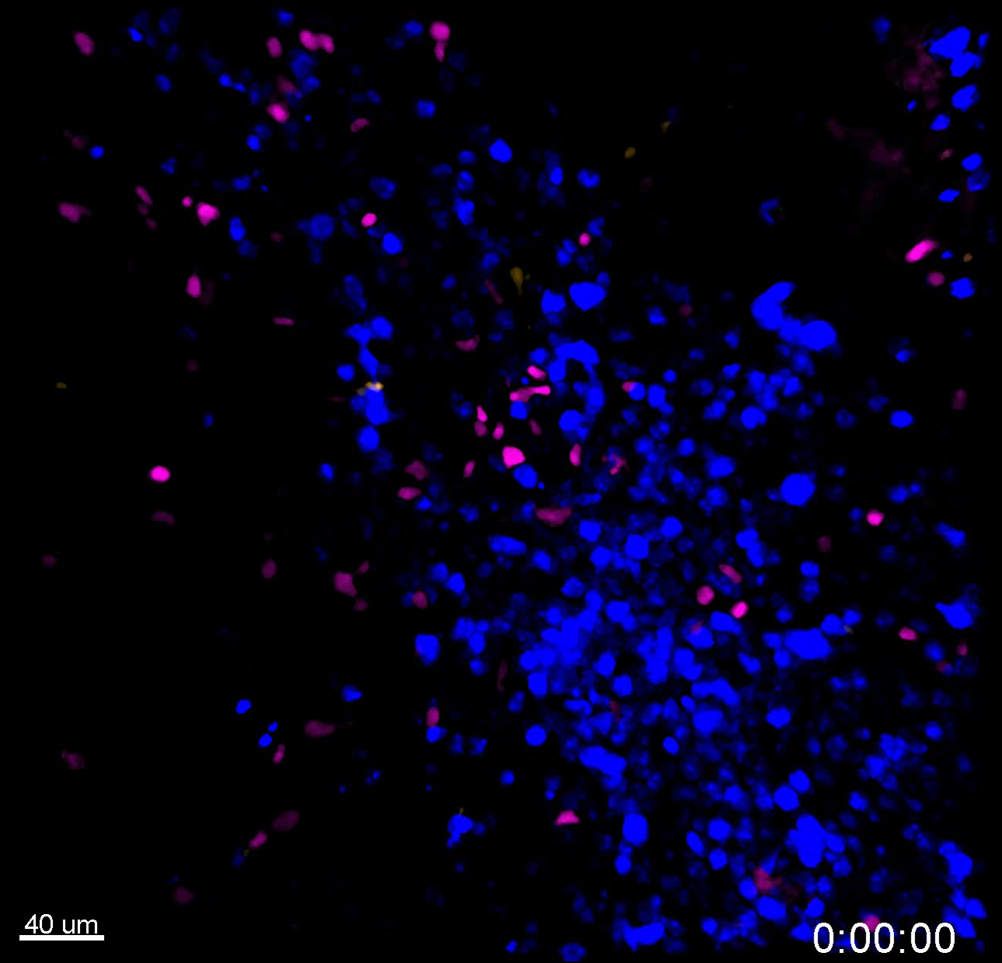
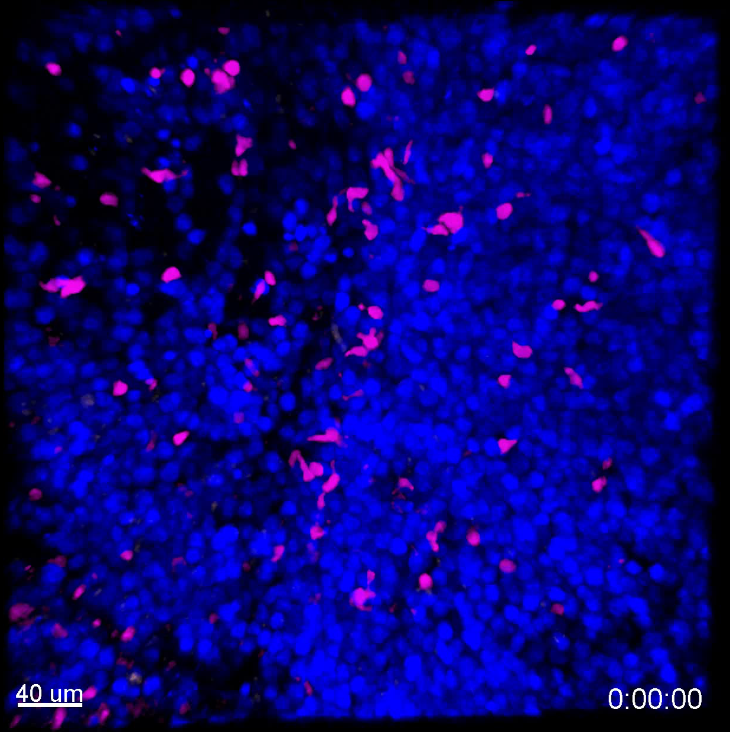
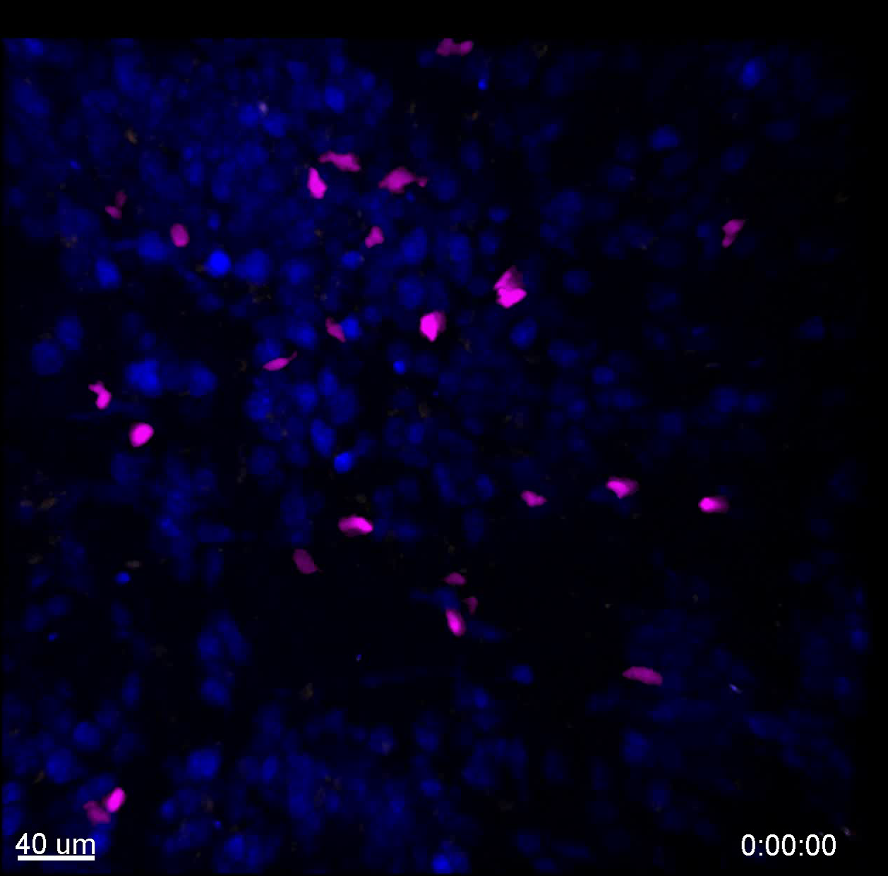
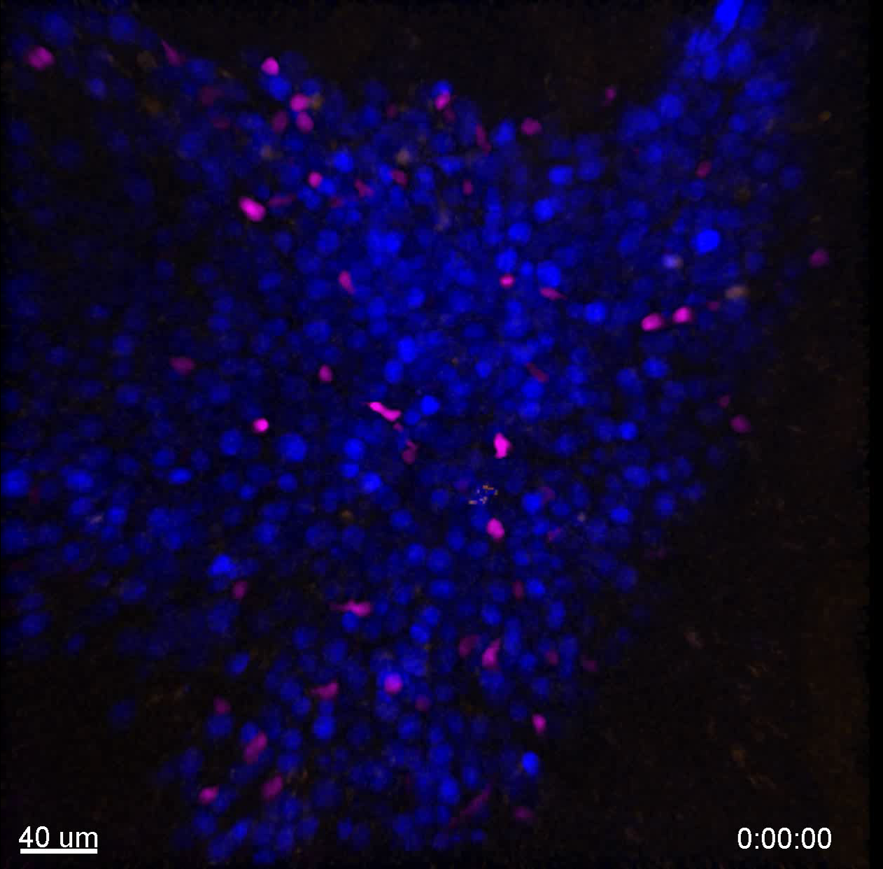
S3c Supplementary Videos
Resident T cells WSU DLCL2
Vehicle
CD20TCB
24 hours
Supplementary video 16
Supplementary video 17
48 hours
Supplementary video 18
Supplementary video 19
72 hours
Supplementary video 20
Supplementary video 21

