Slide 1
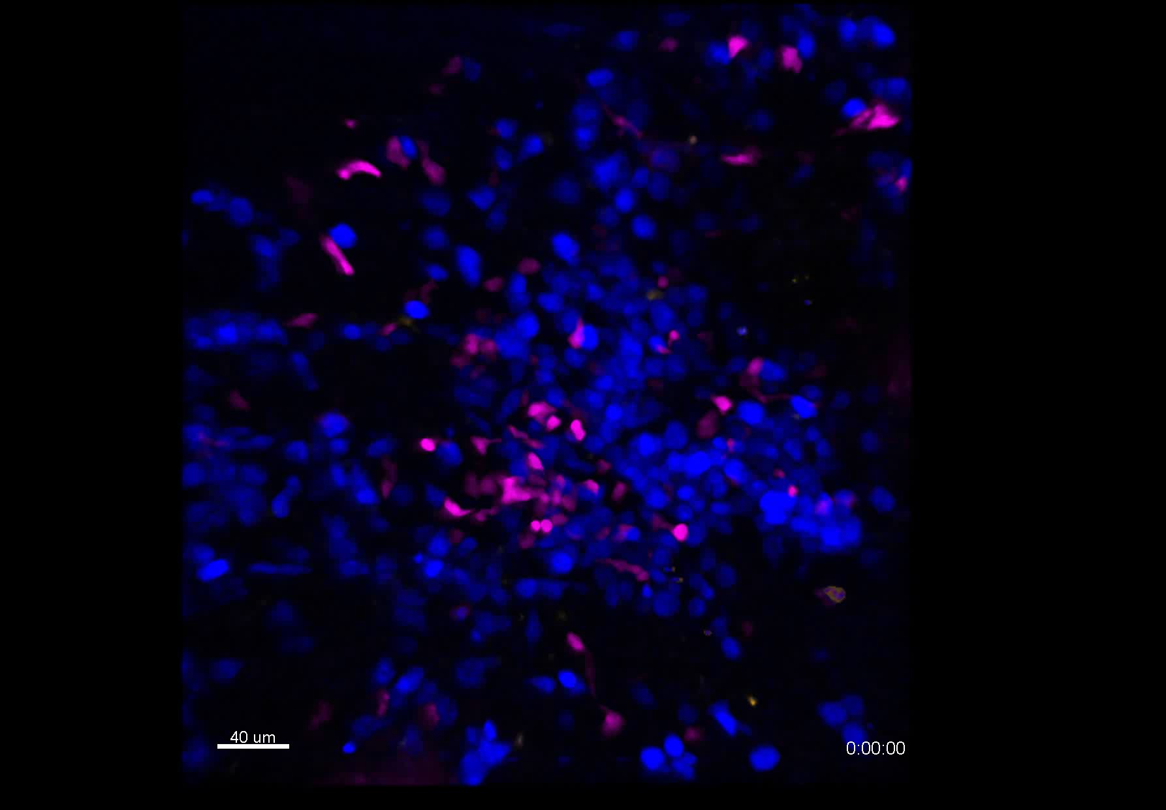
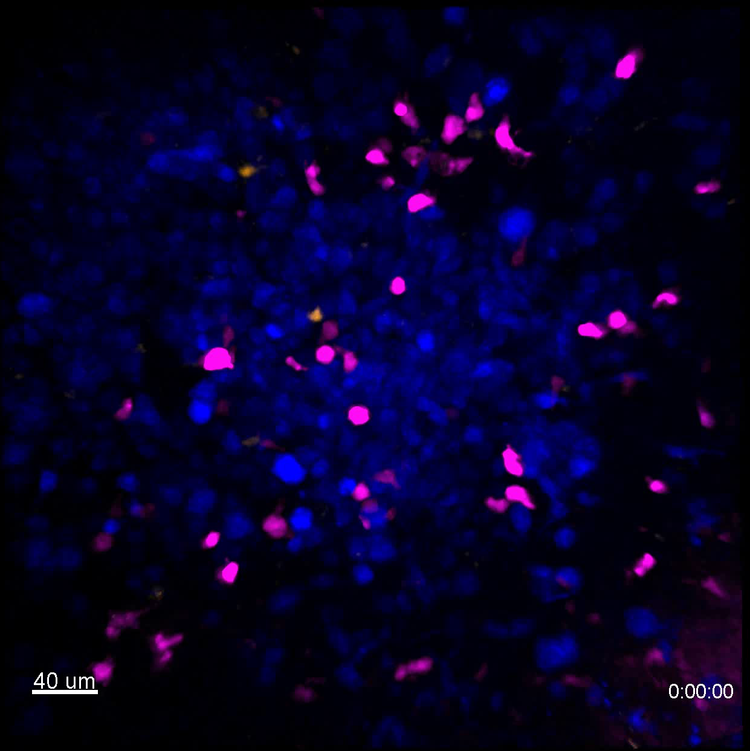
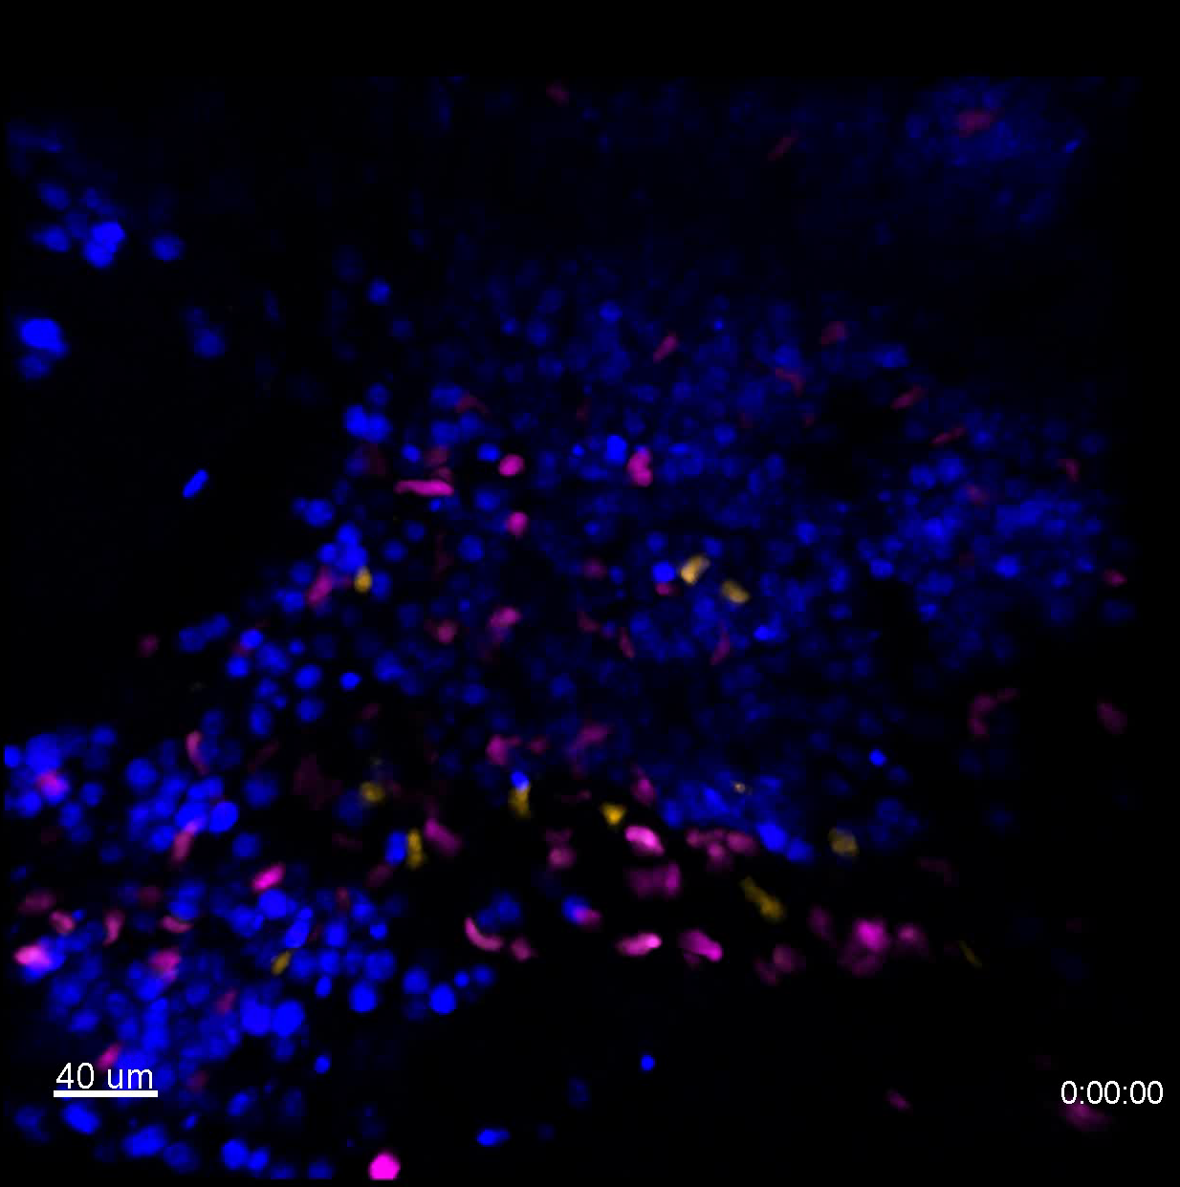
S4 Supplementary Video
Vehicle
Supplementary video 22
CD20-TCB
Supplementary video 23
Vehicle
+
IFNγ tumor pre-treatment
Supplementary video 24
Resident T cells Recruited T cells WSU DLCL2

