Slide 1
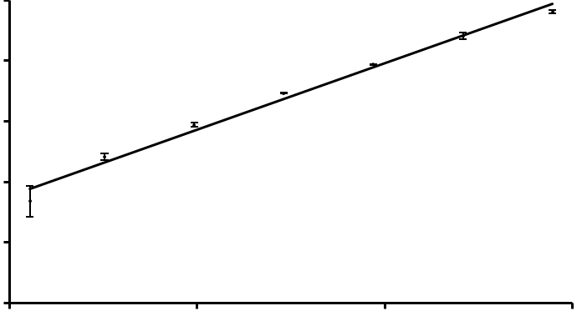

Mean fluorescence intensity
10⁶
R² = 0.991
Mean fluorescence intensity
10⁶
R² = 0.993
a
b
10⁵
10⁵
10⁴
10⁴
10³
10³
10²
10²
10¹
10¹
10¹
10²
10³
10⁴
10¹
10²
10³
10⁴
cHu6.3-IgG (ng/ml)
cAGP4-IgM (ng/ml)
Supplemental Figure 1. Standard curves of cHu6.3-IgG (a) and cAGP4 (b) positive standards. Linear trendline was established between the mean fluorescent intensity and the concentration (µg/ml) of the positive anti-PEG antibodies. Data are presented as the mean and standard deviation of three independent experiments.

Slide 2
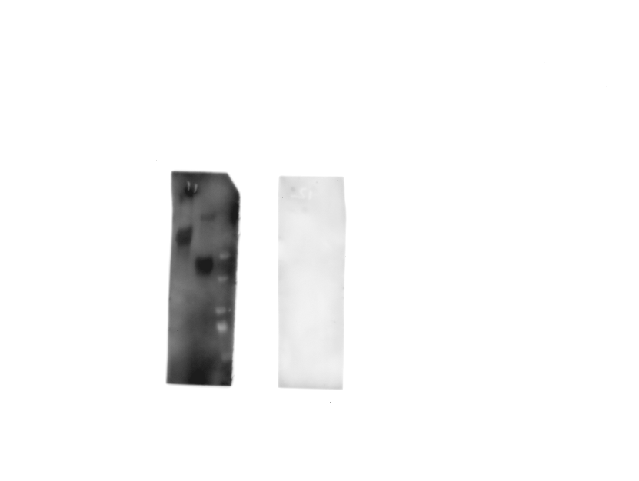
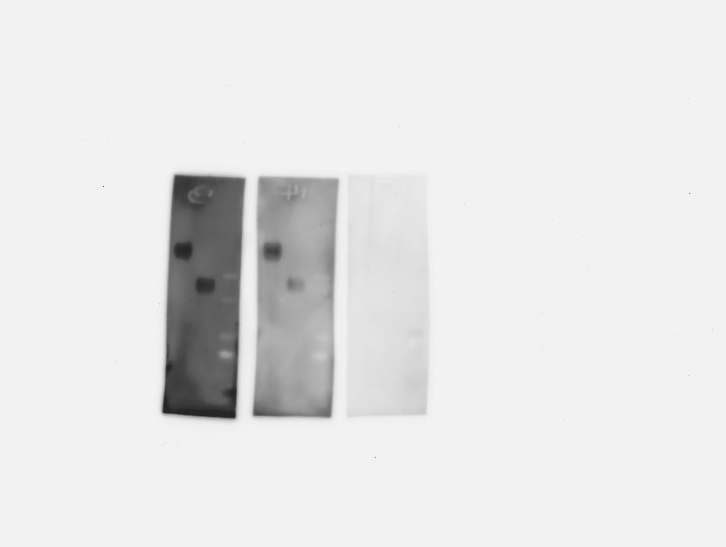
cHu6.3-IgG (1:50,000)
(-) 0.1% Tween-20 (+) 0.1% Tween-20
cAGP4-IgM (1:25,000)
(-) 0.1% Tween-20 (+) 0.1% Tween-20
60 kDa PEG
40 kDa PEG
60 kDa PEG
40 kDa PEG
60 kDa PEG
40 kDa PEG
60 kDa PEG
40 kDa PEG
Supplemental Figure 2. Western blotting of positive anti-PEG antibody standards (cHu6.3-IgG, 1:50,000; cAGP4-IgM, 1:25,000) in washing buffer (PBS) without (-) and with (+) 0.1% Tween-20. Lane 60 kDa PEG: 62.5 ng; lane 40 kDa PEG: 125 ng.

