Slide 1
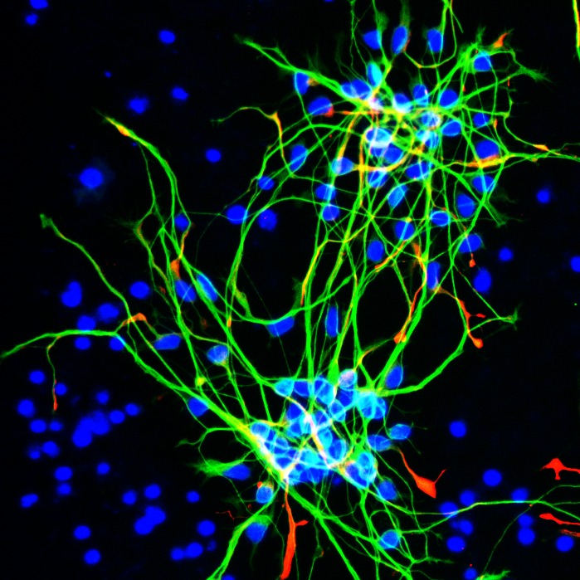
Additional Figure S1
Control
PSEN1
Tuj1
Nestin
DAPI
PSEN2

Slide 2
Additional Figure S2
A
B
Astrocytes
Neurons
C

Slide 3
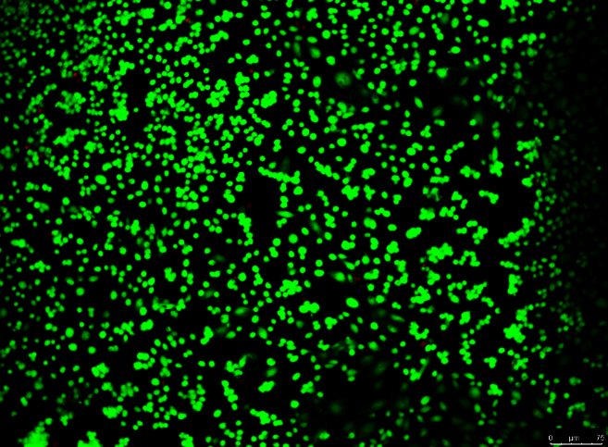
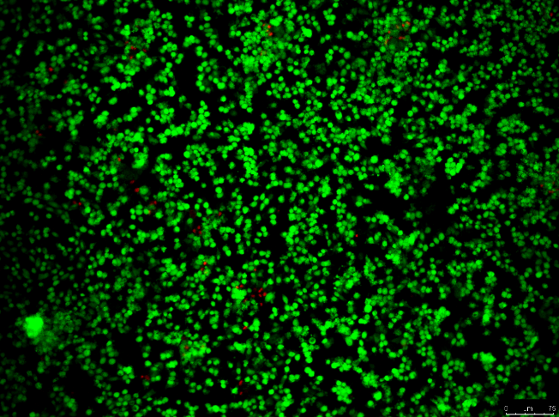
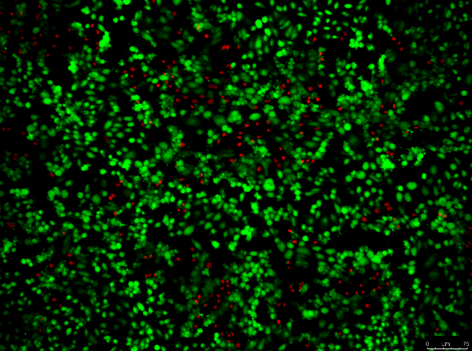
Additional Figure S3
A
Control
PSEN1
PSEN2
Calcein-AM
Ethidium homodimer-1

