Slide 1
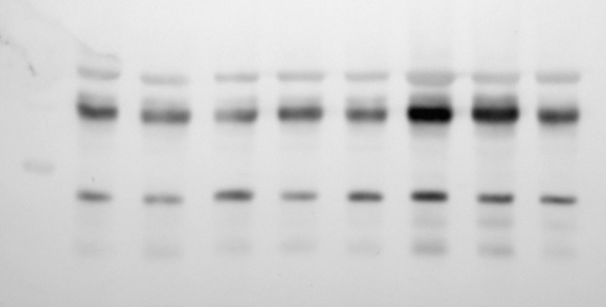
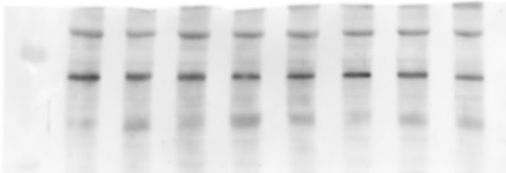
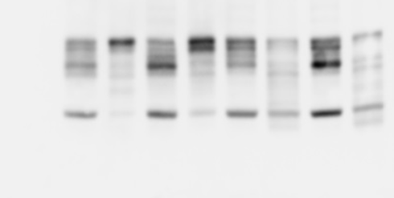
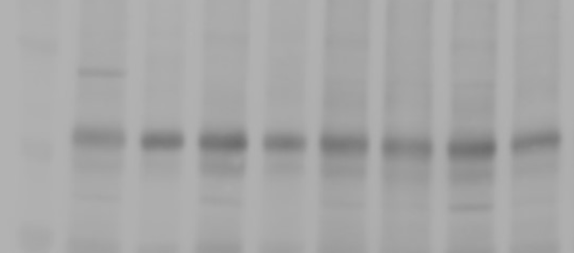
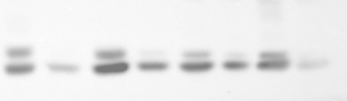
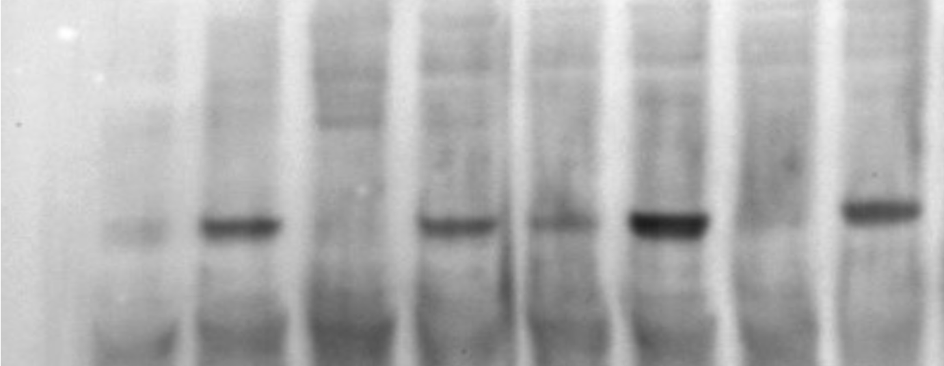
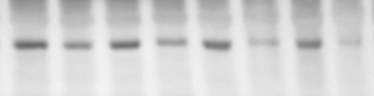
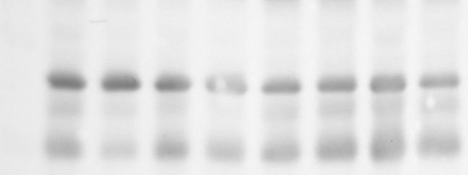
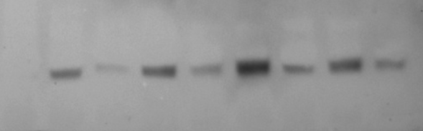
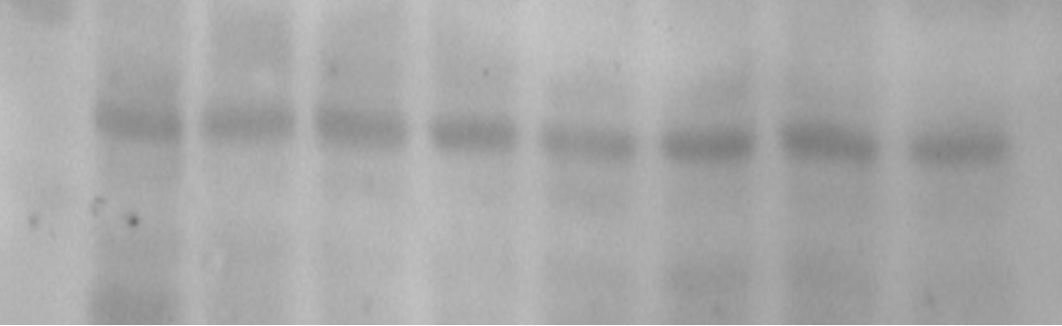
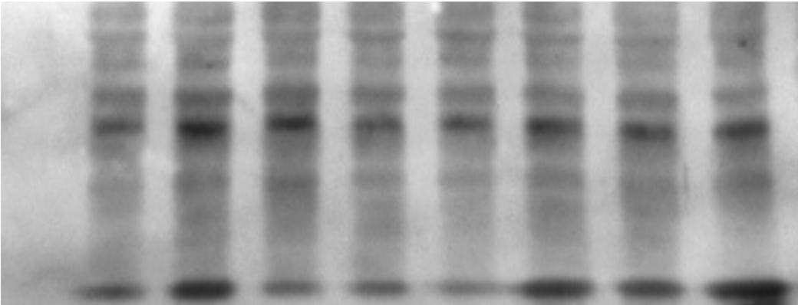
Additional files
A) PCNA
B) β-actin
TS TV TS TV TS TV TS TV
TS TV TS TV TS TV TS TV
≈43KDa
≈36KDa
C) p-NFkB
D) NFkB
TS TV TS TV TS TV TS TV
TS TV TS TV TS TV TS TV
≈65KDa
≈65KDa
E) BCL2
F) Bax
TS TV TS TV TS TV TS TV
TS TV TS TV TS TV TS TV
≈26KDa
≈23KDa
G) p-ERK
H) ERK
TS TV TS TV TS TV TS TV
≈45KDa
TS TV TS TV TS TV TS TV
≈45KDa
I) p-mTOR
J) mTOR
TS TV TS TV TS TV TS TV
≈240KDa
TS TV TS TV TS TV TS TV
≈240KDa
K) Caspase-3
TS TV TS TV TS TV TS TV
Original, full-length blots of (A) PCNA; (B) B-actin; (C) p-NFkB; (D) NFkB; (E) BCL2; (F) BAX; (G) p-ERK; (H) ERK; (I) p-mTOR; (J) mTOR; (K) Caspase-3 in Erlich tumor tissue of mice treated with Fr-BuVt 200mg/Kg (TV) or saline (TS). Red arrows and boxes show representative images regions used in Figure 4a and 4b.
≈17KDa

