Slide 1
Supplementary Figure S1. Prevalence of WNV sero-positivity by zip code in asymptomatic subjects in El Paso, Texas. ArcGIS 10.7.0 (ESRI Inc., Redlands, CA) was used for illustrative purposes.

Slide 2
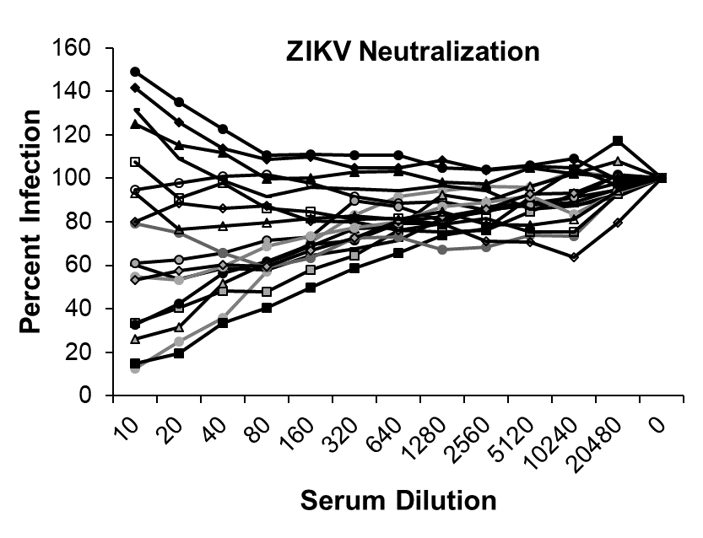
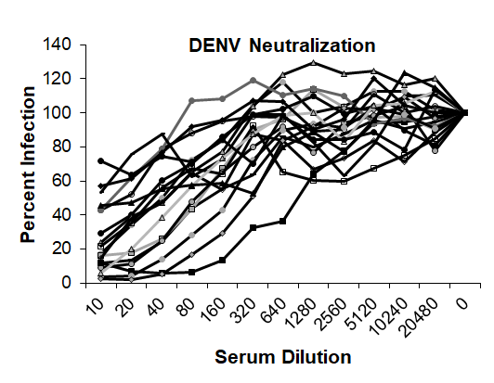
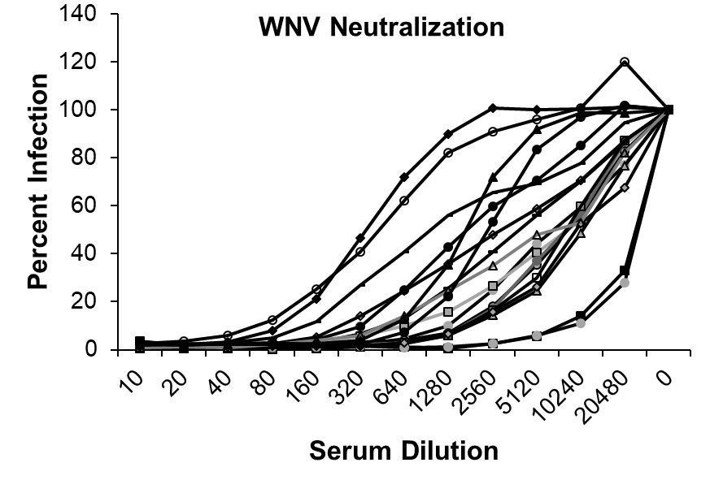
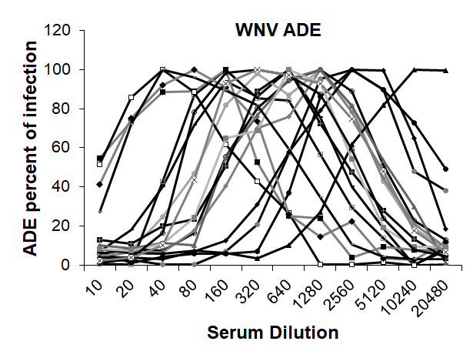
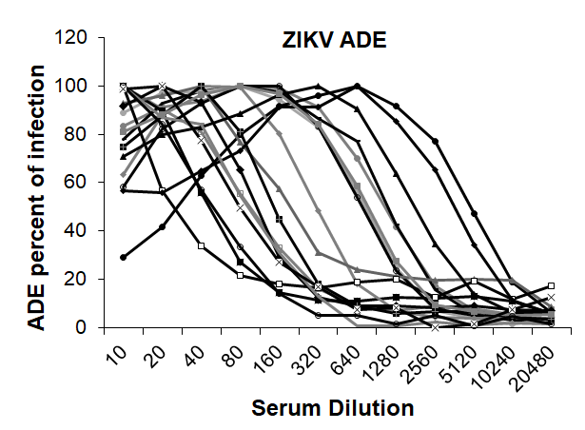
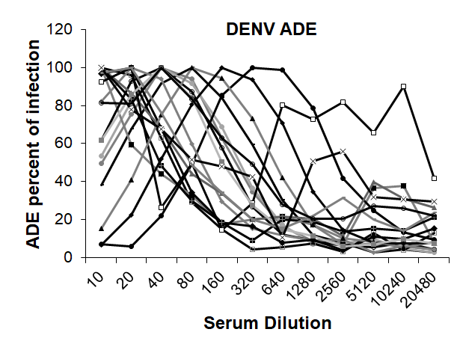
A
B
C
D
E
F
Supplementary Figure S2: Sera samples from symptomatic WNV seropositive donors cause enhancement of ZIKV infection. Vero cells were infected with (A) WNV (B) ZIKV or (C) DENV RVPs in the presence of media alone or serial dilutions of WNV+ sera samples obtained from symptomatic donors. The number of GFP positive cells was analyzed 72h post infection. All wells were assayed in duplicates and graphs were plotted after normalizing data to 100% infection in the absence of any sera. K562 cells were infected with (D) WNV, (E) ZIKV or (F) DENV RVPs in the presence of WNV+ sera samples from symptomatic donors. The number of GFP positive cells was analyzed 48h post infection. All wells were assayed in duplicates and graphs were plotted after normalizing data to peak ADE as 100% infection.

Slide 3
A
B
Supplementary Figure S3: Sera obtained from symptomatic and asymptomatic WNV seropositive donors causes ZIKV enhancement with minimal neutralization. (A) Sera samples from symptomatic and asymptomatic WNV seropositive donors were analyzed for neutralization of ZIKV, WNV and DENV infection. Dilution of serum causing 50% neutralization of respective RVPs was determined. (B) Sera samples from symptomatic and asymptomatic WNV seropositive donors were analyzed for enhancement of ZIKV, WNV and DENV infection. Dilution of serum causing peak ADE for respective RVPs was determined

Slide 4
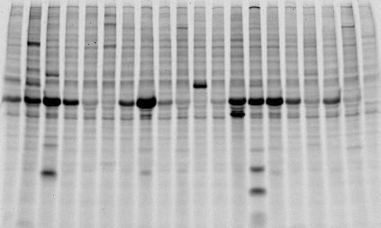
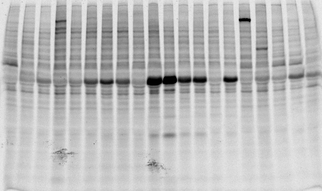
SMP003
SMP004
SMP005
SMP007
SMP001
SMP008
SMP002
SMP013
SMP018
SMP014
SMP012
SMP006
SMP011
SMP009
SMP010
SMP017
SMP016
SMP019
SMP015
SMP020
-E
ASY317
ASY322
ASY127
ASY311
ASY354
ASY383
ASY382
ASY284
ASY356
ASY078
ASY316
ASY110
ASY022
ASY150
ASY036
ASY053
ASY282
ASY239
ASY141
ASY224
-E
Supplementary Figure S4: Uncropped gels for Figure 8A

