Slide 1
Temperature Induced Changes in the Optical Properties of Skin In Vivo
Tyler W. Iorizzo¹, Peter R. Jermain¹, Elena Salomatina,² Alona Muzikansky³,
and Anna N. Yaroslavsky^{1,2*}
¹Advanced Biophotonics Laboratory, University of Massachusetts Lowell, Lowell, MA, 01854
²Department of Dermatology, Massachusetts General Hospital, 50 Staniford Street, Boston, MA, 02114
³Biostatistics Center, Massachusetts General Hospital, Boston, MA, 02114
*Corresponding author information:
Anna N. Yaroslavsky, PhD
University of Massachusetts – Lowell
Advanced Biophotonics Laboratory
175 Cabot Street
Lowell, MA, 01854
Telephone: 1.978.934.3766
Fax: 1.978.934.1305
Anna_Yaroslavsky@uml.edu
AYAROSLAVSKY@mgh.harvard.edu

Slide 2
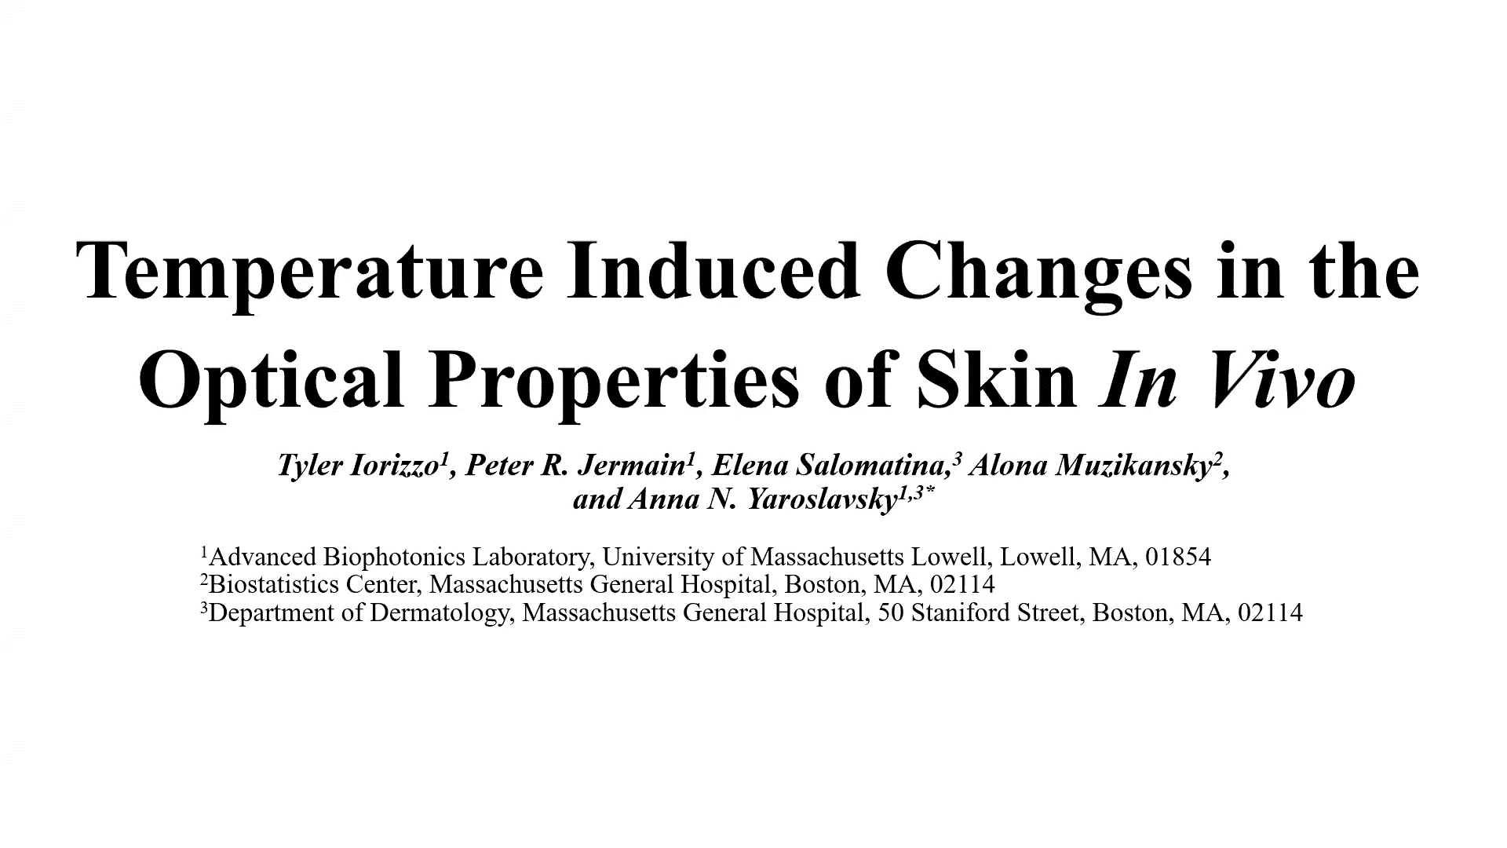

Slide 3


