Slide 1
Supplementary information
Nematode epibionts on skin of the Florida manatee, Trichechus manatus latirostris
Rafael Gonzalez^{1,*}, Natsumi Kanzaki^{1,2} Cathy Beck³, William H. Kern¹ and Robin M. Giblin-Davis¹
¹ Fort Lauderdale Research and Education Center, Department of Entomology and Nematology, University of Florida/IFAS, 3205 College Avenue, Davie, FL 33314-7799, USA
² Kansai Research Center, Forestry and Forest Products Research Institute,
68 Nagaikyutaroh, Fushimi, Kyoto 612-0855 Japan
³ Wetland and Aquatic Research Center, United States Geologic Survey, 7920 NW 71st Street, Gainesville, Florida 32653, U.S.A.
∗ Corresponding author, e-mail: rafg@ufl.edu

Slide 2
55
Pristionchus americanus
100
67
Pristionchus aerivorus
Pristionchus maupasi
100
Pristionchus marianneae
97
Pristionchus arcanus
86
100
Pristionchus exspectatus
Pristionchus pacificus
100
Pristionchus japonicus
Pristionchus triformis
98
100
Pristionchus entomophagus
Pristionchus uniformis
100
99
Pristionchus lheritieri
Pristionchus fissidentatus
98
100
Pristionchus bucculentus
Parapristionchus giblindavisi
Pristionchus sycomori
Pristionchus racemosae
75
Micoletzkya calligraphi
98
100
100
Micoletzkya sexdentati
89
Micoletzkya buetschlii
Micoletzkya masseyi
72
Micoletzkya hylurginophila
100
Micoletzkya palliati
Micoletzkya inedia
Micoletzkya japonica
Sachsia zurstrasseni
95
100
100
Paroigolaimella micrura
Eudiplogasterium levidentus
Paroigolaimella stresemanni
75
96
Tylopharynx foetidus
100
100
Mononchoides sp. RS5441
100
Mononchoides sp. RS9007
Mononchoides sp. RS9008
85
100
Diplogastridae n. gen. “ST”
99
Neodiplogaster unguispiculata DS124
100
Neodiplogaster unguispiculata DS123
94
Neodiplogaster unguispiculata Ap103
Neodiplogaster sp. RGD904
100
100
97
Neodiplogaster acaloleptae
Neodiplogaster sp. RS9009
Neodiplogaster crenatae
96
100
Cutidiplogaster manati
100
Cutidiplogaster sp. “LT”
100
Mononchoides sp. NK2017
100
Mononchoides macrospiculum
Mononchoides compositicola
64
Mononchoides striatus
100
Diplogasteroides (Rhabdontolaimus) nix
100
Diplogasteroides (Rhabdontolaimus) andrassyi
Diplogasteroides (Rhabdontolaimus) asiaticus
80
100
Diplogasteroides (Rhabdontolaimus) luxuriosae
Diplogastrellus (Metadiplogaster) sp. "Tadami"
100
100
Diplogastrellus (Metadiplogaster) sp. RS5608
Pseudodiplogasteroides cf. compositus
56
Pseudodiplogasteroides sp. "Luc8"
100
Butlerius sp. VS-2014
100
Rhabditidoides humicolus
53
Rhabditidoides aegus
Rhabditidoides sp. RS5443
100
100
Diplogasteroides (Fuchsnema) sp. RS5537
100
100
Diplogastrellus (Diplogastrellus) gracilis
Diplogasteroides (Fuchsnema) halleri
100
Diplogastrellus (Diplogastrellus) metamasius
Pseudodiplogasteroides sp. SB257
100
100
Diplogasteroides (Pseudodiplogaster) nasuensis
Diplogasteroides (Pseudodiplogaster) sp. RS5444
Diplogasteroides (Pseudodiplogaster) magnus
Mehdinema alii
100
100
Demaniella sp. NKZ367
94
Rhabditolaimus sp. "Euwallacea"
100
Rhabditolaimus sp. RS5414
100
Rhabditolaimus sp. "Episcapha"
100
Rhabditolaimus sp. RS5442
100
Rhabditolaimus leuckarti
100
Rhabditolaimus anoplophorae
56
Levipalatum texanum
Rhabditolaimus sp. RSA134
100
99
Sudhausia floridensis
Sudhausia crassa
100
100
Sudhausia aristotokia
100
Fictor sp. RS9001
100
92
89
Oigolaimella attenuata
Fictor sp. RS9002
Fictor stercorarius
100
100
Oigolaimella sp. RGD844
Oigolaimella sp. RGD884
Oigolaimella sp. RS9010
100
Acrostichus puri
100
Acrostichus megaloptae
81
Acrostichus halicti
100
100
Acrostichus floridensis
Acrostichus sp. NKZ369
Acrostichus sp. ex. Sagra femolatae
100
Acrostichus rhynchophori
100
Diplogasteriana schneideri
Acrostichus palmarum
100
Diplogasteriana sp. RS9000
Teratodiplogaster variegatae
100
Teratodiplogaster sp. 1 VS-2014
Teratodiplogaster fignewmani
100
Teratodiplogaster sp. 2 VS-2014
100
Parasitodiplogaster obtusinema
100
Parasitodiplogaster nymphanema
100
Parasitodiplogaster citrinema
93
Allodiplogaster cf. lucani
Parasitodiplogaster maxinema
85
Allodiplogaster seani
Allodiplogaster hylobii
100
Allodiplogaster josephi
Allodiplogaster sudhausi
Koerneria cf. luziae
91
Leptojacobus dorci
Koerneria sp. RS9004
Rhabditoides inermis (Outgroup species)
10% difference in ca 2.6 kbs of aligned near-full-length of SSU and D2-D3 LSU
Figure S1. The combined Bayesian tree for the family Diplogastridae inferred from near full length of SSU and D2-D3 LSU. Software used: MAFFT (http://align.bmr.kyushu-u.ac.jp/mafft/software), MEGA v.X (https://www.megasoftware.net/) and MrBayes 3.2 (https://nbisweden.github.io/MrBayes/download.html)

Slide 3
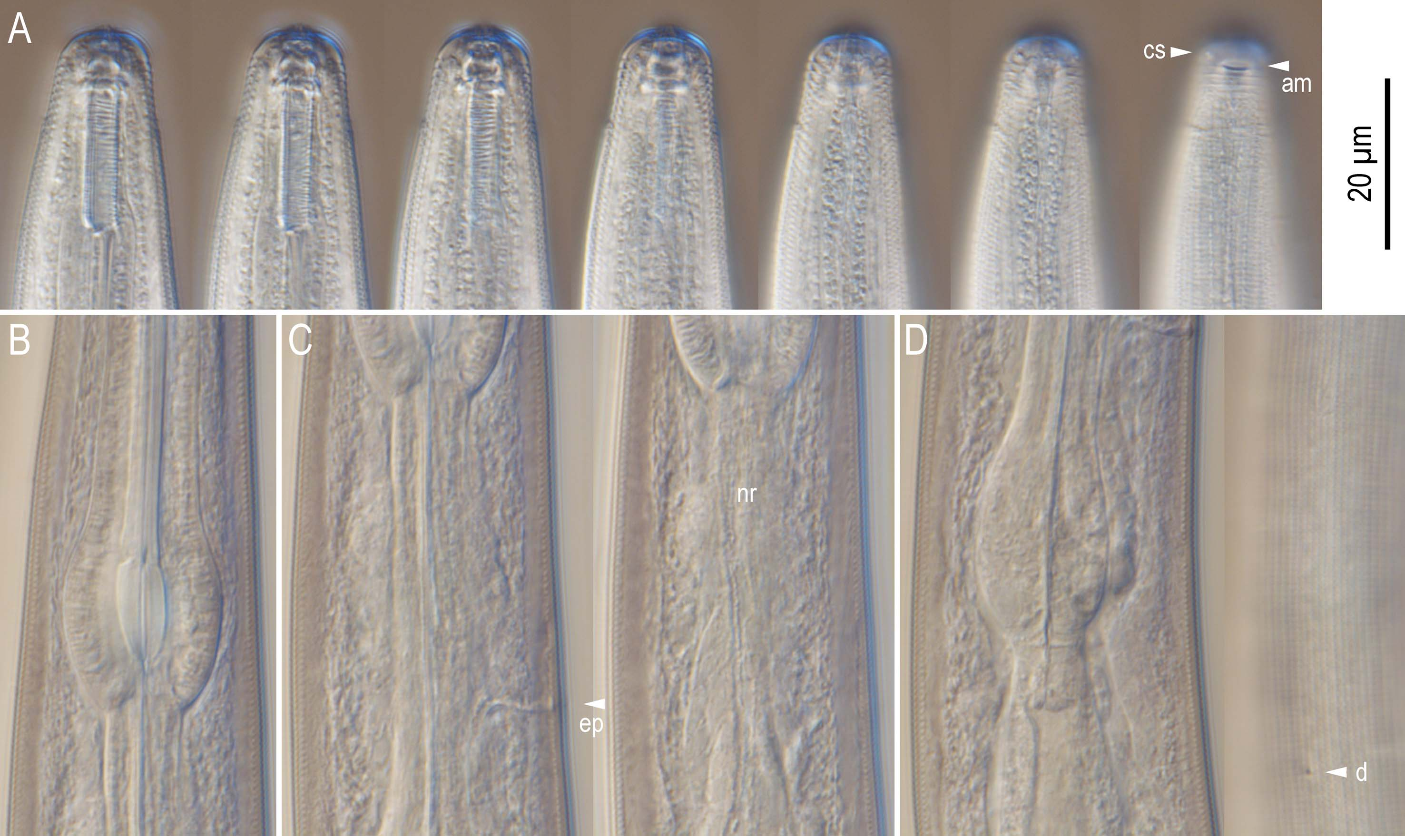
Figure S2. Anterior region of Cutidiplogaster manati. A: Stomatal region in seven different focal planes where "cs" and "am" indicates cephalic sensilla and amphid, respectively; B: Metacorpus (median bulb); C: Isthmus region in two different focal planes where "ep" and "nr" indicates excretory pore and nerve ring, respectively; D: Basal bulb and anterior intestine region in two different focal planes where "d" indicates deirid on body surface.

Slide 4
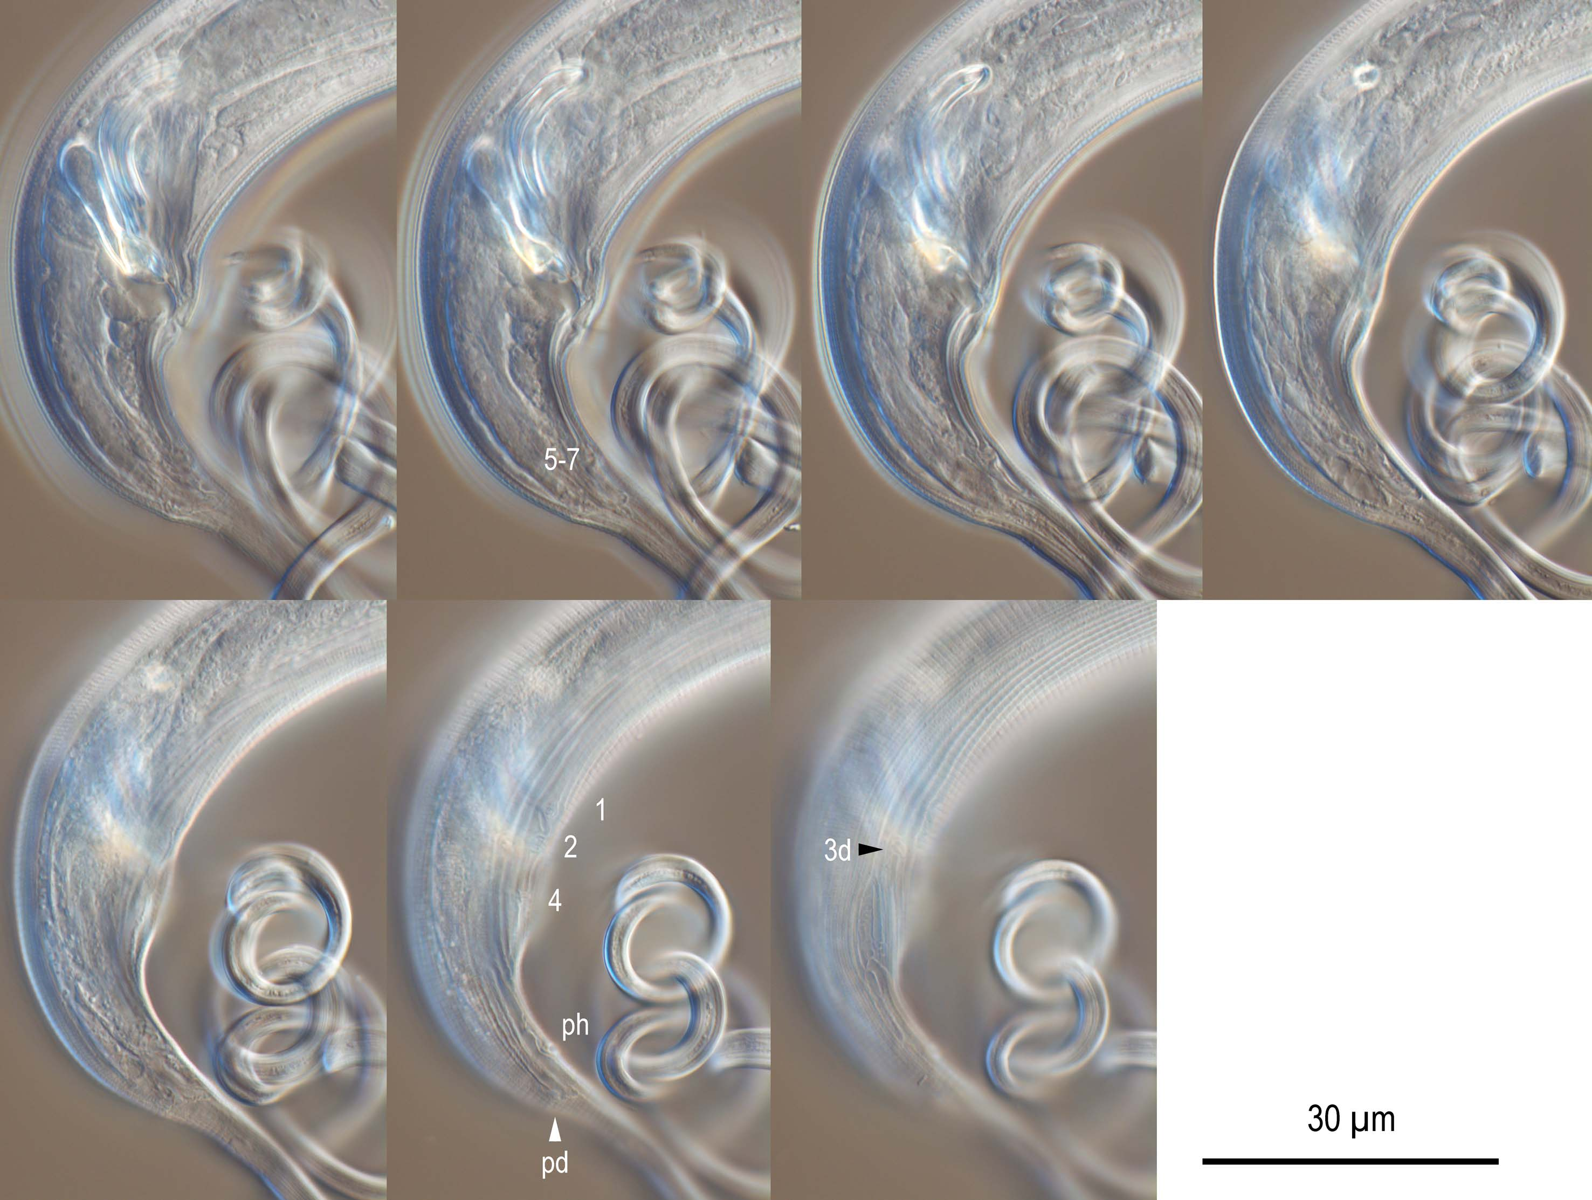
Figure S3. Male tail region of Cutidiplogater manati. Genital papillae are suggested by the numbers or "pd" according to the terminology proposed by Sudhaus & Fürst von Lieven¹⁷. "Ph" suggests phasmid.

Slide 5
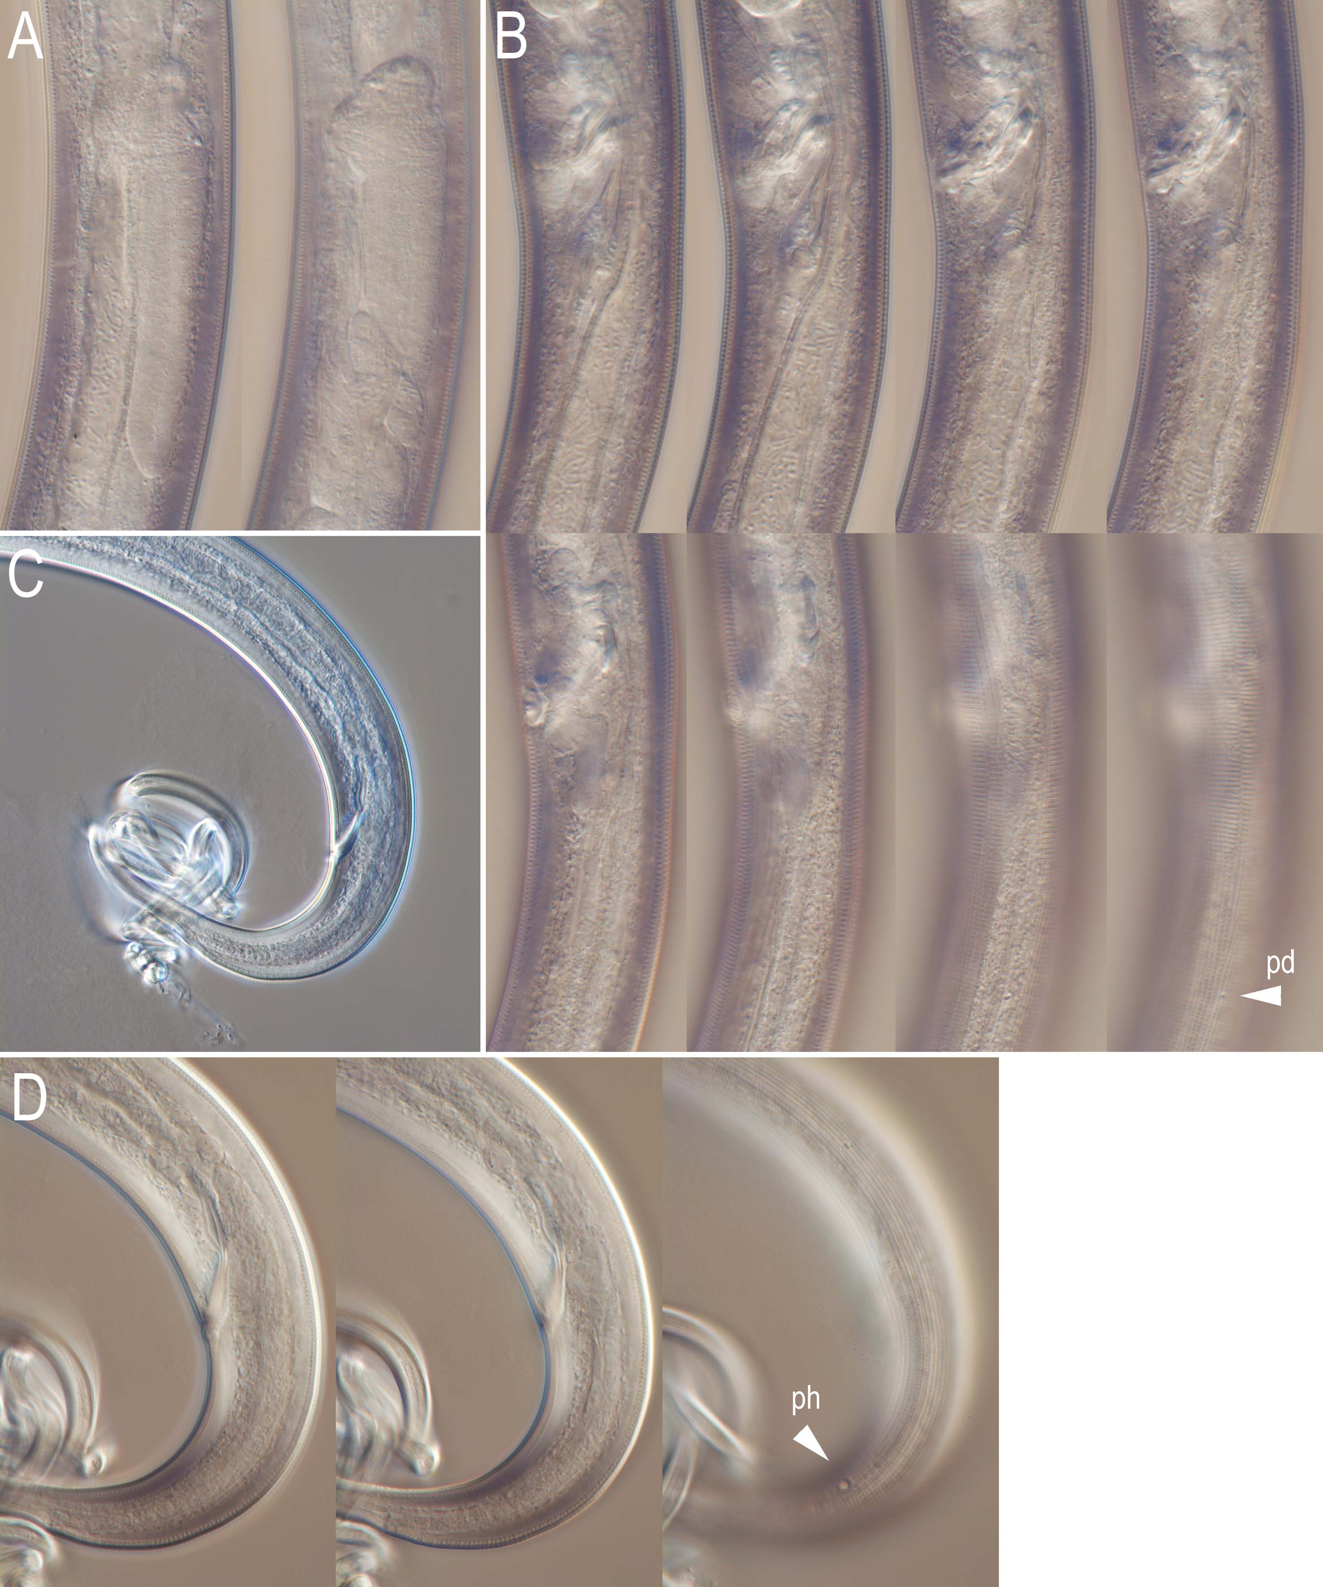
Figure S4. Adult female of Cutidiplogaster manati. A: Ovary in two different focal planes; B: Vulval region in eight different focal planes where "pd" suggests postdeirid on body surface; C: Long and tangled tail tip; D: Anal region in three different focal planes where "ph" suggests phasmid.

Slide 6
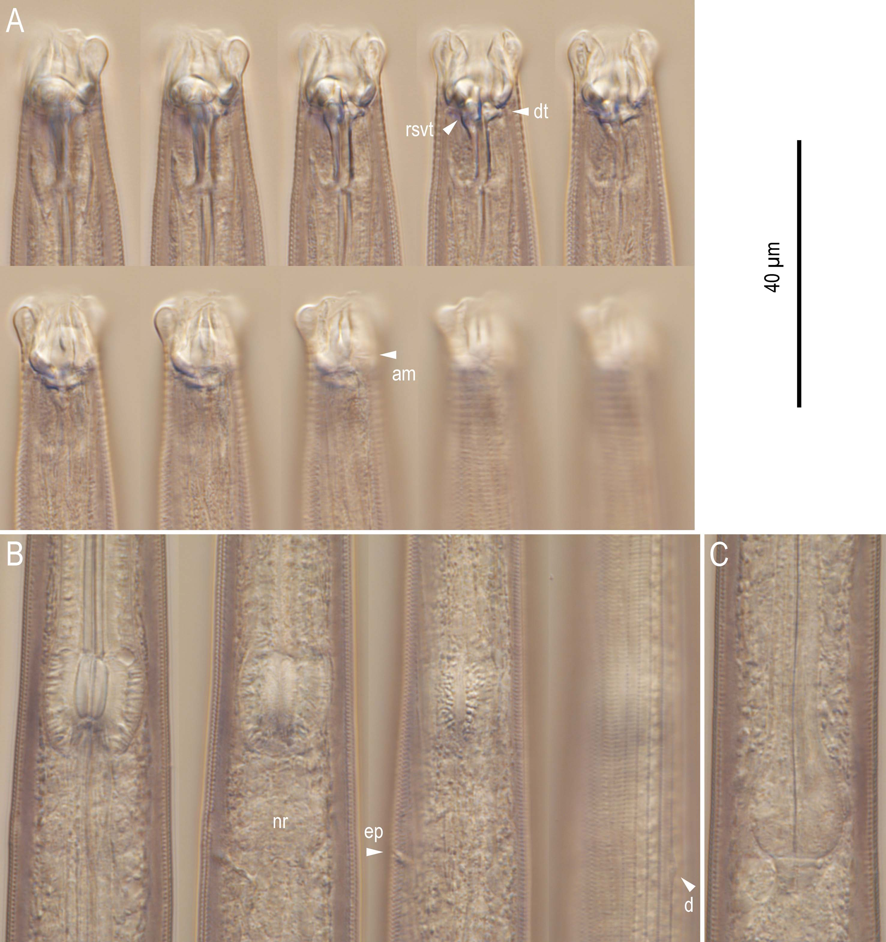
Figure S5. Anterior region of morphotype "LT". A: Stomatal region in ten different focal planes where "rsvt", "dt" and "am", suggest right subventral tooth, dorsal tooth and amphid, respectively; B: Metacorpus (median bulb) region in four different focal planes where "nr", "ep" and "d" suggest nerve ring, excretory pore and deirid, respectively; C: Basal bulb region.

Slide 7
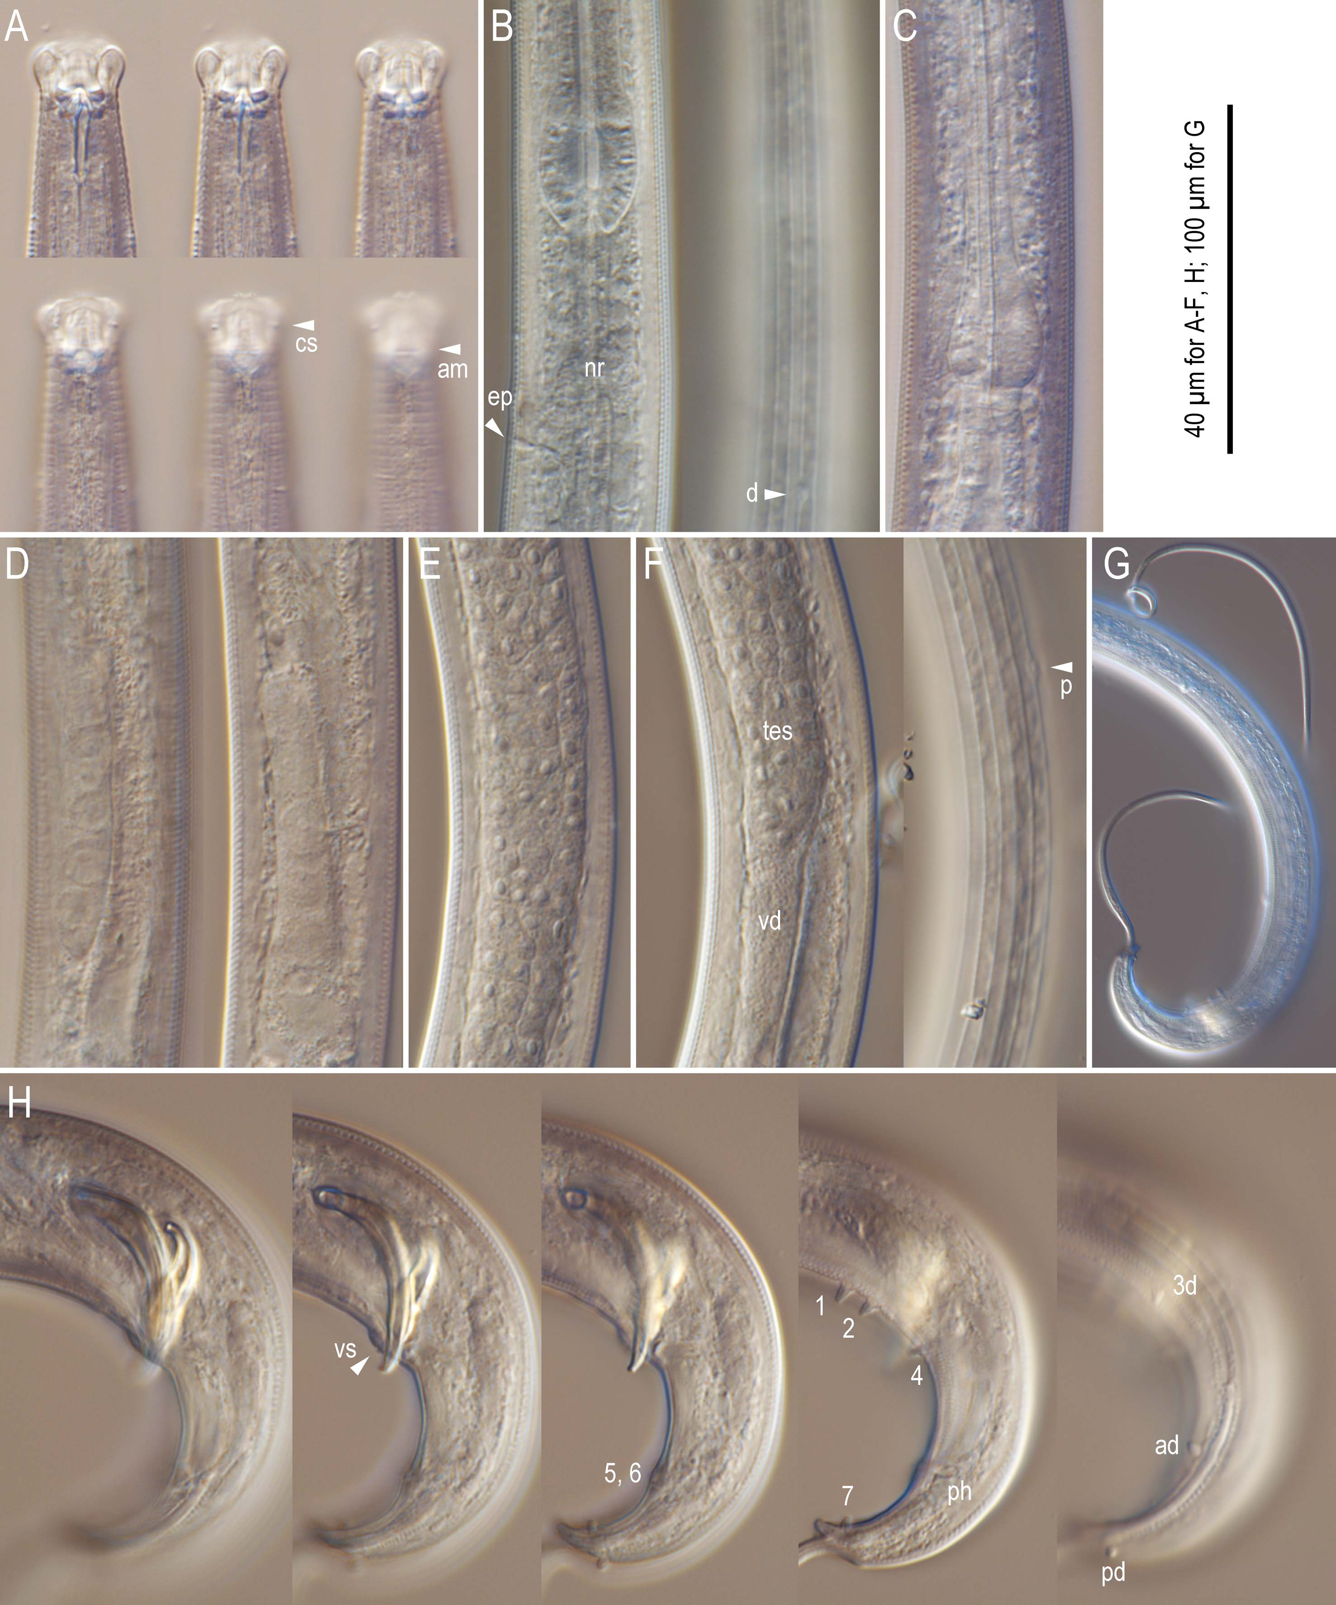
Figure S6. Adult male of morphotype "LT". A: Stomatal region in six different focal planes where “cs” and “am” suggest cephalic sensilla and amphid, respectively; B: Metacorpal region in two different focal planes where “ep”, “nr” and “d” suggest excretory pore, nerve ring and deirid, respectively, C: Posterior pharynx; D: Anterior end of testis in two different focal planes showing reflexion of anterior end; E: Middle region of testis with developing spermatocytes; F: Posterior region of testis in two different focal planes where “tes”, “vd” and “p” suggest testis, vas deferens and postdeirid, respectively, G: Tail showing long whip-like appendage; H: Left lateral view of cloacal region in five different focal planes where genital papillae are suggested by the numbers or "pd" according to the terminology proposed by Sudhaus & Fürst von Lieven¹⁷. "ph" suggests phasmid.

Slide 8
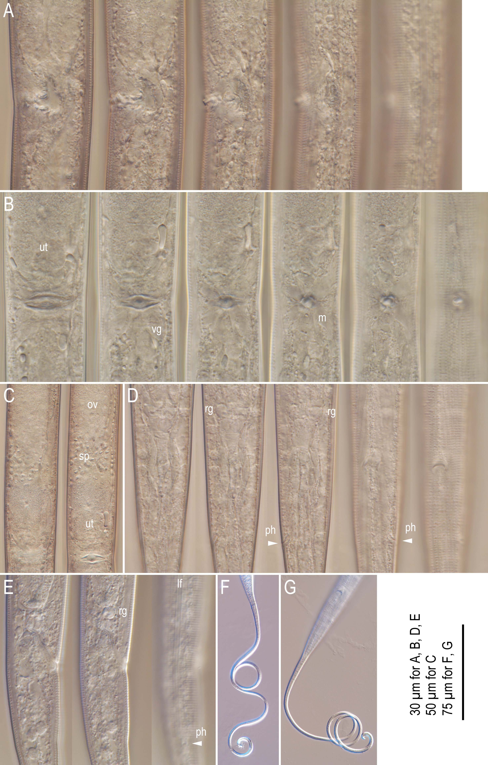
Figure S7. Adult female of morphotype "LT". A: Left lateral view of vulval region in five different focal planes; B: Ventral view of vulval region in six different focal planes where "ut", "vg" and "m" suggest uterus, vaginal gland and vaginal muscle, respectively; C: Ventral view of ovary to vulval region in two different focal planes where "ov", "sp" and "ut" suggest ovary, spermatheca and uterus, respectively; D: Ventral view of anal region in five different focal planes where "rg" and "ph" suggest rectal gland and phasmid, respectively; E: Right lateral view of anal region in three different focal planes where "rg", "lf" and "ph" suggest rectal gland, lateral field and phasmid, respectively.

Slide 9
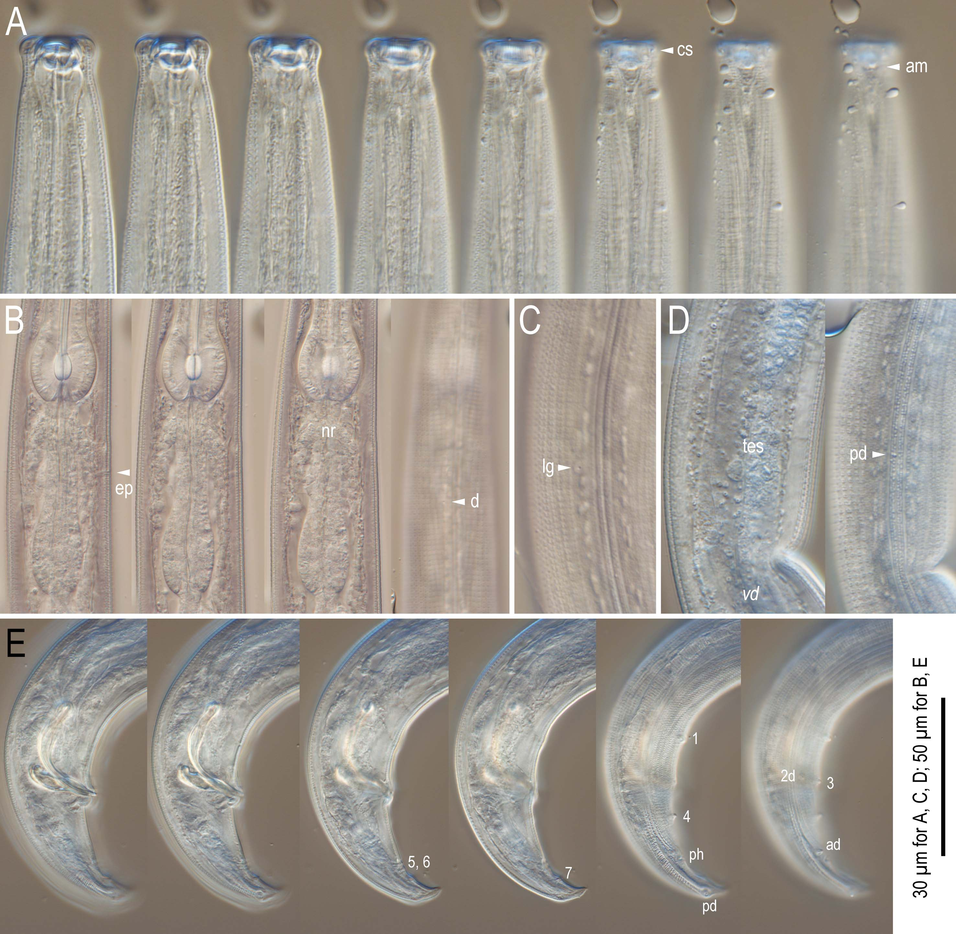
Figure S8. Anterior region and male tail of morphotype "ST". A: Stomatal region in eight different focal planes where "cs" and "am", suggest cephalic sensilla and amphid, respectively; B: Metacorpus (median bulb) region in four different focal planes where "ep", "nr" and "d" suggest excretory pore, nerve ring and deirid, respectively; C: Body surface showing lateral gland (lg) and lateral field; D: Margin between testis and vas deferens in two different focal planes where "tes", "vd" and "pd" suggests testis, vas deferens and postdeirid; E: Male tail region in two different focal planes where genital papillae are suggested by the numbers or "pd" according to the terminology proposed by Sudhaus & Fürst von Lieven¹⁷ and "ph" suggests phasmid.

Slide 10
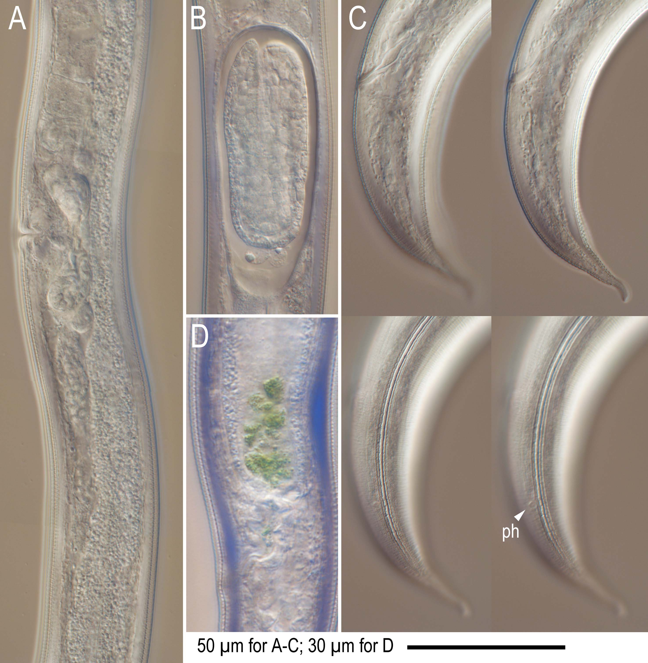
Figure S9. Adult female of morphotype "ST". A: Left lateral view of vulval region; B: Developing embryo in uterus; C: Left lateral view of tail region in four different focal planes where "ph" suggests phasmid; D: Posterior end of intestine with greenish material hypothesized to be digested algae.

