Slide 1
Supplementary Data -Revised

Slide 2
Supplementary Table 1 – Phenotype of target cell populations
Population Identified | Phenotype
MDSC | CD45+ Lin- HLA-DR- CD16- CD123- CD11b+ CD33+ CD14+
Th1 | CD3+ CD4+ CD45RA- CCR6- CXCR3+ CCR4-
Th2 | CD3+ CD4+ CD45RA- CCR6- CXCR3- CCR4+
Treg | CD3+ CD4+ CD127- CD25+
Naive T-cell | CD3+ CD4+/CD8+ CCR7+ CD45RA+
Central Memory T-cell | CD3+ CD4+/CD8+ CCR7+ CD45RO+
Effector Memory T-cell | CD3+ CD4+/CD8+ CCR7- CD45RO+

Slide 3
Supplementary Table 2 – Mean frequencies of representative biomarkers at baseline as a fraction of total WBCs (leukocytes)
Biomarker (Percent of total WBCs) | Clinical Response
 | Worse RFS | Better RFS |  | PD | CR PR SD
Th1 | 0.67 | 0.78 |  | 0.28 | 0.91
Th2 | 1.68 | 2.28 |  | 2.52 | 1.82
Treg | 0.56 | 0.65 |  | 0.67 | 0.59
CD8+ T-cells | 11.51 | 15.22 |  | 9.59 | 15.14

Slide 4
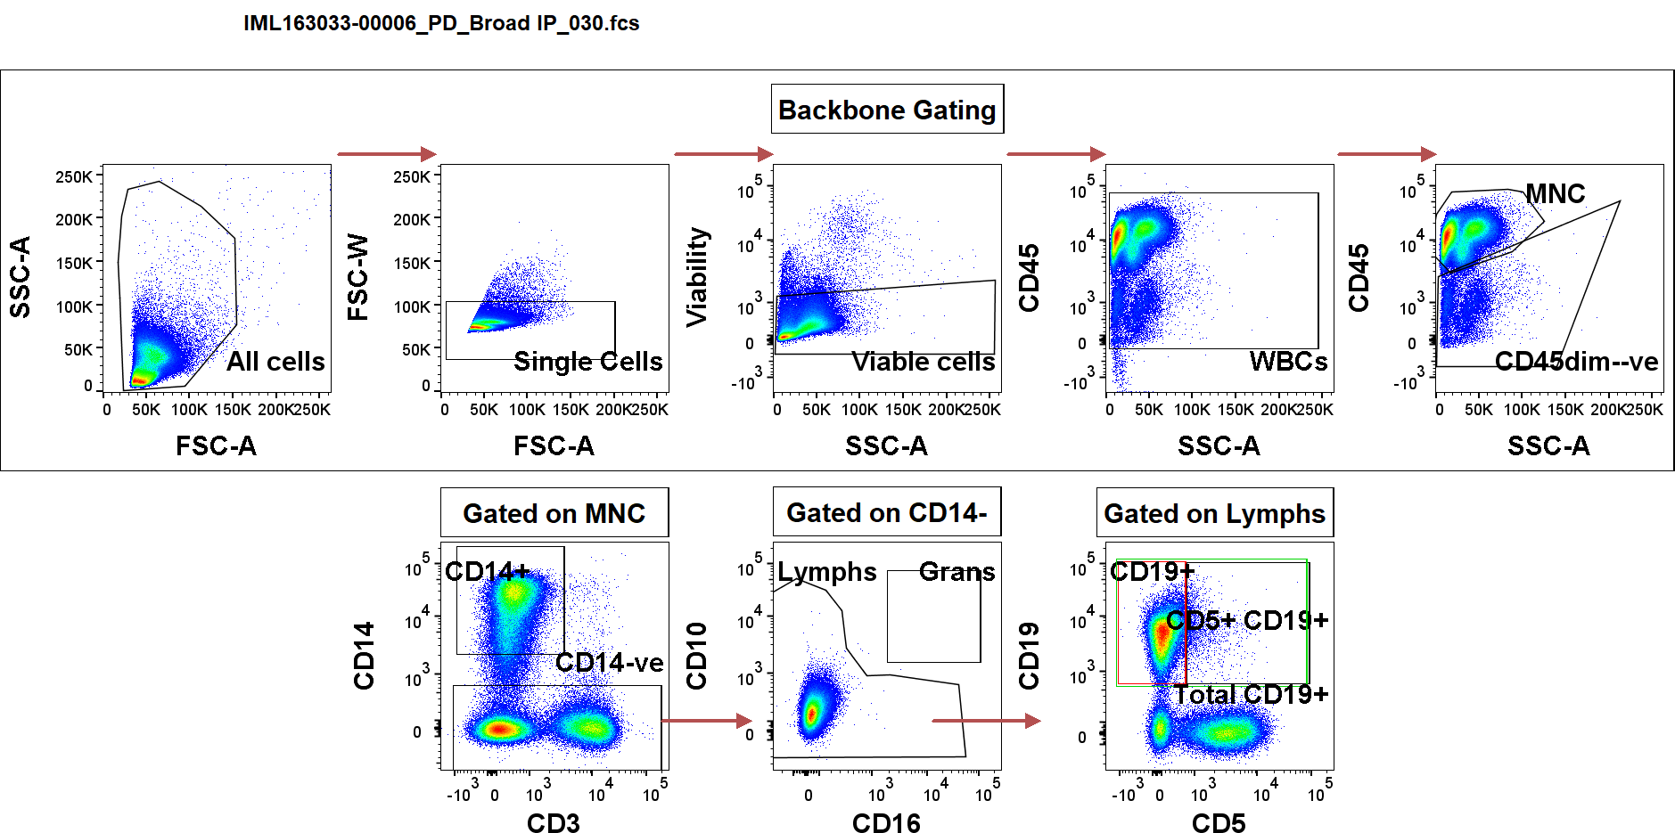
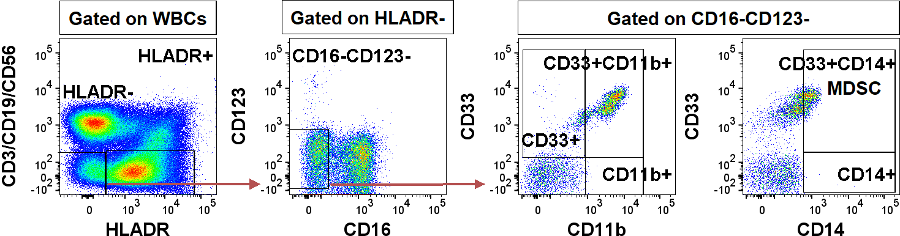
Supplementary Figure 1: Representative gating strategy illustrating identification of (A) B cells shown and (B) MDSCs.
A
B

Slide 5
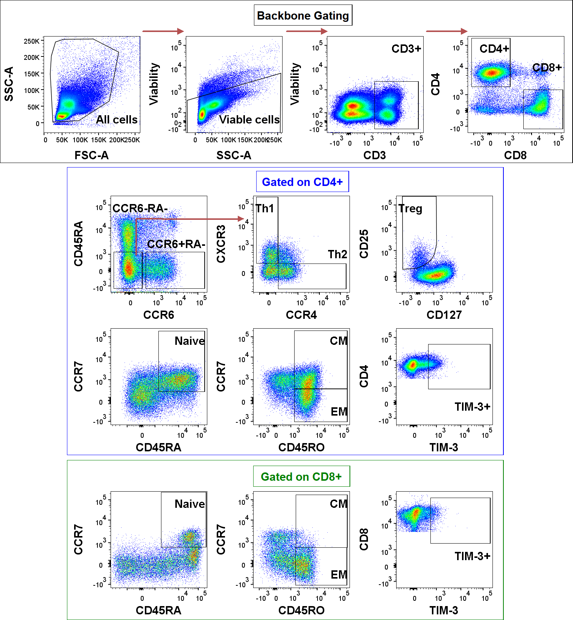
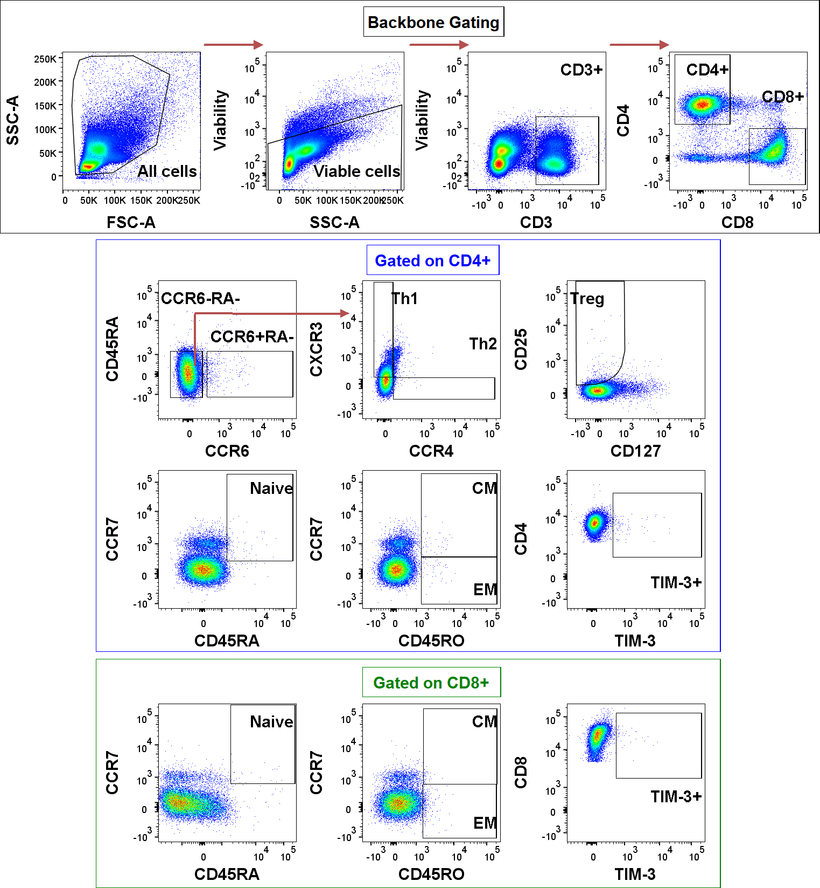
Supplementary Figure 2 (A) Representative gating strategy illustrating identification of CD4+ and CD8+ T cells, helper T cell subsets, Treg cells, memory T cells and checkpoint inhibitor (PD-1, LAG-3, TIM-3) expression. (B) Antibody isotype controls were used for setting gates on CCR4, CCR6, CCR7, CD25, CD45RA, CD45RO, PD-1, LAG-3 and TIM-3.
A
B

