Slide 1
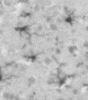
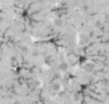


Vehicle
LPS
b
c
a
Iba-1
Young
d
e
Aged

Slide 2
