Slide 1
Supplementary Fig. 1. CONSORT diagram. Primary reasons for discontinuation are listed. Pts patients, Bmab bevacizumab.
47 pts assessed eligibility
1 excluded
- 1 did not meet the inclusion criteria
46 pts received FOLFOXIRI plus Bmab
(SAS: Safety analysis set)
2 excluded
- 2 did not have target lesion
44 pts received FOLFOXIRI plus Bmab
(FAS: Efficacy analysis set)
19 discontinued the protocol therapy
- 8 surgery
- 9 adverse event
- 1 disease progression
- 1 patient’s withdrawal
27 pts completed the protocol therapy

Slide 2
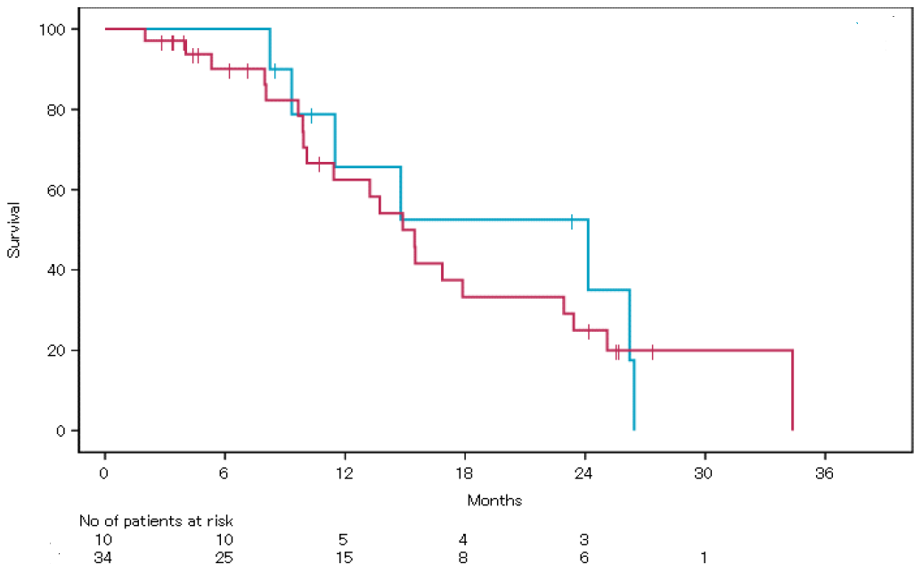
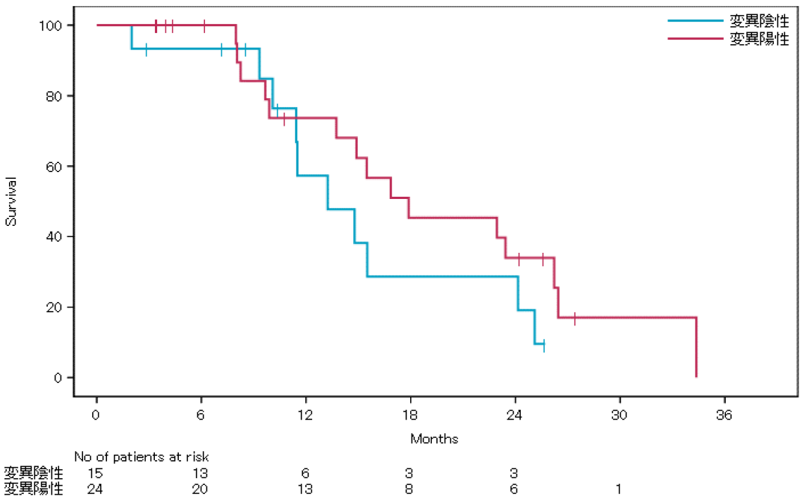

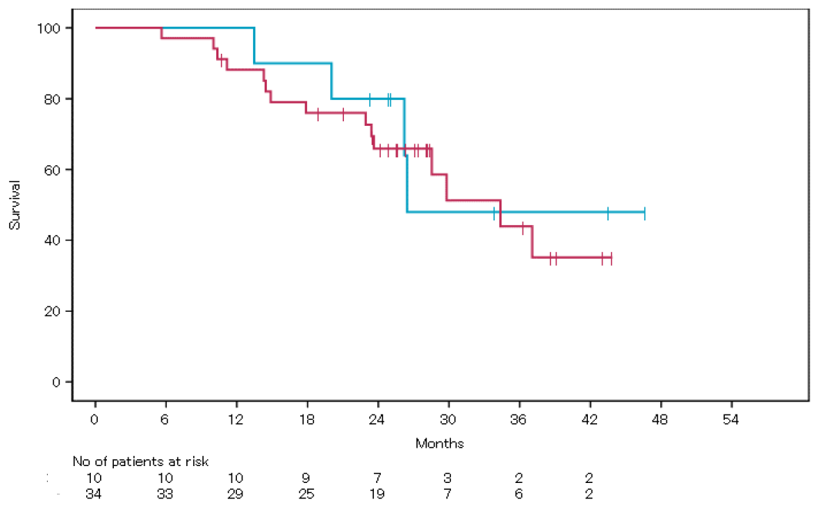
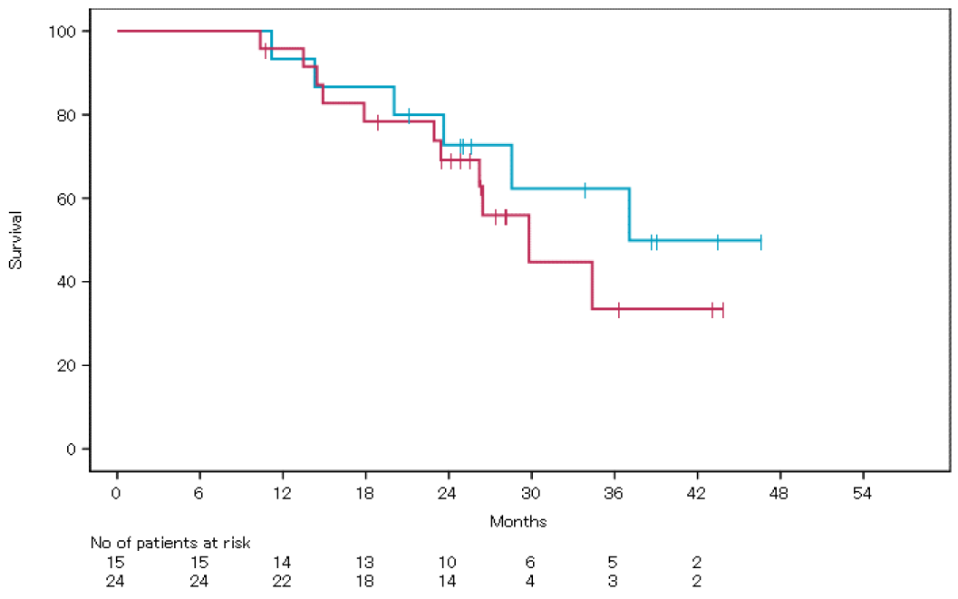
Supplementary Fig. 2. Kaplan-Meier estimates of progression-free survival (A, B) and overall survival (C, D) on basis of primary tumor sidedness and RAS mutational status.
A
B
Right-sided colon
Wild RAS
Left-sided colon
Mutated RAS
Right-sided colon
Wild RAS
Left-sided colon
Mutated RAS
C
D
Right-sided colon
Wild RAS
Left-sided colon
Mutated RAS
Right-sided colon
Wild RAS
Left-sided colon
Mutated RAS

