Slide 1
JAMA Ophthalmology Journal Club Slides:
Association of Metformin Use With Age-Related Macular Degeneration
Blitzer AL, Ham SA, Colby KA, Skondra D. Association of metformin use with age-related macular degeneration: a case-control study. JAMA Ophthalmol. Published online January 1, 2021. doi:10.1001/jamaophthalmol.2020.6331

Slide 2
Introduction
Importance:
  Age-related macular degeneration (AMD) is the leading cause of irreversible blindness in adults older in the US.
  There are no established preventive measures for AMD.
  Metformin, the most commonly prescribed oral antihyperglycemic drug for diabetes, has been shown to have antiaging and protective effects against many age-associated diseases.
Objective:
  To determine whether metformin use is associated with reduced odds of developing AMD.

Slide 3
Methods
Study Design, Setting, and Participants:
  This case-control study of patients from MarketScan, a nationwide health insurance claims database, included a population-based sample of patients.
  Those aged 55 years and older with newly diagnosed AMD from January 2008 to December 2017 were defined as cases.
  Study design looked back 2 years from date of AMD diagnosis or assigned date for matched controls.
  Controls were:
    Screened for ≥2 eye examinations in the past year with no AMD diagnosis
    Required continuous health insurance plan coverage that included prescription drug coverage during the 24 months prior to the index date
    Matched 1:1 on age on index date, anemia, hypertension, region, and Charlson Comorbidity Index score
  Stratified univariable and multivariable logistic regressions were used to test metformin exposures controlling for risk factors for AMD and other medications in the general population and among patients with diabetes.
  Data analyses were conducted from June 2019 to February 2020.

Slide 4
Methods
Main Outcomes and Measures:
  Risk of developing AMD.
Limitations:
  This study does not determine the probability of developing AMD; rather, the association of metformin use and AMD development was reported.
  The diagnoses rely on diagnosis codes from billing records. It is possible that billing records underreport diagnoses or include incorrect diagnoses.
  MarketScan is limited to privately insured patients including Medicare recipients with supplemental coverage.
  Clinical measures (eg, hemoglobin A_{1c}) are not included in the MarketScan claims database.

Slide 5
Results
A total of 312 404 affected individuals (181 817 women [58.2%]) were matched with 312 376 control participants (172 459 women [55.2%]). The age range was 55 to 107 years.
Compared with the control group, the case group had a slightly higher percentage of participants with diabetes and were more likely to be smokers, have hyperlipidemia, and have diabetic retinopathy.
Metformin use was associated with reduced odds of developing AMD (odds ratio [OR], 0.94 [95% CI, 0.92-0.96]).
Low to moderate doses of metformin showed the greatest potential benefit (dosages over 2 years: 1-270 g, OR, 0.91 [95% CI, 0.88-0.94]; 271-600 g, OR, 0.90 [95% CI, 0.87-0.93]).
Both the reduction in odds ratio and the dose-dependent response were preserved in a cohort consisting only of patients with diabetes.
Metformin use was associated with a decreased OR of AMD in patients with diabetes without coexisting diabetic retinopathy (OR, 0.93 [95% CI, 0.91-0.95]) but was a risk factor in patients with diabetic retinopathy (OR, 1.07 [95% CI, 1.01-1.15]).

Slide 6
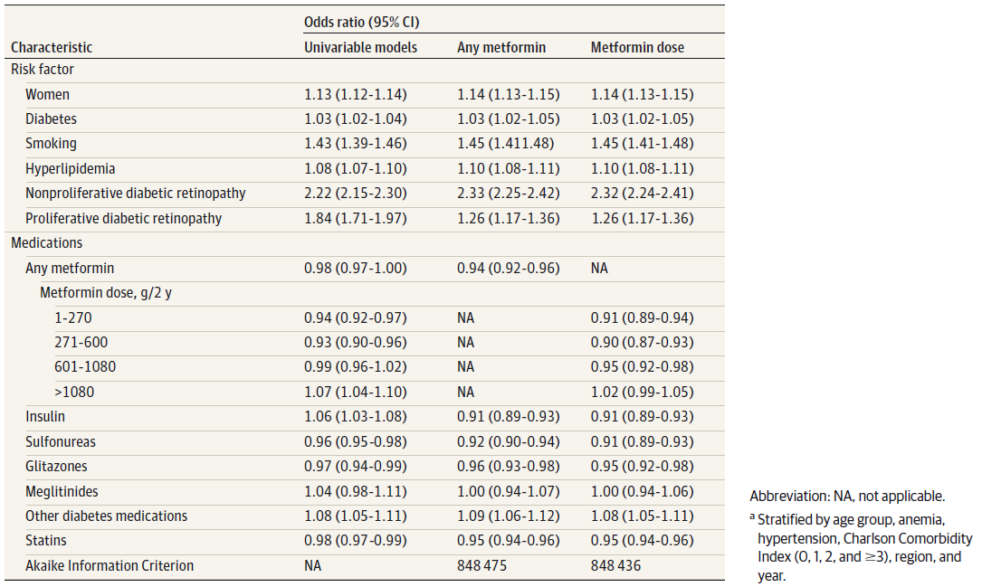
Results
Univariable and Multivariable Logistic Regression Models for Incident Age-Related Macular Degeneration Cases and Matched Controls 55 Years and Older Using MarketScan Research Databases, January 2008 to December 2017 (N = 624 780)ª

Slide 7
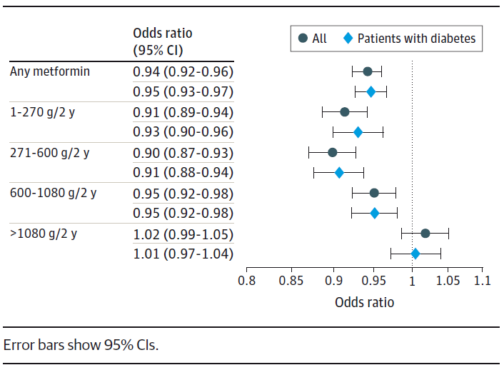
Results
Odds Ratios for Metformin by Dose in the
Full Cohort and Only Patients With Diabetes

Slide 8
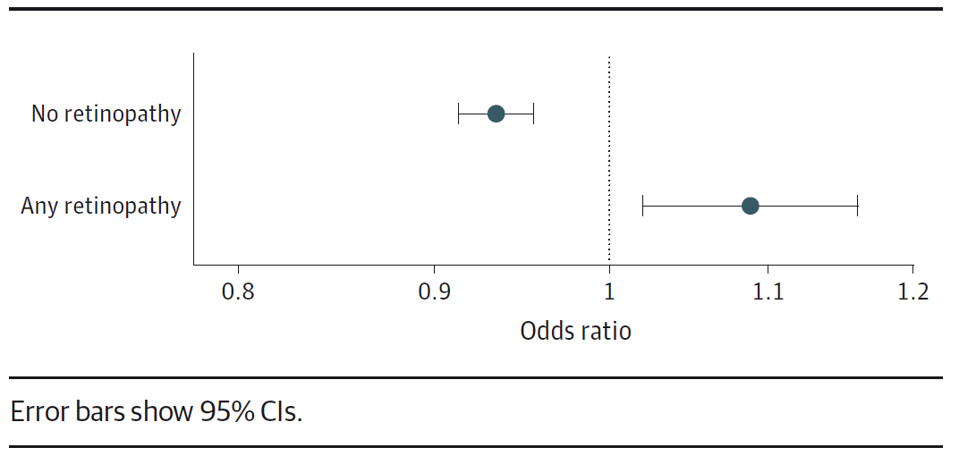
Results
Odds Ratios for Metformin in Patients With Diabetes
With and Without Diabetic Retinopathy

Slide 9
Comment
Metformin, which has been shown to have beneficial associations with multiple diseases of aging, may reduce the odds of developing AMD.
There was a dose-dependent response, with low to moderate doses of metformin showing the greatest benefit.
The reduced odds of developing AMD was preserved in a cohort of individuals with diabetes but only in those without coexisting diabetic retinopathy.
These findings support the hypothesis that metformin could be considered as a possible therapeutic intervention for the prevention or treatment of AMD.
Future studies would be needed to validate these findings and determine the underlying mechanisms.

Slide 10
Contact Information
If you have questions, please contact the corresponding author:
  Dimitra Skondra, MD, PhD, Department of Ophthalmology and Visual Science, University of Chicago Medical Center, 5841 S Maryland Ave, Chicago, IL 60637 (dskondra@bsd.uchicago.edu)
  Funding/Support
This work was supported by a grant from The University of Chicago Institute for Translational Medicine (Dr Skondra).
Conflict of Interest Disclosures
None reported.

