Slide 1
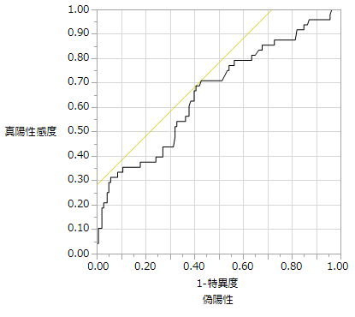
Supplementary Figure 1.
CPK on POD1
Sensitivity
1-Specificity
AUC=0.651

