Slide 1
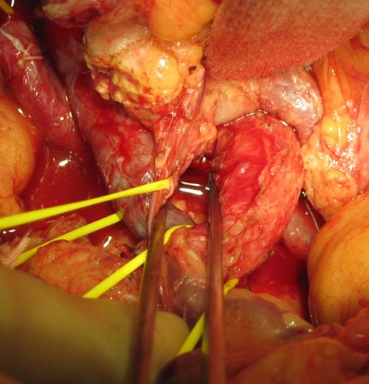
Group A
Group B
SMV
SMA
SMA
SMV

