Slide 1
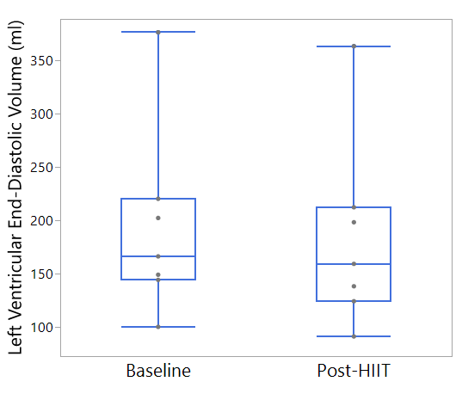
Supplemental Figure 1: Left Ventricular End-Diastolic Volume Before and After Training
p=0.02
Supplemental Figure 1: Left Ventricular End-Diastolic Volume (LVEDV) Before and After HIIT (n=7)– LVEDV was measured during device turn-down before and after training. HIIT resulted in a significant reduction in LVEDV: 168 (144, 216) ml to 159 (124, 212) ml.

Slide 2
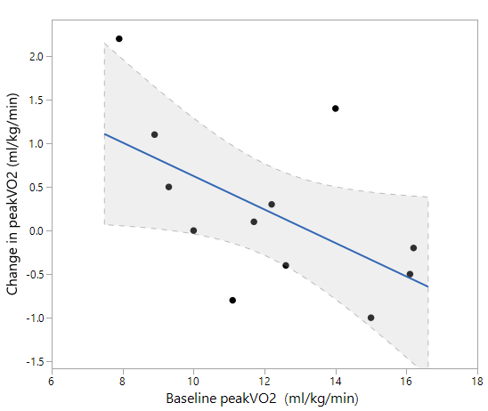
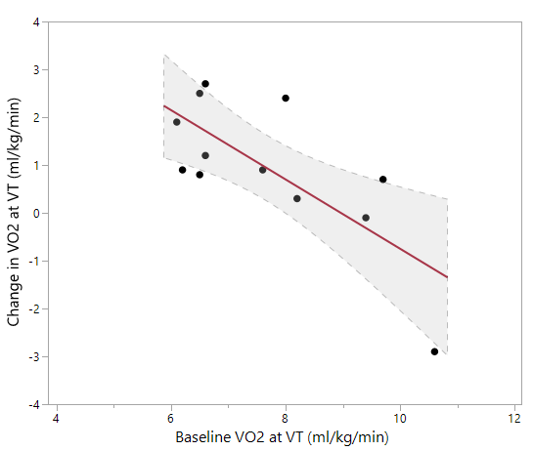
y = - 0.19 (x) + 2.5 ; R²=0.32, p=0.05
y = - 0.72 (x) + 6.5 ; R²=0.54, p=0.006
Supplemental Figure 2: Association Between Improvement in Oxygen Consumption and Baseline Level of Fitness. Subject’s baseline submaximal and maximal oxygen uptake was strongly correlated with improvements in V̇O2 at VT (R²=0.54, p=0.006) and modestly correlated with improvements in V̇O2peak (R²=0.32, p=0.05) respectively

Slide 3
Supplemental Table 1. Reproducibility of CPX Parameters
Variable (n=12) | Test 1 | Test 2 | p Value | Absolute change in median from Test 1 to Test 2 | Tests for which T1>T2 (%) | Tests for which T2> T1 (%)
V̇O₂peak (ml·kg⁻¹·min⁻¹) | 11.1 (9.6, 14.6) | 12.0 (9.1, 14.5) | 0.733 | 0.9 | 41.7 | 58.3
Exercise Time (seconds) | 489 (400, 528) | 540 (464, 569.5) | 0.052 | 36.3 | 16.7 | 83.3
VE/VCO₂ at peak exercise | 38.0 (33.5, 42.5) | 38.5 (33.5, 42.0) | 0.938 | 0.3 | 33.3 | 25.0
VO₂ at VT (ml·kg⁻¹·min⁻¹) | 7.4 (6.5, 10.5) | 6.6 (6.4, 8.7) | 0.380 | 0.6 | 66.7 | 33.3
V̇O2 at VT/ V̇O2peak (%) | 70 (62, 78) | 64 (53, 77) | 0.29 | 6 | 58.3 | 41.6
Work Rate at peak exercise (Watts) | 90.5 (72.0, 101.5) | 99.0 (68.5, 110.5) | 0.380 | 3.2 | 41.7 | 58.3
Heart Rate at peak exercise (bpm) | 130.0 (99.0, 140.0) | 129.0 (103.5, 138.5) | 0.970 | 0.8 | 33.3 | 66.7
RER at peak exercise | 1.22 (1.18, 1.28) | 1.28 (1.18, 1.33) | 0.123 | 0.0 | 25.0 | 66.7
RPE at peak exercise | 15.5 (15.0, 17.0) | 17.0 (15.0, 18.0) | 0.297 | 0.8 | 25.0 | 41.7
Work Rate at VT (Watts) | 25.5 (5.5, 60.0) | 33.0 (9.5, 52.5) | 1.000 | 0.8 | 58.3 | 33.3
Reproducibility of CPX Parameters in Patients with LVAD. Values are expressed Median (IQR: 25, 75). P values represent comparisons of values in T1 vs T2 using Wilcoxon rank-sum test. T1>T2 and T2>T1 indicate proportion of patients with higher median values for each variable during first and second test respectively. VE=minute ventilation, VT= ventilatory threshold, VO₂ = rate of oxygen consumption, RER= respiratory exchange ratio, RPE= rate of perceived exertion (Borg scale 6-20), VCO₂= volume of exhaled carbon dioxide.

