Slide 1
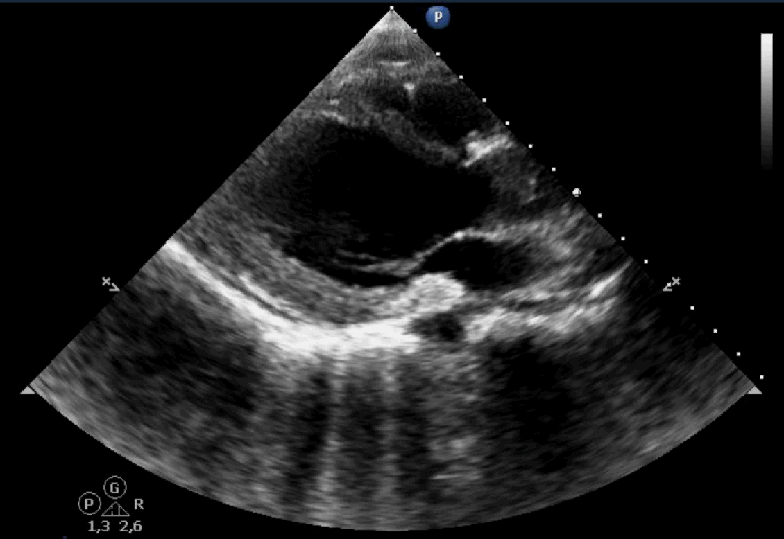
PLAX Acute Phase

