Slide 1
S. Fig 1.
Electronic Supplementary Material
Figure 1: Spatial distribution of 93 ions discriminating no-MI control and MI day 1 infarcted left ventricle of the MALDI IMS imaging Data in positive ionization mode using two no-MI controls and two MI day 1 infarcted hearts.

Slide 2
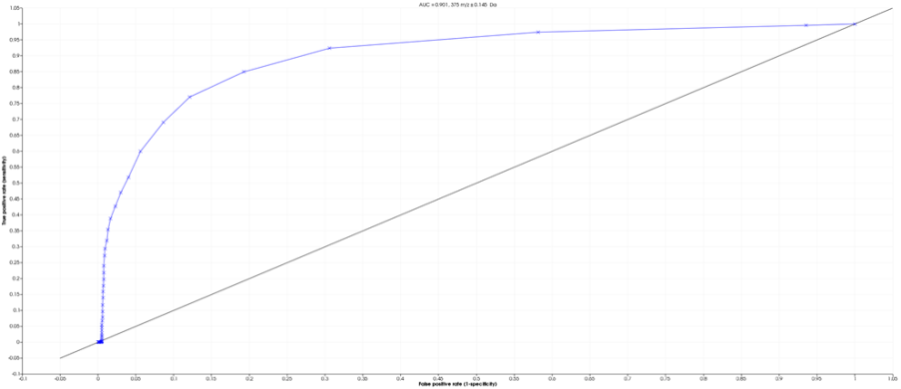
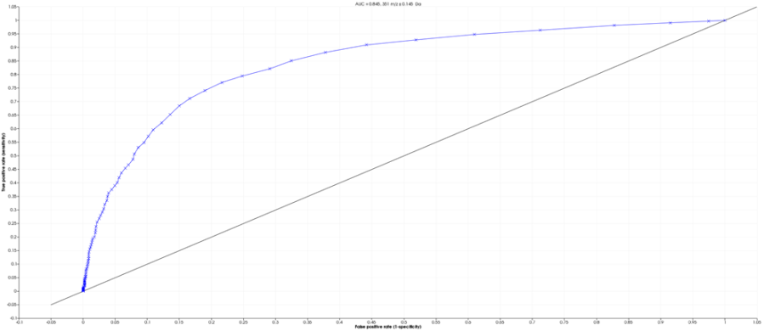
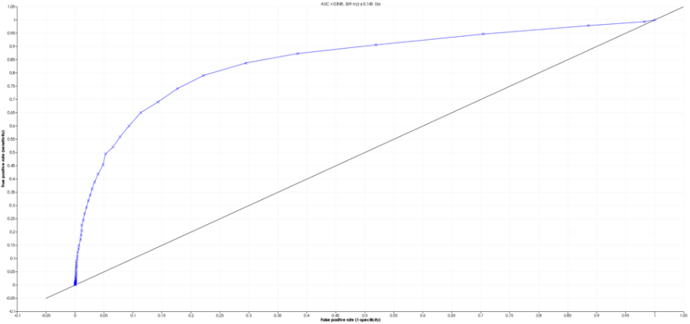
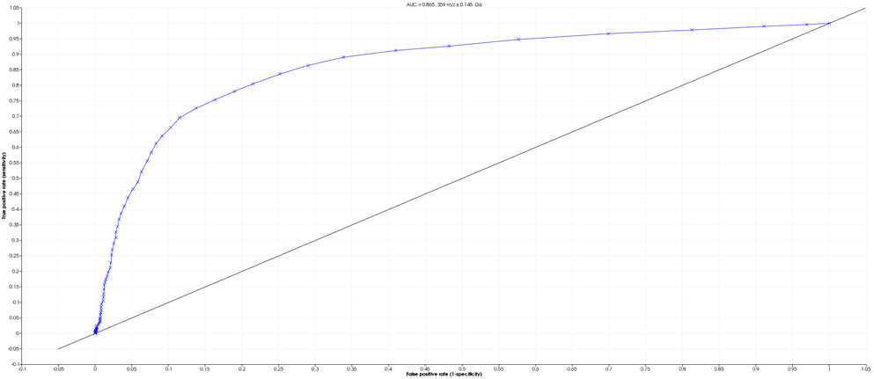
S. fig 2.
A.
C.
True positive rate (sensitivity)
True positive rate (sensitivity)
False positive rate (1-specificity)
D.
False positive rate (1-specificity)
B.
True positive rate (sensitivity)
True positive rate (sensitivity)
False positive rate (1-specificity)
False positive rate (1-specificity)
Fig 2: Receiver operating characteristic (ROC) and area under curve (AUC) of spatial distribution and relative intensity of 4 bioactive lipids in negative ionization mode: (3a) m/z 375 AUC=0.9 – (3b) m/z 369 AUC=0.9 – (3c) m/z 351 AUC=0.89 – (3d) m/z 359 AUC=0.9. The maximum AUC=1 means that the diagnostic test is perfect in the differentiation between the no-MI control and MI day 1 left ventricle samples

Slide 3
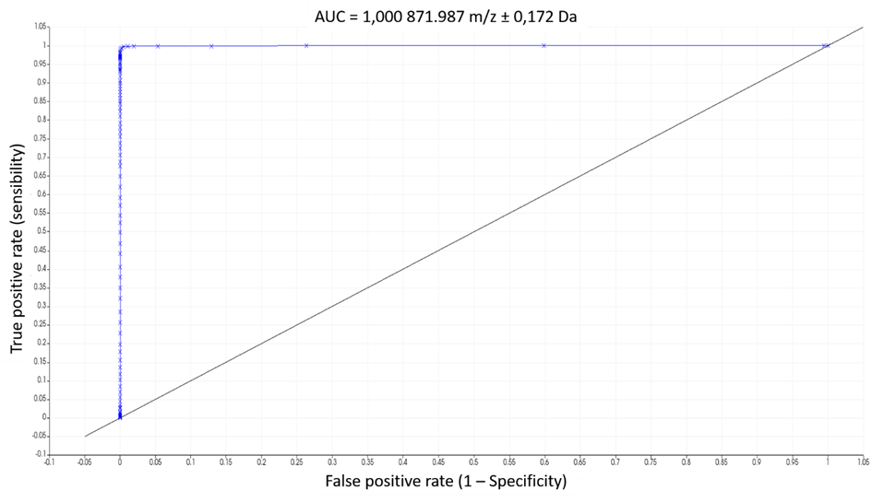
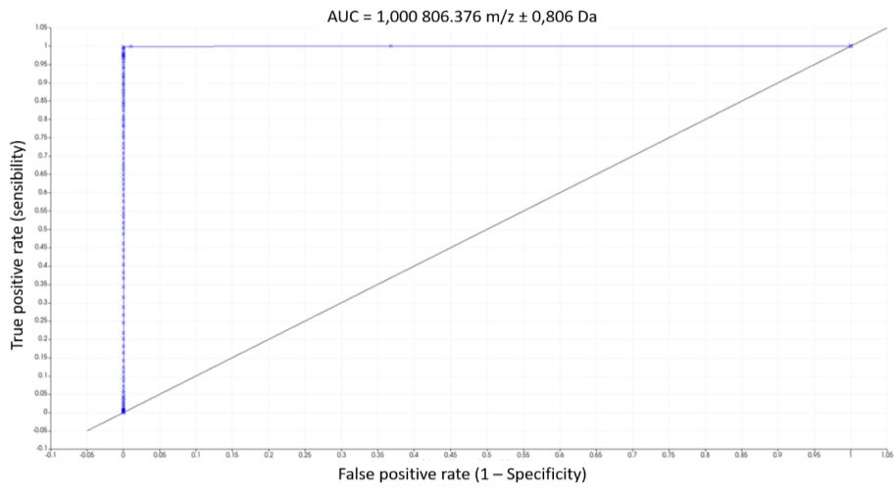
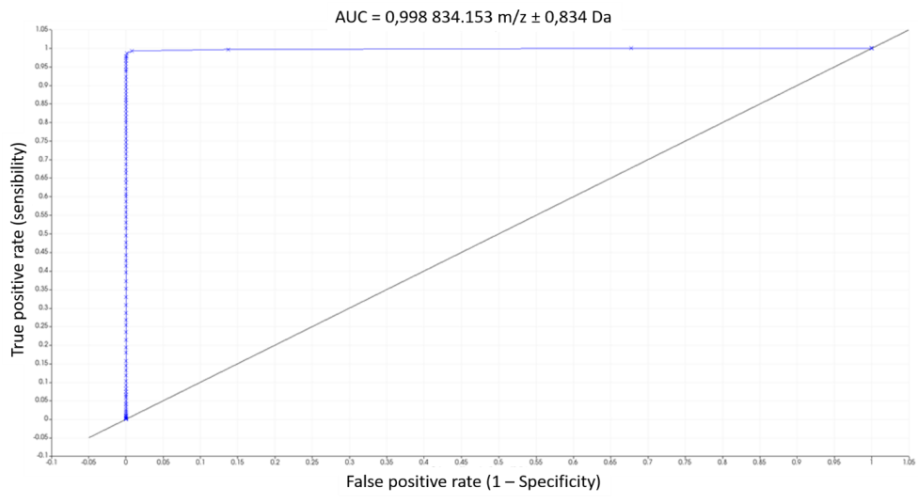
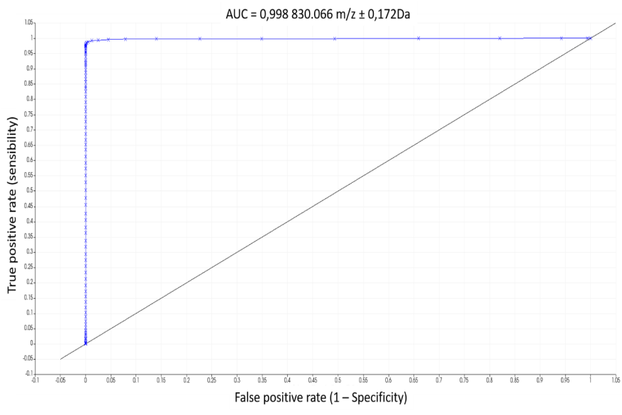
S. fig 3.
A.
C.
True positive rate (sensitivity)
True positive rate (sensitivity)
False positive rate (1-specificity)
D.
False positive rate (1-specificity)
B.
True positive rate (sensitivity)
True positive rate (sensitivity)
False positive rate (1-specificity)
False positive rate (1-specificity)
Fig 3: Receiver operating characteristic (ROC) and area under curve (AUC) of spatial distribution and relative intensity of 4 bioactive lipids in positive ionization mode: (4a) m/z 871.9 AUC=1,000 - (4b) m/z 834.1 AUC=0.998 – (4c) m/z 806.3 AUC=1.000 – (4d) m/z 830 AUC=0.998.

Slide 4
S. table 1.
Centroid [m/z] ± [Da] AUC at centroid - Descriminative mz MI control
589.847 0.173 0.817238
605.892 0.173 0.805725
613.656 0.173 0.822321
614.691 0.173 0.769713
616.675 1.294 0.868687
623.490 0.173 0.80646
629.701 0.173 0.861382
630.650 0.259 0.866832
631.685 0.173 0.767112
658.600 0.259 0.859038
677.147 1.380 0.918616
704.925 1.725 0.937763
720.107 0.173 0.752984
722.178 0.345 0.918937
723.213 0.173 0.787828
731.236 0.259 0.84074
732.271 0.259 0.877663
733.996 0.259 0.93463
735.031 0.259 0.82444
740.984 0.173 0.837451
742.019 0.173 0.782873
746.160 0.345 0.931282
747.195 0.345 0.90921
748.230 0.345 0.947777
749.179 0.259 0.85357
750.042 0.173 0.759182
755.994 0.173 0.959567
757.029 0.173 0.874834
758.064 0.345 0.960346
759.617 0.863 0.954474
761.083 0.259 0.885984
762.032 0.173 0.824202
768.934 0.173 0.801223
770.055 0.259 0.933452
771.004 0.173 0.811223
772.039 0.345 0.963476
773.074 0.345 0.943618
774.110 0.345 0.929332
775.145 0.345 0.913638
776.094 0.259 0.876398
779.544 1.812 0.820102
782.046 0.345 0.980907
782.995 0.259 0.945298
783.944 0.173 0.910242
784.979 0.173 0.884236
785.928 0.259 0.945053
786.963 0.259 0.887855
787.998 0.259 0.884546
789.033 0.173 0.756836
789.982 0.173 0.813774
792.053 0.173 0.832712
796.452 2.847 0.910969
799.903 0.259 0.934817
800.938 0.173 0.761288
801.973 0.259 0.885563
804.044 0.259 0.958834
804.993 0.173 0.858563
807.926 2.415 0.989361
810.945 0.259 0.908895
811.980 0.259 0.886957
812.929 0.173 0.836552
813.964 0.173 0.88279
818.019 0.259 0.894819
820.003 0.345 0.984362
820.952 0.259 0.943084
823.885 2.329 0.995292
826.904 0.173 0.88172
828.888 1.294 0.985029
830.958 0.259 0.962817
831.994 0.259 0.969597
832.943 0.173 0.884777
834.927 1.294 0.977609
836.997 0.259 0.916382
837.946 0.173 0.810328
841.914 0.173 0.782229
845.279 1.812 0.851024
847.867 0.259 0.977115
848.902 0.259 0.915705
849.937 0.259 0.952175
850.886 0.173 0.87718
851.921 0.345 0.994767
852.870 0.259 0.982701
853.905 0.259 0.960261
854.854 0.173 0.755155
855.889 0.345 0.981922
857.011 0.259 0.955776
857.960 0.173 0.925001
870.899 0.173 0.867104
872.884 1.294 0.983845
874.868 0.173 0.873876
1421.618 0.173 0.754063
1448.619 0.173 0.768607
1449.654 0.173 0.752664
Table 1: List of 93 ions discriminating no-MI control and MI day 1 infarcted left ventricle from the MALDI IMS imaging data in positive ionization mode with ROC values obtained from SCilLs software 2016b

