Slide 1
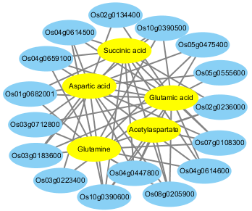
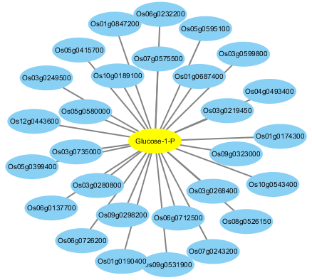
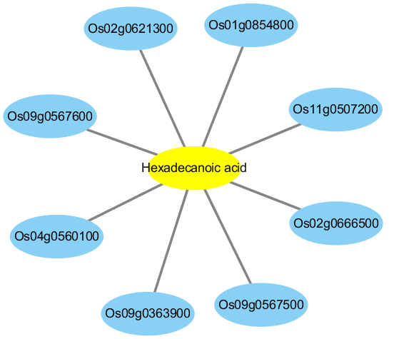
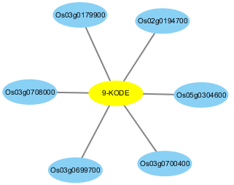
A
B
C
D
Figure S4. Gene–metabolite correlation network representing the genes and metabolites co-enriched in KEGG pathways involved in melatonin-mediated salt tolerance. The gene–metabolite pairs are connected within the network by edges. Blue and yellow nodes indicate genes and metabolites, respectively.

