Slide 1
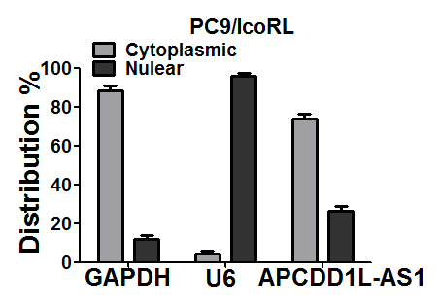
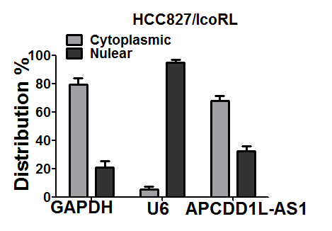
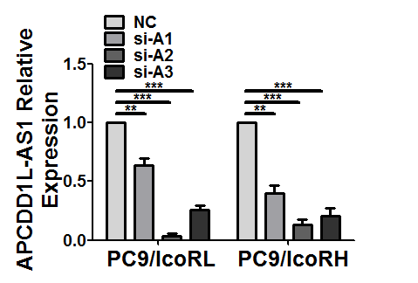
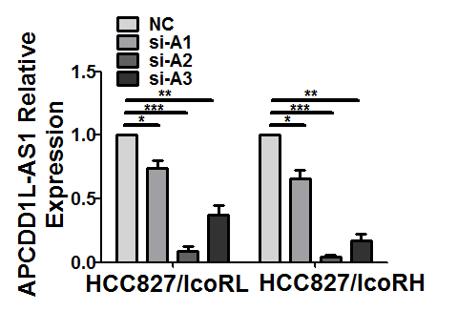
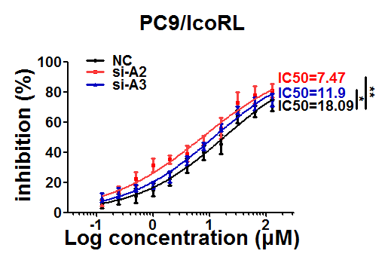
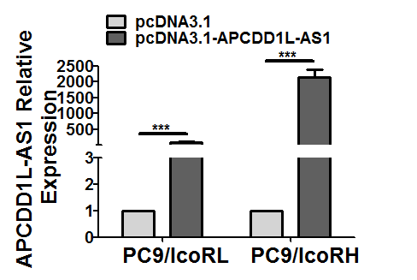
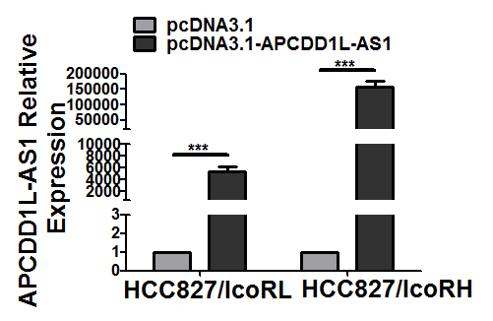
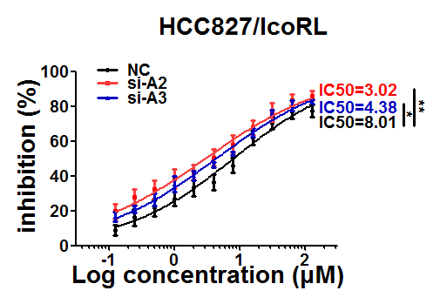
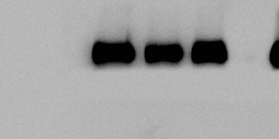
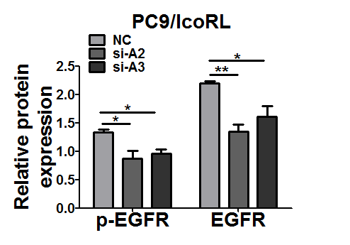
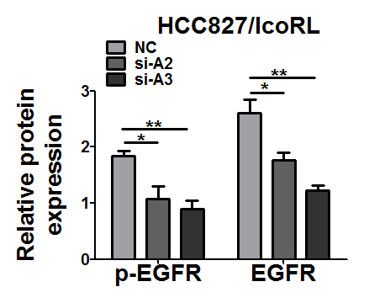
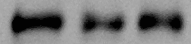
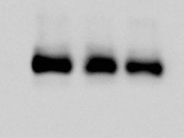
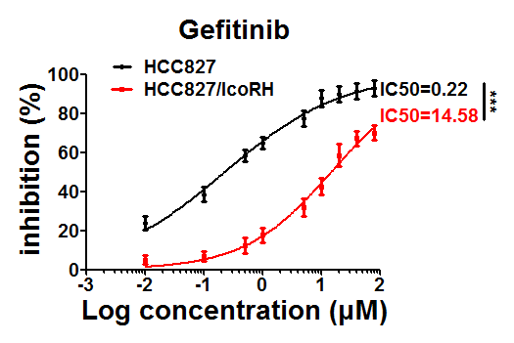

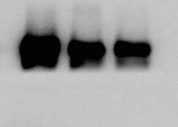
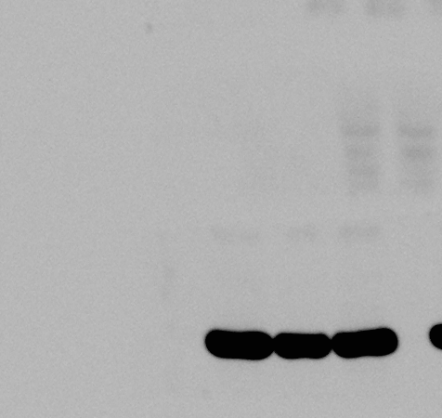
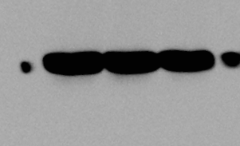
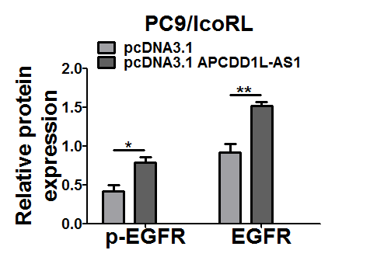
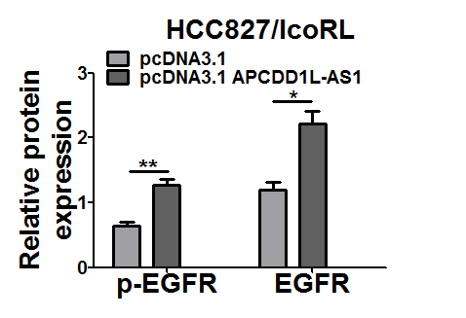
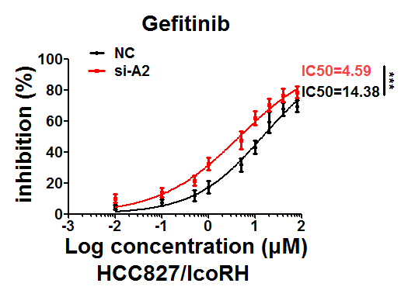
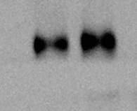
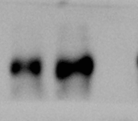
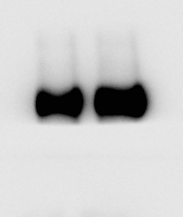
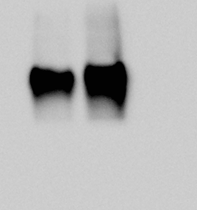
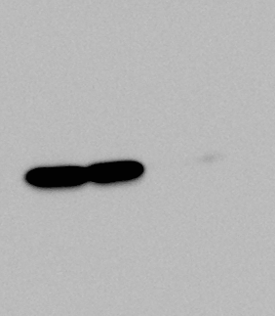
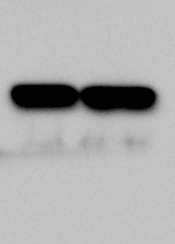
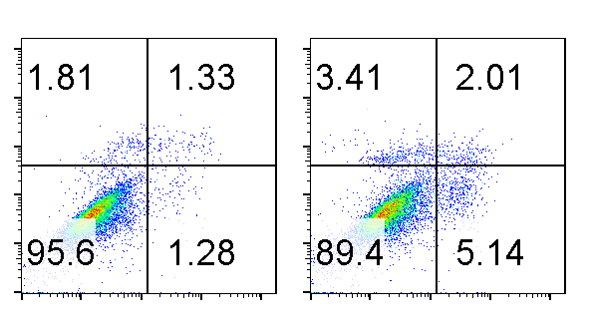
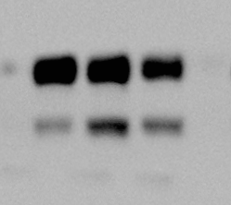
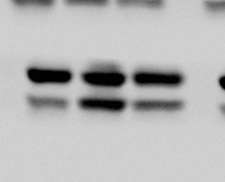
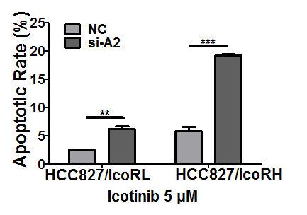
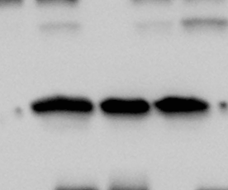
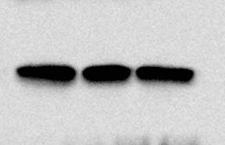
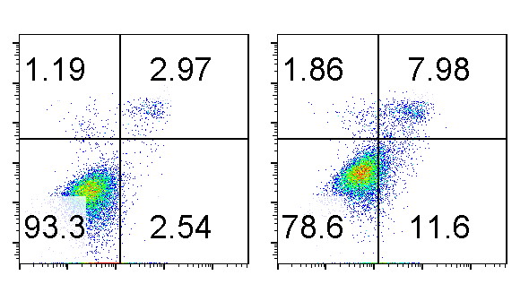
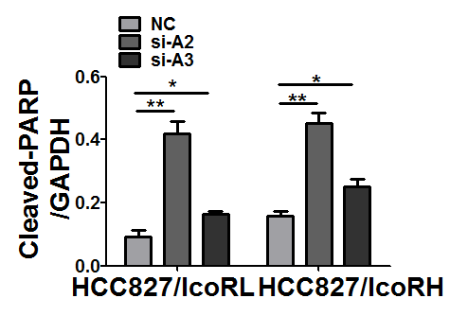
Figure S1
A
B
HCC827/IcoRH
Merge
DAPI
18S
DAPI
U6
Merge
C
DAPI
APCDD1L-AS1
Merge
E
D
si-A2
NC
si-A3
si-A2
si-A3
F
NC
G
p-EGFR
EGFR
GAPDH
PC9/IcoRL
HCC827/IcoRL
pcDNA3.1
APCDD1L-AS1
pcDNA3.1
APCDD1L-AS1
pcDNA3.1
pcDNA3.1
p-EGFR
EGFR
GAPDH
PC9/IcoRL
HCC827/IcoRL
si-A2
si-A2
NC
NC
si-A3
H
I
si-A3
NC
si-A2
PARP
Cleaved-PARP
HCC827/IcoRL
GAPDH
PI
HCC827/IcoRL
HCC827/IcoRH
HCC827/IcoRH
Annexin V FITC
Icotinib 5 μM

Slide 2
Figure S1. EGFR up-regulation and apoptosis inhibition by APCDD1L-AS1 in icotinib-resistant LUAD cells.
(A) The relative expression of APCDD1L-AS1 in cytoplasm or nucleus of the icotinib-resistant cells (PC9/IcoRL, HCC827/IcoRL) was determined by qRT-PCR. (B) The localization of APCDD1-AS1 in the HCC827/IcoRH cells was detected by RNA-FISH. Blue, DAPI-stained nuclei; Red, Cy3-labeled positive hybridization signals (scale bar, 100 μm). U6 and 18S were used as positive controls. (C and D) The efficiency of APCDD1L-AS1 KD (C) and OE (D) in the icotinib-resistant cells were confirmed by qRT-PCR. (E) The effect of APCDD1L-AS1 KD on the IC50 value of icotinib was evaluated in icotinib-resistant cells (PC9/IcoRL, HCC827/IcoRL) by MTT assay. (F) The level of EGFR and p-EGFR in APCDD1L-AS1 KD- or OE-icotinib-resistant cells (PC9/IcoRL, HCC827/IcoRL) was determined by western blot. (G) The gefitinib sensitivity in HCC827/IcoRH and HCC827 cells treated with different concertrations of gefitinb for 96h was determined by MTT; The effect of APCDD1L-AS1 KD on the IC50 value of gefitinib was evaluated in HCC827/IcoRH cells by MTT assay. (H and I) The apoptosis of APCDD1L-AS1-KD-icotinib-resistant cells with the treatment of icotinib (5 μM) was analyzed by flow cytometry (H), and apoptosis-related protein PARP (I) in the HCC827/IcoRL and HCC827/IcoRH was assessed by western blot. GAPDH was served as the internal control. The mean ± SD of triplicate experiments were plotted, *P< 0.05, **P< 0.01, ***P< 0.001.

Slide 3
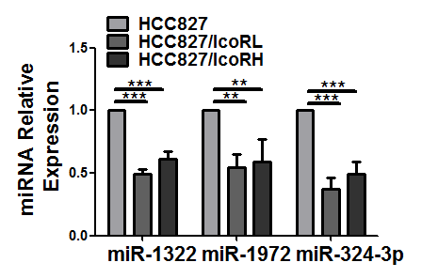
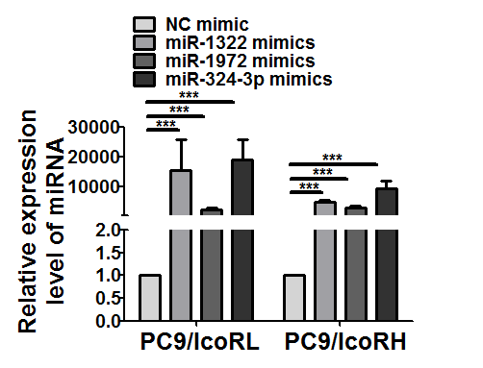
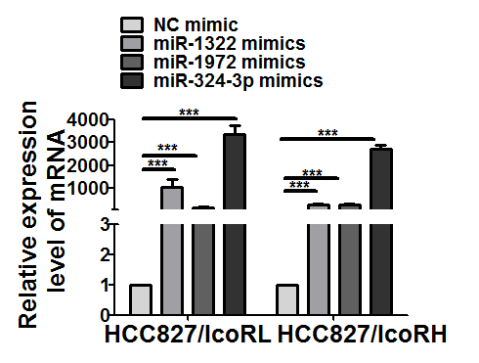
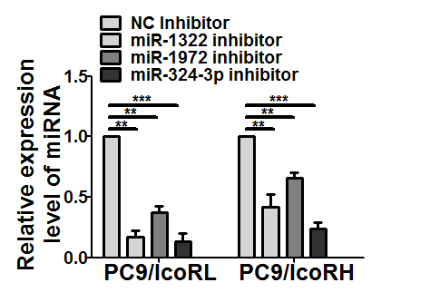
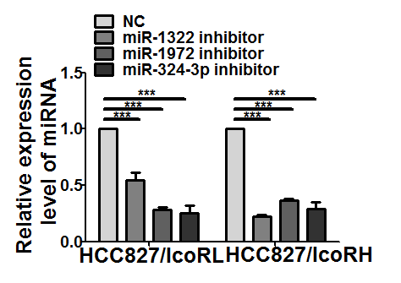
Figure S2
A
B
C
Figure S2. Efficiency of miR-1322/miR-1972/miR-324-3p knockdown and overexpression.
(A) The expression level of miRNAs in the parental cells and their icotinib-resistant cells (HCC827, HCC827/IcoRL and HCC827/IcoRH) was determined by qRT-PCR. (B and C) The efficiency of mimics (B) and inhibitor (C) of miR-1322, miR-1972 or miR-324-3p in the icotinib-resistant cells was confirmed by qRT-PCR. The mean±SD of triplicate experiments were plotted, **P< 0.01, ***P< 0.001.

Slide 4
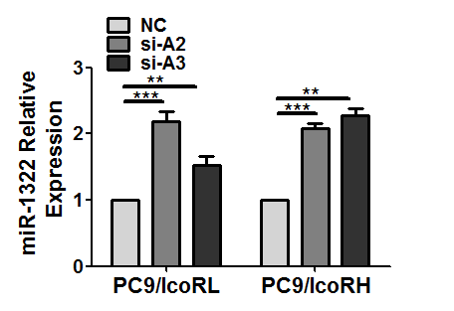
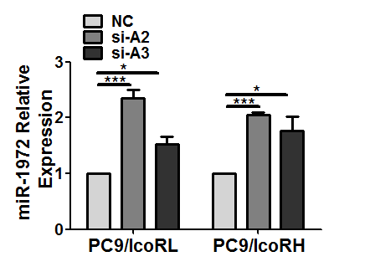
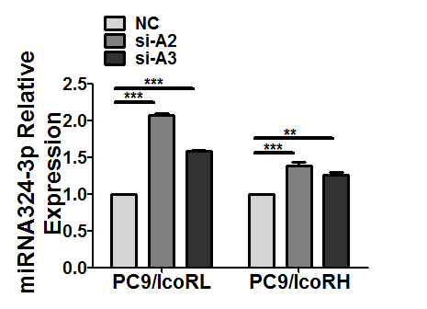
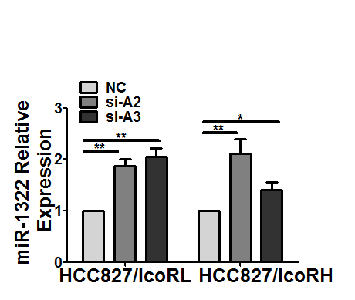
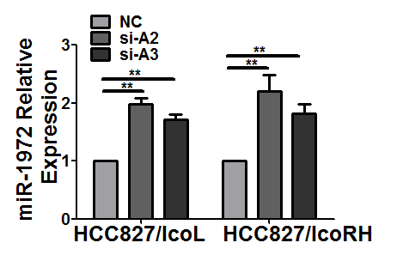
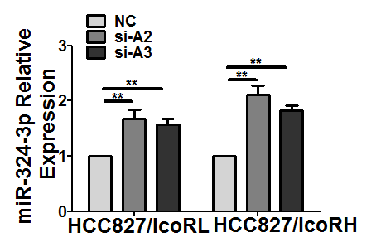
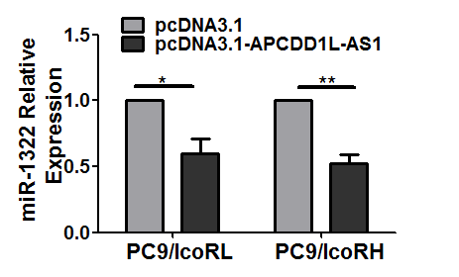
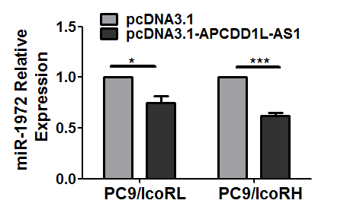
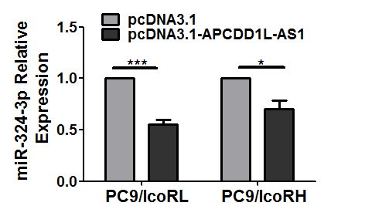
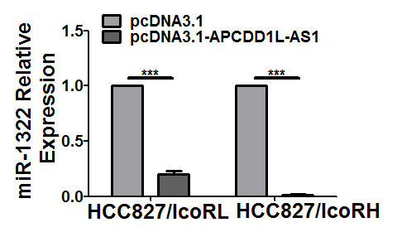
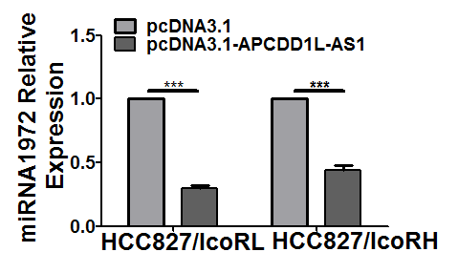







Figure S3
A
B
C

Slide 5
Figure S3. Reciprocal suppression by APCDD1L-AS1 sponging with miR-1322, miR-1972 and miR-324-3p.
(A and B)The expression of miR-1322, miR-1972 or miR-324-3p in APCDD1-AS1 KD- (A) or OE-icotinib-resistant cells (B) was analyzed by qRT-PCR. (C) The effect of miR-1322, miR-1972 or miR-324-3p mimics or inhibitors on APCDD1L-AS1 expression in icotinib-resistant cells was detected by qRT-PCR. The mean ± SD of triplicate experiments were plotted, *P< 0.05, **P< 0.01, ***P< 0.001.

Slide 6






Figure S4
A
B
Figure S4. Reversal of icotinib resistance by miR1322/miR1972/miR324-3p in LUAD cells
(A) The effect of miR-1322, miR-1972 or miR-324-3p mimics on the icotinib sensitivity of the icotinib-resistant cells (PC9/IcoRH, HCC827/IcoRL and HCC827/IcoRH) was determined by MTT assay. (B) After co-transfection with miR-1322, miR-1972 or miR-324-3p inhibitor and si-RNA APCDD1L-AS1, the viability of the icotinib-resistant cells (PC9/IcoRH, HCC827/IcoRL and HCC827/IcoRH) with the treatment of icotinib for 72h was determined by MTT assay. The mean±SD of triplicate experiments were plotted, *P< 0.05, **P< 0.01, ***P< 0.001.

Slide 7



















Figure S5
A
B
HCC827/IcoRH
HCC827/IcoRL
HCC827
SIRT5
GAPDH
C
miR-1972 mimics
miR-324-3p mimics
miR-1322 mimics
D
NC mimic
SIRT5
HCC827/IcoRL
GAPDH
SIRT5
HCC827/IcoRH
GAPDH
miR-1972 inhibitor
miR-1322 inhibitor
miR-324-3p inhibitor
NC inhibitor
SIRT5
HCC827/IcoRL
GAPDH
SIRT5
HCC827/IcoRH
GAPDH
Figure S5. Negative regulation of SIRT5 by miR-1322/miR-1972/miR-324-3p.
(A and B) The expression of SIRT5 in the parental cells and their icotinib-resistant cells (HCC827, HCC827/IcoRL and HCC827/IcoRH) was detected by qRT-PCR (A) and western blot (B). (C and D) The effect of miR-1322, miR-1972 or miR-324-3p mimics or inhibitors on SIRT5 expression in HCC827/IcoRL and HCC827/IcoRH cells was detected by qRT-PCR (C) and western blot (D). The mean±SD of triplicate experiments were plotted, *P< 0.05, **P< 0.01, ***P< 0.001.

Slide 8










Figure S6
A
B
si-SIRT5-1
si-SIRT5-1
si-SIRT5-2
si-SIRT5-2
NC
NC
P-EGFR
EGFR
GAPDH
PC9/IcoRL
HCC827/IcoRL
Figure S6. EGFR down-regulation after SIRT5 knockdown in icotinib-resistant LUAD cells.
(A ) The KD efficiency of SIRT5 in the icotinib-resistant LUAD cells was confirmed by qRT-PCR. (B) The level of EGFR and p-EGFR in SIRT5 KD-icotinib-resistant cells (PC9/IcoRL and HCC827/IcoRL) was detected by western blot. The mean±SD of triplicate experiments were plotted, *P< 0.05, **P< 0.01, ***P< 0.001.

Slide 9



































Figure S7
A
B
CHX
0h
Si-NC
SIRT5 Si-2
EGFR
2h
4h
8h
CHX
0h
2h
4h
8h
EGFR
HCC827/IcoRH
HCC827/IcoRH
GAPDH
GAPDH
C
HCC827/ICORH
Si-NC
+
_
+
_
Si-SIRT5-2
_
+
_
+
MG132
_
_
+
+
DMSO
+
+
_
_
EGFR
GAPDH
D
si-SIRT5-2
si-SIRT5-1
si-SIRT5-2
NC
NC
si-SIRT5-1
P62
LC3B-I
LC3B-II
GAPDH
E
PC9/IcoRL
HCC827/IcoRL
si-SIRT5-2+CQ
si-SIRT5-2+CQ
si-SIRT5-2
si-SIRT5-2
NC
NC
P-EGFR
EGFR
GAPDH
PC9/IcoRL
HCC827/IcoRL
si-SIRT5-2+3MA
si-SIRT5-2+3MA
si-SIRT5-2
si-SIRT5-2
NC
NC
P-EGFR
EGFR
GAPDH
PC9/IcoRL
HCC827/IcoRL

Slide 10
Figure S7. Acceleration of EGFR degradation by SIRT5 knockdown.
(A) The RNA expression of EGFR in SIRT5 KD-icotinib-resistant cells was detected by qRT-PCR. (B) The protein level change of EGFR in SIRT5 KD-HCC827/IcoRH cells treated with CHX (20μg/ml) at different time point were detected by western blot. (C) The protein level of EGFR in SIRT5 KD-HCC827/IcoRH cells with the treatment of MG-132 (10 μM) for 12h were determined by western blot. (D) The level of LC3B and p62 in SIRT5 KD-icotinib-resistant cells (PC9/IcoRL and HCC827/IcoRL) was determined by western blot. (E) The level of EGFR, p-EGFR in SIRT5 KD-icotinib-resistant LUAD cells (PC9/IcoRL and HCC827/IcoRL) treated with CQ (50 μM) or 3-MA (10 mM) was determined by western blot. The mean ± SD of triplicate experiments were plotted, n.s., not statistically significant, *P< 0.05, **P< 0.01, ***P< 0.001.

Slide 11












Figure S8
A
si-SIRT5-2+CQ
si-SIRT5-2+3MA
si-SIRT5-2+CQ
si-SIRT5-2+3MA
si-SIRT5-2
si-SIRT5-2
si-SIRT5-2
si-SIRT5-2
PARP
NC
NC
NC
NC
Cleaved-PARP
GAPDH
PC9/IcoRL
HCC827/IcoRL
B
HCC827/IcoRH
DAPI
EGFR
LC3B
Merge
si-NC
DAPI
EGFR
LC3B
Merge
si-SIRT5-2
Figure S8. EGFR colocalized with the autophagic vesicle marker LC3B during SIRT5 knockdown. (A) The level of PARP in SIRT5 KD-PC9/IcoRL and HCC827/IcoRL cells with the treatment of CQ (50 μM) or 3-MA (10 mM) was determined by western blot. (B) The SIRT5 KD-HCC827/IcoRH cells and negative control cells expressing EGFR or LC3B were observed by Immunofluorescence (scale bar, 50μm) and colocalization was analyzed by confocal microscopy. The mean ± SD of triplicate experiments were plotted, *P< 0.05, **P< 0.01, ***P< 0.001.

Slide 12












Figure S9
A
B
NC
si-A2
si-A3
NC
si-A2
si-A3
SIRT5
GAPDH
HCC827/IcoRL
HCC827/IcoRH
C
D
pcDNA3.1
APCDD1L-AS1
pcDNA3.1
APCDD1L-AS1
pcDNA3.1
pcDNA3.1
SIRT5
GAPDH
HCC827/IcoRL
HCC827/IcoRH
Figure S9. Negative regulation of SIRT5 by APCDD1L-AS1.
(A-D) The RNA and protein expression of SIRT5 in APCDD1L-AS1 KD- (A and B) or OE-HCC827/IcoRL and HCC827/IcoRH cells (C and D) was detected by qRT-PCR and western blot. The mean ± SD of triplicate experiments were plotted, **P< 0.01, ***P< 0.001.

