Slide 1
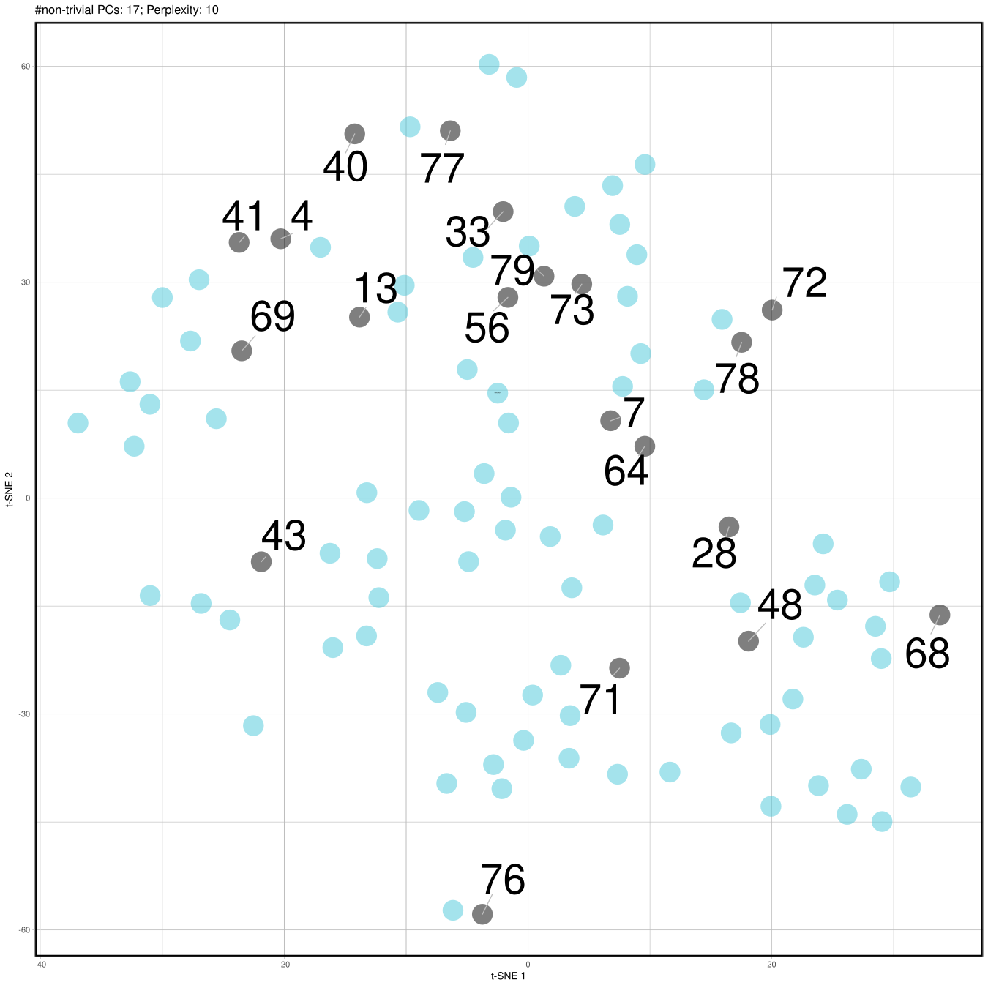
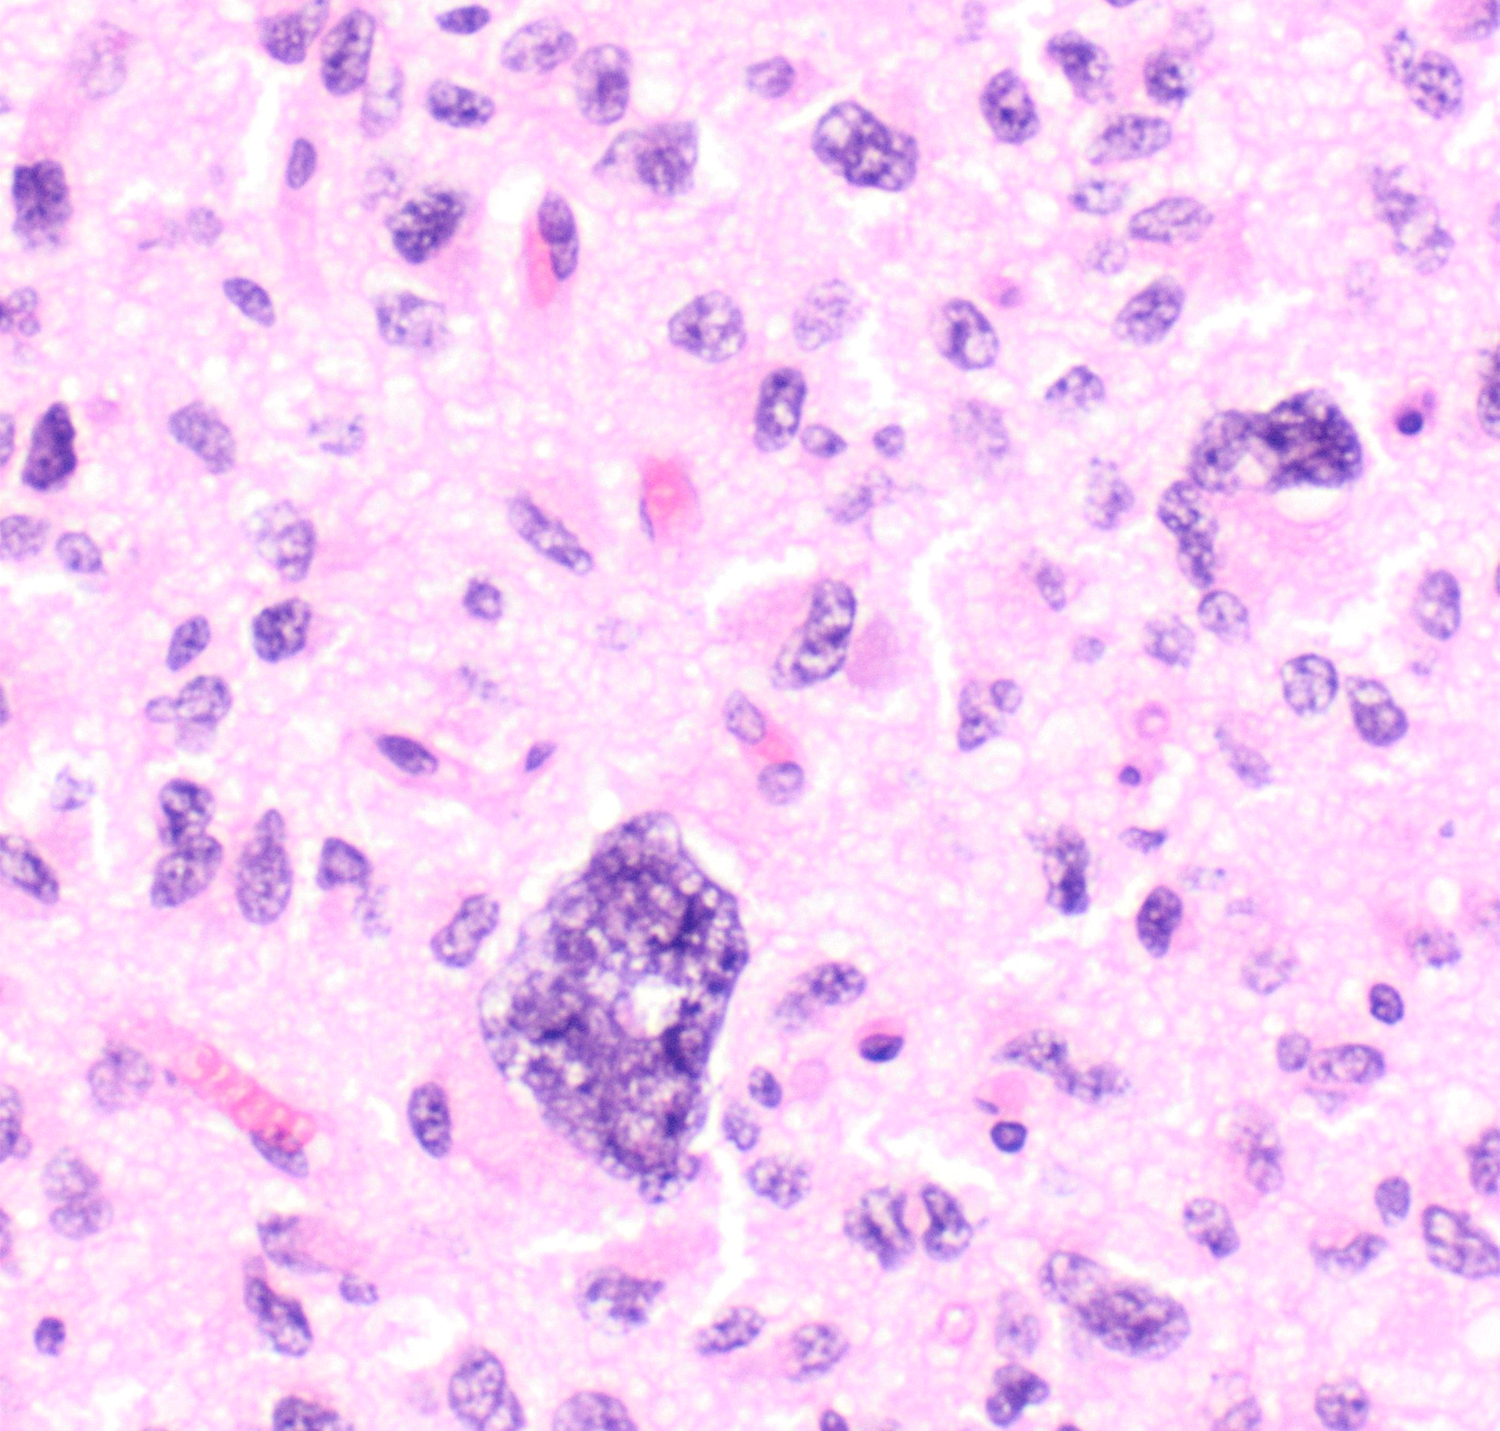
Schüller et al., Figure 1
a
Case | 56 | 29 | 41 | 6 | 65 | 4 | 74 | 83 | 13 | 30 | 64 | 21 | 40 | 48 | 55 | 82 | 76 | 7 | 12 | 78 | 79 | 11 | 54 | 67 | 24 | 81 | 28 | 36 | 72 | 2 | 8 | 26 | 32 | 34 | 37 | 42 | 44 | 57 | 80 | 9 | 19 | 31 | 35 | 43 | 51 | 62 | 63 | 70 | 71 | 77 | 68 | 10 | 46 | 23 | 1 | 38 | 69 | 73 | 17 | 22 | 60 | 61 | 5 | 15 | 16 | 47 | 50 | 75 | 27 | 3 | 20 | 33 | 39 | 49 | 18 | 25 | 45 | 52 | 58 | 59 | 66 | 14 | 53
Gender | m | f | m | m | f | m | m | m | f | NA | f | f | m | f | m | m | f | m | m | m | f | m | m | m | f | m | m | m | m | f | m | f | m | m | m | m | m | f | m | f | f | f | f | m | f | m | f | m | f | m | f | f | NA | f | m | m | m | m | m | m | m | m | f | f | f | f | m | f | f | f | f | m | m | m | f | f | m | f | f | m | f | f | m
Age | adolescent | NA | adult | adult | adult | adolescent | adult | adult | adolescent | adult | adolescent | adult | adult | adolescent | adult | adult | adolescent | adult | NA | adult | adult | adolescent | adult | adolescent | adult | adult | adolescent | adolescent | adult | NA | adult | adolescent | adult | adolescent | adolescent | adolescent | adult | adolescent | adolescent | adolescent | adolescent | adult | adolescent | adolescent | adult | adolescent | adolescent | NA | adolescent | adult | adult | adolescent | NA | adolescent | adult | adolescent | adult | adult | adolescent | adult | adult | adolescent | adolescent | adolescent | adult | adolescent | adult | adolescent | adult | adolescent | adolescent | adult | adult | adolescent | adult | adolescent | adolescent | adult | adolescent | adolescent | adolescent | adult | adolescent
Localization | ST | ST | SP | ST | ST | SP | CB | ST | BS | BS | ST | BS | ST | BS | ST | ST | CB | ST | NA | CB | ST | BS | ST | BS | ST | NA | SP | ST | SP | ST | BS | ST | BS | BS | BS | ST | BS | BS | ST | ST | ST | BS | BS | BS | ST | BS | BS | ST | BS | ST | SP | BS | SP | BS | BS | BS | ST | ST | BS | BS | BS | BS | NA | BS | BS | SP | SP | SP | BS | BS | SP | ST | ST | BS | NA | BS | NA | BS | BS | ST | BS | ST | ST
Status | 0 | NA | 1 | 0 | 0 | NA | 0 | 0 | 0 | 0 | 0 | NA | 1 | 1 | 0 | 1 | 1 | 0 | NA | NA | 0 | 0 | NA | 1 | 0 | NA | 1 | 0 | NA | NA | 0 | 1 | 1 | NA | 1 | 1 | 0 | 0 | 1 | 0 | 0 | 1 | 0 | 0 | 0 | 1 | 0 | NA | 1 | 0 | 0 | 1 | NA | NA | 0 | 0 | 0 | 0 | 0 | 1 | 0 | 0 | NA | 0 | 0 | 1 | 1 | 0 | 0 | NA | 1 | 1 | NA | 0 | 0 | NA | NA | 1 | NA | 1 | 1 | 1 | 0
WHO Grade* | IV | IV | II | IV | IV | IV | III | IV | IV | IV | III | III | IV | NA | III | III | IV | IV | NA | IV | IV | IV | IV | III | III | III | IV | III | II | IV | III | III | IV | III | IV | III | III | III | III | NA | IV | IV | III | IV | IV | IV | IV | IV | IV | IV | IV | II | IV | II | IV | II | IV | IV | IV | III | II | IV | IV | IV | III | IV | II | IV | II | III | IV | II | IV | II | IV | II | II | III | IV | III | III | II | IV
H3F3A | MU | MU | MU | MU | MU | MU | MU | MU | MU | MU | MU | MU | MU | MU | MU | MU | MU | MU | MU | MU | MU | MU | MU | MU | MU | MU | MU | MU | MU | MU | MU | MU | MU | MU | MU | MU | MU | MU | MU | MU | MU | MU | MU | MU | MU | MU | MU | MU | MU | MU | MU | MU | MU | MU | MU | MU | MU | MU | MU | MU | MU | MU | MU | MU | MU | MU | MU | MU | MU | MU | MU | MU | MU | MU | MU | MU | MU | MU | MU | MU | MU | MU | MU
BRAF | MU | WT | WT | WT | WT | WT | WT | WT | WT | WT | WT | WT | WT | WT | WT | WT | WT | WT | WT | WT | WT | WT | WT | WT | WT | WT | WT | WT | WT | WT | WT | WT | WT | WT | WT | WT | WT | WT | WT | WT | WT | WT | WT | WT | WT | WT | WT | WT | WT | WT | WT | WT | WT | WT | WT | WT | WT | WT | WT | WT | WT | WT | WT | WT | WT | WT | WT | WT | WT | WT | WT | WT | WT | WT | WT | WT | WT | WT | WT | WT | WT | WT | WT
FGFR1 | WT | p.K656E | p.K656E | p.K656E | p.N546K | p.N546K | p.N546K | p.N546K | p.N546K | p.N546K | WT | WT | WT | WT | WT | WT | WT | WT | WT | WT | WT | WT | WT | WT | WT | WT | WT | WT | WT | WT | WT | WT | WT | WT | WT | WT | WT | WT | WT | WT | WT | WT | WT | WT | WT | WT | WT | WT | WT | WT | WT | WT | WT | WT | WT | WT | WT | WT | WT | WT | WT | WT | WT | WT | WT | WT | WT | WT | WT | WT | WT | WT | WT | WT | WT | WT | WT | WT | WT | WT | WT | WT | WT
NF1 | WT | MU | MU | WT | MU | MU | WT | NA | WT | WT | MU | MU | MU | MU | MU | MU | MU | MU | MU | MU | MU | MU | MU | MU | MU | MU | WT | WT | WT | WT | WT | WT | WT | WT | WT | WT | WT | WT | WT | WT | WT | WT | WT | WT | WT | WT | WT | WT | WT | WT | NA | NA | NA | NA | WT | WT | WT | WT | WT | WT | WT | WT | WT | WT | WT | WT | WT | WT | NA | NA | NA | NA | NA | NA | NA | NA | NA | NA | NA | NA | NA | NA | NA
TP53 | WT | WT | WT | WT | MU | WT | WT | WT | WT | WT | MU | MU | MU | MU | MU | MU | MU | WT | WT | WT | WT | WT | WT | WT | WT | WT | MU | MU | MU | MU | MU | MU | MU | MU | MU | MU | MU | MU | MU | MU | MU | MU | MU | MU | MU | MU | MU | MU | MU | MU | MU | MU | MU | MU | WT | WT | WT | WT | WT | WT | WT | WT | WT | WT | WT | WT | WT | WT | NA | NA | NA | NA | NA | NA | NA | NA | NA | NA | NA | NA | NA | WT | WT
ATRX | WT | NA | WT | loss | WT | loss | loss | MU | NA | NA | loss | NA | NA | WT | WT | WT | WT2 | loss | loss | loss | MU | NA | NA | NA | WT | WT | loss | loss | MU | NA | NA | NA | NA | NA | NA | NA | NA | NA | NA | WT | WT | WT | WT | WT | WT | WT | WT | WT2 | WT2 | WT2 | loss | NA | NA | WT | loss | loss | loss | MU | NA | NA | NA | NA | WT | WT | WT | WT | WT | WT2 | loss | NA | NA | NA | NA | NA | WT | WT | WT | WT | WT | WT | WT | loss | WT
 |  | Sex | n (%)
WT |  | male | 45 (56.0)
f |  | female | 36 (44.4)
NA |  | n.a. | 2 (2.4)
 |  | Age | n (%)
WT |  | > 18 years | 37 (47.4)
adolescent |  | < 18 years | 41 (52.6)
NA |  | n.a. | 5 (6.0)
 |  | Localization | n (%)
WT |  | supratent. | 30 (38.5)
BS |  | brainstem | 35 (44.9)
CB |  | cerebellum | 3 (3.8)
SP |  | spinal cord | 10 (12.8)
NA |  | n.a. | 5 (6.0)
 |  | Status | n (%)
0 |  | alive | 39 (60.9)
1 |  | dead | 25 (39.1)
NA |  | n.a. | 19 (22.9)
 |  | WHO grade of initial diagnosis | n (%)
II |  | II | 13 (16.3)
III |  | III | 23 (28.8)
IV |  | IV | 44 (55.0)
NA |  | n.a. | 3 (3.6)
 |  | H3F3A | n (%)
MU |  | K27M | 83 (100)
 |  | FGFR1 | n (%)
p.K656E |  | p.K656E | 3 (3.6)
p.N546K |  | p.N546K | 6 (7.2)
WT |  | WT* | 74 (89.2)
 |  | NF1 | n (%)
MU |  | MU | 20 (31.8)
WT |  | WT | 43 (68.3)
NA |  | n.a. | 20 (24.1)
 |  | TP53 | n (%)
MU |  | MU | 36 (51.4)
WT |  | WT | 34 (48.6)
NA |  | n.a. | 13 (15.7)
 |  | ATRX | n (%)
MU |  | MU | 4 (7.4)
WT |  | WT | 5 (9.3)
loss |  | loss (IHC) | 15 (27.8)
WT |  | WT (IHC) | 30 (55.6)
NA |  | n.a. | 29 (34.9)
 |  | BRAF | n (%)
MU |  | p.V600E | 1 (1.2)
WT |  | WT* | 82 (98.8)
b
c
f
60
FGFR1 WT*
Case 7
Case 5
30
t-SNE 2
d
e
0
FGFR1 MU
-30
Case 6
Case 74
FGFR1 MU
BRAF MU
BRAF/FGFR1 WT*
-40
Unknown (Reference)
-60
g
h
-20
0
20
FGFR1
t-SNE 1
Subgroup |  | p-value
Age (<18 years) |  | 0.031
Localization (ST) |  | 0.002
FGFR1 (MU) |  | 0.026
2.75
MU (n=7)
WT* (n=56)
0.22
p=0.023
0.10

