Slide 1
A
10 nM 50 nM
1.5
1.0
0.5
0.0
#
#
*
#
*
#
*
*
*
Col1a2/Gapdh expression (AU)
NT
siRNA-4215
NT
siRNA-4215
siRNA-3825
siRNA-LacZ
siRNA-3825
siRNA-LacZ
siRNA-3554
siRNA-3554
B
10 nM 50 nM
#
#
#
2.0
1.5
1.0
0.5
0.0
#
#
#
#
*
#
*
*
*
#
*
*
#
*
#
*
#
*
*
*
*
24 h 48 h 72 h 24 h 48 h 72 h
Supplementary Figure 1: (A) qPCR analyses of Col1a2 expression revealed a strong gene suppression in murine embryonic fibroblasts (MEFs) 48 hours post transfection using siRNA-3554 and siRNA-3825, at both concentrations tested 10 and 50 nM. siRNA-4215 minimally affected Col1a2 expression. (B) The stability of Col1a2 suppression of the two most effective siRNAs was evaluated 24, 48 and 72 hours post transfection in MEFs plated at 2×10⁴ cells/well. qPCR analyses showed a milder suppression compared to the cells plated at the lower concentration, indicating that the silencing efficacy is indeed cell concentration dependent. # p value <0.05 vs NT, * p value <0.05 vs siRNA-LacZ.

Slide 2
NT
siRNA-3554
siRNA-LacZ
Supplementary Figure 2: Col1a1 qPCR revealed unchanged Col1a1 expression level in murine osteoblasts upon 10 nM siRNA-3554 transfection and thus siRNA-3554 Col1a2 specificity.

Slide 3
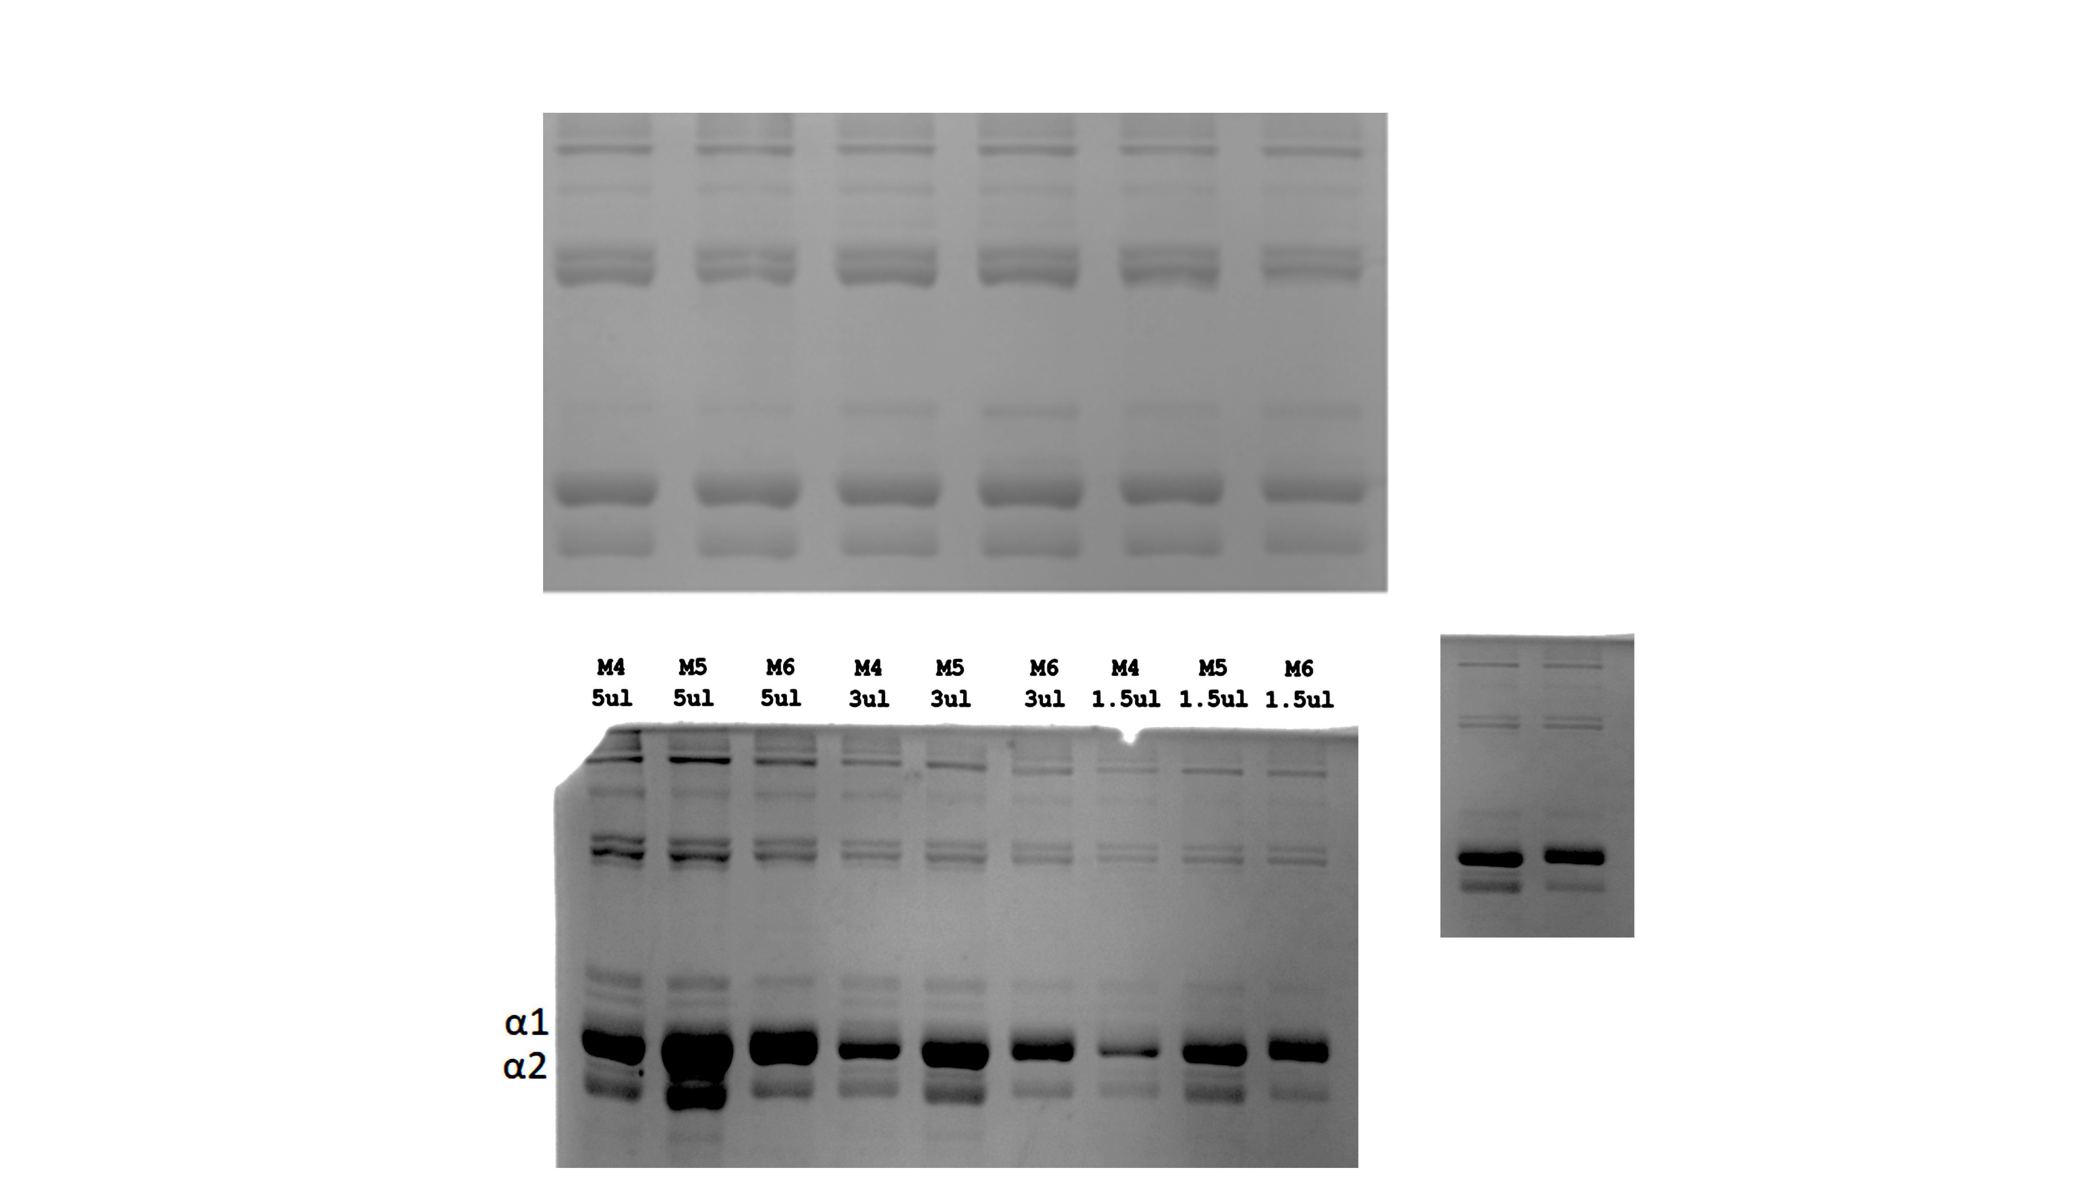
siRNA-LucF
B
siRNA-3554
A
α1(III)₃
β11(I)
β12(I)
α1(I)
α2(I)
C
MSCs
Collagen
Osteoclasts
Supplementary Figure 3: (A) Intramuscular biphasic calcium phosphate (BCP) implant loaded with murine EGFP-MSCs and injected with siRNAs just before sample collection. (B) Representative SDS-Urea-PAGE of pepsin digested collagen from BCP implants. The analyses revealed an increased α1/α2 ratio in samples injected with siRNA-3554, demonstrating its efficiency also at the protein level. (C) Histological analysis of intramuscular BCP implants injected with PBS extracted 28 days after transplantation. EGFP-MSCs are stained in brown following immunohistochemistry using anti-EGFP antibody. Masson’s Trichrome staining revealed collagen in green, as indicated by red asterisks. TRAP staining revealed the presence of osteoclasts (pink) in the implant. High magnification images are provided for all the panels in the inserts. Black scale bar = 100 μm, white scale bar = 30 μm.

Slide 4
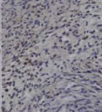
PBS siRNA-3554 siRNA-LucF
Anti-CD68
Supplementary Figure 4: Immunohistochemistry for the macrophage marker CD68 (brown signal) on sections obtained from BCP implants injected with PBS, siRNA-3554 or siRNA-LucF indicated that siRNAs did not affect the number of macrophages, marker of inflammation. Representative images are shown and magnified in the insert. Black scale bar = 100 μm, white scale bar = 35 μm.

