Slide 1
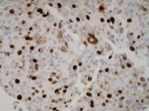
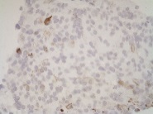
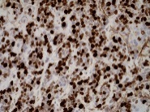
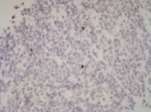
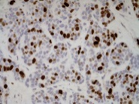
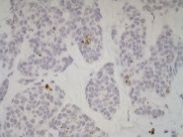
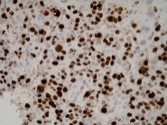
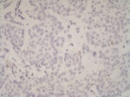
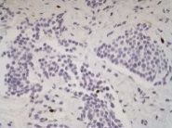
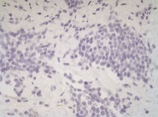
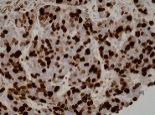
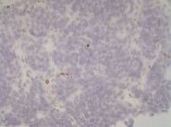
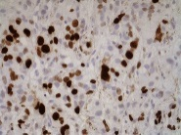
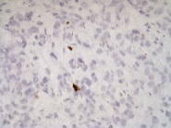
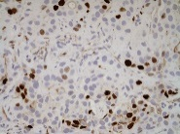
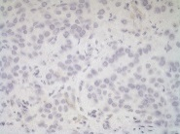
Supplemental Figure S1
A
Cleaved Caspase-3
Ki67
N.S.
N.S.
Mutation Key:
D538G
Y537C
Y537S
L536H
R555H
Y537D
WT
B
ER:
ER:
WT ER
Mutant ER
Ki67
CC-3
Ki67
CC-3
01-003
01-002
01-006
01-004
01-009
01-005
01-010
01-007
Supplemental Figure S1. A-B. Biopsies (N=16-18 ER WT, N=12 with ER mutation) were taken from patients with accessible metastatic breast cancer and stained for Ki67, and cleaved caspase-3 (CC-3). Depicted is the percent positive cells ± SEM as determined by a pathologist (A). Unpaired Student’s two-tailed t-test for Ki67 and Mann-Whitney test for CC-3. Representative images for four separate patients per group were taken at 400X (B).

Slide 2
Supplemental Figure S2
A
B
Pearson r = 0.4093; p < 0.0470
Pearson r = 0.4360; p < 0.0332
C
D
Pearson r = 0.2908; p = N.S.
Pearson r = 0.1308; p = N.S.
Supplemental Figure S2. A-D. Immunohistochemical analysis of hormone receptor status of metastatic breast cancer specimens in Figure1 were correlated for ER versus PR (A), ER versus AR (B), ER versus GR (C), and PR versus AR (D) using percent positive cells for each steroid hormone receptor (N=14 ER WT, N=10 with ER mutation), Pearson correlation (r); p-value represents significance of non-linear slope after simple linear regression.

Slide 3
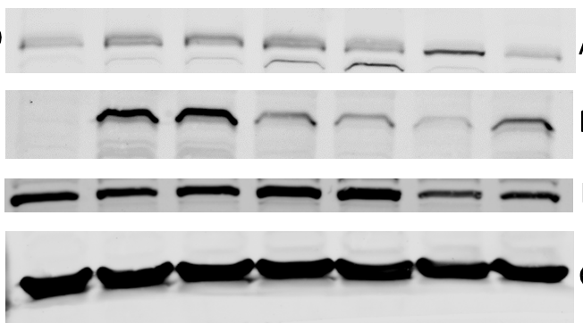
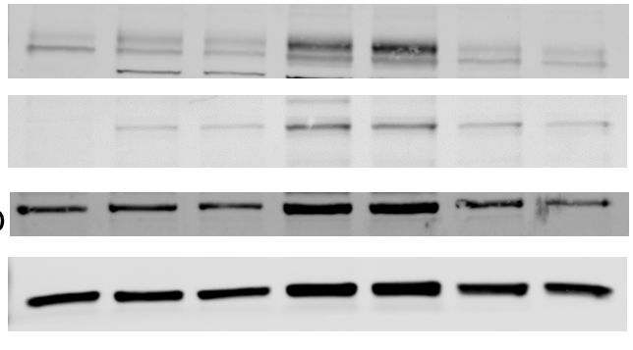
Supplemental Figure S3
A
MCF-7
MCF7
B
T47D
T-47D
MCF7
WT
Y537S
D538G
WT
Y537S
D538G
Par
#1
#2
#1
#2
#1
#2
Par
#1
#2
#1
#2
#1
#2
AR -
- 110 kDa
AR -
- 110 kDa
Flag-ER -
- 67 kDa
Flag-ER -
- 67 kDa
ER -
- 67 kDa
ER -
- 67 kDa
GAPDH -
- 37 kDa
GAPDH -
- 37 kDa
Supplemental Figure S3. MCF-7 and T-47D cells were created with CRISPR-Cas9 to stably express either flag-tagged wildtype or flag-tagged mutant estrogen receptor alpha. Individual clones of (A) MCF-7 and (B) T-47D cells were harvested in RIPA buffer and immunoblotting was performed to detect AR, Flag (ER), ER-alpha (ER), or GAPDH. Parental MCF-7 and T-47D cells that were not engineered to contain the flag-tag were used as a control.

Slide 4
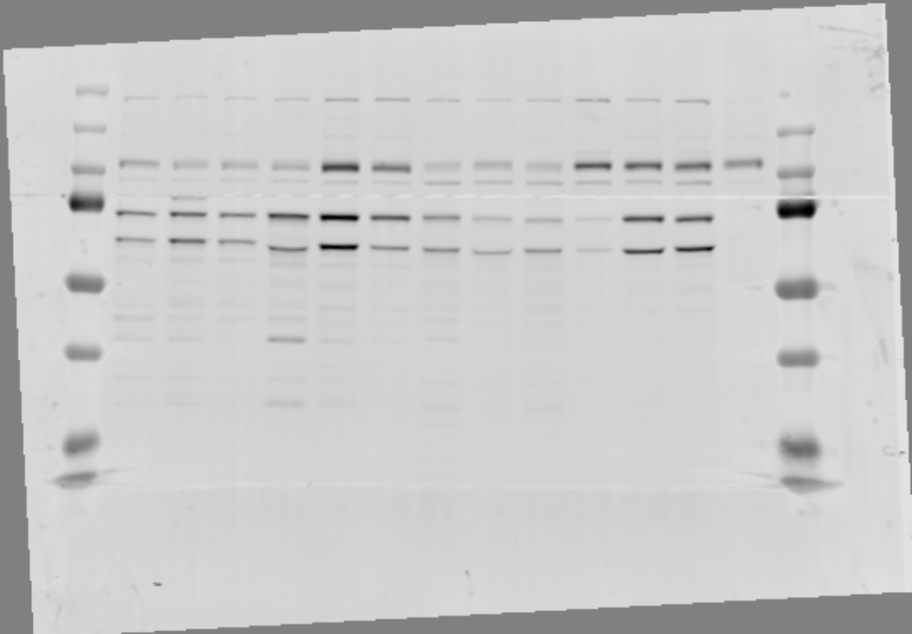
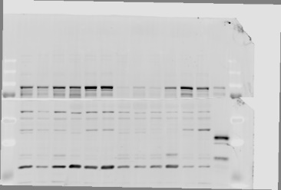

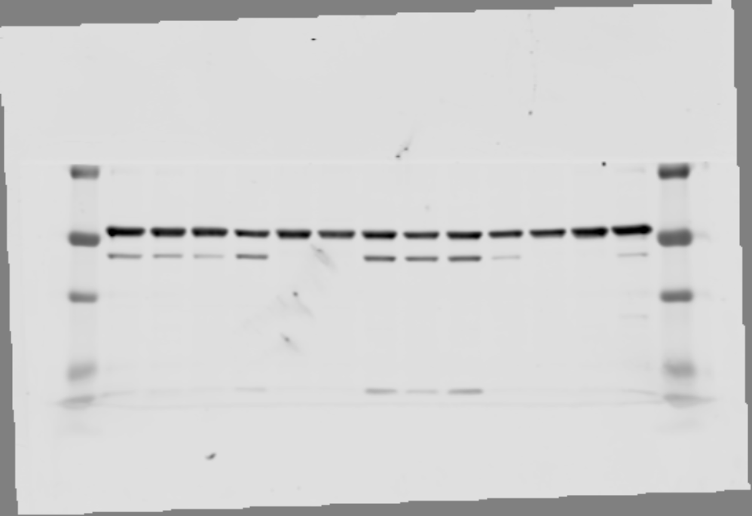
Supplemental Figure S4
T-47D
T-47D LTED
WT
D538G
Y537S
WT
D538G
Y537S
AR -
- 110 kDa
ER -
1.0
5.9
3.4
15.2
27.2
16.3
1.0
0.6
0.5
0.2
1.9
1.2
- 65 kDa
GR -
1.0
2.7
1.2
7.9
23.7
9.5
- 94 kDa
PR-B -
- 118 kDa
PR-A -
1.0
1.7
1.3
0.2
4.6
2.1
- 90 kDa
Tub. -
1.0
1.3
1.0
0.1
2.0
1.0
- 48 kDa
Supplemental Figure S4. AR, ER, GR and PR expression was determined by western blot analysis of WT, D538G, and Y537S T-47D cells grown in normal growth media (left) or after long-term estrogen deprivation (LTED, right).

Slide 5
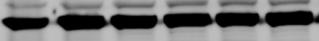
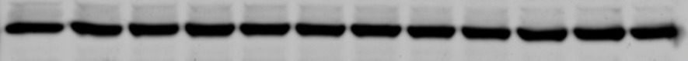
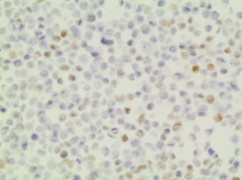
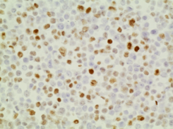
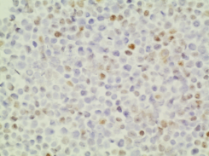
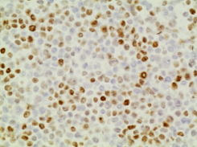
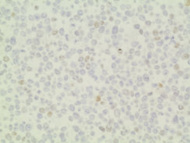
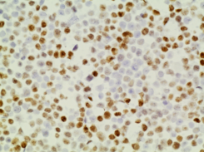
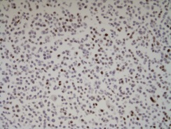
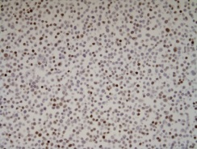
Supplemental Figure S5
A
24 hrs
48 hrs
72 hrs
Susp.: - - - + + + - - - + + + - - - + + +
AR -
- 110 kDa
ERα -
- 65 kDa
GR -
- 85 kDa
Tub. -
- 48 kDa
24 hrs
48 hrs
72 hrs
Susp.: - - + + - - + + - - + +
PR-B -
- 110 kDa
PR-A -
Tub. -
- 48 kDa
B
24 hrs
48 hrs
72 hrs
Att.
Susp.
Att.
Susp.
Att.
Susp.
AR
ER
PR
200X
Supplemental Figure S5. A-B. MCF-7 cells were grown in full serum under adherent culture conditions (-) or forced anchorage-independent conditions (on poly-HEMA coated plates, Susp or +) for 24, 48, or 72 hours (N=2-3) and whole cell lysates probed by western blot for A. AR, ER, GR, and alpha-tubulin (top) and PRA/B (bottom). B. MCF-7 were grown under the same culture conditions (Att = attached, Susp = suspension) then pelleted and IHC performed for AR, ER, and PR on FFPE sections. Representative images are shown at 200x. C. Immunoblot showing AR and ER protein expression levels in MCF-7 and T-47D genome-edited ESR1 mutant cells generated by the Oesterreich lab after growth for 48 hours in 2D (attached) or 3D (Ultra-Low Attachment plates) conditions. Cells were hormone deprived for 3 days prior to seeding.

Slide 6
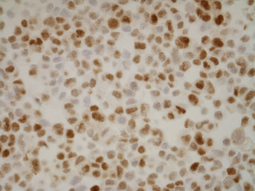
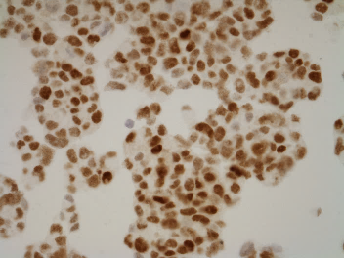
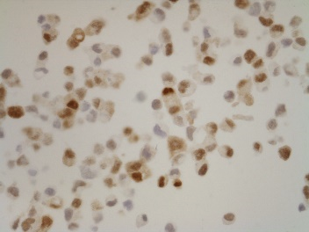
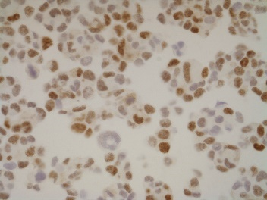
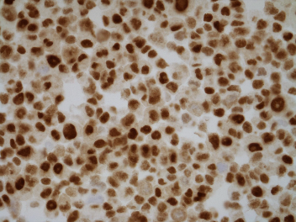
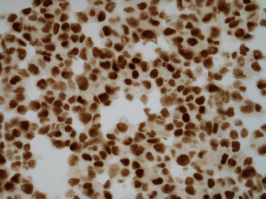
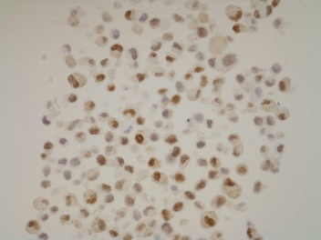
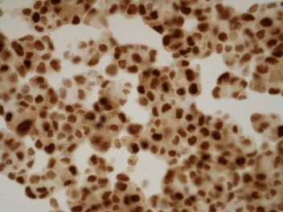
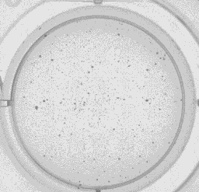
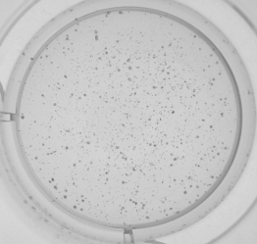
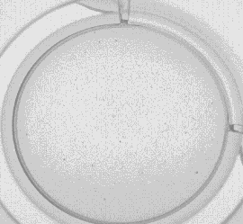
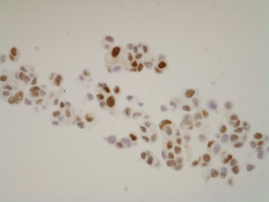
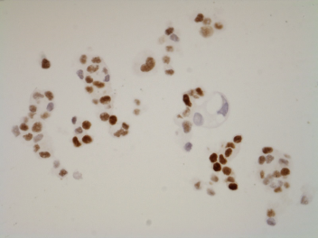
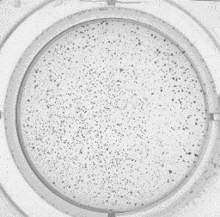
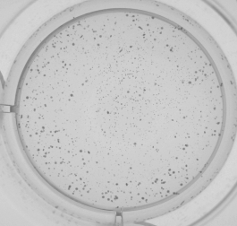
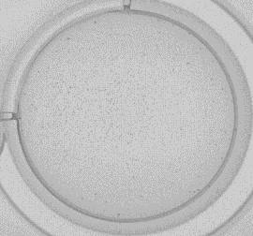
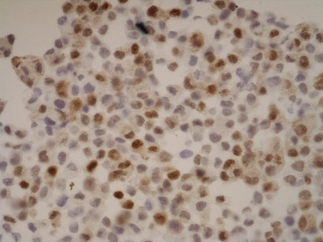
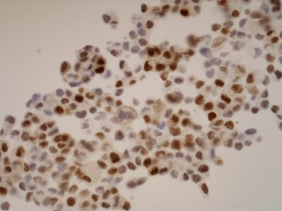
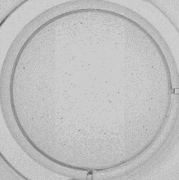


Supplemental Figure S6
A
T-47D
B
Att. 24 hrs
Susp. 24 hrs
Vehicle
WT
Sevi
Vehicle
D538G
C
T-47D
Sevi
Vehicle
Enza 20μM
Sevi 20μM
WT
Vehicle
D538G
Y537S
Sevi
Y537S
AR, 400X
Supplemental Figure S6. A-B. WT, D538G, and Y537S T-47D cells were grown in normal media under attached (Att.) or on poly-HEMA plates (Susp.) and treated without or with 20μM Sevi for 24 hours. Cells were pelleted, formalin-fixed and paraffin-embedded prior to IHC for AR. Representative images for AR expression are shown in A and quantitation with ImageScope software for percent positive nuclei for staining intensities of 0-3+ is shown in B. C. WT, D538G, and Y537S T-47D cells were plated/well in 0.3% agar and treated with 20μM Sevi, 20μM Enza or EtOH control. Cells were allowed to grow for three weeks with bi-weekly media and drug changes. Representative images of anchorage-independent growth (top). Mean colony number was quantified using Image J software (bottom), N=3, One way ANOVA with Tukey’s multiple comparison test is depicted. Two way ANOVA, interaction between cell line and treatment p > 0.0001.

Slide 7





Supplemental Figure S7
MCF-7
T-47D
WT
Y537S
D538G
WT
Y537S
D538G
2D 3D 2D 3D 2D 3D
2D 3D 2D 3D 2D 3D
AR -
ER -
1.0
0.5
1.1
1.9
1.3
1.7
1.0
0.6
0.9
0.9
0.9
0.8
Tub. -
1.0
1.1
0.5
0.5
0.7
0.7
1.0
1.0
0.6
0.6
1.2
1.3
Supplemental Figure S7. Immunoblot showing AR and ER protein expression levels in MCF-7 and T-47D genome-edited ESR1 mutant cells generated by the Oesterreich lab after growth for 48 hours in 2D (attached) or 3D (Ultra-Low Attachment plates) conditions. Cells were hormone deprived for 3 days prior to seeding.

Slide 8
Supplemental Figure S8
A
B
C
D
E
F
Supplemental Figure S8. A-F. The expression of CHI3L1 in MCF-7s (A) and T-47Ds (B), IFITM3 in MCF-7 (C) T-47Ds (D), and IFITM1 in MCF-7s (E) and T-47Ds (F) is shown as normalized RNA-seq counts in ER mutant lines generated by three laboratories (N=2/group). Mean ± SEM.

Slide 9
Supplemental Figure S9
A
B
C
Supplemental Figure S9. A. Mutation co-occurrence depicted as an oncoprint mutual exclusivity analysis generated using cBioPortal shows data from the Archer VariantPlex Solid Tumor Assay performed from FFPE sections of core needle biopsies of breast cancer metastases shown in Figures 1 and 7. B-C. Mutation co-occurrence depicted as an oncoprint and mutual exclusivity analysis generated using cBioPortal and data from the 2016 INSERM database (B) and the 2020 metastatic breast cancer project database (C). Mutual exclusivity analysis for A: Mutual exclusivity: ESR1 and TP53 p<0.0001; Co-occurrence: ESR1 and PIK3CA p=0.036; Trend towards mutual exclusivity: TP53 and PIK3CA p=0.103. Mutual exclusivity analysis B: Mutual exclusivity: ESR1 and TP53 p=0.047; Trend towards mutual exclusivity: TP53 and PIK3CA p=0.18; Trend towards co-occurrence: ESR1 and PIK3CA p=0.199.

Slide 10
Supplemental Figure S10
A
N.S.
N.S.
p=0.01
N.S.
N.S.
TP53
TP53
TP53
TP53
TP53
B
P=0.03
N.S.
p=0.002
N.S.
N.S.
PIK3CA
PIK3CA
PIK3CA
PIK3CA
PIK3CA
Supplemental Figure S10. A-B. Quantification of tumor infiltrating immune cells in the same biopsies characterized in Figure 1 and 7 stratified based on A. TP53 mutations (N=12 WT, N=12 mutant) or C. PIK3CA mutations (N=17 WT, N=7 mutation) status. Mean percent positive cells ± SEM is shown with a Mann-Whitney test.

Slide 11


Supplemental Figure S11
Tissue Segmentation:
Tumor
coIF Key:
CD68
PD-L1
Stroma
Stroma
Tumor
PD-L1+CD68+
intra-tumoral stroma
PD-L1+CD68+ tumor
N.S.
p=0.004
Mutation Key:
D538G
Y537C
Y537S
L536H
R555H
Y537D
WT
*
ER:
ER:
Supplemental Figure S11. Biopsies from patients with metastatic breast cancer (n=14 ER WT, n=11 ER mutation) were stained for PD-L1 and CD68 using Opal™ TSA technology (Akoya Biosciences). Slides were scanned using a Vectra 3 Automated Quantitative Pathology Imaging System (Perkin Elmer), and up to 5 representative fields/tumor were analyzed. Percent positivity of PD-L1+CD68+ cells was stratified using tissue segmentation for areas with predominantly tumor (red in segmentation example) or predominantly intra-tumoral stroma (green in segmentation example). Mean ± SEM, Mann-Whitney test.

