Slide 1
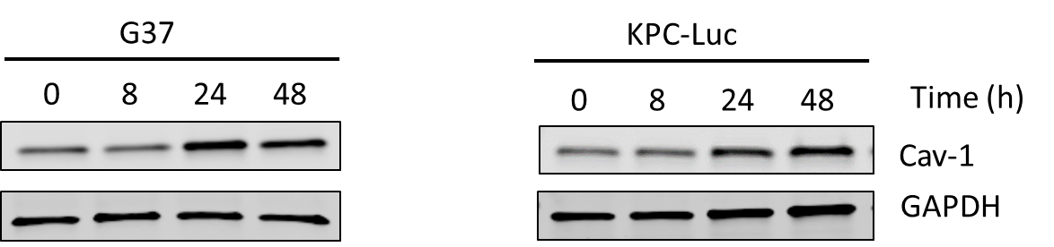
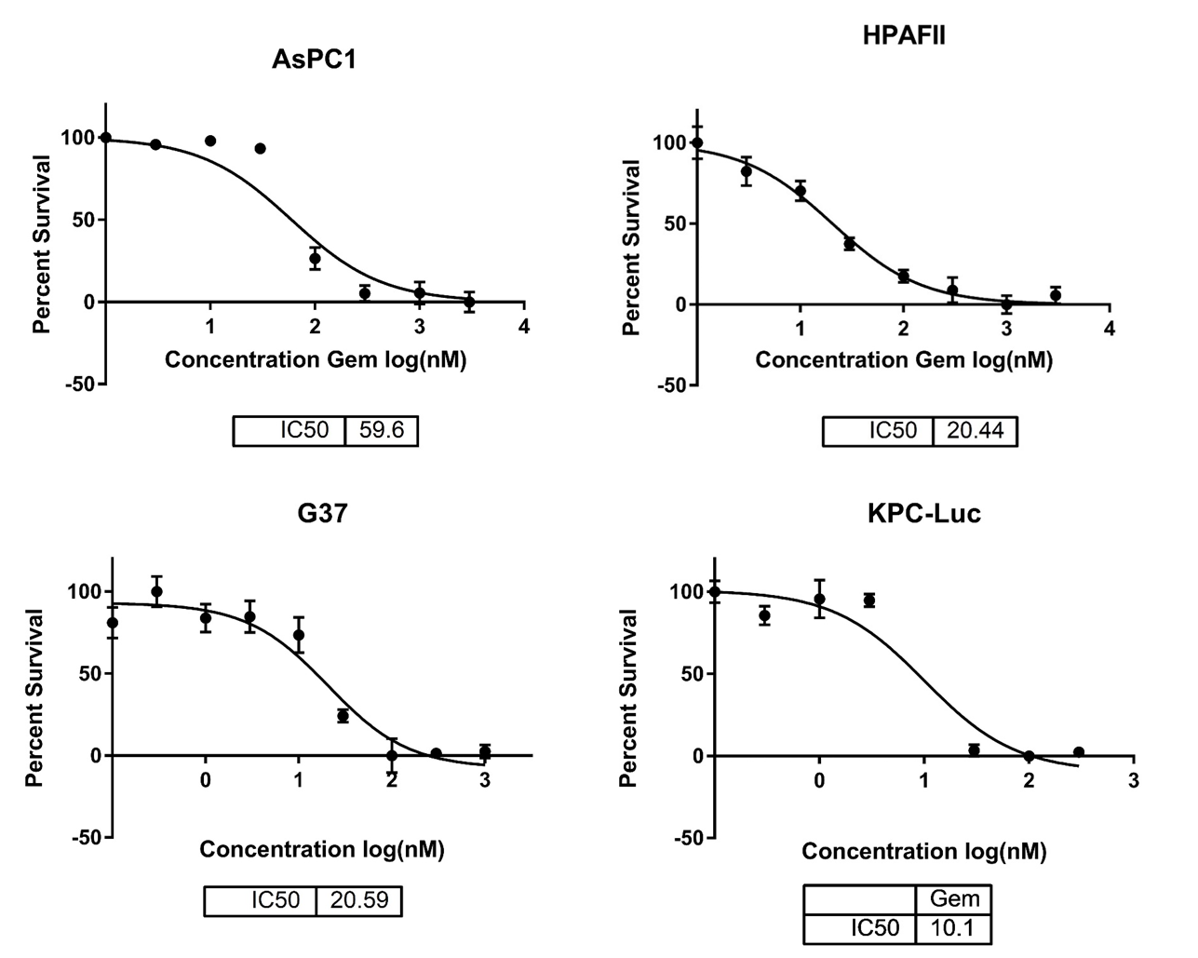
Supplementary Figure 1.
A) KPC-Luc and G37 cells were treated with gemcitabine (50 nM) for 8, 24, 48 hours and Cav-1 expression was measured by western blot. B) Gemcitabine IC50 curves for cell lines AsPC-1, HPAFII, KPC-Luc and G37.
A
Gemcitabine IC50s
B

Slide 2
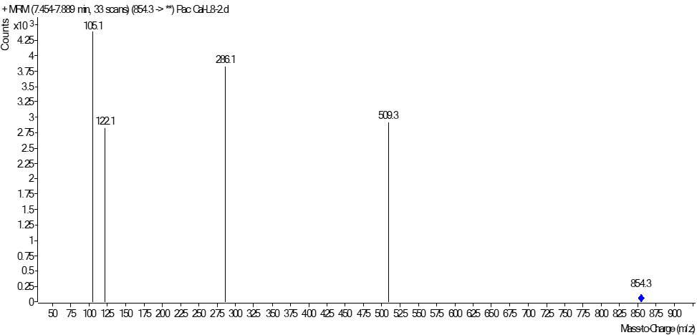
Supplementary Figure 2.
Mass spectrometry peak plot for determination of paclitaxel intracellular concentration.

Slide 3
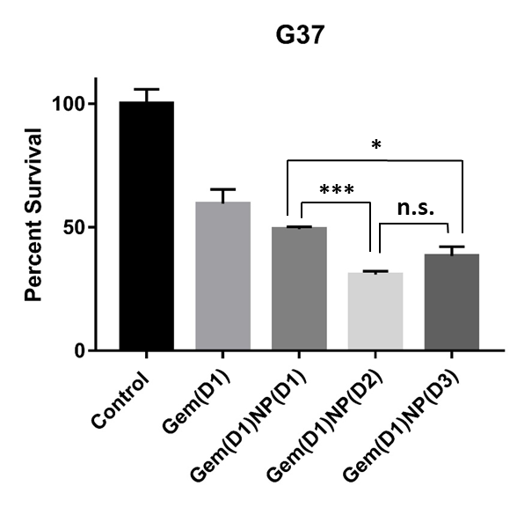
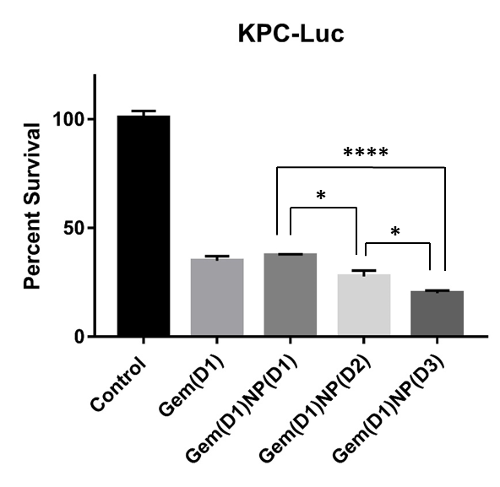
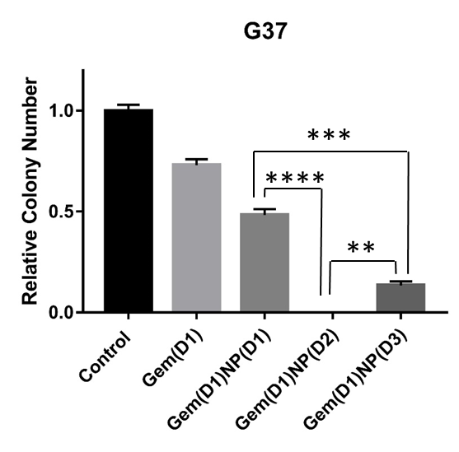
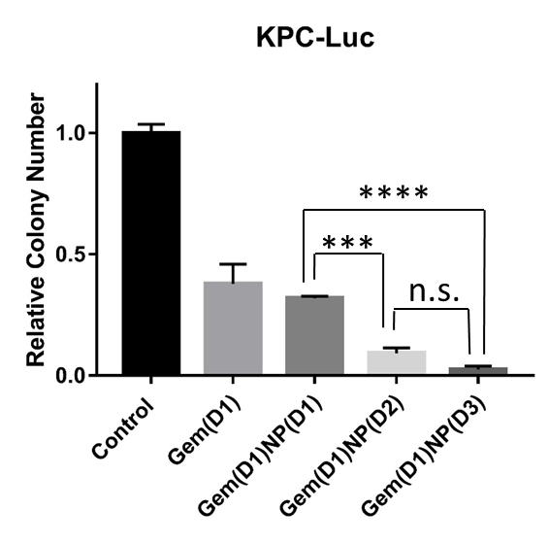
Supplementary Figure 3.
A-B: G37 and KPC-Luc cells were treated with vehicle control or gemcitabine (Gem, 50 nM) for a total of 24 hours with either NP (1 nM) delivered on same day [Gem(D1)NP(D1)], NP added on day 2 [Gem(D1)NP(D2)], or NP treated on day 3 with a 24 hour gap of no treatments [Gem(D1)NP(D3)]. NP and gemcitabine were removed after 24 hours of treatment for each condition. Following 72 hours from the start of treatments, proliferation was measured by alamarBlue assay. C-D: Colony forming assays normalized to the control treatment (vehicle) are shown for C) G37 and D) KPC-Luc cells for the different treatment schedules. *p < 0.05, **p < 0.01, ***p < 0.001, ****p<0.0001.
A
AlamarBlue
B
AlamarBlue
C
Colony Formation
D
Colony Formation

Slide 4
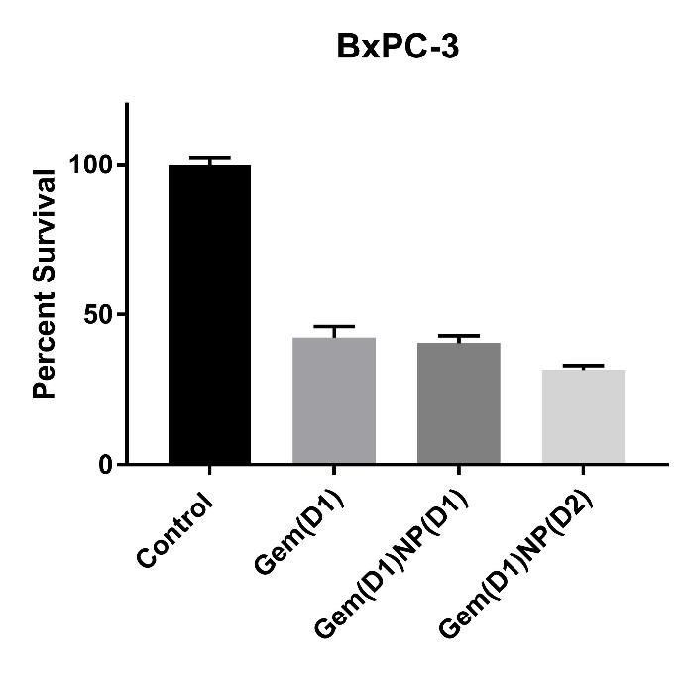
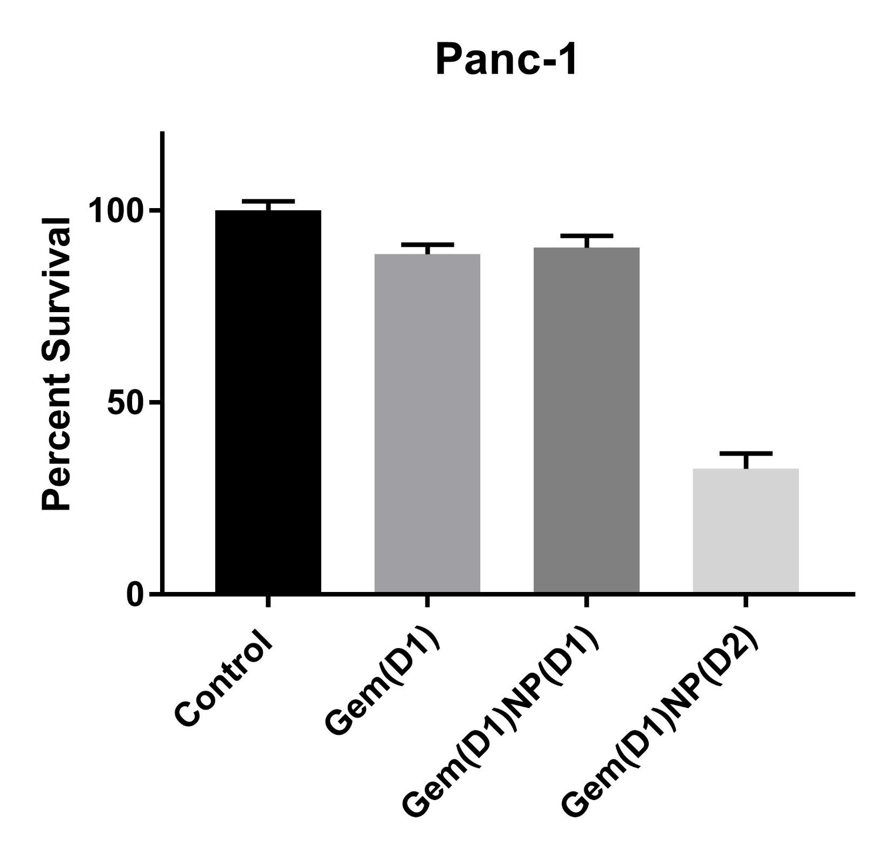
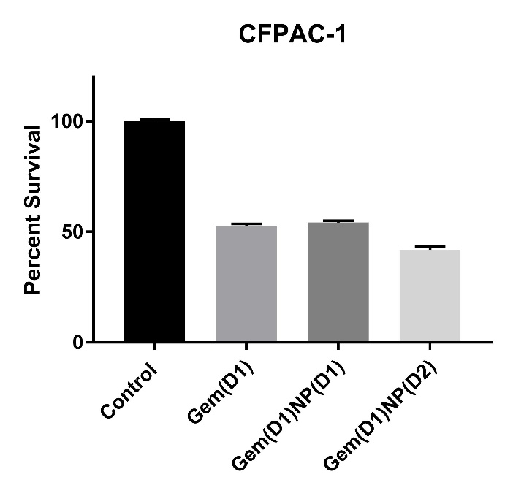
Supplementary Figure 3 (Cont). E-G: AlamarBlue assays for Cav-1 expressing PDAC cell lines with higher Cav-1 expression
E
F
G
***

Slide 5
Supplementary Figure 4.
FHs 74 Int cells (immortalized small intestinal cell line) were treated with different gemcitabine and NP scheduling regimens and proliferation measured by IncuCyte analysis.

Slide 6
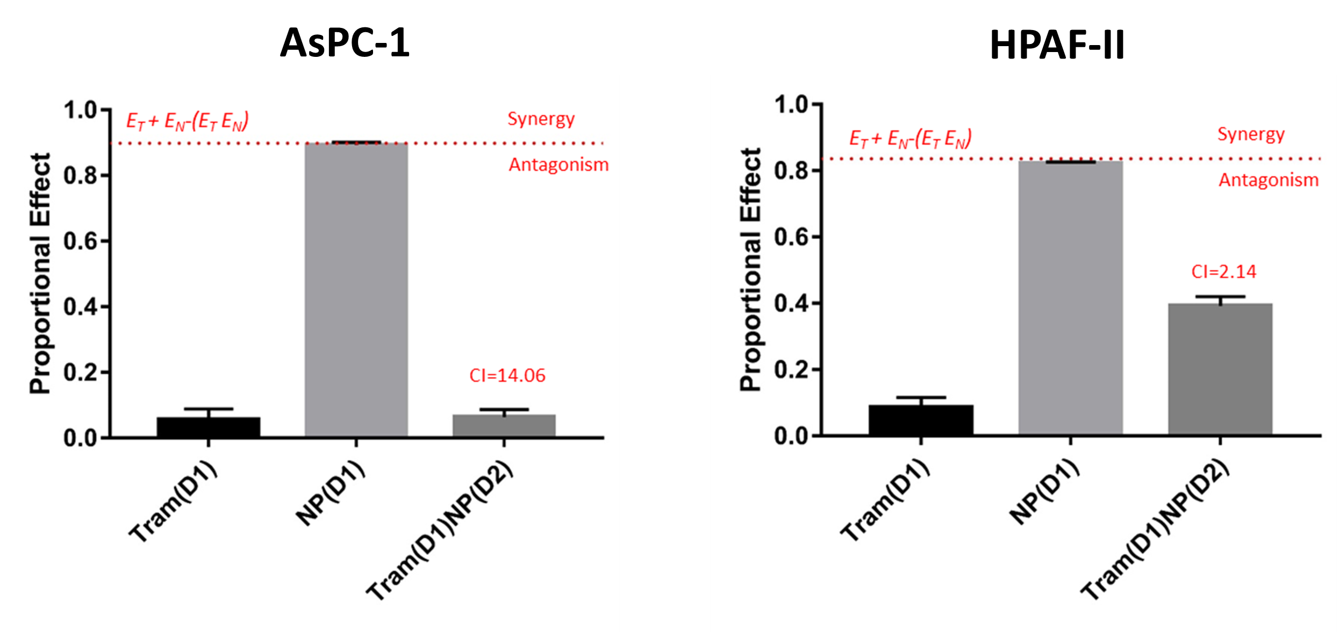
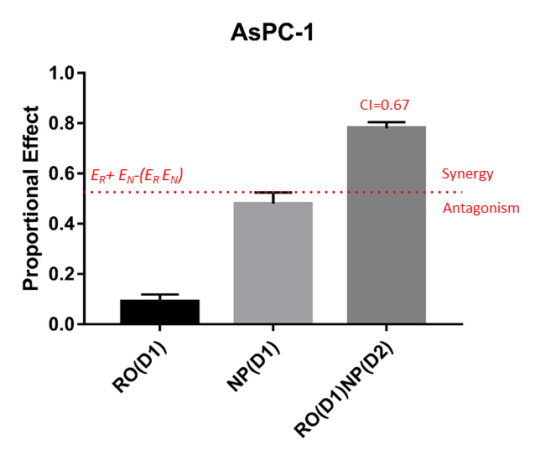
Supplementary Figure 5.
Bliss Independence with observed additivity, synergy and antagonism of drug combinations of A) trametinib and NP in AsPC-1 and HPAF-II cells or B) RO-3306 and NP in AsPC-1 cells with combination index (CI) scores.
A
B

Slide 7
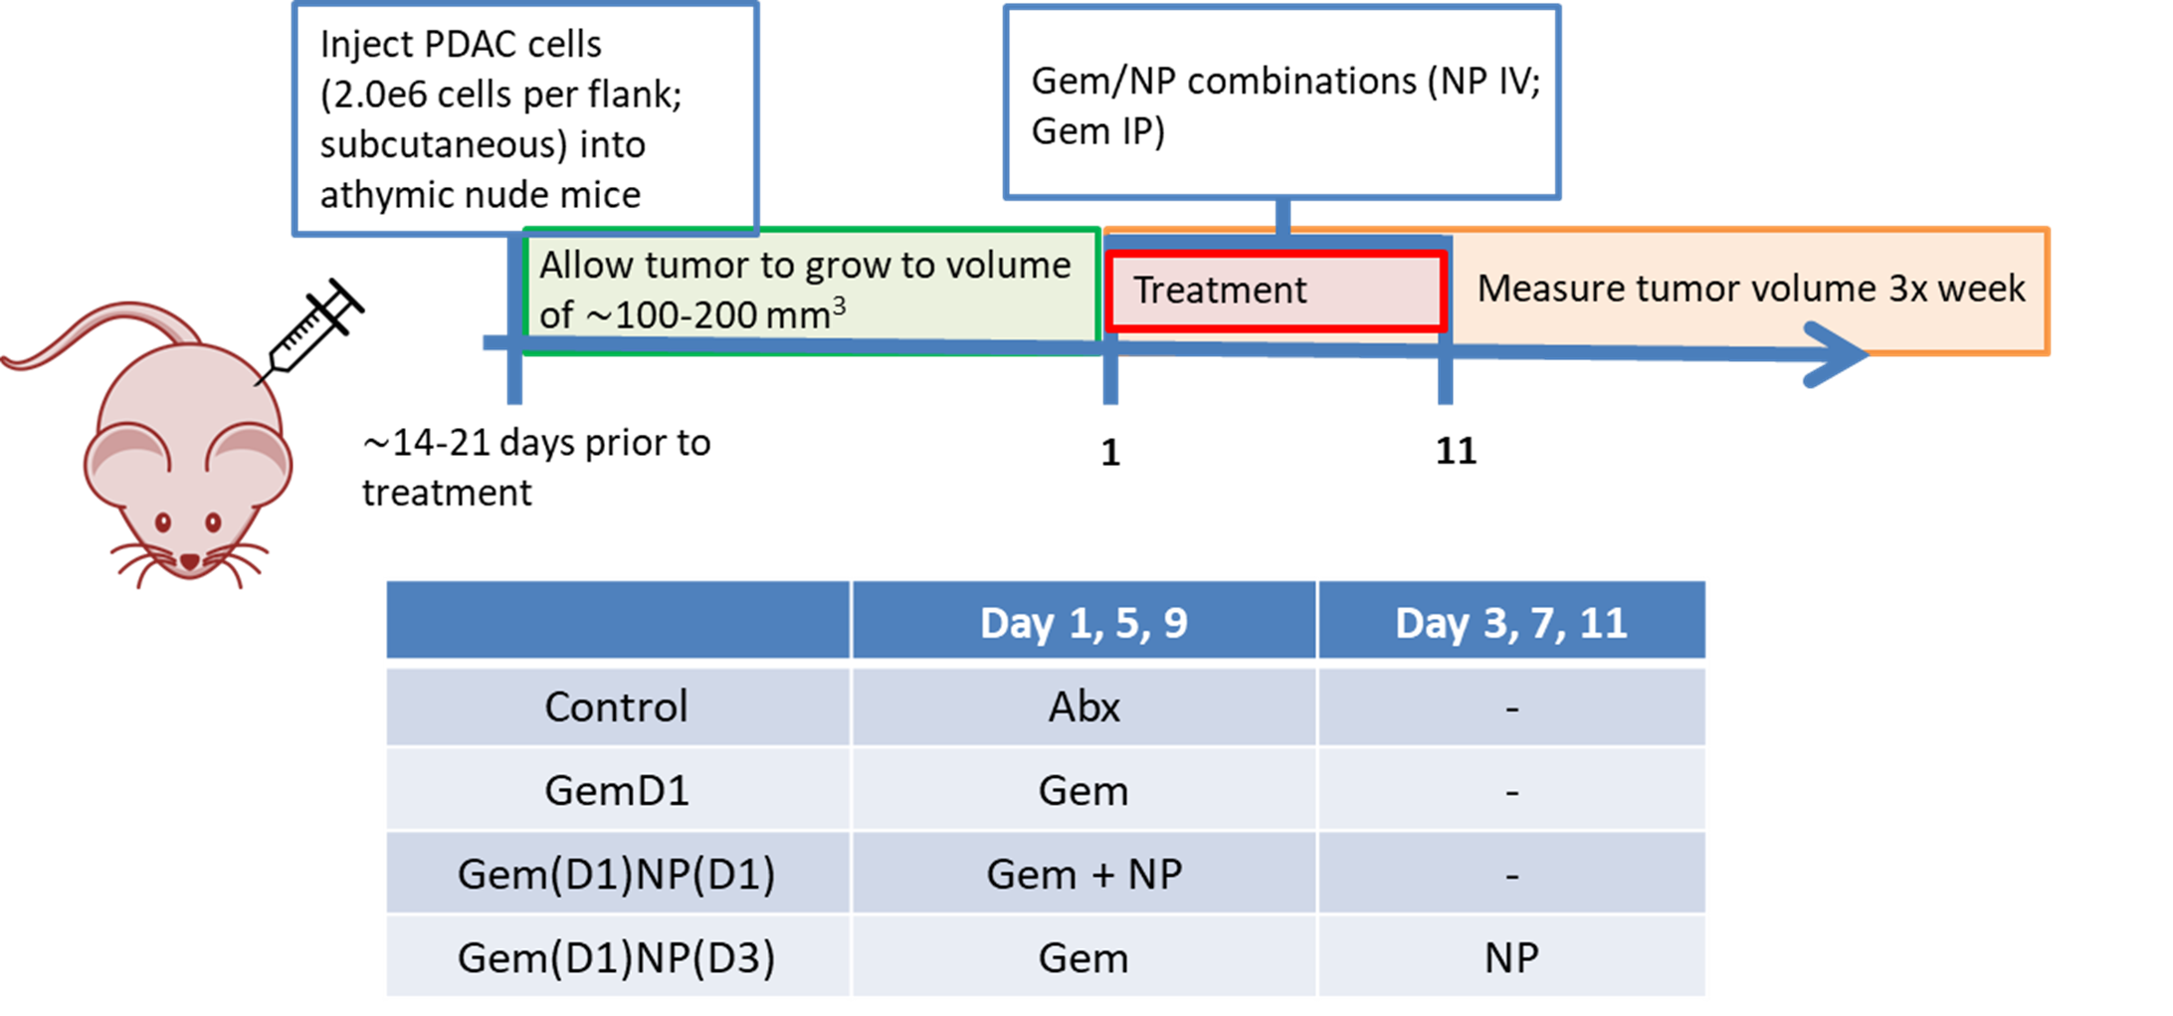
Supplementary Figure 6.
Tumor xenografts were formed by subcutaneously injecting 2.0 x 10⁶ AsPC-1, HPAF-II, and 1.0 x 10⁶ G37 cells into the flanks of athymic nude mice. Once tumors reached the initial starting volume (100-200 mm³), mice were randomized to the 4 groups shown, with gemcitabine intraperitoneally (50 mg/kg) always dosed on days 1,5,9 and NP intravenously (20 mg/kg) dosed on days 1,5,9 or 3,7,11.

Slide 8
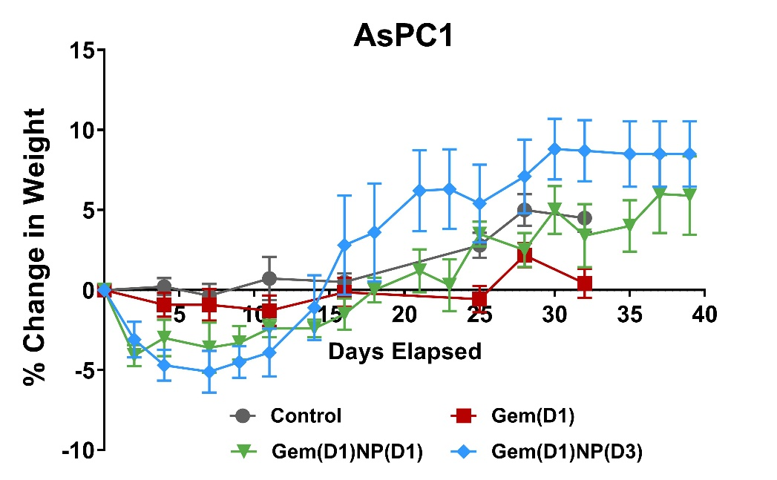
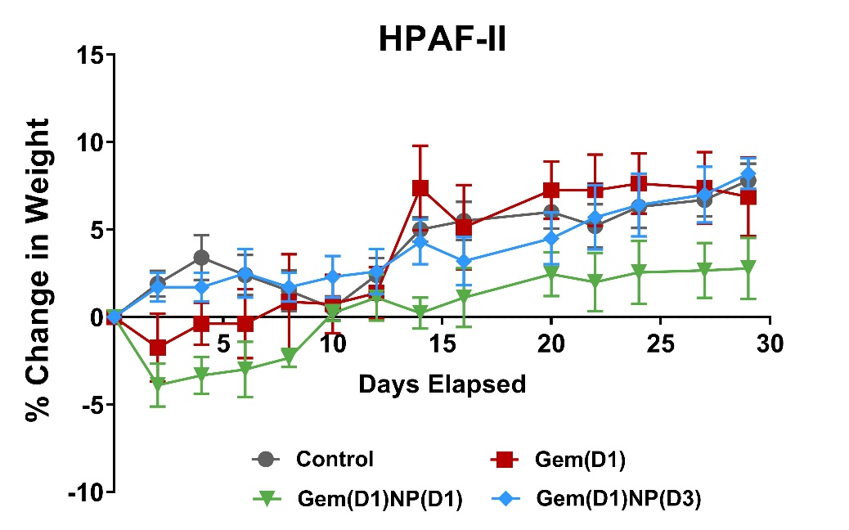
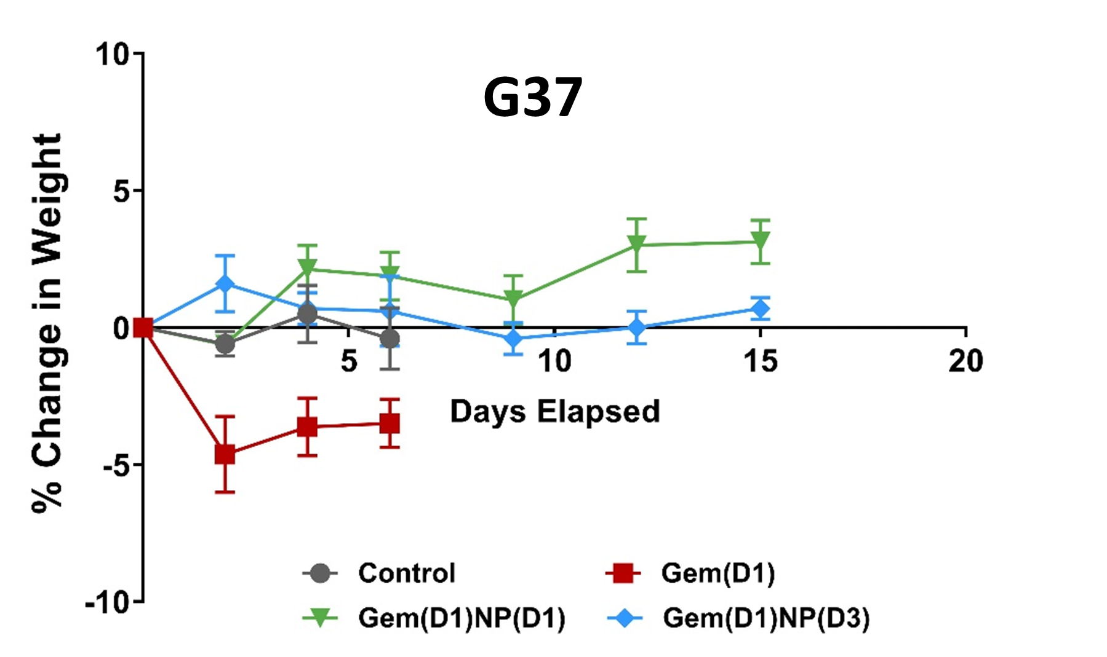
Supplementary Figure 7.
Mouse body weights measured during in-vivo flank model experiments displayed as change in percentage over course of the study. No substantial increased toxicity was observed with altered Gem(D1)NP(D3) scheduling compared to other dosing regimens.

