Slide 1
Suppl Figure 1: Consort diagram
NGS
913 pts between March 15-Oct 19 that passed QC (diagnostic = 627; CRPC = 286).
CDK 12 cohort
43 pts with identified alterations in CDK12 (31 Biallelic; 11 Monoallelic; 1 considered as predominant MMR and excluded, tot n=42).
Clinical data available
180 pts (144 Controls, 28 Biallelic, 8 Monoallelic)
EXOME
211 pts (diagnostic=93; CRPC=118)
TIL studies conducted on the available samples
CD3: 122 Controls, 17 Biallelic, 7 Monoallelic pts;
Multicolor IF: 35 Controls, 13 Biallelic and 4 Monoallelic pts.
Notes:
Consort diagram. Depiction of assays performed on two different cohorts of sample patients. NGS=next generation sequencing, CN=copy number, TIL= tumor lymphocyte infiltrate

Slide 2
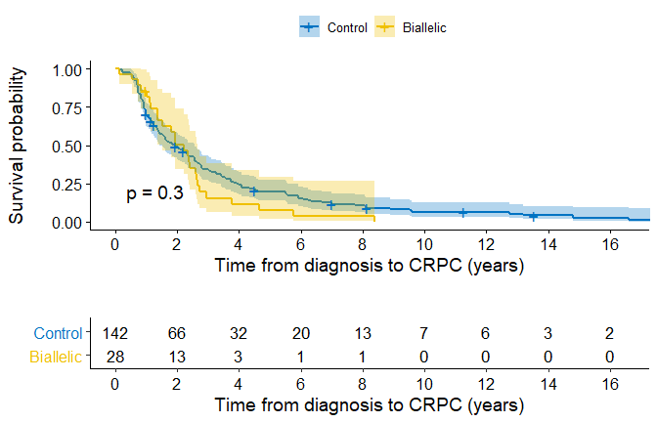
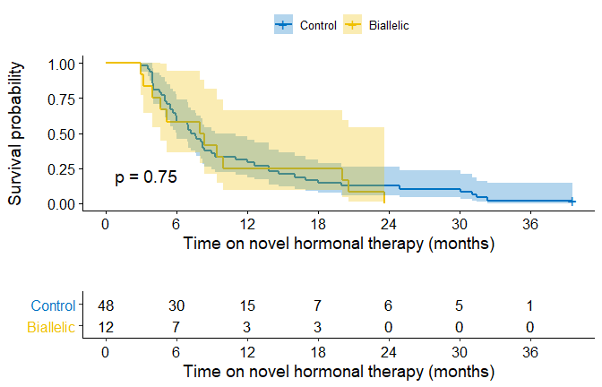
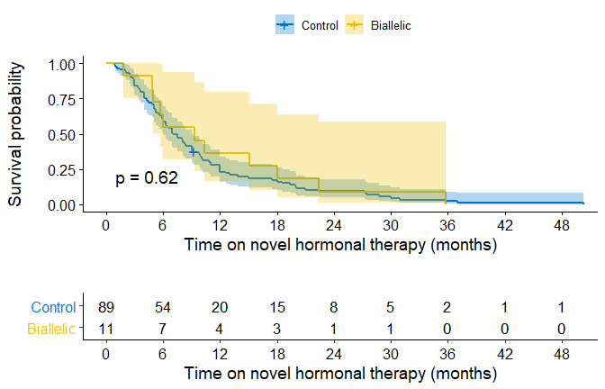
Suppl Figure 2: Kaplan-Meier survival curves
A
B
C
Notes:
Suppl. Figure 2A: Kaplan-Meier survival curves from diagnosis to castration resistant prostate cancer (CRPC) date. CDK12 biallelic mutant cases in yellow, control in blue.

Slide 3
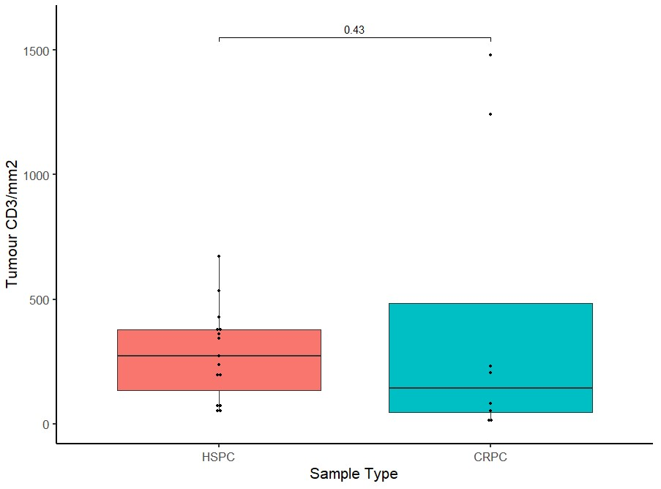
Suppl Figure 3: CD3+ density in diagnostic (HSPC) vs CRPC samples for CDK12 cases
Tumor CD3⁺/mm²
Notes:
Suppl Figure 3

Slide 4
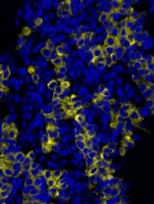
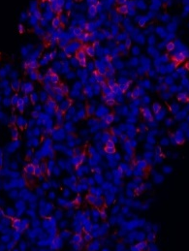
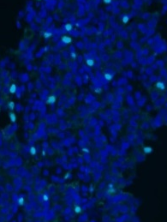
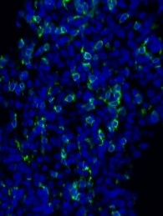
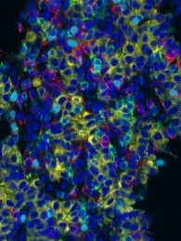
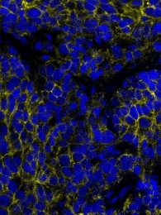
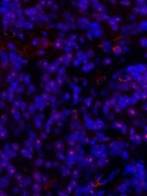
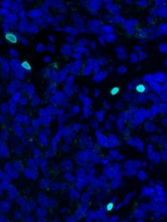
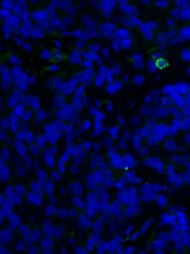
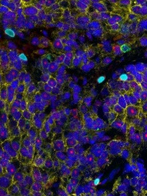
Suppl Figure 4
PanCK
CD4
FOXP3
CD8
Merge
Pat.18B LN
Bi-allelic
Pat.12B Arch
Pat.1M Arch
Mono-allelic
Pat.2M Arch
Control
Pat.1C LN
Notes:
Suppl Figure 4. Multi-spectral, multi-color Immunofluorescence for T-cells infiltration in CDK12 biallelic, monoallelic and control group biopsy samples.

