Slide 1
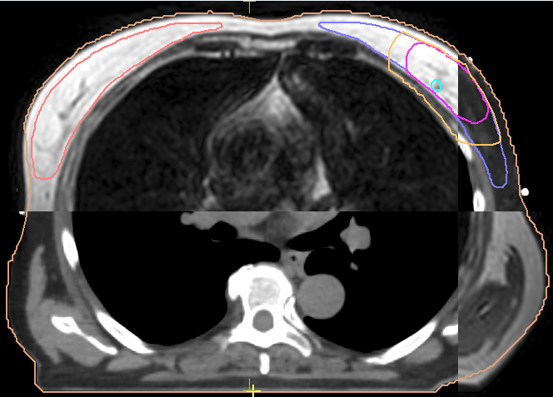
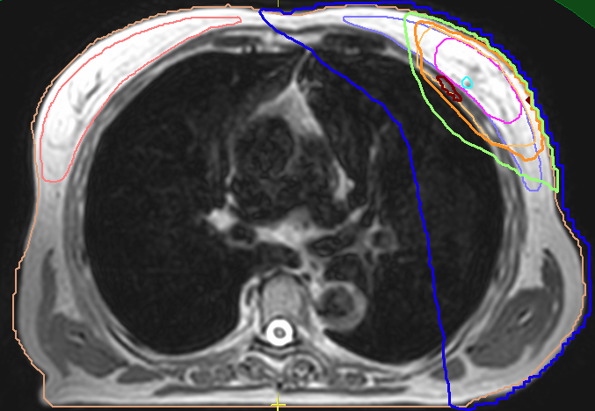
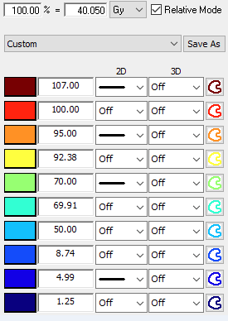
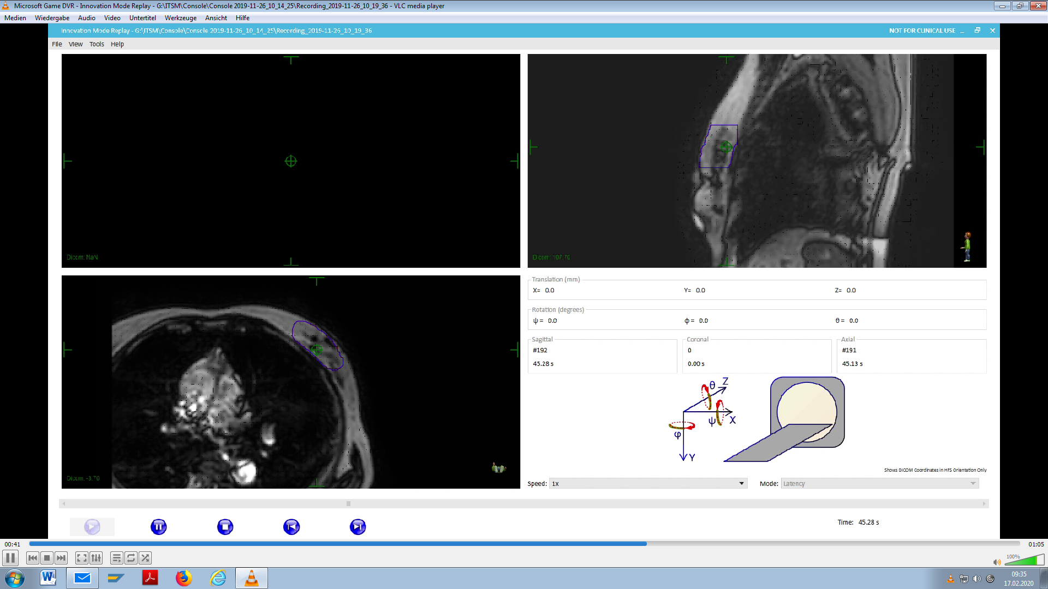
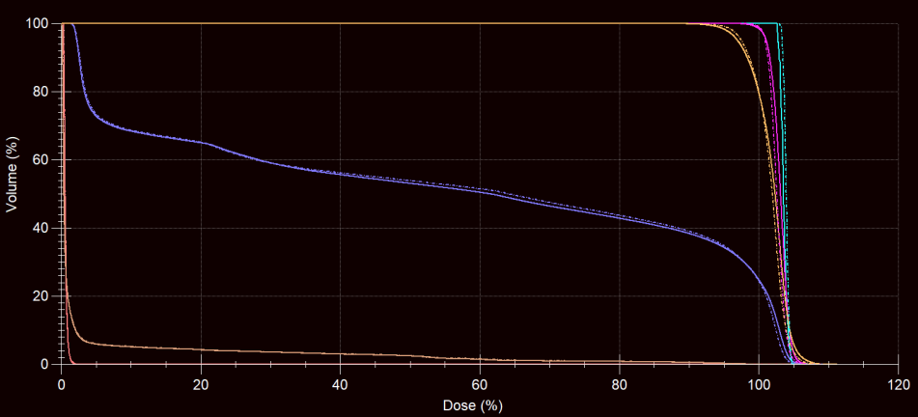
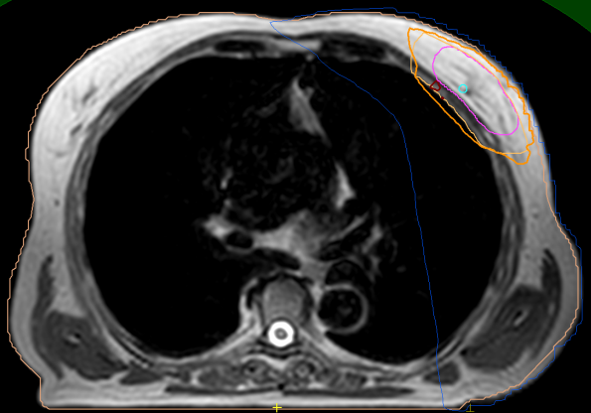
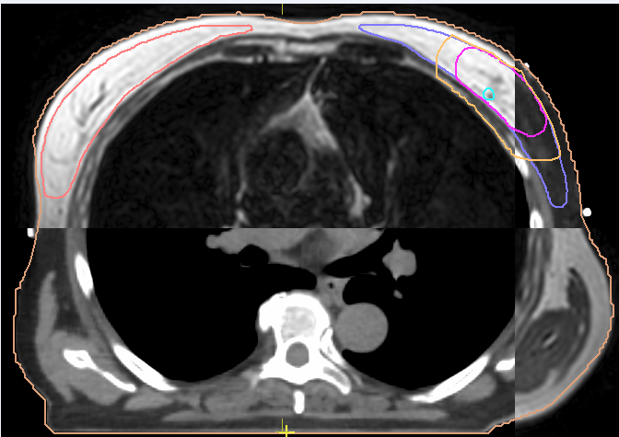
Matching planning CT and MR
Daily treatment plan adaptation
Motion monitoring
A
C
D
post-treatment MR imaging
Matching planning CT and MR of the day
E
B
Supplementary figure 1

Slide 2
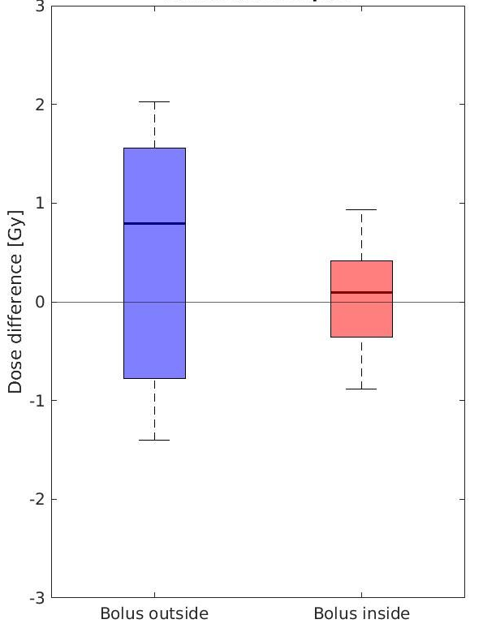
Supplementary figure 2

Slide 3
3.1
Supplementary figure 3

Slide 4
A
B
Total items | 143 | 130 | 117 | 142
0-1 | 126 | 118 | 107 | 132
2 | 11 | 7 | 3 | 7
3-4 | 6 | 5 | 7 | 3
Supplementary figure 4

