Slide 1
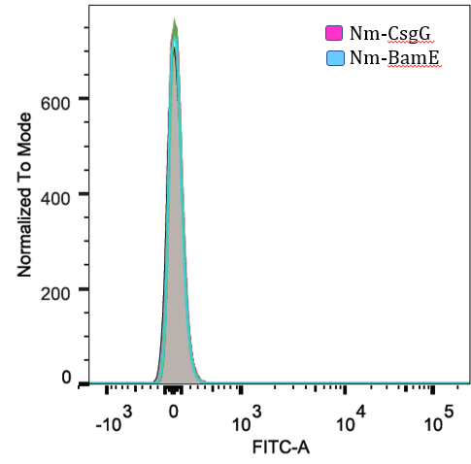
FACS using anti-NmBamE polyclonal antibodies
25°C, BL21DE3 (InaK-NmBamE)
25°C, T7 expressIq (InaK-NmBamE)
A
B

