Slide 1
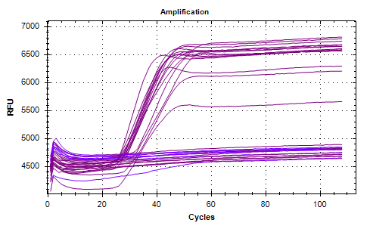
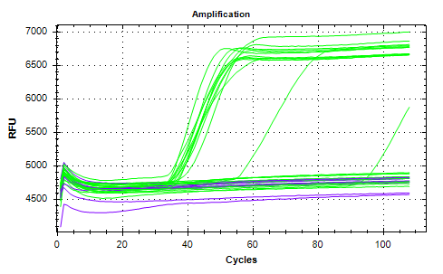
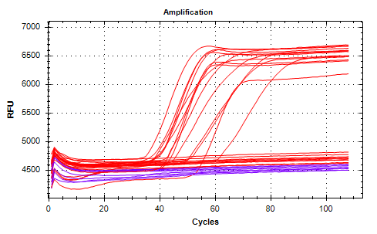
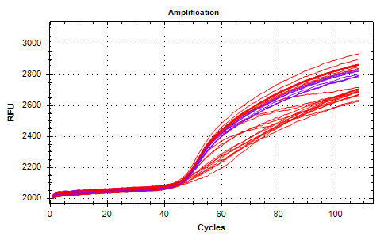
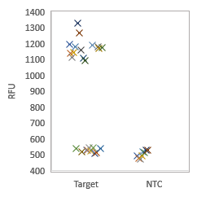
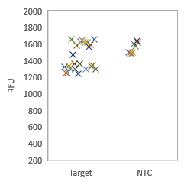
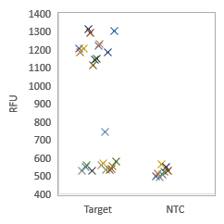
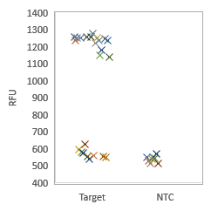
Supplementary Figure1
IAV
IAV+E1
IAV+E1+IBV
ActB signal (ROX) in IAV+E1+IBV
A
B
C
D
Positives
Positives
Positives
NTC
NTC
NTC
733.7
764.7
720.7
390
E
Primer sets | Positive by Real time data | Av. Cq (min) | Std dev | NTC | Positive by NEO2 scan | NTC
IAV | 15/24 | 13.2 | 0.9 | 0/8 | 15/24 | 0/8
IAV+E1 | 12/24 | 17.6 | 2.7 | 0/8 | 12/24 | 0/8
IAV+E1+IBV | 14/24 | 20.3 | 3.1 | 0/8 | 14/24 | 0/8

Slide 2
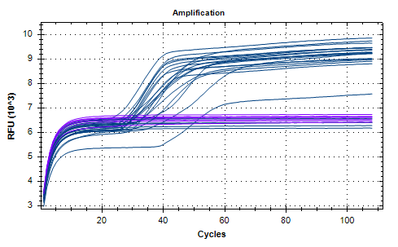
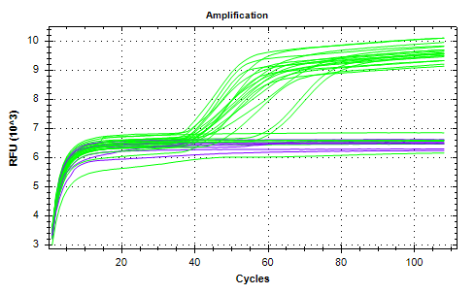
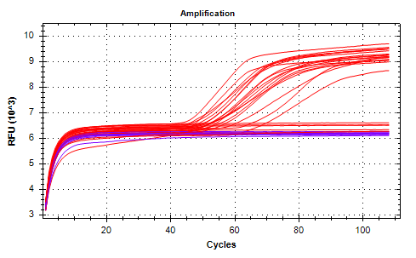
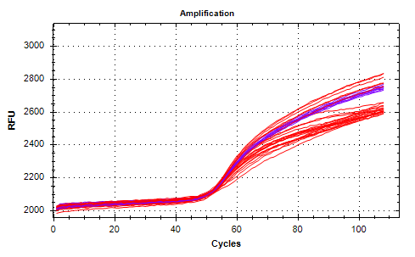
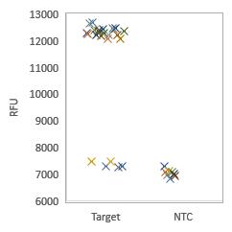
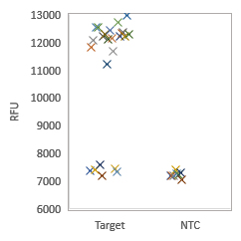
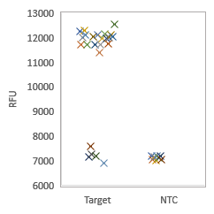
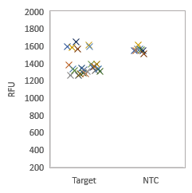
Supplementary Figure 2
A
B
C
D
IBV
IBV+E1
IBV+E1+IAV
ActB signal (ROX) in IBV+E1+IAV
Positives
Positives
Positives
NTC
NTC
NTC
8382.2
8241.3
7852.1
390
E
Primer sets | Positive by Real time data | Av. Cq (min) | Std dev | NTC | Positive by NEO2 scan | NTC
IBV | 19/24 | 7.2 | 3.5 | 0/8 | 15/24 | 0/8
IBV+E1 | 19/24 | 13.2 | 4.7 | 0/8 | 12/24 | 0/8
IBV+E1+IAV | 18/24 | 19.9 | 2.3 | 0/8 | 14/24 | 0/8

