Slide 1
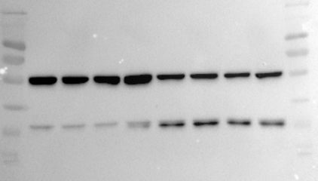
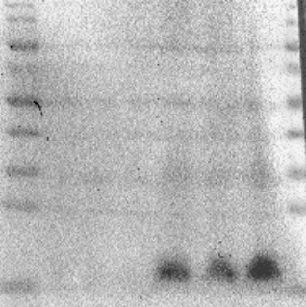
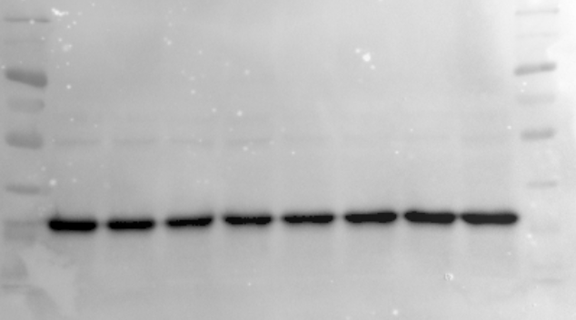
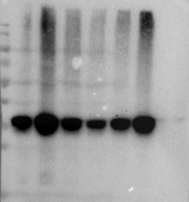
Figure 1a
Control
Cisplatin
Figure 1c
Control
Cisplatin
kDa
kDa
180
180
130
130
100
100
70
70
55
GSDME-FL
55
40
35
40
25
GSDME-N
35
cleaved caspase-3
15
Control
Cisplatin
Control
Cisplatin
kDa
180
kDa
130
180
130
100
100
70
70
55
55
40
40
GAPDH
35
GAPDH
35

Slide 2
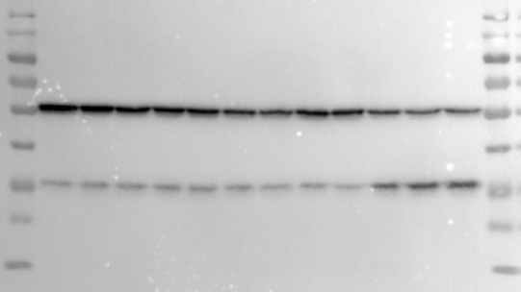
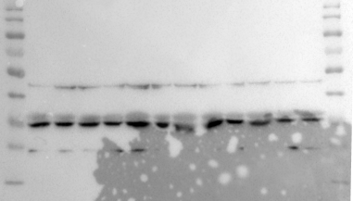
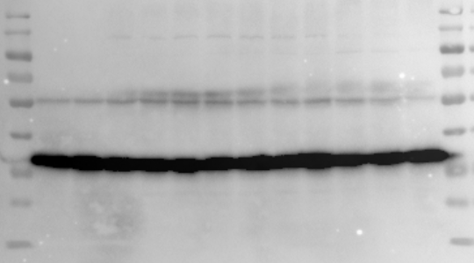
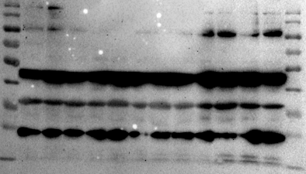
Figure 1d
Cisplatin
Cisplatin
kDa
Control
2.5μg/ml
5μg/ml
10μg/ml
kDa
Control
2.5μg/ml
5μg/ml
10μg/ml
180
180
130
130
100
100
70
70
GSDME-FL
55
55
40
40
GSDME-N
35
Caspases 3
35
25
25
15
15
kDa
kDa
180
180
130
130
100
100
70
70
55
55
40
GAPDH
40
35
35
25
25
15
C-Caspases 3
15

Slide 3
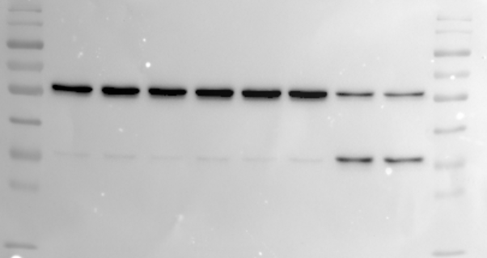
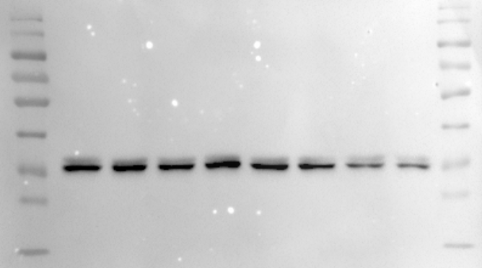
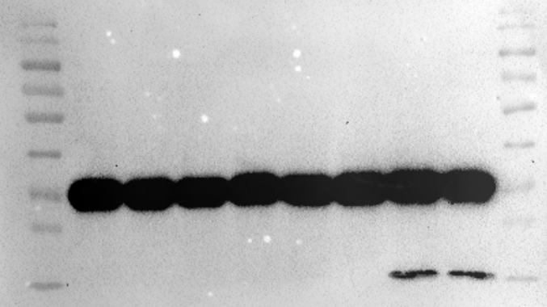
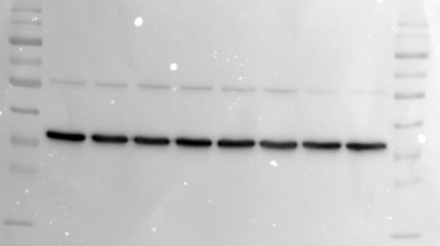
Figure 1 f
Cisplatin (10μg/ml)
Cisplatin (10μg/ml)
kDa
Control
6h
12h
24h
Control
6h
12h
24h
180
kDa
130
180
100
130
70
100
GSDME-FL
55
70
40
55
GSDME-N
35
40
25
Caspases 3
35
25
15
15
kDa
kDa
180
180
130
130
100
100
70
70
55
55
40
40
GAPDH
35
35
25
25
C-Caspases 3
15
15

Slide 4
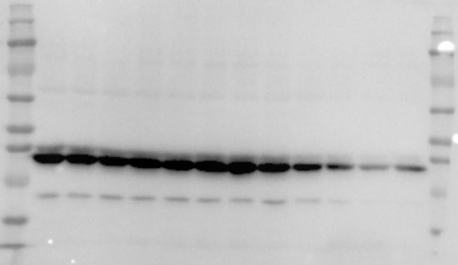
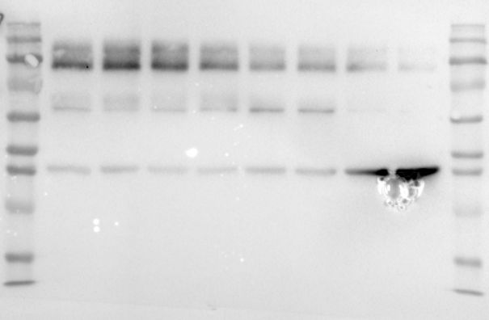
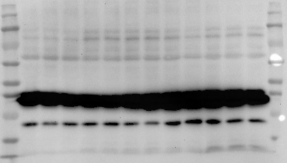
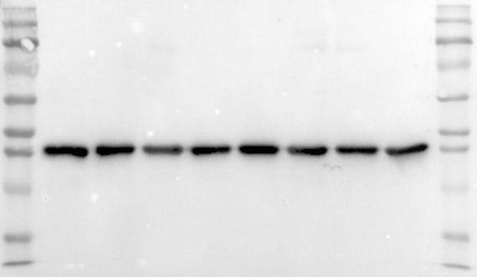
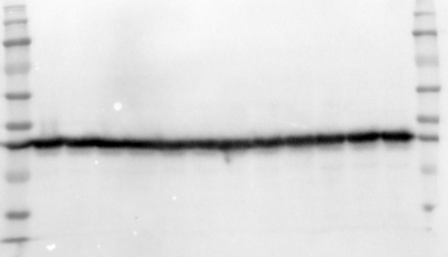
kDa
Figure 1f
Cisplatin (10μg/ml)
180
Control
6h
12h
24h
130
kDa
100
180
70
Cisplatin (10μg/ml)
130
55
100
40
Control
6h
12h
24h
70
Caspases 3
35
GSDME-FL
55
25
40
15
GSDME-N
35
10
kDa
25
180
130
15
100
70
10
55
40
kDa
35
180
25
130
15
100
C-Caspases 3
10
70
kDa
55
180
130
40
100
GAPDH
35
70
55
25
40
GAPDH
35
15
25
10
15
10

Slide 5
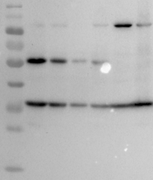
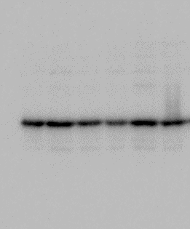
Figure2 a
WT
HET
KO
WT
HET
KO
kDa
kDa
180
180
130
130
100
100
70
70
GSDME
55
55
40
40
35
GAPDH
35
25
25
15
15

Slide 6
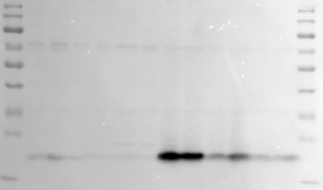
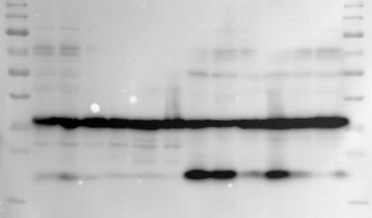
Figure2 f
Cisplatin
kDa
WT
HET
KO
WT
HET
KO
180
130
100
70
55
40
35
25
NGAL
15
kDa
180
130
100
70
55
40
GAPDH
35
25
15
2, 2, 2, 2, 2, 2,

Slide 7
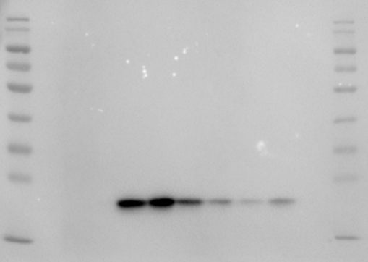
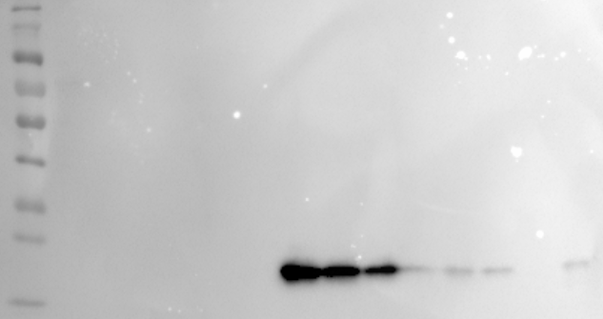
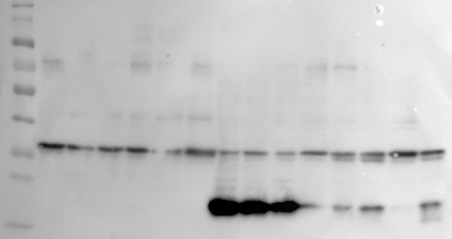
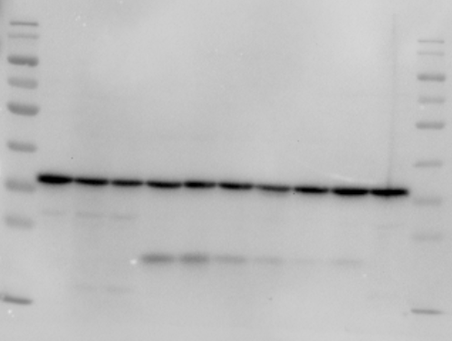
Figure2 f
Cisplatin
Cisplatin
WT
WT
HET
KO
HET
HET
KO
WT
HET
kDa
KO
kDa
WT
KO
180
180
130
130
100
100
70
70
55
55
40
40
35
35
25
25
NGAL
NGAL
15
15
kDa
kDa
180
180
130
130
100
100
70
70
55
55
40
40
GAPDH
35
GAPDH
35
25
25
15
15
2, 2, 2, 3, 3, 2,
1,1,1,2,2,3

Slide 8
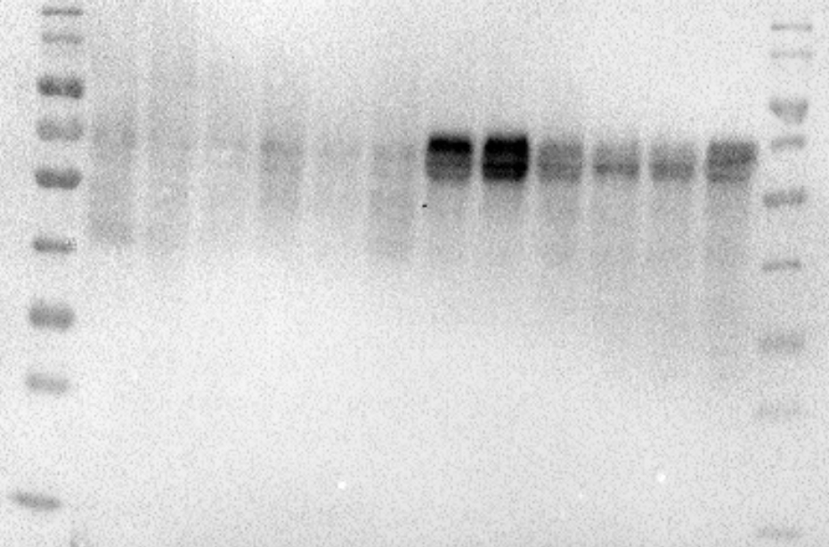
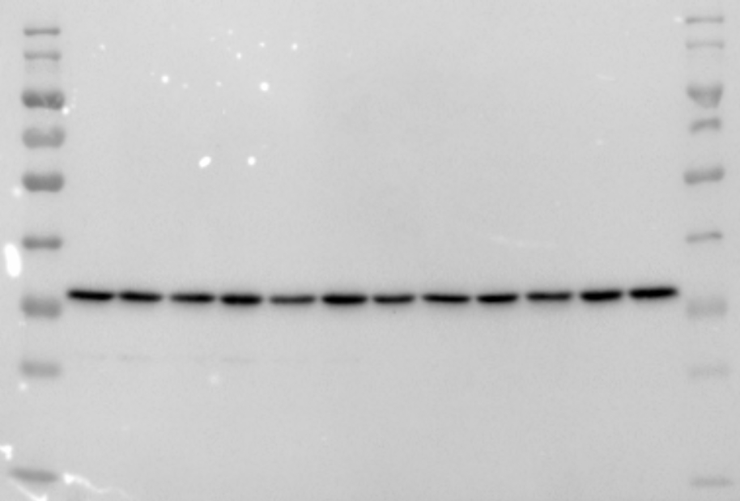
Figure2 f
Cisplatin
kDa
WT
HET
KO
WT
HET
KO
180
130
100
KIM-1
70
55
40
35
25
15
kDa
180
130
100
70
55
40
GAPDH
35
25
15

Slide 9
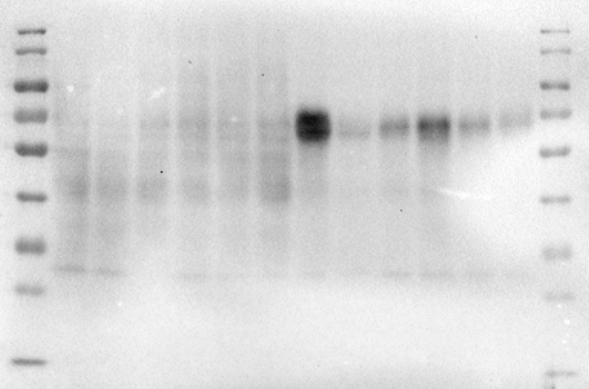
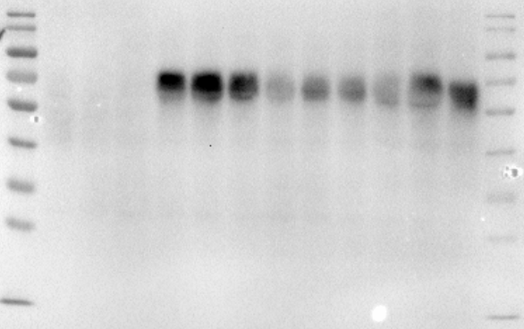
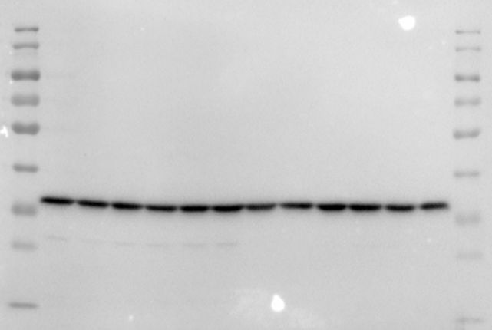
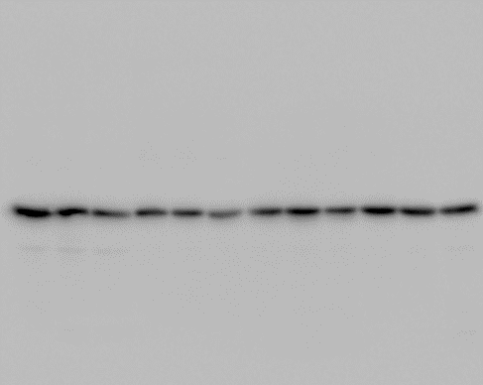
Figure2 f
Cisplatin
Cisplatin
WT
HET
KO
WT
HET
KO
kDa
WT
HET
KO
HET
kDa
KO
WT
180
180
130
130
100
100
KIM-1
70
KIM-1
70
55
55
40
40
35
35
25
25
15
15
kDa
kDa
180
180
130
130
100
100
70
70
55
55
40
40
GAPDH
GAPDH
35
35
25
25
15
15

Slide 10
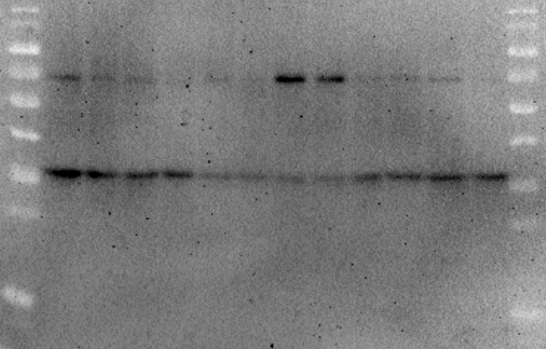
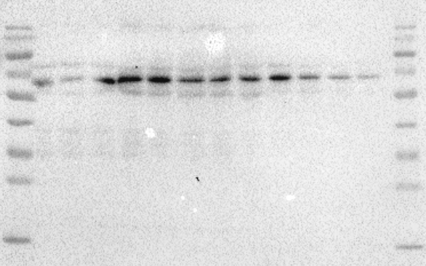
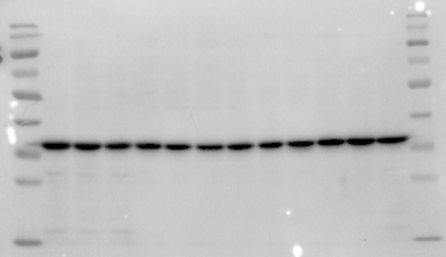
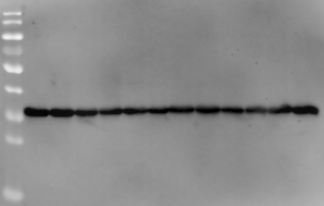
Figure 3 h
Cisplatin
Cisplatin
kDa
WT
HET
KO
WT
HET
KO
WT
HET
KO
WT
HET
KO
180
130
100
P-p65
70
55
P-p65
40
35
25
15
kDa
180
130
100
70
55
40
GAPDH
GAPDH
35
25
15

Slide 11
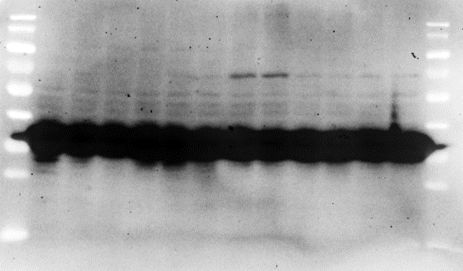
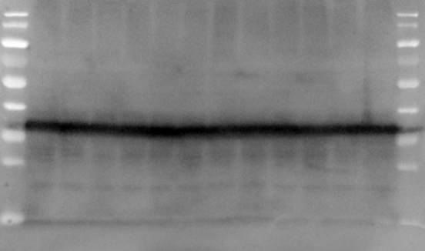
Figure 3 h
Cisplatin
kDa
WT
HET
KO
WT
HET
KO
180
130
100
P-p65
70
55
40
35
25
15
kDa
180
130
100
70
55
40
GAPDH
35
25
15

Slide 12
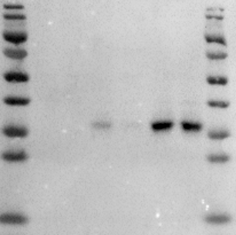
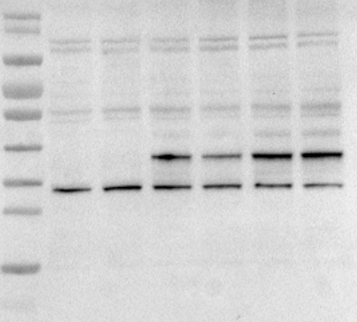
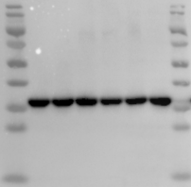
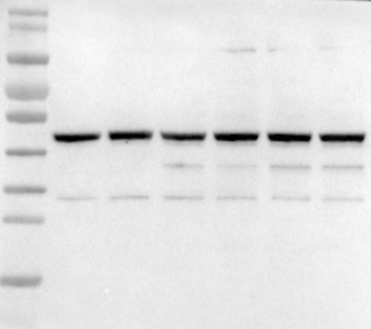
Figure4 a
HA-GSDME-N
vector
2 μg
3 μg
GSDME antibody
HA-GSDME-N
HA antibody
kDa
vector
2μg
3μg
180
kDa
130
180
100
130
70
100
55
70
55
40
HA-GSDME-N
40
HA-GSDME-N
35
25
35
25
15
15
kDa
180
kDa
130
180
100
130
70
100
55
70
β-actin
55
40
40
GAPDH
35
35
25
25
15
15

Slide 13
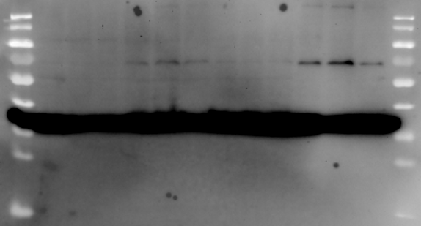
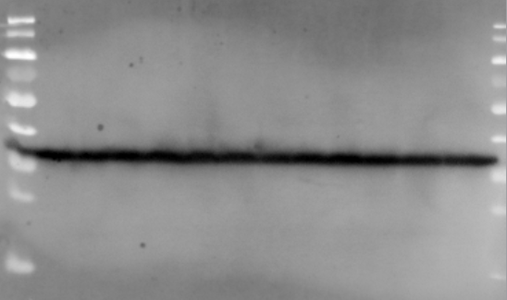
Figure 4h
GSDME-N - - + +
Cisplatin - + - +
kDa
180
130
100
P-p65
70
55
40
35
25
15
kDa
180
130
100
70
55
40
GAPDH
35
25
15

Slide 14
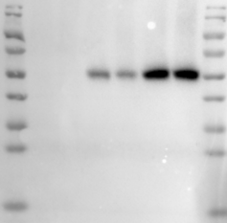
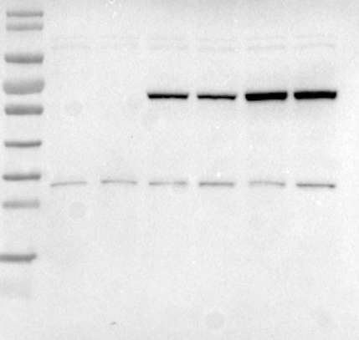
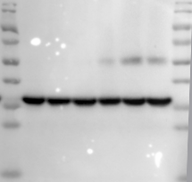
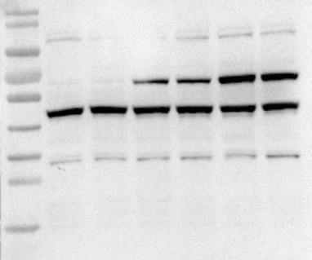
Figure 5 a
HA-FL-GSDME
HA-FL-GSDME
HA antibody
GSDME antibody
vector
2μg
3μg
kDa
vector
2 μg
3 μg
kDa
180
180
130
130
100
100
70
HA-FL-GSDME
70
HA-FL-GSDME
55
55
40
40
35
35
25
25
15
15
kDa
180
kDa
130
180
100
130
70
100
55
70
40
β-actin
55
GAPDH
40
35
25
35
25
15
15

Slide 15
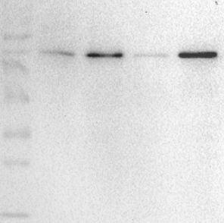
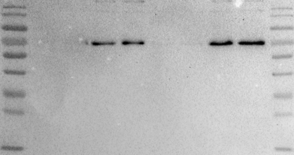
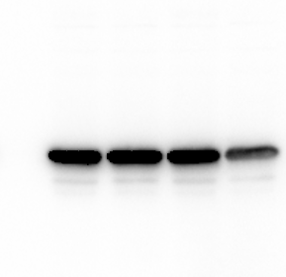

Figure 5 h
FL-GSDME - - + +
FL-GSDME - - + +
Cisplatin - + - +
Cisplatin - + - +
kDa
kDa
180
180
130
130
100
100
P-p65
70
P-p65
70
55
55
40
40
35
35
25
25
15
15
kDa
kDa
180
180
130
130
100
100
70
70
55
55
40
40
GAPDH
35
GAPDH
35
25
25
15
15

Slide 16


Figure 6a
si-NC
si-GSDME
kDa
180
130
100
70
GSDME
55
40
35
25
15
kDa
180
130
100
70
55
40
GAPDH
35
25
15

Slide 17




Figure 6h
si-GSDME - - + +
si-GSDME - - + +
Cisplatin - + - +
Cisplatin - + - +
kDa
kDa
180
180
130
130
100
100
P-p65
70
P-p65
70
55
55
40
40
35
35
25
25
15
15
kDa
kDa
180
180
130
130
100
100
70
70
55
55
40
40
GAPDH
35
GAPDH
35
25
25
15
15

Slide 18




Figure 7a
Z-DEVD-FMK - - + +
Z-DEVD-FMK - - + +
Cisplatin - + - +
Cisplatin - + - +
kDa
kDa
180
180
130
130
100
100
70
70
55
GSDME-FL
55
40
40
Caspases 3
35
GSDME-N
35
25
25
15
15
kDa
180
kDa
130
180
100
130
70
100
55
70
40
55
GAPDH
35
40
25
35
25
15
C-Caspases 3
15

Slide 19




Figure 8e
Sham
IR
Sham
IR
kDa
WT
KO
WT
KO
kDa
WT
KO
WT
KO
180
180
130
130
100
100
70
70
55
55
40
40
35
35
25
25
NGAL
NGAL
15
15
kDa
kDa
180
180
130
130
100
100
70
70
55
55
40
GAPDH
40
GAPDH
35
35
25
25
15
15

Slide 20
Figure 8g
Sham
IR
WT
KO
WT
KO
kDa
180
130
KIM-1
100
70
55
40
35
25
15
kDa
180
130
100
70
55
40
GAPDH
35
25
15

Slide 21


Figure S1 b
kDa
Control
Cisplatin
Control
Cisplatin
180
kDa
130
180
130
100
100
70
70
FL-GSDMD
55
55
40
GAPDH
40
GSDMD-N
35
35
25
25
15
15

Slide 22
Figure S3 e
WT
KO
WT
KO
Vector
Vector+Cis
Vector+Cis
GSDME-N+Cis
kDa
kDa
Vector
Vector+Cis
Vector+Cis
GSDME-N+Cis
180
180
130
130
100
100
70
55
70
55
40
GAPDH
40
35
25
35
NGAL
25
15
15

Slide 23




Figure S4 a
Z-VAD-FMK - - + +
Z-VAD-FMK - - + +
Cisplatin - + - +
Cisplatin - + - +
kDa
kDa
180
130
130
100
100
70
GSDME-FL
55
70
40
55
GSDME-N
35
40
25
Caspases 3
35
25
15
15
kDa
kDa
180
180
130
130
100
100
70
70
55
55
40
40
35
GAPDH
35
25
25
C-Caspases 3
15

Slide 24




Figure S5a
si-caspase3 - - + +
Cisplatin - + - +
si-caspase3 - - + +
kDa
Cisplatin - + - +
180
kDa
130
180
100
130
70
100
GSDME-FL
55
70
40
55
GSDME-N
35
40
25
Caspases 3
35
25
15
15
kDa
180
kDa
130
180
100
130
70
100
55
70
55
40
40
GAPDH
35
35
25
25
C-Caspases 3
15
15

