Slide 1
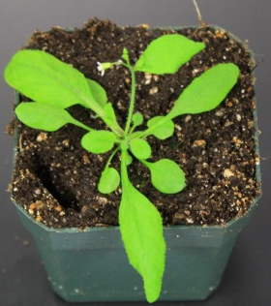
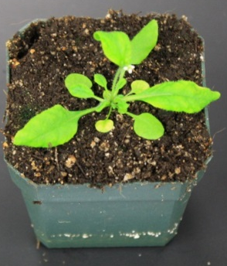
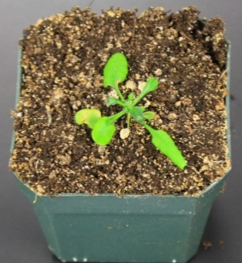
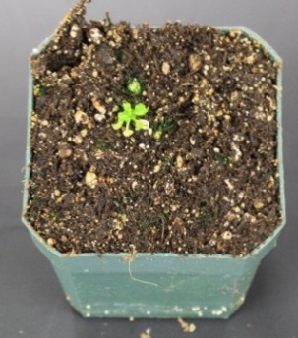
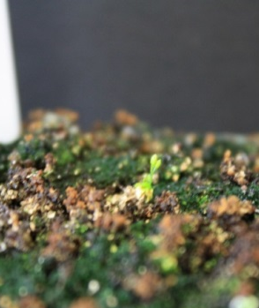
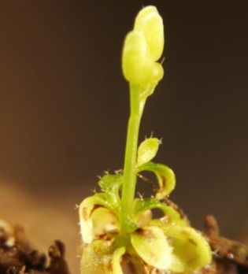
Wild type
35S:UMAMIT14-4
35S:UMAMIT18
35S:UMAMIT24
35S:UMAMIT25
35S:UMAMIT25
Supplemental Figure 1. Phenotypes of UMAMIT14, UMAMIT18, UMAMIT24 and UMAMIT25 over-expressing plants.
Notes:
Supplemental Figure 1. Phenotypes of UMAMIT14, UMAMIT18, UMAMIT24 and UMAMIT25 over-expressing plants.

Slide 2
**
p <0.01
A
B
C
****
p <0.0001
D
E
F
**
****
Supplemental figure 2. Concentration of IAA and ABA in 35S:UMAMIT14-4 (A, B) and 35S:UMAMIT14-6 (C, D) plants. The hormones were extracted from five-week old plants. Error bars: standard deviation, n=4. Significant differences compared to the wild type are indicated by asterisks according to Student’s t-test.
Notes:
Supplemental figure 2. Concentration of IAA and ABA in 35S:UMAMIT14-4 (A, B) and 35S:UMAMIT14-6 (C, D) plants. The hormones were extracted from five-week old plants. Error bars: standard deviation, n=4. Significant differences compared to the wild type are indicated by asterisks according to Student’s t-test.

Slide 3
A
B
*
WT
**
35S:UT14-4
*
**
*
*
*
*
*
*
*
*
*
WT
*
35S:UT14-4
Supplemental Figure 3: Leaf amino acid composition of five-week old wild type and 35S:UMAMIT14-4 plants.
(A) Absolute quantity of amino acids in WT and 35S:UMAMIT14-4 leaves. (B) The same set of data as in (A), presented as relative composition of amino acid compared to the total amino acids. Significant differences are indicated by asterisks according to t-test (p<0.05 with n=4).

Slide 4
Primer name | Sequence
UMAMIT14 amplification (Forward) | ACAAGTTTGTACAAAAAAGCAGGCTTCGATATGGCTTTAAAAACATGGAAG
UMAMIT14 amplification (Reverse) | ACCACTTTGTACAAGAAAGCTGGGTCTCAGACTGATTCATTGGTGTTAGGCCT
UMAMIT18 amplification (Forward) | GACAAGTTTGTACAAAAAAGCAGGCTCAATAAAGATGAAAGGTGGAAGCATG
UMAMIT18 amplification (Reverse) | GACCACTTTGTACAAGAAAGCTGGGTACYAGGTACTGGTAACCACACCGTTAGT
UMAMIT24 amplification (Forward) | GGACAAGTTTGTACAAAAAAGCAGGCTTCATGAAGAGTGTAGTTGCAATGGTGGC
UMAMIT24 amplification (Reverse) | GGACCACTTTGTACAAGAAAGCTGGGTCGGGGACATCTCTATTTACTGATGAAAGATT
UMAMIT25 amplification (Forward) | GGACAAGTTTGTACAAAAAAGCAGGCTTCATGGCTAAATCAGATATGTTGCCGTT
UMAMIT25 amplification (Reverse) | GGACCACTTTGTACAAGAAAGCTGGGTCAGGCGATGTAGACCTTGTGGAACC
UMAMIT14 qRT-PCR (Forward) | ACACCAATTGAGGCATACAGC
UMAMIT14 qRT-PCR (Reverse) | ACGACTTAAGCGTGATCGCTTGG
Actin 2 qRT-PCR (Forward) | GGTAACATTGTGCTCAGTGGTGG
Actin 2 qRT-PCR (Reverse) | AACGACCTTAATCTTCATGCTGC
PR1 qRT-PCR (Forward) | GCGGTAGGCGTAGGTCCCA
PR1 qRT-PCR (Reverse) | CGCCAGACAAGTCACCGCTA
ALD1 qRT-PCR (Forward) | GTG CAA GAT CCT ACC TTC CCG GC
ALD1 qRT-PCR (Reverse) | CGG TCC TTG GGG TCA TAG CCA GA
Ubiquitin qRT-PCR (Forward) | GGCCTTGTATAATCCCTGATGAATAAG
Ubiquitin qRT-PCR (Reverse) | AAAGAGATAACAGGAACGGAAACATAGT
Table S1. Primers used for cloning and qRT-PCR. Primer sequences are given from 5’ to 3’. Underlined bases were added for the creation of attB1 and attB2 in forward and reverse primers, respectively.
Notes:
Table S1. Primers used for cloning and qRT-PCR. Primer sequences are given from 5’ to 3’. Underlined bases were added for the creation of attB1 and attB2 in forward and reverse primers, respectively.

