Slide 1
Mcl-1
Bcl-xL
PBS
DEN
PBS
DEN
WT
KO
WT
KO
WT
KO
WT
KO
37kDa
37kDa
25kDa
25kDa
Bak
Bax
PBS
DEN
PBS
DEN
WT
KO
WT
KO
WT
KO
WT
KO
37kDa
37kDa
25kDa
25kDa
20kDa
15kDa
β-actin
PBS
DEN
50kDa
WT
KO
WT
KO
37kDa
Sup. Fig. 1

Slide 2
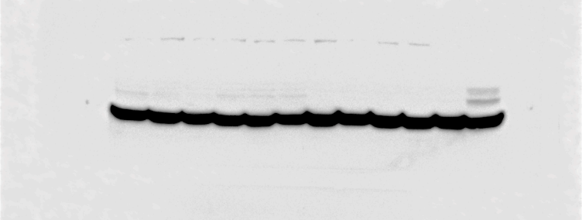
HO-1
β-actin
PBS
DEN
PBS
DEN
37kDa
WT
KO
WT
KO
50kDa
WT
KO
WT
KO
25kDa
37kDa
β-actin overexposed
Sup. Fig. 2

Slide 3
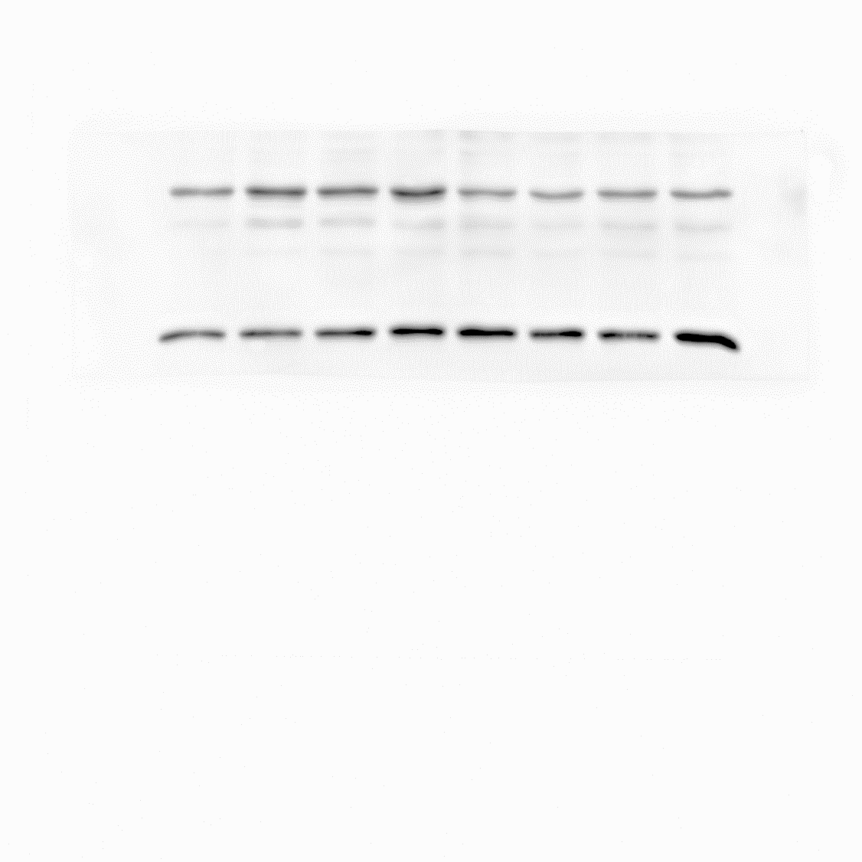
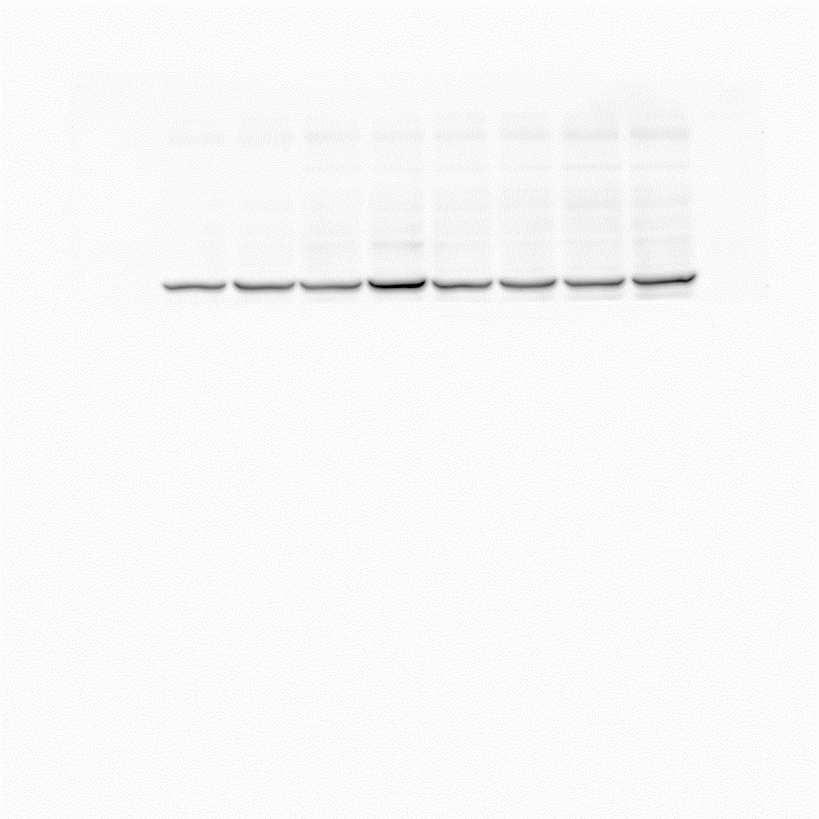
HO-1
β-actin
37kDa
vehicle
NAC
25kDa
50kDa
vehicle
NAC
37kDa
Sup. Fig. 3

