Slide 1
The Gerbode Defect – a case series
November 2020
EHJ-CR-D-20-01104

Slide 2
Introduction
The Gerbode defect is a rare abnormal communication between the left ventricle and right atrium.¹
The lesion is either congenital or acquired
Gerbode defect types:
Type 1 (indirect or infravalvular):
Membranous interventricular septal defect + tricuspid regurgitation (either due to poor leaflet apposition or leaflet perforation)
Type 2 (direct or supravalvular):
Direct connection from the left ventricle to right atrium through the superior part of the membranous interventricular septum.
Type 3 (intermediate):
a combination of direct and indirect routes
The relative incidence of the different types are 12%, 81%, and 7%, respectively.²

Slide 3
Case Presentation
History and Examination Findings
Patient 1:
64-year-old male
Bioprosthetic aortic valve replacement (5 months prior)
Presentation:
10 day history of fatigue, shortness of breath, and peripheral oedema.
Observations:
BP 110/60 mmHg
HR 72 bpm
RR 25 bpm
Sats 100% on air
Temp 37.7 C
Examination:
Pan-systolic and early diastolic murmur
Fine right basal crepitations
Bilateral mild pitting oedema
Patient 2:
81-year-old male
Bioprosthetic aortic valve replacement (5 years prior)
Presentation:
Found collapsed. Delirium, pyrexia, and dyspnoea.
Observations:
BP 78/60 mmHg
HR 120 bpm
RR 38 bpm
Sats 77% on air
Temp 37.8 C
Examination:
Soft systolic murmur
Bi-basal fine crepitations
Bilateral pitting oedema

Slide 4
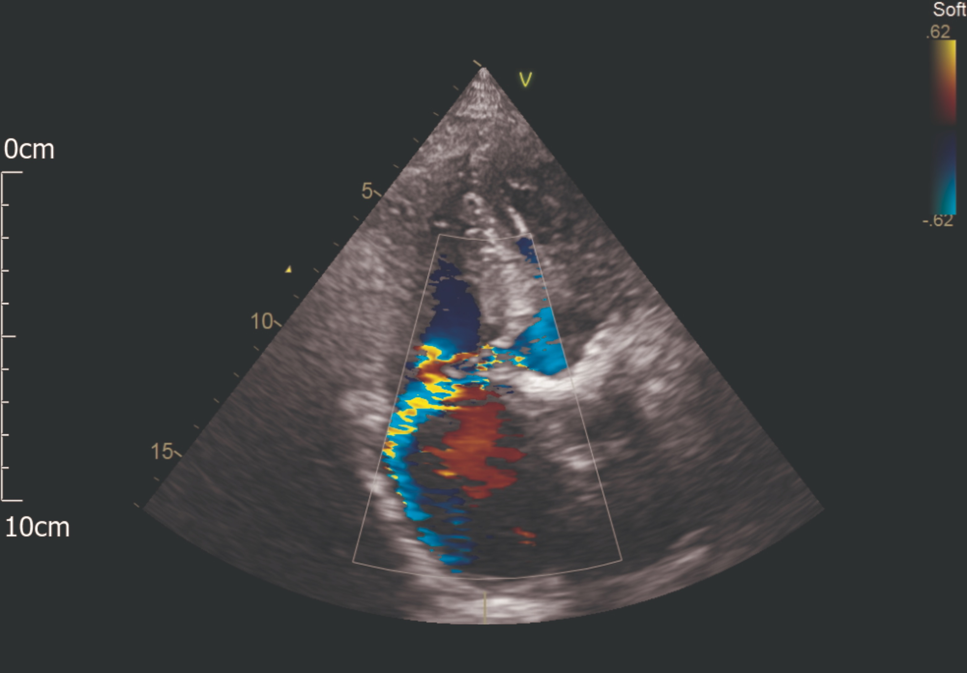
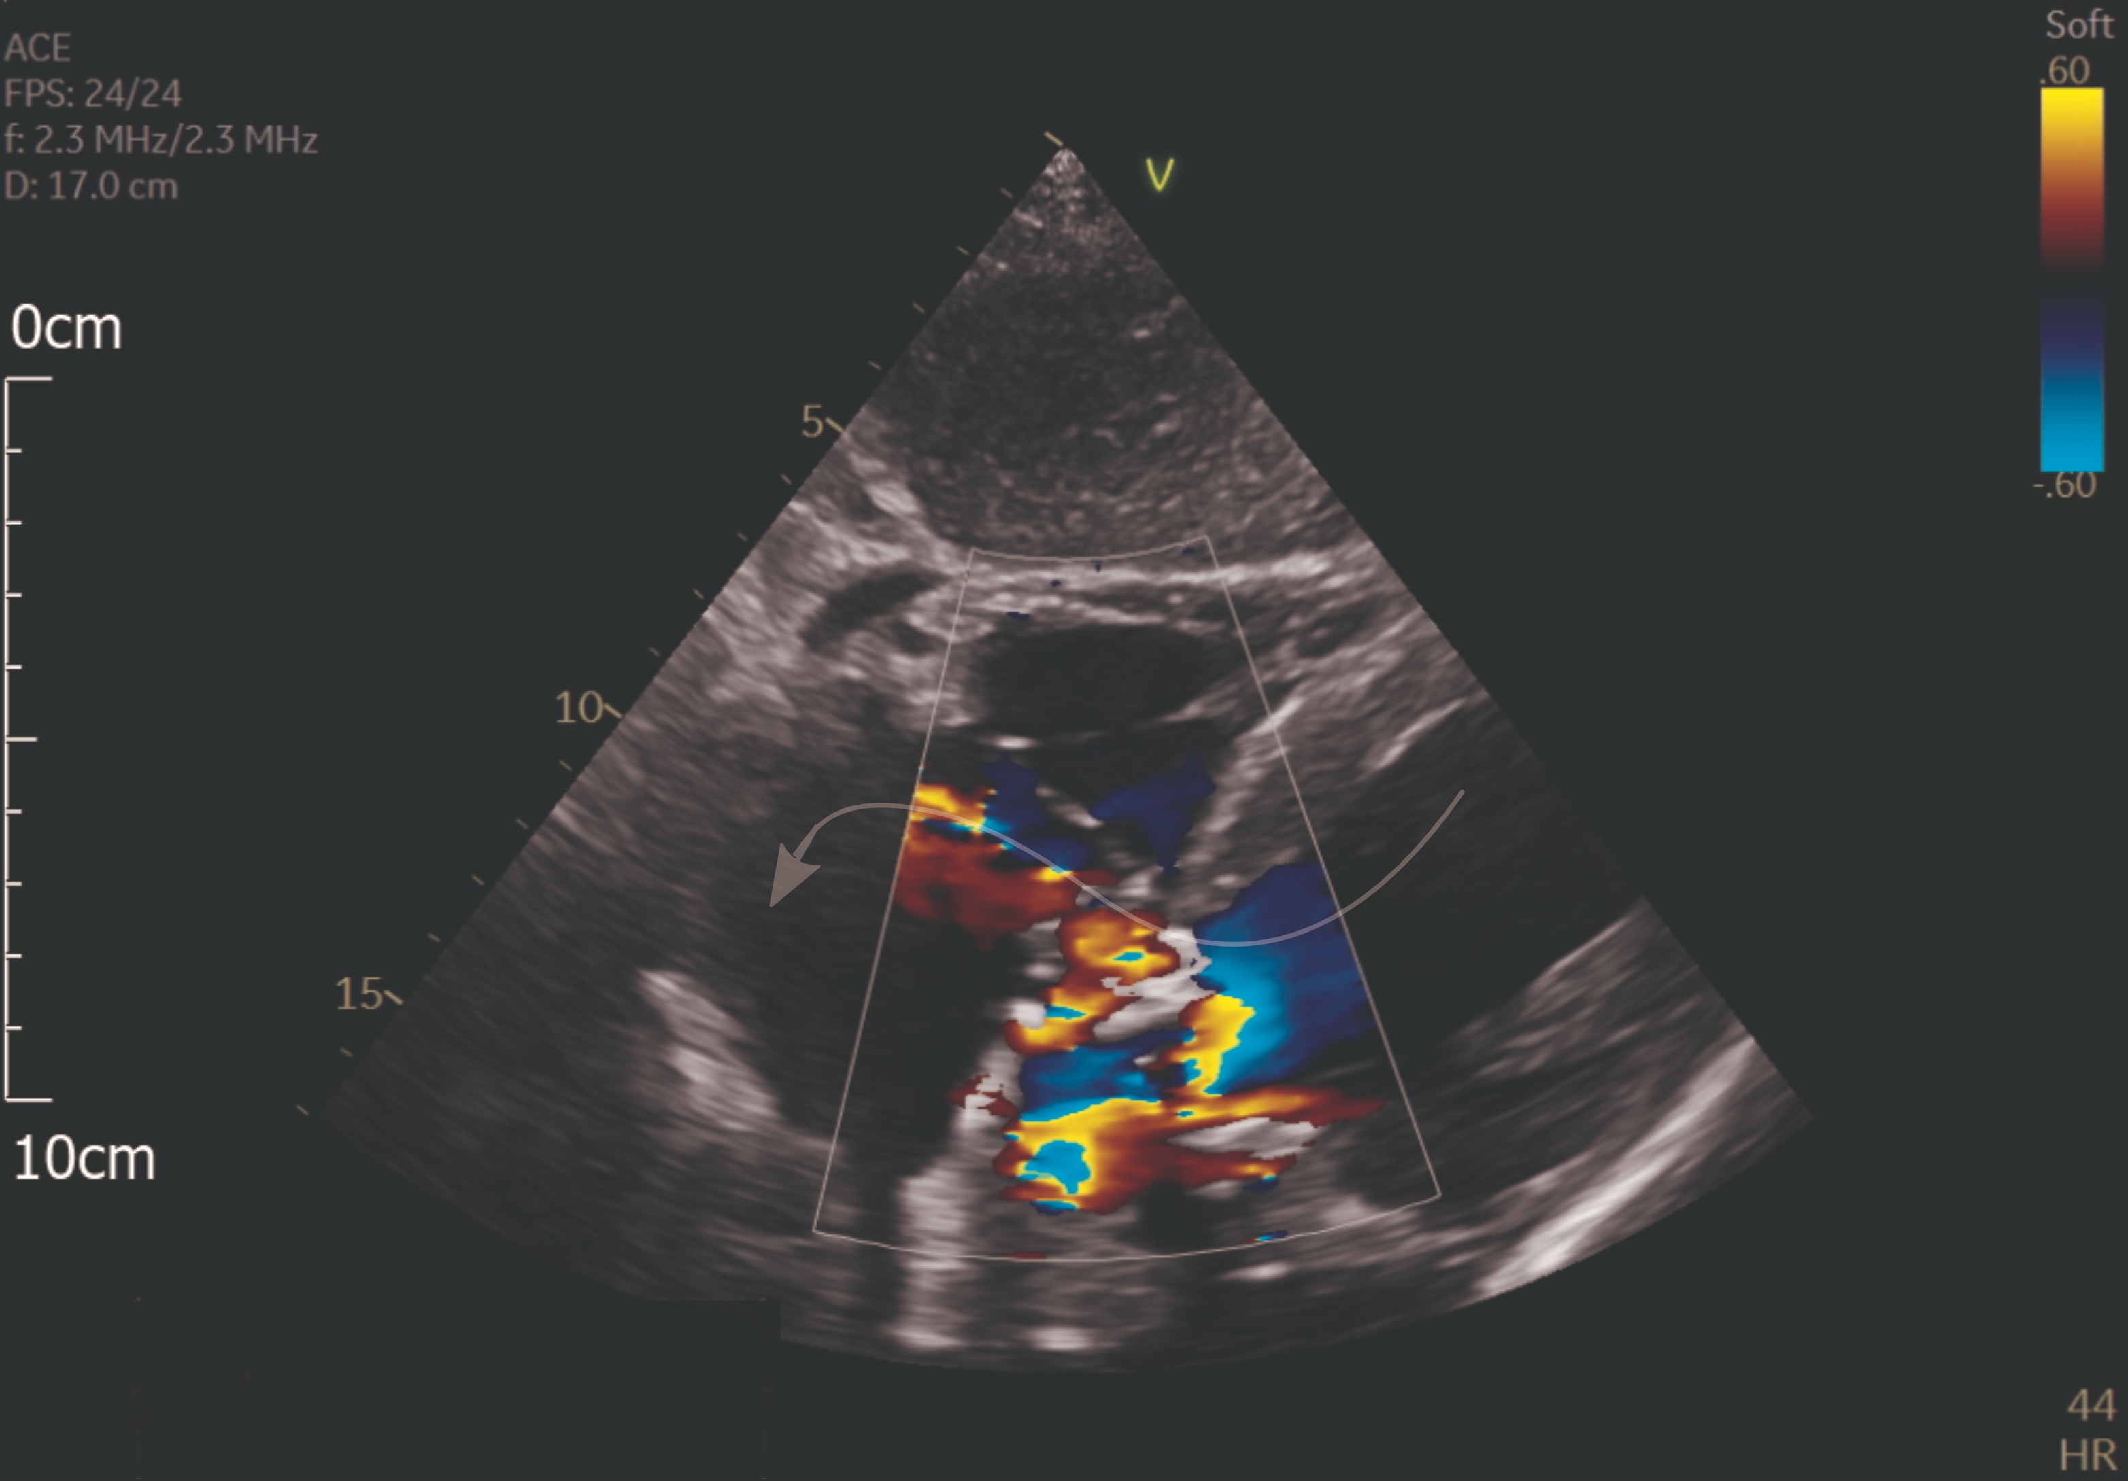
Case Presentation
Investigations – echocardiogram
Patient 1 (A4Ch view):
Patient 2 (SubC view):
Apical 4-chamber view with colour flow mapping. A high velocity jet can be seen from the left ventricular outflow tract into the right atrium.
Subcostal 4-chamber view with colour flow mapping demonstrating flow from the left ventricle into the right atrium, through the aortic root lesion.

Slide 5
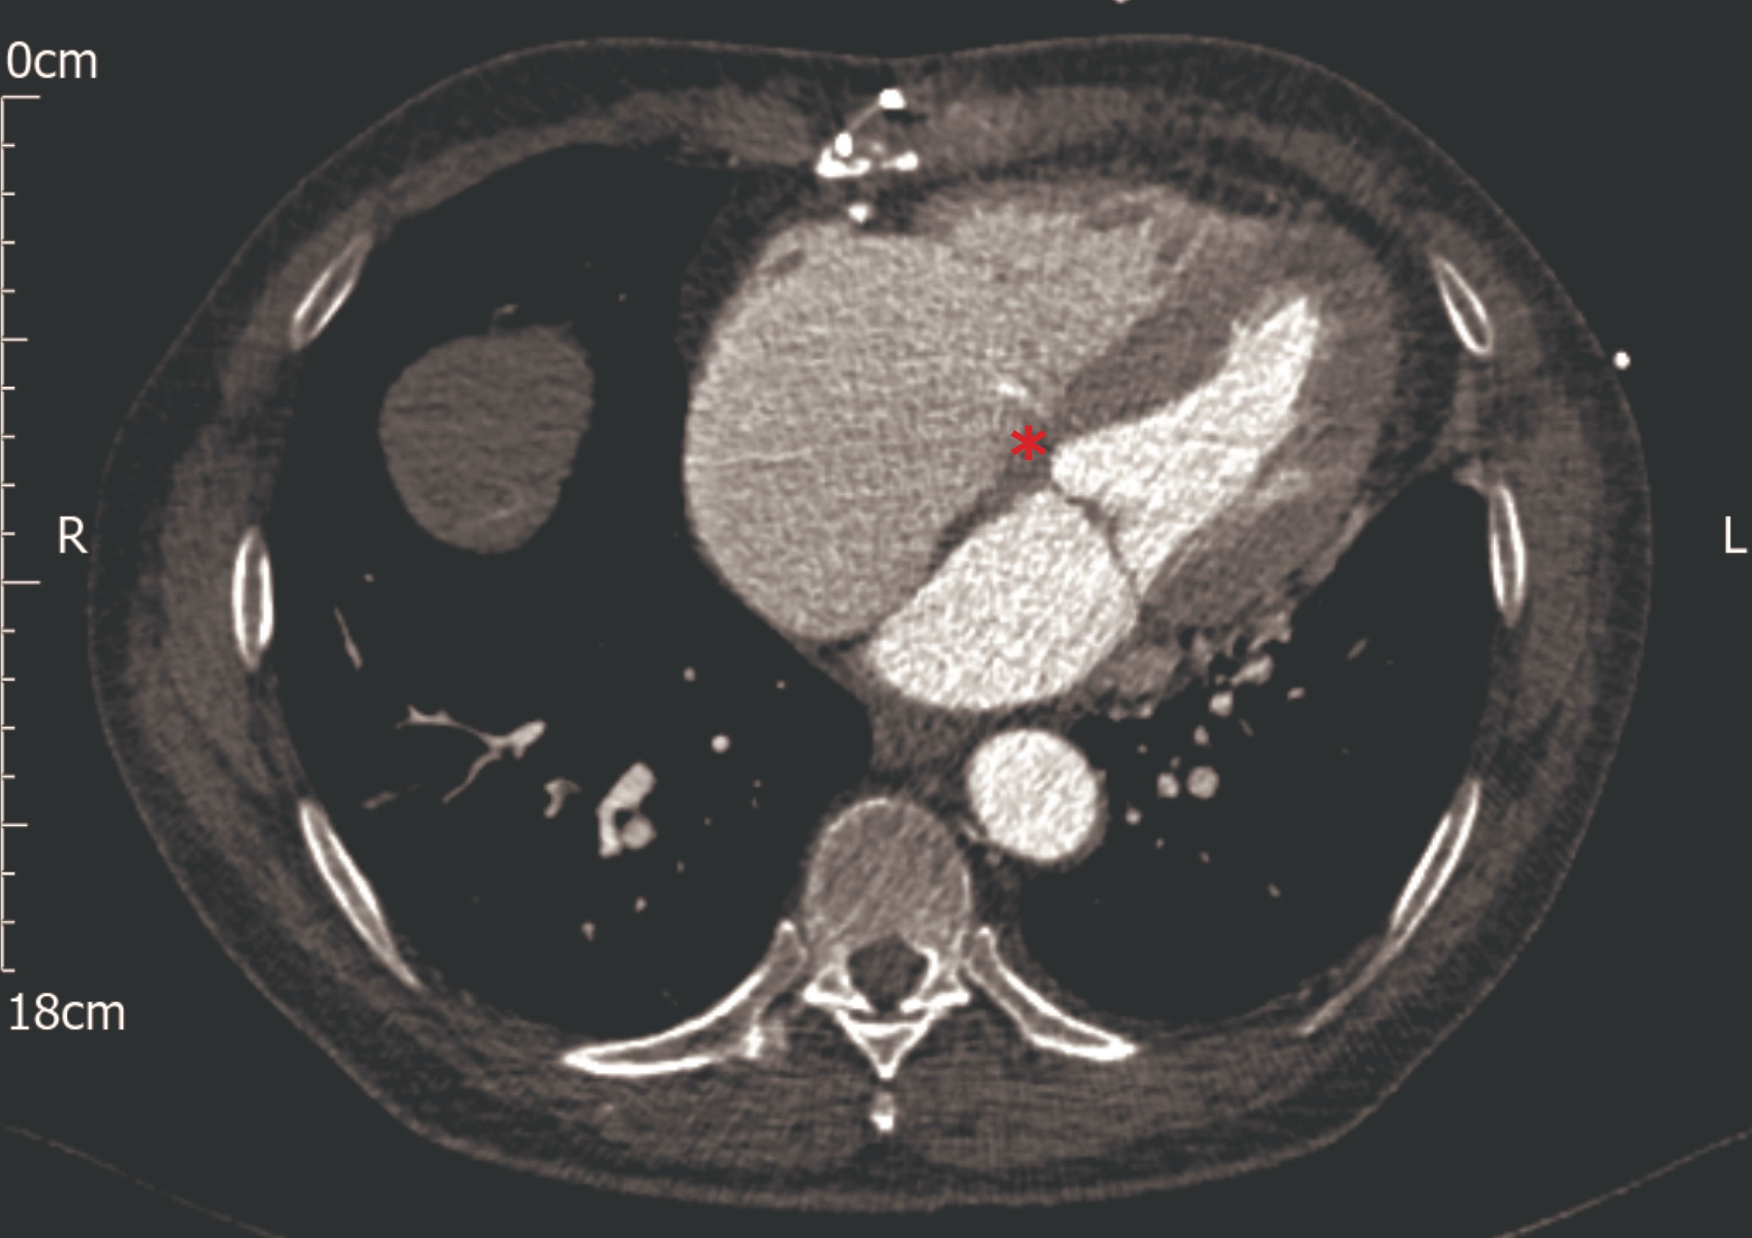
Case Presentation
Investigations – cardiac CT
Patient 1:
Coronal arterial phase contrast CT image demonstrating a thin jet of contrast entering a dilated right atrium through a defect in the wall of the left ventricular outflow tract (red asterisk)
Transverse arterial phase contrast CT image demonstrating a thin jet of contrast entering a dilated right atrium (red asterisk)

Slide 6
Case Presentation
Management
Patient 1:
Intravenous antibiotics
      Blood cultures grew: Staphylococcus warneri
      Gentamicin, vancomycin and rifampicin
Surgical aortic valve replacement and LV-RA fistula repair (day 10 of admission)
Discharged home after 1 month in hospital
Patient 2:
Intravenous antibiotics
      Blood cultures grew: Klebsiella pneumoniae
      Piperacillin with Tazobactam
    Stabilisation in the intensive care unit
    After several days laboratory investigations revealed rising inflammatory markers
    CT thorax/abdomen/pelvis demonstrated new occlusion of the superior mesenteric artery and right lower lobe pneumonia.
    Despite ongoing antibiotic treatment and best supportive care, the patient deteriorated.
    Move to symptom control and palliative care
    The patient passed away peacefully

Slide 7
Discussion
The Gerbode defect:
Most cases of acquired Gerbode defects are related to either cardiac valve surgery or infective endocarditis.³
Aortic valve endocarditis is the most common valve associated with the Gerbode defect.³
Infective endocarditis:
Is rare in the context of healthy valves
      incidence ~1.7-6.2 per 100,000 patient years
Is much more common in the context of prosthetic valves
      1-6% of patients / 0.3-1.2% per patient-year
Coagulase-negative Staphylococci (CNS) are the most frequent causative organism (40%) in the intermediate period after cardiac valve surgery (60 days – 1 year).

Slide 8
Discussion
Pitfalls in diagnosis of the Gerbode defect:
Take care to differentiate an RA regurgitant jet secondary to a Gerbode defect, from pure tricuspid regurgitation.^{3, 4}
At echocardiography, ensure the colour-flow mapping area includes the membranous interventricular septum, left ventricular outflow tract, and right atrium, in multiple views
Management:
Very limited evidence base to guide the treatment of Gerbode defects
In infective endocarditis, surgical intervention has been associated with a significantly lower in-hospital mortality (Odds Ratio 0.61)⁵
In a review of acquired Gerbode defect reports, a surgical management strategy has been associated with a 90% chance of survival, compared to 57% with no intervention.² (n.b. very high risk of patient selection and reporting bias)

Slide 9
Learning Points
An acquired Gerbode defect is a rare but important complication of aortic valve endocarditis and valve surgery associated with a high mortality
Care should be taken to assess for Gerbode defect shunts on echocardiogram, as they can be misinterpreted as more common cardiac pathology.
Alternative imaging with trans-oesophageal echocardiography or cardiac CT should be undertaken if there is a strong suspicion of a Gerbode defect

Slide 10
References
Gerbode F, Hultgren H, Melrose D, Osborn J. Syndrome of left ventricular-right atrial shunt; successful surgical repair of defect in five cases, with observation of bradycardia on closure. Ann Surg. Sep 1958;148(3):433-46. doi:10.1097/00000658-195809000-00012
Yuan SM. A Systematic Review of Acquired Left Ventricle to Right Atrium Shunts (Gerbode Defects). Hellenic J Cardiol. 2015 Sep-Oct 2015;56(5):357-72.
Xhabija N, Prifti E, Allajbeu I, Sula F. Gerbode defect following endocarditis and misinterpreted as severe pulmonary arterial hypertension. Cardiovasc Ultrasound. Sep 2010;8:44. doi:10.1186/1476-7120-8-44
Tehrani F, Movahed MR. How to prevent echocardiographic misinterpretation of Gerbode type defect as pulmonary arterial hypertension. Eur J Echocardiogr. Dec 2007;8(6):494-7. doi:10.1016/j.euje.2006.07.014
Murdoch DR, Corey GR, Hoen B, Miro JM, Fowler VG, Bayer AS et al. Clinical presentation, etiology, and outcome of infective endocarditis in the 21st century: the International Collaboration on Endocarditis-Prospective Cohort Study. Arch Intern Med. Mar 2009;169(5):463-73. doi:10.1001/archinternmed.2008.603

