Slide 1
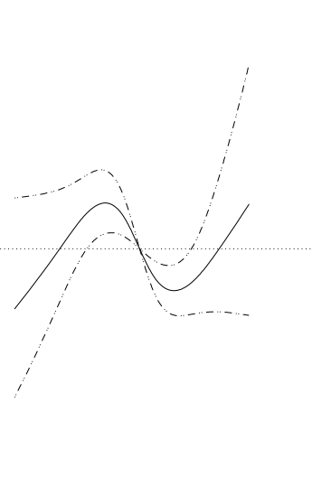
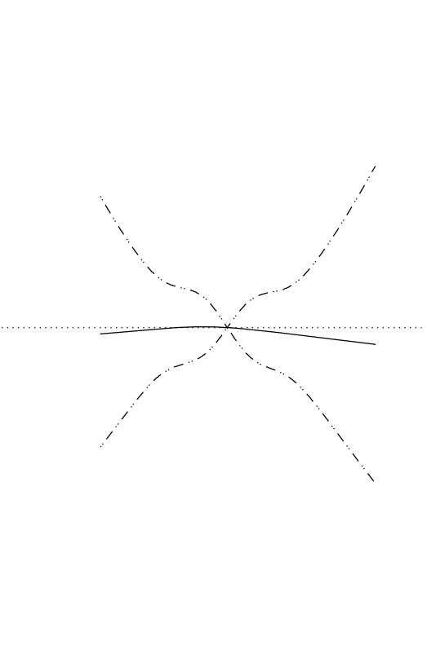
Supplementary Figure 1
(A)
(B)
1.5
1.5
OR
1.0
OR
1.0
0.5
0.5
130
135
140
145
150
-10
-8
-6
-4
-2
0
2
4
6
8
10
Pre-HD SNa (mEq/L)
ΔSNa (mEq/L)

Slide 2
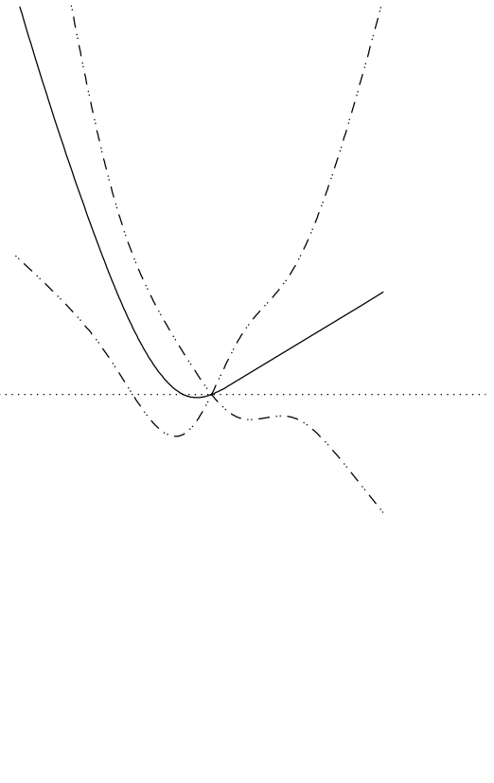
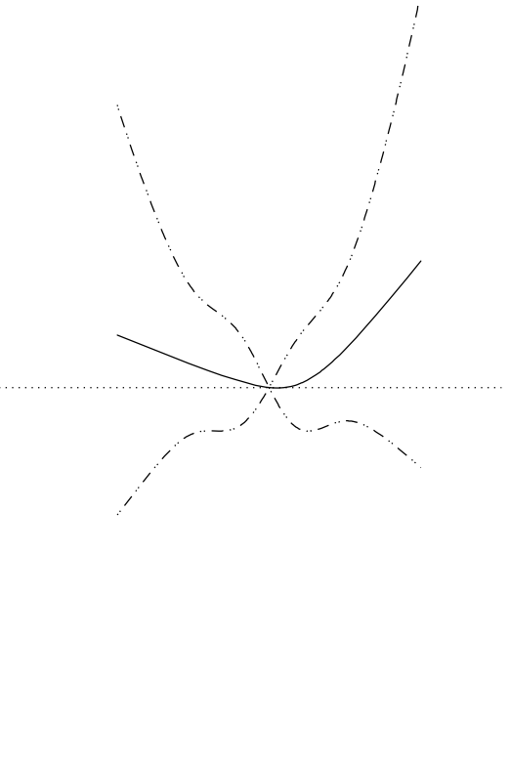
Supplementary Figure 2
(A)
(B)
1.5
1.5
OR
1.0
OR
1.0
0.5
0.5
130
135
140
145
150
-10
-8
-6
-4
-2
0
2
4
6
8
10
Pre-HD SNa (mEq/L)
ΔSNa (mEq/L)

Slide 3
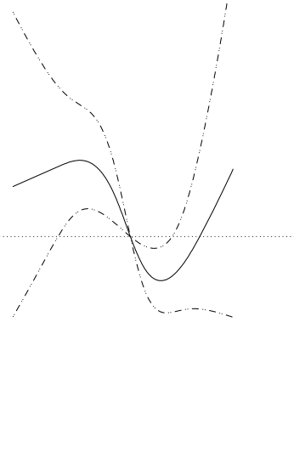
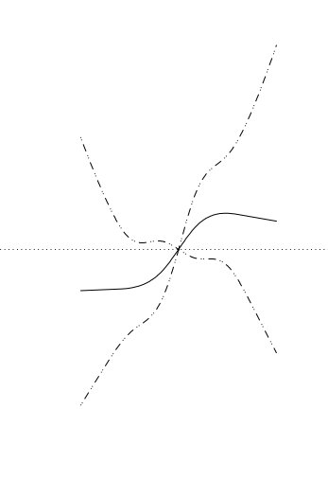
Supplementary Figure 3
(A)
(B)
1.5
1.5
HR
1.0
OR
OR
1.0
0.5
0.5
130
135
140
145
150
-10
-8
-6
-4
-2
0
2
4
6
8
10
Pre-HD SNa (mEq/L)
ΔSNa (mEq/L)

