Slide 1
Participants Consented N=129
8 uncontactable
3 withdrew prior to sampling
Participants Included N=118
13 withdrew from study
22 lost to follow-up
8 hospitalized
4 early termination for other reasons
Had at least one RT-PCR positive specimen N=72
Had at least one paired oral fluid and nasal OP specimen N=60

Slide 2
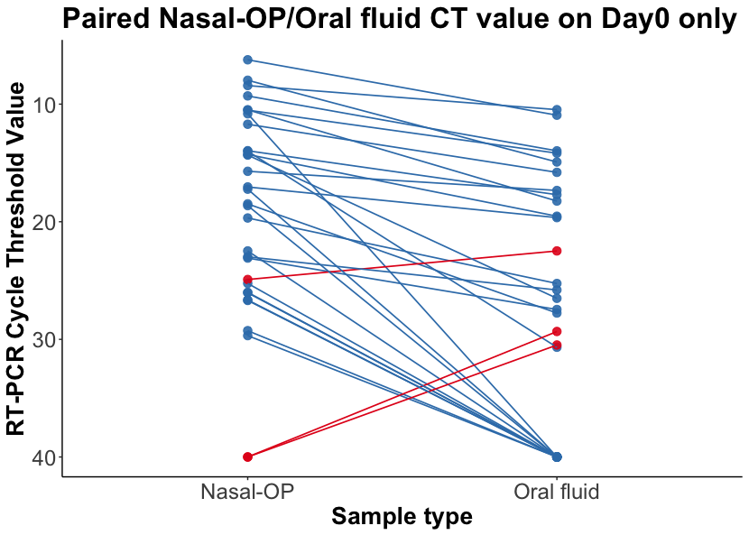
 | positive agreement | negative agreement
D0 | 62%(18/29) | 80%(8/10)
D3 | 48%(18/37) | 100%(11/11)
D7 | 32%(7/22) | 100%(18/18)
D14 | 10%(2/20) | 96%(23/24)

Slide 3
Pre-spit (N = 28) |  | Pre-spit |  |  |  | Post-spit (N = 32) | Post-spit | Post-spit
 |  | Nasal-OP |  |  |  |  |  | Nasal-OP
 |  | + | - | Total |  |  |  | + | - | Total
Saliva | + | 16 | 1 | 17 |  | Saliva | + | 29 | 2 | 31
 | - | 27 | 23 | 50 |  |  | - | 36 | 37 | 73
 | Total | 43 | 24 | 67 |  |  | Total | 65 | 39 | 104

