Slide 1
Suplementary Figure 1: Flow chart diagram of patients
selection in our study.
Patients admitted with a confirmed diagnosis of COVID-19; between April 6th and April 17th, 2020 (n=133)
5 patients were excluded due to the impossibility of performing the measurement by BIA.
-1patient was excluded due to ethnicity,
-2 extensive skin lesions (psoriasis, trophic disorders in lower limbs due to venous insufficiencies)
-1 extravasation of fluids through the route and local hematomas,
-1 amputation.
Patients were selected to participate in our study
(n=128)
Participation declined (n=1)
Informed consent obtained. Patients included in our study. We measurement PhA in first 72 hours after admission.
(n=127)
Clinical follow-up until day 90.
(n=127)

Slide 2
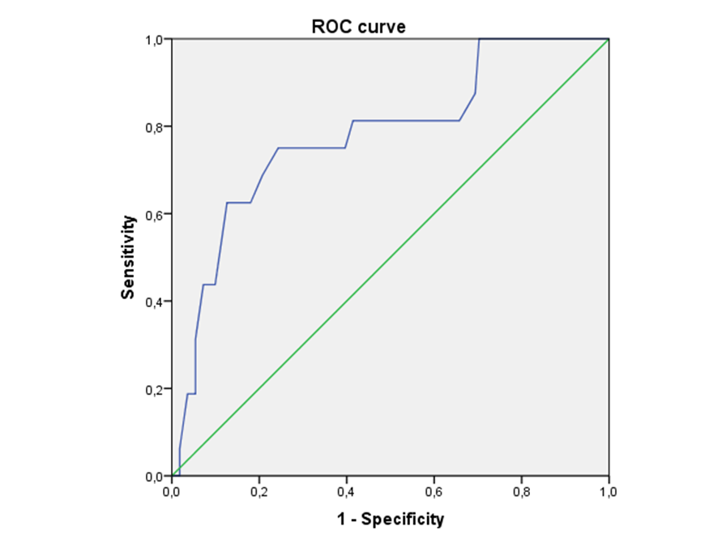
Suplementary Figure 2: ROC Curve SPhA.
Characteristic curves for prediction of mortality in patients with COVID-19 disease (n = 127). PhA cut-off point for predicting mortality was -1.85, with 75% sensitivity and 75% specificity

Slide 3
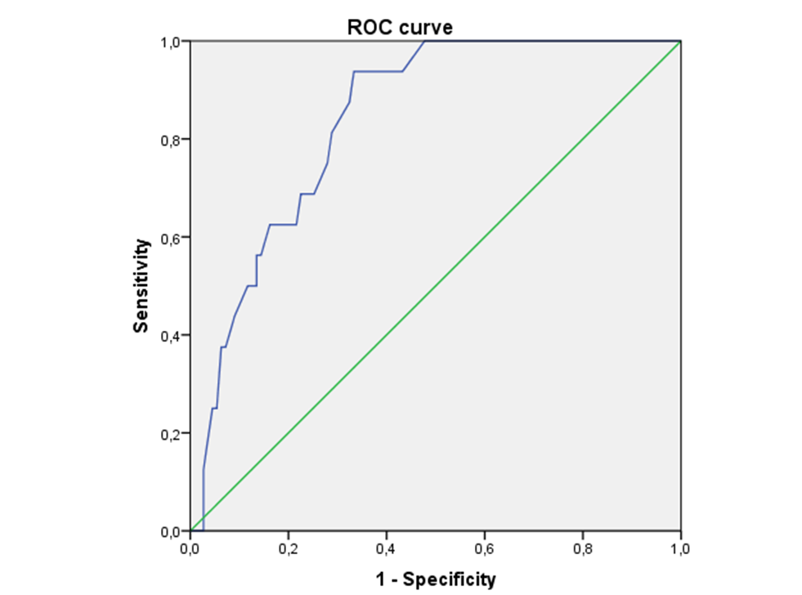
Supplementary Figure 3: ROC Curve PhA
Characteristic curves for prediction of mortality in patients with COVID-19 disease (n = 127). PhA cut-off point for predicting mortality was 3.95, with 93.8% sensitivity and 66.7% specificity.

