Slide 1
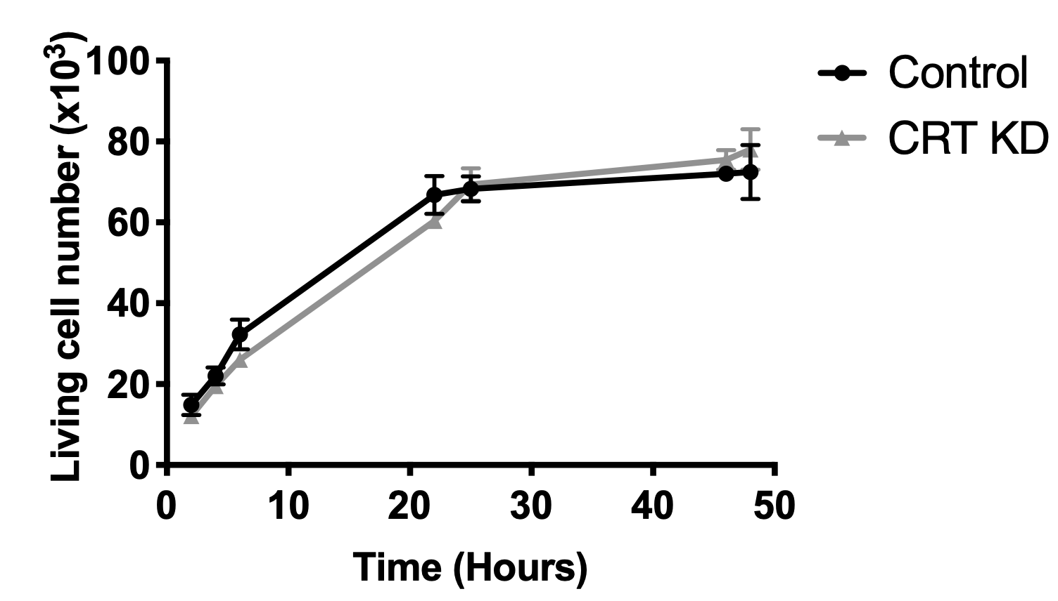
Supplementary Figure 1
A B
Control CRT KD

