Slide 1
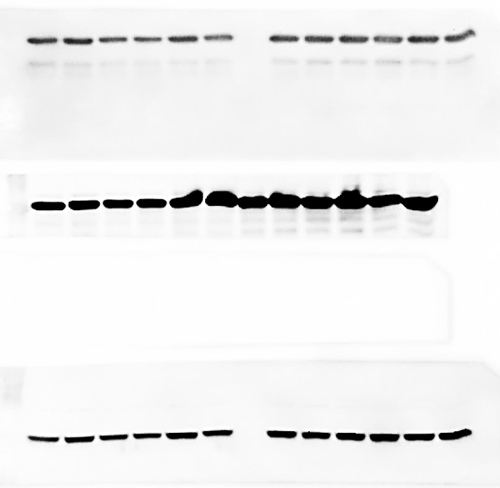
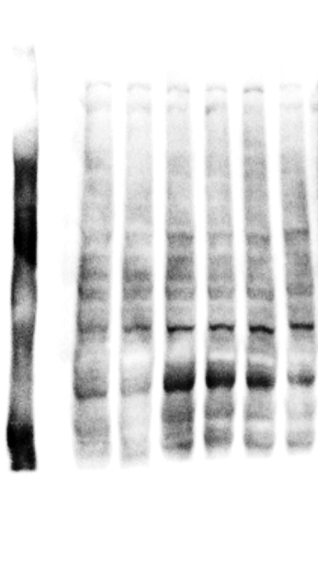
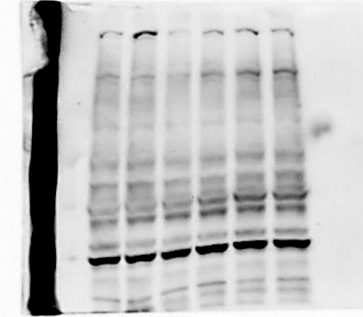
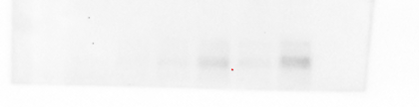
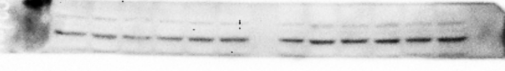
E
C
Control#1
Control#2
siKIF3A#1
siKIF3A#2
siIFT88#1
siIFT88#2
Control#1
Control#2
siKIF3A#1
siKIF3A#2
siIFT88#1
siIFT88#2
BCPAP (whole cells)
TPC1 (whole cells)
VDAC1 34
GAPDH 37
HSP60 60
D
TPC1
(mitochondrial fraction)
F
BCPAP
(mitochondrial fraction)
Control#1
Control#2
siKIF3A#1
siKIF3A#2
siIFT88#1
siIFT88#2
Control#1
Control#2
siKIF3A#1
siKIF3A#2
siIFT88#1
siIFT88#2
VDAC1 oligomerization
VDAC1 oligomerization
72
72
55
55
43
43
34
α-Tubulin
50
α-Tubulin
50
BCPAP
TPC1
HSP60
Figure 3. full-length blots

