Slide 1








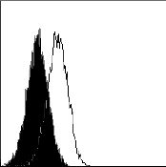
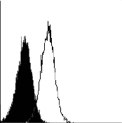
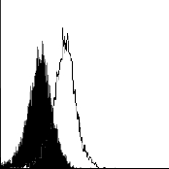
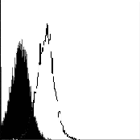
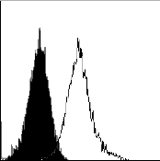
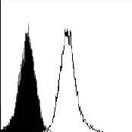
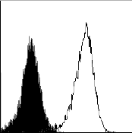
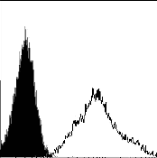









Supplemental Figure 6
A
CMF1/1-1
P34*
CMF1/1-2
P21*
CMT1/1-4
P22*
CMT1/1-6
P20*
HLA- I
CMF1/1-1
P34*
CMF1/1-2
P21*
HLA- I
CMT1/1-4
P22*
CMT1/1-6
P20*
HLA-G
CMF1/1-1
P32*
HLA-G
CMF1/1-2
P19*
CMT1/1-4
P23*
CMT1/1-6
P18*
HLA-E
HLA-E
B
CMF1/1-1
P32*
CMF1/1-2
P19*
CMT1/1-4
P23*
CMT1/1-6
P18*
CD47
C
CD47
CMF1/1-1
P40*
CMF1/1-2
P16*
CMT1/1-4
P12*
CMT1/1-6
P16*
MAL II
Negative Control
Lectin
SNA
Sialidase + Lectin
sialic acid

